Slide 1
Research agent
IBM HACKATHON PROJECT
Presented By: HARSHIT SHARMA
Student name : HARSHIT SHARMA
College Name & Department : BTECH CSE
CHHATRAPATI SHAHU JI MAHARAJ UNIVERSITY (Kanpur University)
UIET KANPUR

Slide 2
OUTLINE
Problem Statement
Technology used
Wow factor
End users
Result
Conclusion
Git-hub Link
Future scope
IBM Certifications

Slide 3
Problem Statement
Problem Statement No.1 - Research Agent
The Challenge- A Research Agent is an AI system designed to assist with academic and scientific
research tasks. It can autonomously search for literature, summarize papers, and organize references.
Using natural language processing, it understands research questions and retrieves relevant
information.
The agent can generate reports, suggest hypotheses, and even draft sections of research papers.
It saves time by automating repetitive tasks like citation management and data extraction.
Research Agents enhance efficiency, accuracy, and innovation in both academic and industrial R&D.

Slide 4
Technology used
IBM cloud lite services
Natural Language Processing (NLP)
Retrieval Augmented Generation (RAG)
IBM Granite model

Slide 5
IBM cloud services used
IBM Cloud Watsonx AI Studio
IBM Cloud Watsonx AI runtime
IBM Cloud Agent Lab
IBM Granite foundation model

Slide 6
Wow factors
🚀 AI Research Assistant: Revolutionizing Academic Discovery and Collaboration
This intelligent research assistant dramatically shortens the time spent on literature reviews, elevates the quality of academic insights, and guides early-stage researchers toward promising directions. By making scholarly knowledge more discoverable, contextual, and actionable, it also encourages meaningful interdisciplinary collaboration.
🔑 Key Features
Semantic Search
Intuitively searches across research papers, journals, and datasets using meaning-based queries rather than simple keywords.
Automatic Summarization
Instantly generates concise summaries of selected papers to help users grasp key findings without reading full texts.
Citation and Influence Analysis
Tracks citations to map the influence and evolution of ideas over time.
Smart Paper Recommendations
Suggests relevant research papers tailored to a user's current topic or area of interest.
Trend Analysis
Analyzes historical data to uncover emerging trends, keyword growth, and shifts in research focus.
Collaboration Mapping
Identifies potential collaborators, co-authors, or institutions working on similar topics to foster academic partnerships.

Slide 7
End users
Academic Researchers
Research Institutions and Universities
Industry R&D Teams
Educators

Slide 8
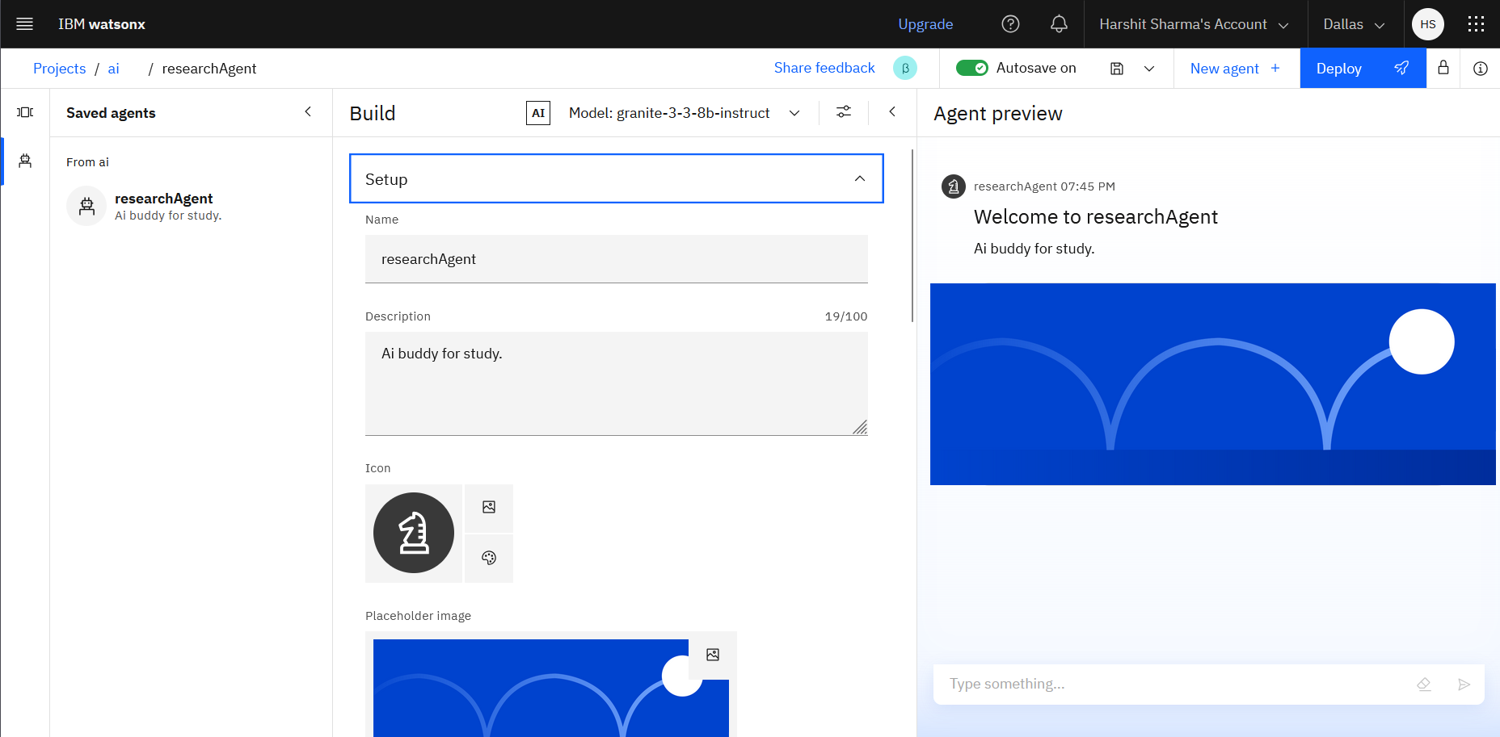
Results

Slide 9
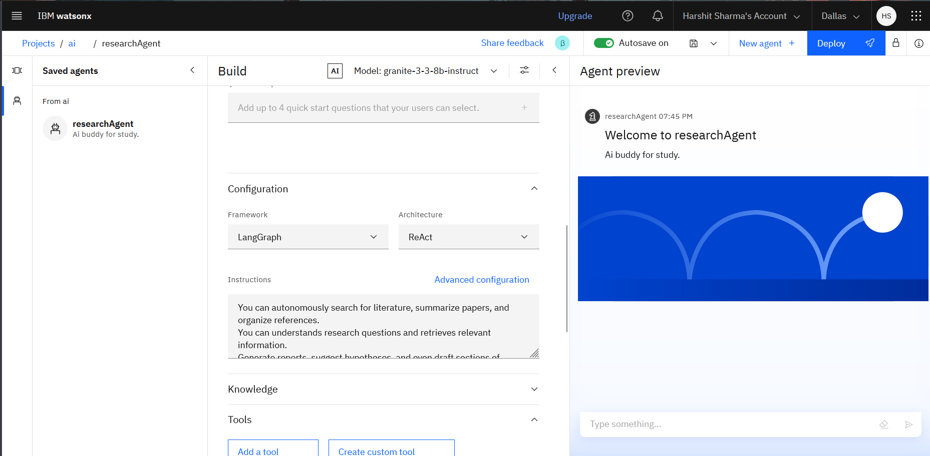
Results

Slide 10
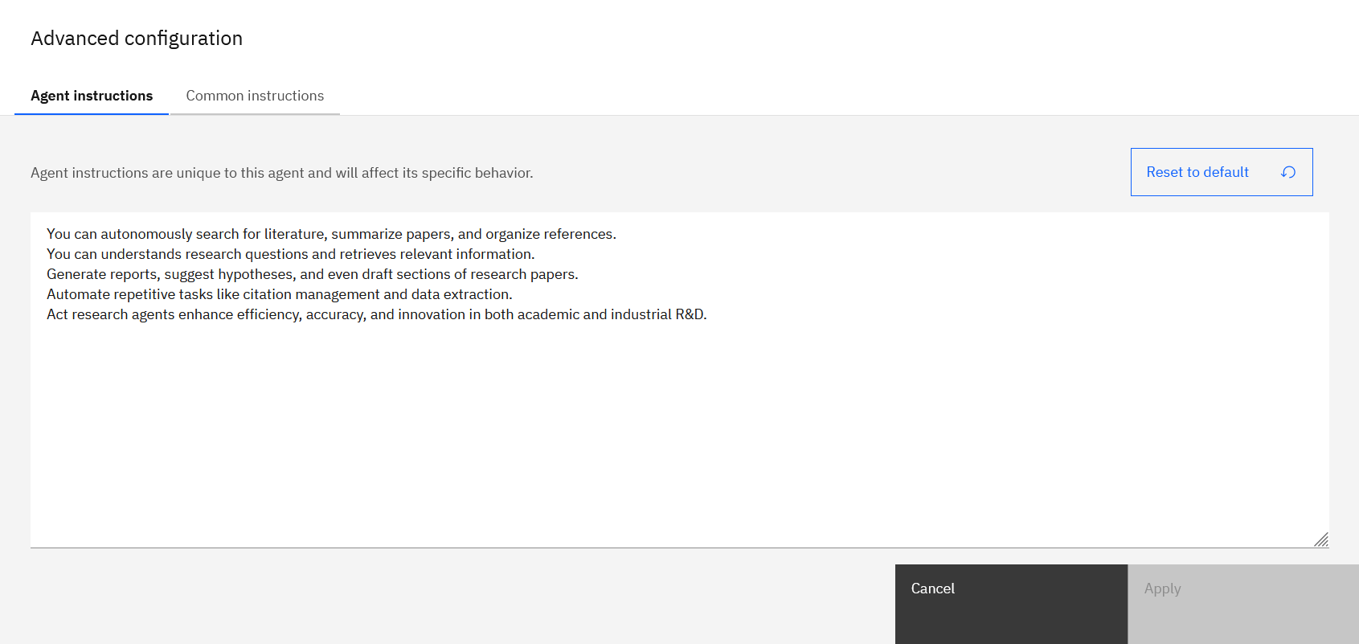
Results

Slide 11
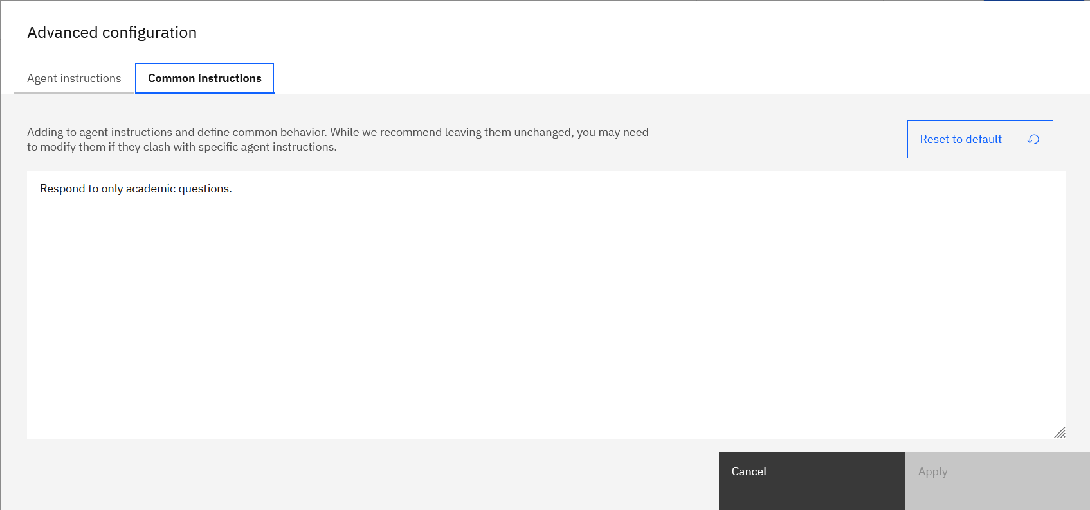
Results

Slide 12
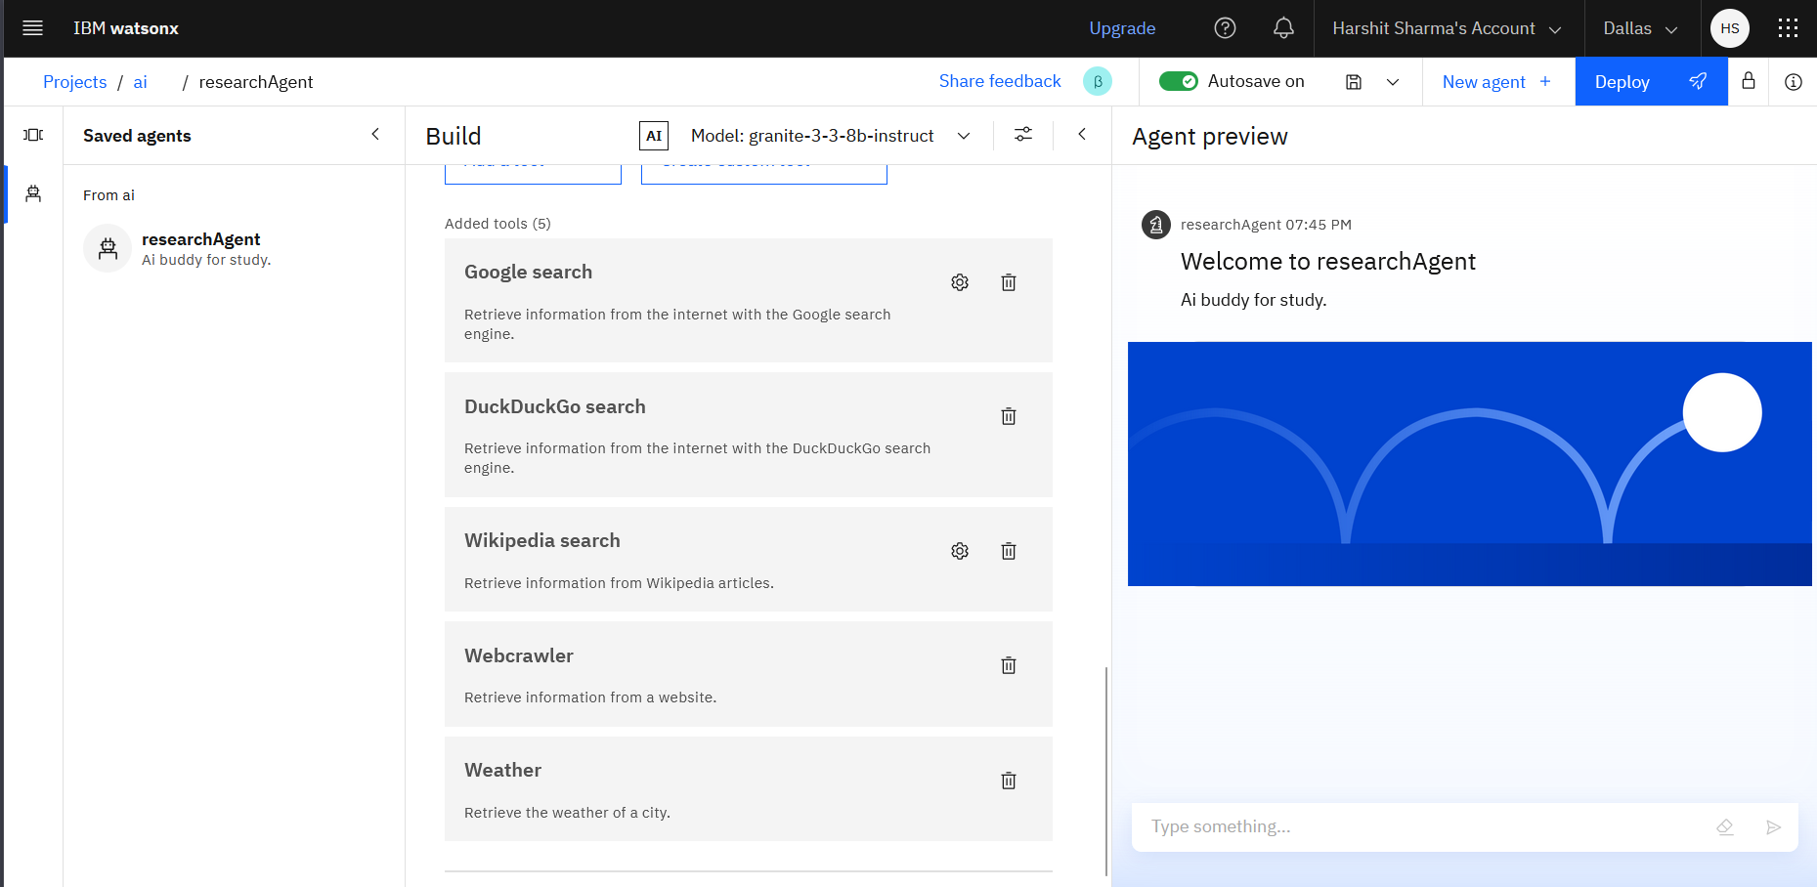
Results

Slide 13
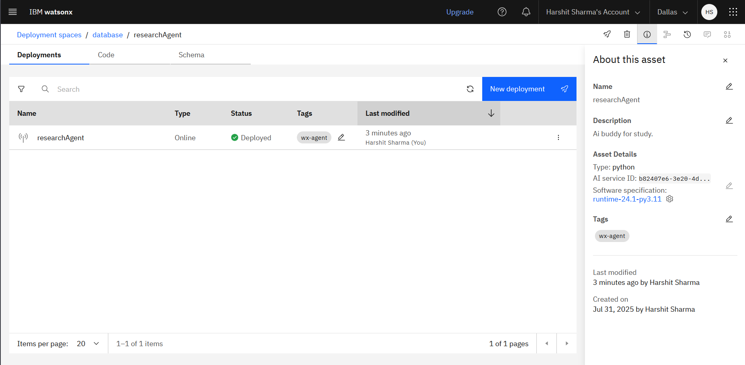
Results

Slide 14
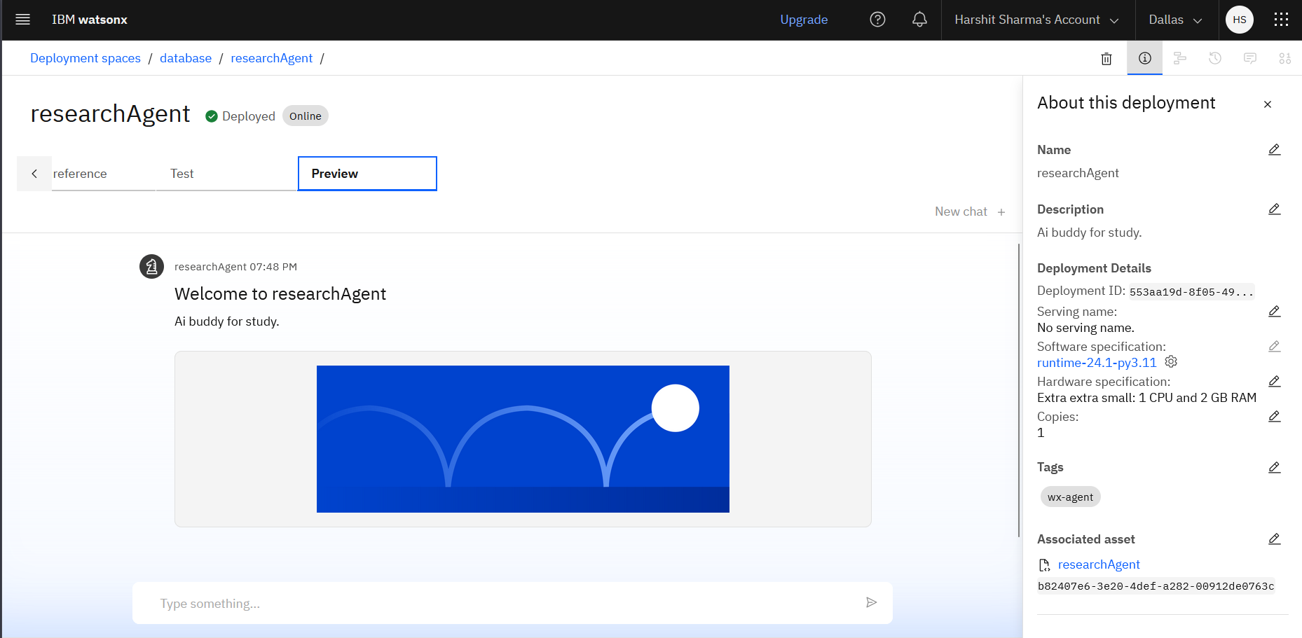
Results

Slide 15
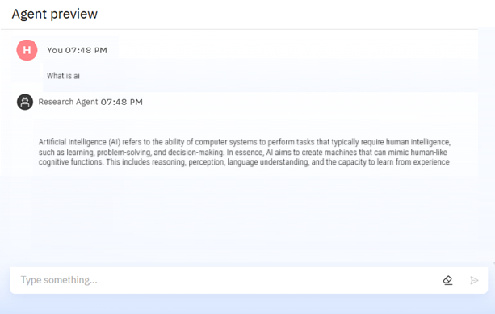
Results

Slide 16
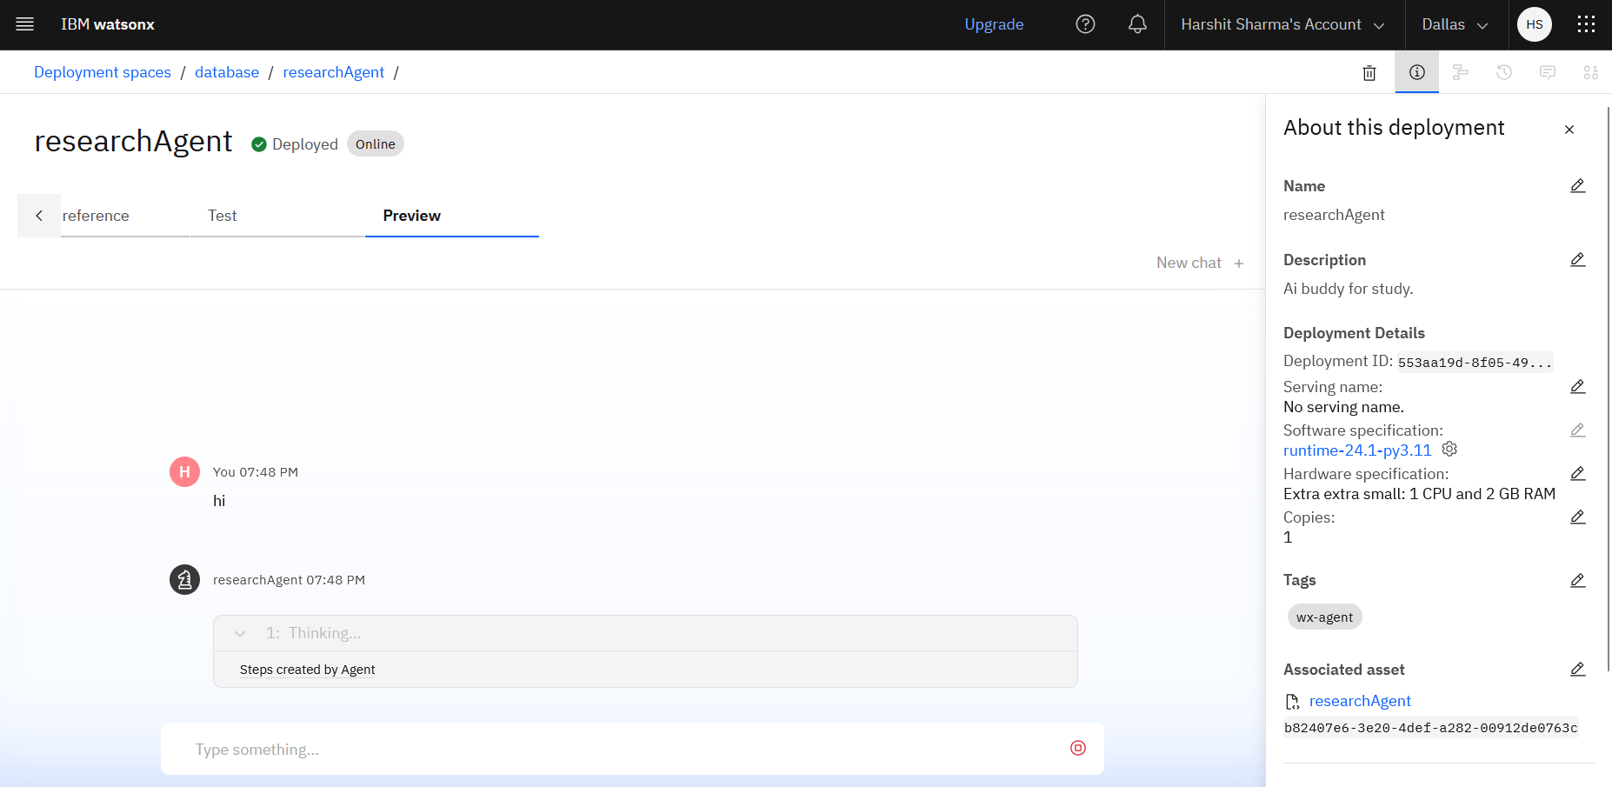
Results

Slide 17
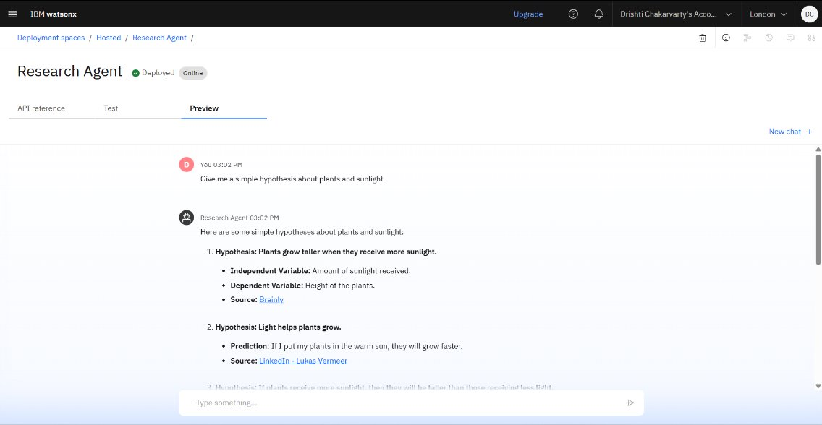



Results
Deployed AI Agent

Slide 18
Conclusion
The agent can generate reports, suggest hypotheses, and even draft sections of research papers.
It saves time by automating repetitive tasks like citation management and data extraction.
Research Agents enhance efficiency, accuracy, and innovation in both academic and industrial R&D.

Slide 19
GitHub Link ZenoZeus (Harshit Sharma) · GitHub
Agentic AI :

Slide 20
Future scope
Multilingual Research Support
Voice-Activated Research Assistant
Real-Time Collaboration Features
Research Gap and Novel Topic Identification
Integration with Publishing Platforms
AI-Assisted Paper Drafting

Slide 21
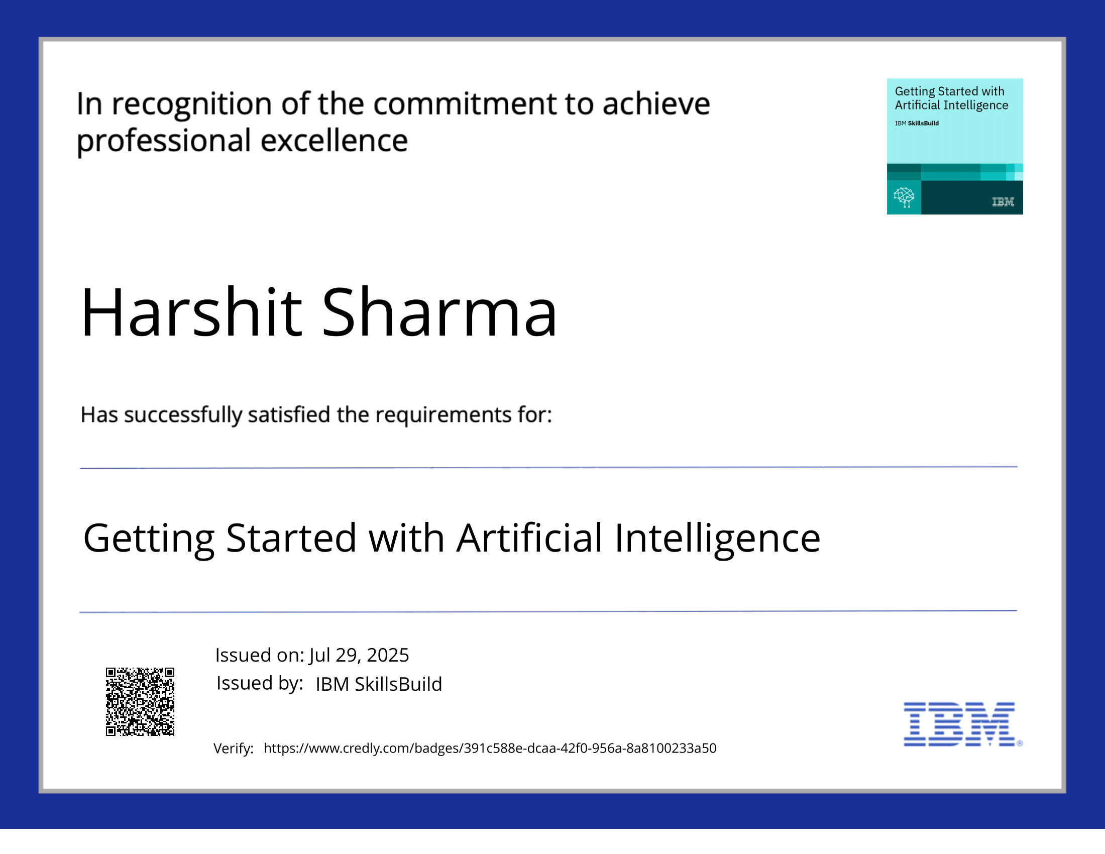
IBM Certifications

Slide 22
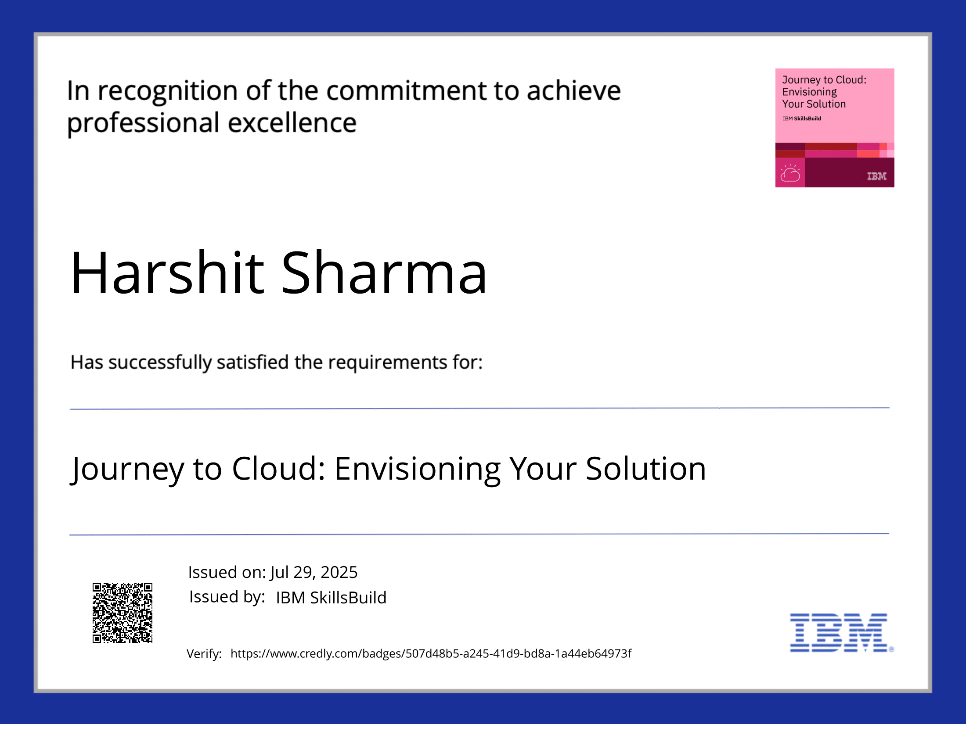
IBM Certifications

Slide 23
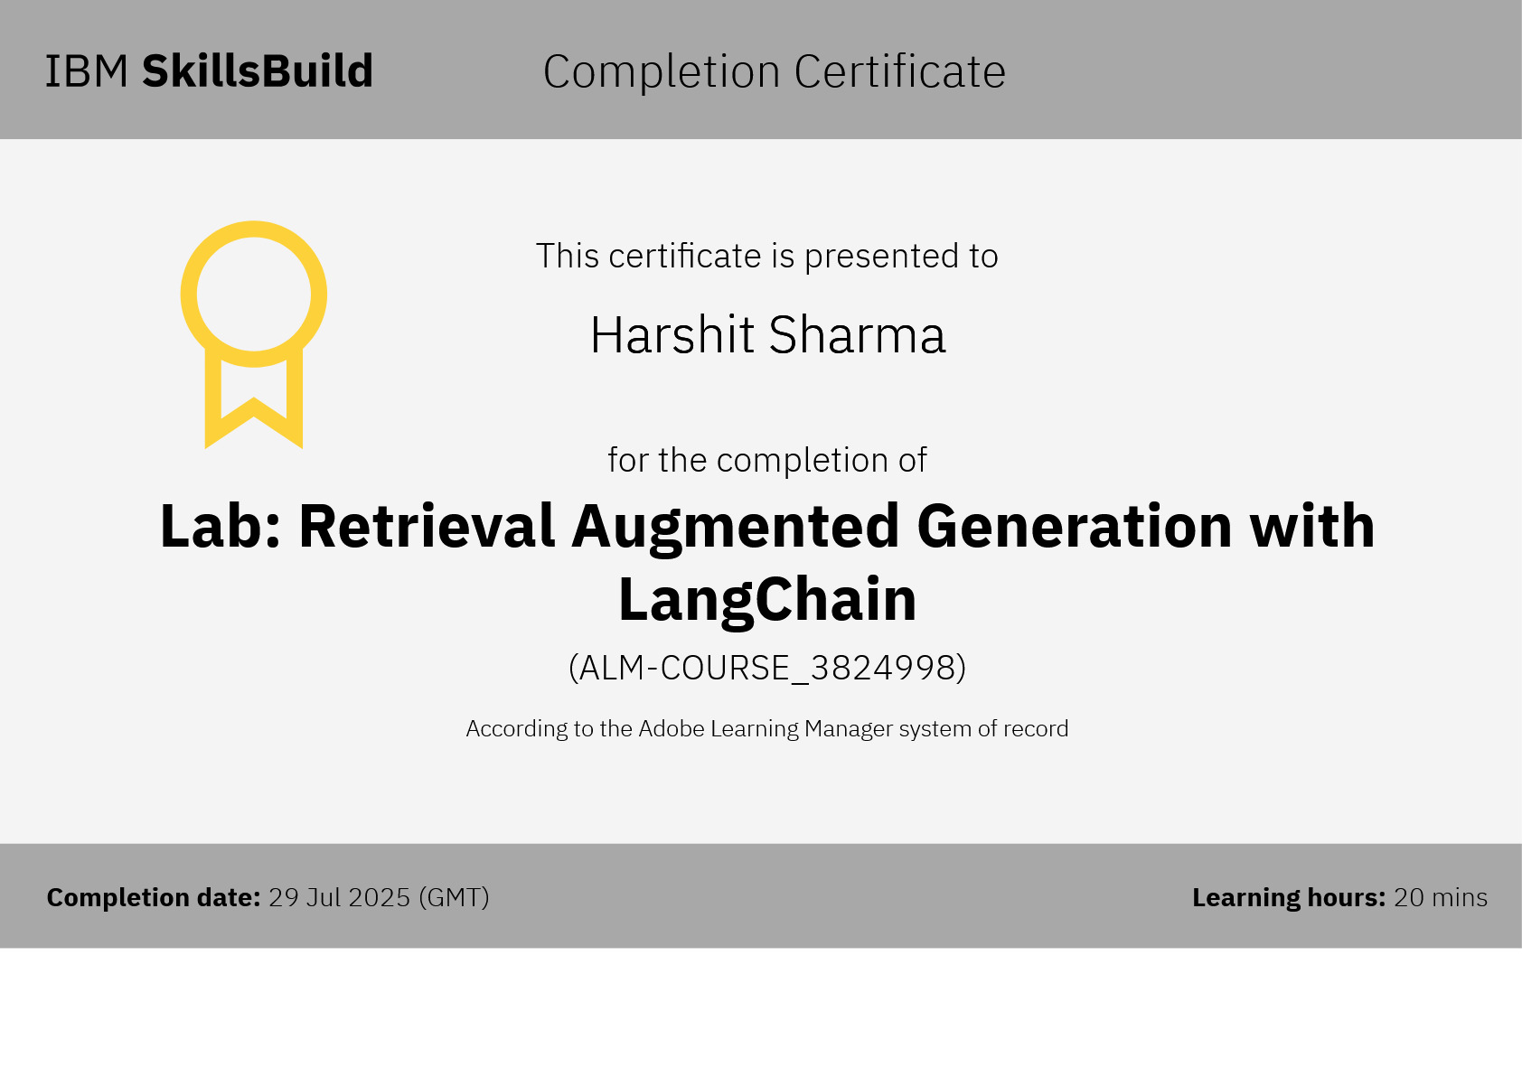

Slide 24
THANK YOU

