Slide 1
大師之路 有你有我
KNN introduction

Slide 2
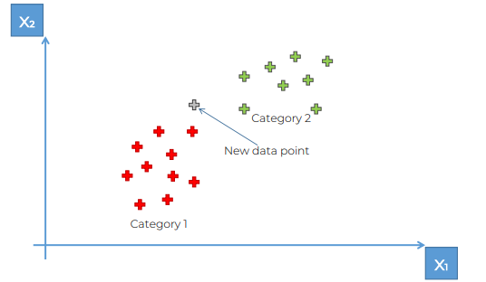
KNN
KNN
從多個獨立變數預測一個類別變數。
概念
鄰近點選擇（Nearest Neighbors Selection）：
KNN 通過選擇與新樣本最接近的 K 個已知樣本（即最鄰近點），並基於這些鄰近點的類別來預測新樣本的類別。這種方法不需要明確的數據映射或轉換，而是直接在原始數據空間中進行操作。
距離計算（Distance Calculation）：
在 KNN 中，計算新樣本與每個訓練樣本之間的距離是決定最近鄰居的關鍵步驟。常用的距離度量方法包括歐幾里得距離、曼哈頓距離和切比雪夫距離等。
投票機制（Voting Mechanism）：
一旦選定了 K 個最鄰近的點，KNN 會使用投票機制來決定新樣本的類別。如果是分類問題，最常見的類別（在 K 個鄰近點中）會被選為預測結果；如果是回歸問題，則可能計算這些鄰近點的平均值或加權平均值。
常用評估指標
準確率（Accuracy）：測量模型預測正確的比例
精確率（Precision）：正確預測為正例的比例
召回率（Recall）：實際為正例中模型預測正確的比例
F1 分數（F1 Score）：精確率和召回率的調和平均
AUC-ROC 曲線（Area Under Curve - Receiver Operating Characteristics）：用於評估分類模型在所有可能的閾值下的整體表現
假設 k = 5
步驟1：選擇鄰居的數量 K
步驟2：根據歐幾里得距離，找出新數據點的 K 個最近鄰居
步驟3：在這些 K 個鄰居中，計算每個類別的數據點數量
步驟4：將新數據點歸類到鄰居數量最多的類別中

Slide 3


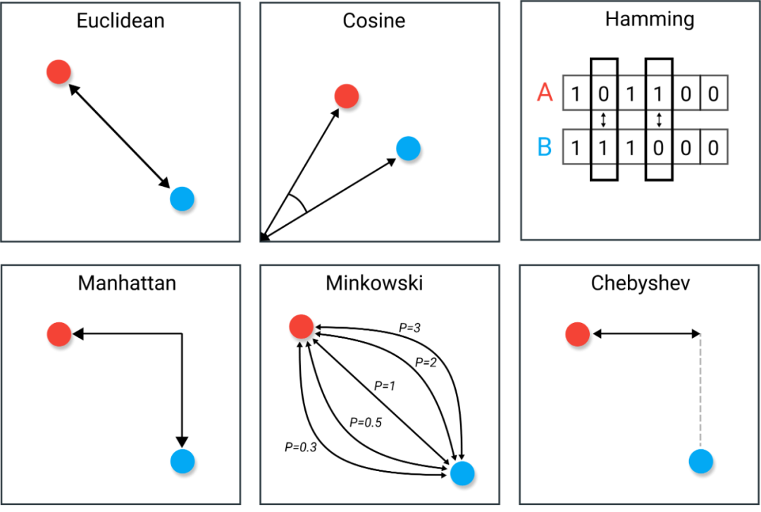
KNN
機器學習中的距離計算
從多個獨立變數預測一個類別變數。
 | Distance | Descible | Drawbacks | Usage
1 | Euclidean L2 distance | The standard method of distance calculation in a Cartesian plane. | It does not perform well in high-dimensional spaces (curse of dimensionality) and is not scale-invariant. | Widely used in 2D or 3D space for geometry, physics, and various algorithms, such as in machine learning for clustering.
2 | Cosine Similarity | Measures the cosine of the angle between two vectors in a multi-dimensional space | Not an actual distance metric, but rather a similarity measure. | Text analysis, determining document or string similarity in machine learning and data mining.
3 | Hamming | Measures the number of positions at which the corresponding symbols are different. | Only applicable to strings of equal length; not a metric for numerical distances. | Information theory for error detection and correction, coding theory.
4 | Manhattan L1 distance | Measures the distance between points in a grid-based path. | Assumes grid-like path movement, which is not always realistic in physical space. | Useful in urban planning, circuit design, and some machine learning models.
5 | Minkowski | A generalization of both Euclidean and Manhattan distances | Choosing an appropriate 𝑝p can be non-trivial and impacts the calculation significantly. | In machine learning, different values of p can be chosen to experiment with the performance of models.
6 | Chebyshev | Based on the maximum difference along any coordinate dimension. | It can be overly simplistic for some applications, as it only considers the largest difference. | Chess games for calculating the distance of the king's move, operations research, and some computer algorithms.
1
2
3
4
5
6

Slide 4
KNN 參考資料
小結
你知道Cross Entropy和KL Divergence代表什麼意義嗎？談機器學習裡的資訊理論
https://ycc.idv.tw/deep-dl_2.html
https://medium.com/@ashisharora2204/logistic-regression-maximum-likelihood-estimation-gradient-descent-a7962a452332
Maximum Likelihood Estimate and Logistic Regression simplified
https://pmirla.github.io/2016/07/20/maximum-likelihood-explanation.html

