Slide 1
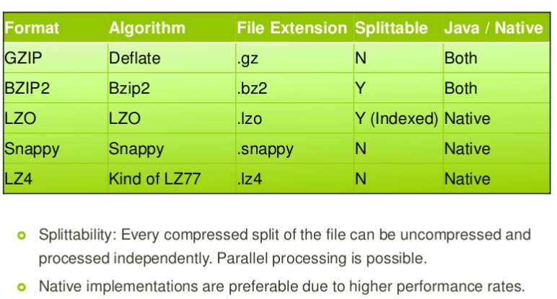
HDFS Compression Algorithms
Snappy 可用來壓縮 AVRO 的 Block 資料, Splittable 功能由 AVRO 提供
Notes:
Data Compression in Hadoop
http://comphadoop.weebly.com/
gzip:
gzip is naturally supported by Hadoop. gzip is based on the DEFLATE algorithm, which is a combination of LZ77 and Huffman Coding.
bzip2:
bzip2 is a freely available, patent free (see below), high-quality data compressor. It typically compresses files to within 10% to 15% of the best available techniques (the PPM family of statistical compressors), whilst being around twice as fast at compression and six times faster at decompression.
LZO:
The LZO compression format is composed of many smaller (~256K) blocks of compressed data, allowing jobs to be split along block boundaries. Moreover, it was designed with speed in mind: it decompresses about twice as fast as gzip, meaning it’s fast enough to keep up with hard drive read speeds. It doesn’t compress quite as well as gzip — expect files that are on the order of 50% larger than their gzipped version. But that is still 20-50% of the size of the files without any compression at all, which means that IO-bound jobs complete the map phase about four times faster.
Snappy:
Snappy is a compression/decompression library. It does not aim for maximum compression, or compatibility with any other compression library; instead, it aims for very high speeds and reasonable compression. For instance, compared to the fastest mode of zlib, Snappy is an order of magnitude faster for most inputs, but the resulting compressed files are anywhere from 20% to 100% bigger. On a single core of a Core i7 processor in 64-bit mode, Snappy compresses at about 250 MB/sec or more and decompresses at about 500 MB/sec or more. Snappy is widely used inside Google, in everything from BigTable and MapReduce to our internal RPC systems.

Slide 2

bzip2 is a free and open-source file, compression program that uses the Burrows–Wheeler algorithm.
Notes:
1. Invalid result caused by bzip2 input format in MapReduce framework (這篇文章所講的問題, Hadoop 2.7 以後的版本已解決)
https://www.lewuathe.com/invalid-result-caused-by-bzip2-input-format-in-mapreduce-framework.html
2. How do you set bzip2 block size when using tar?
https://serverfault.com/questions/2600/how-do-you-set-bzip2-block-size-when-using-tar
Issues about compression and input split
When considering how to compress data that will be processed by MapReduce, it is important to understand whether the compression format supports splitting. Consider an uncompressed file stored in HDFS whose size is 1 GB. With an HDFS block size of 64 MB, the file will be stored as 16 blocks, and a MapReduce job using this file as input will create 16 input splits, each processed independently as input to a separate map task.
Imagine now the file is a gzip-compressed file whose compressed size is 1 GB. As before, HDFS will store the file as 16 blocks. However, creating a split for each block won’t work since it is impossible to start reading at an arbitrary point in the gzip stream and therefore impossible for a map task to read its split independently of the
others. The gzip format uses DEFLATE to store the compressed data, and DEFLATE stores data as a series of compressed blocks. The problem is that the start of each block is not distinguished in any way that would allow a reader positioned at an arbitrary point in the stream to advance to the beginning of the next block, thereby synchronizing itself with the stream. For this reason, gzip does not support splitting.
In this case, MapReduce will do the right thing and not try to split the gzipped file, since it knows that the input is gzip-compressed (by looking at the filename extension) and that gzip does not support splitting. This will work, but at the expense of locality: a single map will process the 16 HDFS blocks, most of which will not be local to the map. Also, with fewer maps, the job is less granular, and so may take longer to run.
If the file in our hypothetical example were an LZO file, we would have the same problem since the underlying compression format does not provide a way for a reader to synchronize itself with the stream. However, it is possible to preprocess LZO files using an indexer tool that comes with the Hadoop LZO libraries. The tool builds an index of split points, effectively making them splittable when the appropriate MapReduce input format is used.
A bzip2 file, on the other hand, does provide a synchronization marker between blocks (a 48-bit approximation of pi), so it does support splitting.

Slide 3
ABC.csv
ABC.bz2
Blk a
map
Blk a
map
10g
1g
80 -100 m

Slide 4
MapReduce 處理 bzip2 檔案 (一)
$ hadoop fs -mkdir -p mydataset/sales
$ wget http://eforexcel.com/wp/wp-content/uploads/2017/07/1000000%20Sales%20Records.zip
$ unzip '1000000 Sales Records.zip'
$ dir '1000000 Sales Records.csv'
-rw-r--r-- 1 bigred bigred 120M 7月 29 2017 '1000000 Sales Records.csv'
$ head -n 3 1000000\ Sales\ Records.csv
Region,Country,Item Type,Sales Channel,Order Priority,Order Date,Order ID,Ship Date,Units Sold,Unit Price,Unit Cost,Total Revenue,Total Cost,Total Profit
Sub-Saharan Africa,South Africa,Fruits,Offline,M,7/27/2012,443368995,7/28/2012,1593,9.33,6.92,14862.69,11023.56,3839.13
Middle East and North Africa,Morocco,Clothes,Online,M,9/14/2013,667593514,10/19/2013,4611,109.28,35.84,503890.08,165258.24,338631.84
$ cat 1000000\ Sales\ Records.csv | grep Taiwan | wc -l
5483
Notes:
1. Downloads 18 - Sample CSV Files / Data Sets for Testing (till 1.5 Million Records) - Sales
http://eforexcel.com/wp/downloads-18-sample-csv-files-data-sets-for-testing-sales/
2. what's the difference between “hadoop fs” shell commands and “hdfs dfs” shell commands? (一定要看)
https://stackoverflow.com/questions/18142960/whats-the-difference-between-hadoop-fs-shell-commands-and-hdfs-dfs-shell-co
hadoop fs <args>
FS relates to a generic file system which can point to any file systems like local, HDFS etc. So this can be used when you are dealing with different file systems such as Local FS, (S)FTP, S3, and others
S3 => amazon

Slide 5
MapReduce 處理 bzip2 檔案 (二)
$ bzip2 -1 -kz '1000000 Sales Records.csv' -c > sales.bz2
-z --compress force compression
-k --keep keep (don't delete) input files
-1 .. -9 set block size to 100k .. 900k
$ dir sales.bz2
-rw-r--r-- 1 bigred bigred 30M 7月 28 09:14 sales.bz2
$ hadoop fs -D dfs.block.size=16m -put sales.bz2 mydataset/sales/
$ hdfs fsck mydataset/sales/sales.bz2
......
Total blocks (validated): 2 (avg. block size 15386158 B)
........
Notes:
-1 (or --fast) to -9 (or --best)
Set the block size to 100 k, 200 k .. 900 k when compressing.
Has no effect when decompressing. See MEMORY MANAGEMENT below.
The --fast and --best aliases are primarily for GNU gzip
compatibility. In particular, --fast doesn't make things
significantly faster. And --best merely selects the default
behaviour.

Slide 6
MapReduce 處理 bzip2 檔案 (三)
bzip2 可 spiltable, 所以會用二個 Map Process 處理 bzip2 檔案內容, 因它有 2 個 Block
$ yarn jar $HADOOP_HOME/share/hadoop/mapreduce/hadoop-mapreduce-examples-3.3.4.jar grep mydataset/sales/ tmp/sales/ 'Taiwan'
$ hdfs dfs -ls tmp/sales/
Found 2 items
-rw-r--r-- 2 bigred bigboss 0 2020-07-08 04:48 /tmp/sales/_SUCCESS
-rw-r--r-- 2 bigred bigboss 12 2020-07-08 04:48 /tmp/sales/part-r-00000
$ hdfs dfs -cat tmp/sales/part-r-00000
5483 Taiwan

