Slide 1
HBase 大數據資料庫
Notes:
1. 物聯網資料庫IoTDB從Apache孵化器畢業成頂級專案
https://www.ithome.com.tw/news/140208

Slide 2
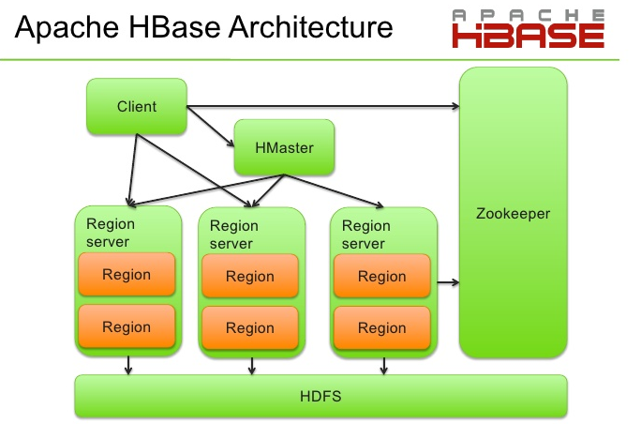
HBase 系統運作架構
Notes:
有媒體報導，近2.3萬個MongoDB資料庫被清除並遭到勒索，駭客要脅不付錢就向當地GDPR主管機關舉發
https://www.ithome.com.tw/news/138754

Slide 3
啟動 Hbase
$ starthba
dtm2: ZooKeeper started
dtm1: Hbase Master started
dtw1: Region Server started
dtw2: Region Server started
dtw3: Region Server started
$ hdfs dfs -ls /hbase
Found 12 items
drwxr-xr-x - bigred bigboss 0 2021-10-26 22:30 /hbase/.hbck
drwxr-xr-x - bigred bigboss 0 2021-10-26 22:30 /hbase/.tmp
drwxr-xr-x - bigred bigboss 0 2021-10-26 22:30 /hbase/MasterData
drwxr-xr-x - bigred bigboss 0 2021-10-26 22:30 /hbase/WALs
drwxr-xr-x - bigred bigboss 0 2021-10-26 22:30 /hbase/archive
drwxr-xr-x - bigred bigboss 0 2021-10-26 22:30 /hbase/corrupt
drwxr-xr-x - bigred bigboss 0 2021-10-26 22:14 /hbase/data
-rw-r--r-- 3 bigred bigboss 42 2021-10-26 22:29 /hbase/hbase.id
..........
Notes:
ZooKeeper four word command
Function description
conf
Detailed information output related service configuration.
cons
List all connected to the connection details / session complete server client. Including "accept / send" number of packages, session ID, operational delay, the execution and so on information.
dump
List of untreated session and temporary nodes.
envi
Output detailed information about the service environment (from the conf command).
reqs
List of untreated request
ruok
Test whether the service is in the correct state. If so, then the service returns "imok", or will have no corresponding.
stat
Output a list of client performance and connected.
wchs
Detailed information of watch list server.
wchc
Through the detailed information session list server watch, its output is a list of relatedwith watch session.
wchp
Through the detailed information on the watch server path list. Its output is associated with one of session path.
For example: $ echo conf | nc localhost 2181; echo ""
clientPort=2181
secureClientPort=-1
dataDir=/home/bigred/zk/version-2
dataDirSize=424
dataLogDir=/home/bigred/zk/version-2
dataLogSize=424
tickTime=2000
maxClientCnxns=60
minSessionTimeout=4000
maxSessionTimeout=40000
serverId=0

Slide 4
連接 ZooKeeper Server
$ echo ruok | nc dtm2 2181; echo ""
imok
[註] zookeeper 3.6.1 版本內定沒啟用 four word command, 例如 ruok 命令, 請看以下資訊
$ echo ruok | nc localhost 2181; echo ""
ruok is not executed because it is not in the whitelist.
$ zkCli.sh -server dtm2 ls /hbase
Connecting to dtm3
WATCHER::
WatchedEvent state:SyncConnected type:None path:null
[backup-masters, draining, flush-table-proc, hbaseid, master, master-maintenance, online-snapshot, rs, running, splitWAL, switch, table]
2021-10-26 22:38:35,649 [myid:] - ERROR [main:ServiceUtils@42] - Exiting JVM with code 0

Slide 5
檢測 HBase 資料庫系統
啟動 HBase Shell
$ hbase shell 2>/dev/null
HBase Shell
Use "help" to get list of supported commands.
Use "exit" to quit this interactive shell.
Version 2.3.5, r38bf65a22b7e9320f07aeb27677e4533b9a77ef4, Sun Feb 23 02:06:36 PST 2020
hbase(main):001:0> status
.....
1 active master, 0 backup masters, 3 servers, 0 dead, 1.0000 average load
Notes:
$ echo "status" | hbase shell -n 2>/dev/null
1 active master, 0 backup masters, 3 servers, 0 dead, 0.6667 average load
Took 0.6020 seconds
$ sudo apk add jruby
(1/4) Installing jruby-libs (9.2.18.0-r0)
(2/4) Installing libc6-compat (1.2.2-r3)
(3/4) Installing java-jffi-native (1.3.4-r1)
(4/4) Installing jruby (9.2.18.0-r0)
Executing busybox-1.33.1-r3.trigger
OK: 1153 MiB in 234 packages

Slide 6

HBase 資料表操作
HBase shell commands
https://learnhbase.wordpress.com/2013/03/02/hbase-shell-commands/
Notes:
HBase Commands – General, Data Definition, & Data Manipulation (完整命令說明)
https://data-flair.training/blogs/hbase-commands/

Slide 7
HBase 資料表結構

Slide 8
管理資料表 (一)
建立資料表
hbase(main):001:0> create 'tc','vi'
增加資料
hbase(main):002:0> put 'tc', 'row1', 'vi:make', 'bmw'
hbase(main):003:0> put 'tc', 'row1', 'vi:model', '5 series'
hbase(main):004:0> put 'tc', 'row1', 'vi:year', '2010'
hbase(main):005:0> put 'tc', 'row1', 'vi:year', '2012'
查詢資料
hbase(main):006:0> get 'tc','row1'
COLUMN CELL
vi:make timestamp=1388331445953, value=bmw
vi:model timestamp=1388331456072, value=5 series
vi:year timestamp=1388331468503, value=2012
1 row(s) in 0.0930 seconds
Notes:
1. Best practices for loading data in HBase
https://www.ibm.com/docs/en/imdm/11.6?topic=tables-best-practices-loading-data-in-hbase
I have created a table in HBase with a pre split of 8 regions, with HexStringSplit as spliting algorithm.
hbase> create 't1', 'f1', {NUMREGIONS => 15, SPLITALGO => 'HexStringSplit'}
HexStringSplit 拆分算法
HexStringSplit 把数据从“00000000”到“FFFFFFFF”之间的数据长度按照 n 等分之后算出每一段的起始 rowkey 和结束 rowkey，以此作为拆分点
UniformSplit 拆分算法
UniformSplit 有点像 HexStringSplit 的 byte 版，传参还是 n，唯一不一样的是起始和结束不是String，而是byte[]。起始rowkey是ArrayUtils.EMPTY_BYTE_ARRAY。结束 rowkey 是 new byte[] {xFF, xFF, xFF, xFF, xFF, xFF, xFF, xFF}。最后调用 Bytes.split方法把起始 rowkey 到结束 rowkey 之间的长度 n 等分，然后取每一段的起始和结束作为拆分点。默认的拆分点算法就这两个。还可以通过实现 SplitAlgorithm 接口实现自己的拆分算法。或者干脆手动定出拆分点。
hbase(main):001:0> create 'cars', {NAME=>'vi', VERSIONS=>'2'}
hbase(main):008:0> get 'cars','row1', {COLUMN => 'vi:year', VERSIONS => 3}

Slide 9
管理資料表 (二)
hbase(main):002:0> put 'tc', 'row2', 'vi:make', 'volvo'
hbase(main):003:0> put 'tc', 'row2', 'vi:model', 's60'
hbase(main):004:0> put 'tc', 'row2', 'vi:year', '2011'
hbase(main):018:0> scan 'tc'
ROW COLUMN+CELL
row1 column=vi:make, timestamp=1552394652348, value=bmw
row1 column=vi:model, timestamp=1552394662923, value=5 series
row1 column=vi:year, timestamp=1552394684508, value=2012
row2 column=vi:make, timestamp=1552394730907, value=volvo
row2 column=vi:model, timestamp=1552394756042, value=s60
row2 column=vi:year, timestamp=1552394869326, value=2011
刪除欄位資料
hbase(main):024:0> deleteall 'tc', 'row1', 'vi:year'
hbase(main):030:0> scan 'tc'
ROW COLUMN+CELL
row1 column=vi:make, timestamp=1552394652348, value=bmw
row1 column=vi:model, timestamp=1552394662923, value=5 series
row2 column=vi:make, timestamp=1552394730907, value=volvo
row2 column=vi:model, timestamp=1552394756042, value=s60
row2 column=vi:year, timestamp=1552394869326, value=2011
Notes:
scan 't1', {STARTROW=>'a1s1', ENDROW=>'a4s1'}
Another option is using regexString:
scan 't1', {FILTER => "RowFilter(=, 'regexstring:*s1')"}
scan 'CWRK', {COLUMNS => 'STUDENT', FILTER => "ValueFilter ( =, 'binaryprefix:MIT')"}

Slide 10
管理資料表 (四)
hbase(main):026:0> count 'tc'
2 row(s) in 0.0390 seconds
=> 2
刪除資料表
hbase(main):011:0> disable 'tc'
0 row(s) in 3.5250 seconds
hbase(main):012:0> drop 'tc'
0 row(s) in 1.3540 seconds
hbase(main):013:0> exit

Slide 11
HBase 運作架構
Notes:
1. An In-Depth Look at the HBase Architecture
https://www.mapr.com/blog/in-depth-look-hbase-architecture#.VfxPdN-qqkp
2. WAL
http://hbase.apache.org/book.html#regionserver.arch
3. HDInsight HBase: 9 things you must do to get great HBase performance
https://blogs.msdn.microsoft.com/ashish/2016/09/02/hdinsight-hbase-9-things-you-must-do-to-get-great-hbase-performance/
Master
If more than one master, master election will be forced.
Root Region Server (負責 Meta Table)
This znode holds the location of the server hosting the root of all tables in hbase.
Region Server
A directory in which there is a znode per Hbase region server.
Region Servers register themselves with ZooKeeper when they come online
負責 Meta Table 的 Region Server 如毀壞, Hbase Master 會重新指派一部 Region Server 負責 Meta Table, 因 Meta Table 存在 HDFS,
被指派的 Region Server 可快速取回 Meta Table 資料
The actual hfiles for META are located in /hbase/data/hbase/meta/ in HDFS.

Slide 12
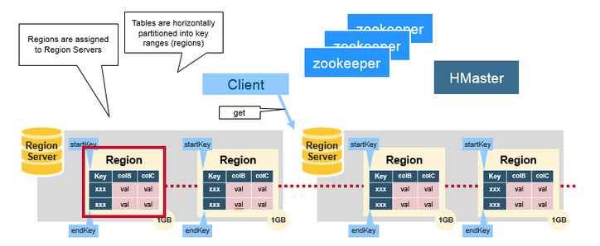
Hbase 資料運作架構
Regions
HBase Tables are divided horizontally by row key range into “Regions.”
A region contains all rows in the table between the region’s start key
and end key. Regions are assigned to the nodes in the cluster,
called “Region Servers,” and these serve data for reads and writes.
A region server can serve about 6500 regions. Usually right around 200 regions per RegionServer has yielded the best results.
Notes:
Region Splitting
Initially, there is only one region for a table. When regions become too large after adding more rows, the region is split into two at the middle key, creating two roughly equal halves.
1. Pre splitting
Create a table with many regions by supplying the split points at the table creation time. Pre splitting is recommended but have a caveat-- poorly chosen splitting points can end up with heterogeneous load distribution, which degrades the cluster performance.
2. Auto splitting
Default split policy. It splits the regions when the total data size of one of the stores in the region gets bigger than configured “hbase.hregion.max.filesize”, which has a default value of 10GB. Automatic splitting is determined by the configuration value hbase.hregion.max.filesize. It is not recommended that you set this to Long.MAX_VALUE in case you forget about manual splits. A suggested setting is 100GB, which would result in > 1hr major compactions if reached.
3. Manual splitting
Split regions that are unevenly loaded from CLI.

Slide 13
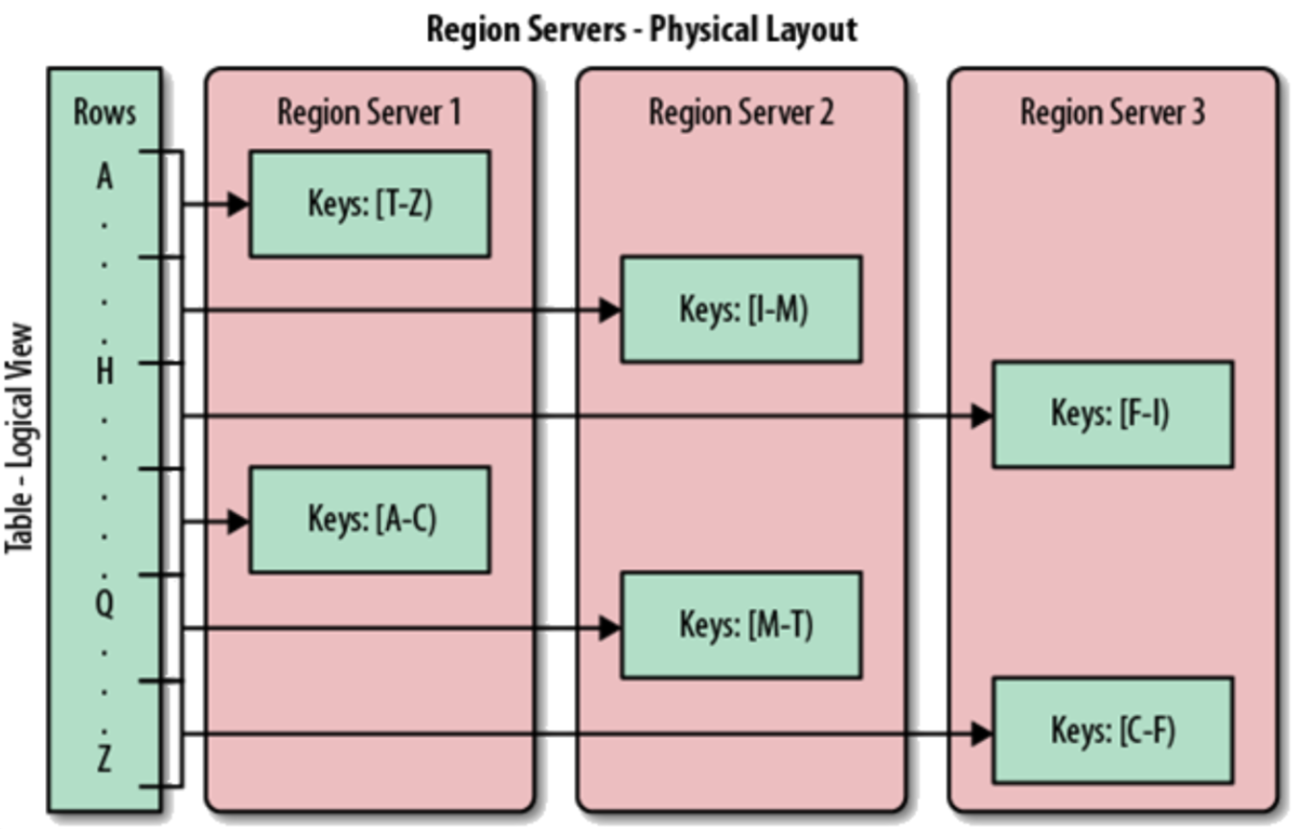
Hbase 資料運作架構
Notes:
1. Day 12 - HBase RowKey Design
https://ithelp.ithome.com.tw/articles/10191752
2. How to avoid HBase Hotspotting?
https://dwgeek.com/avoid-hbase-hotspotting.html/
建立 Salted Row key 的 Table
create 'tableName', {NAME => 'colFam', VERSIONS => 2, COMPRESSION => 'SNAPPY'}, {SPLITS => ['0','1','2','3','4','5','6','7']}

Slide 14
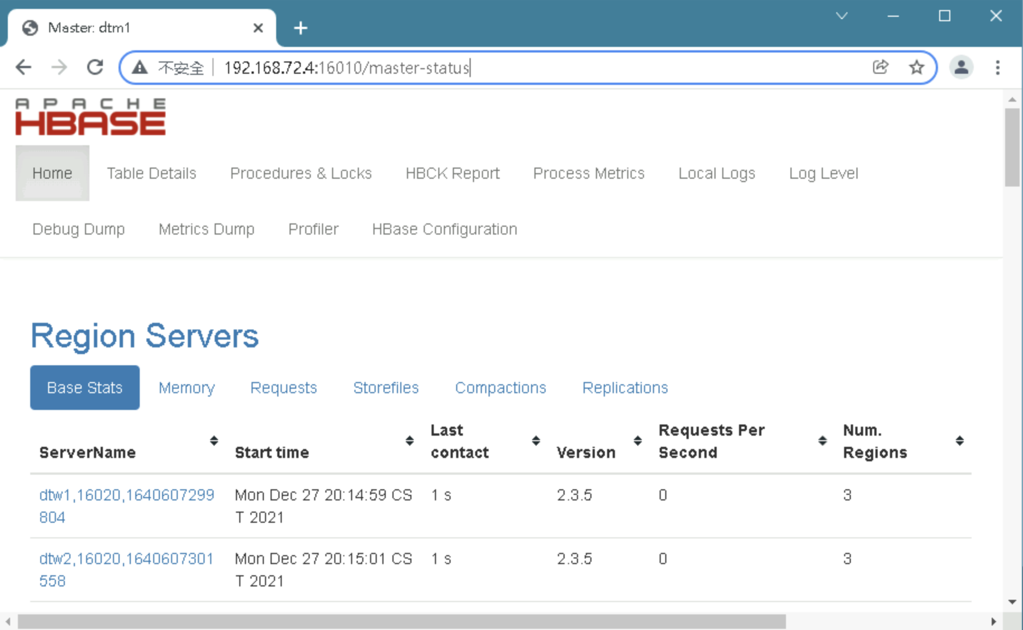
HBase 管理網站
Notes:
1. SPLIT TABLE 的三種方法
https://tsai-cookie.blogspot.com/2018/10/hbase-split-table.html

Slide 15
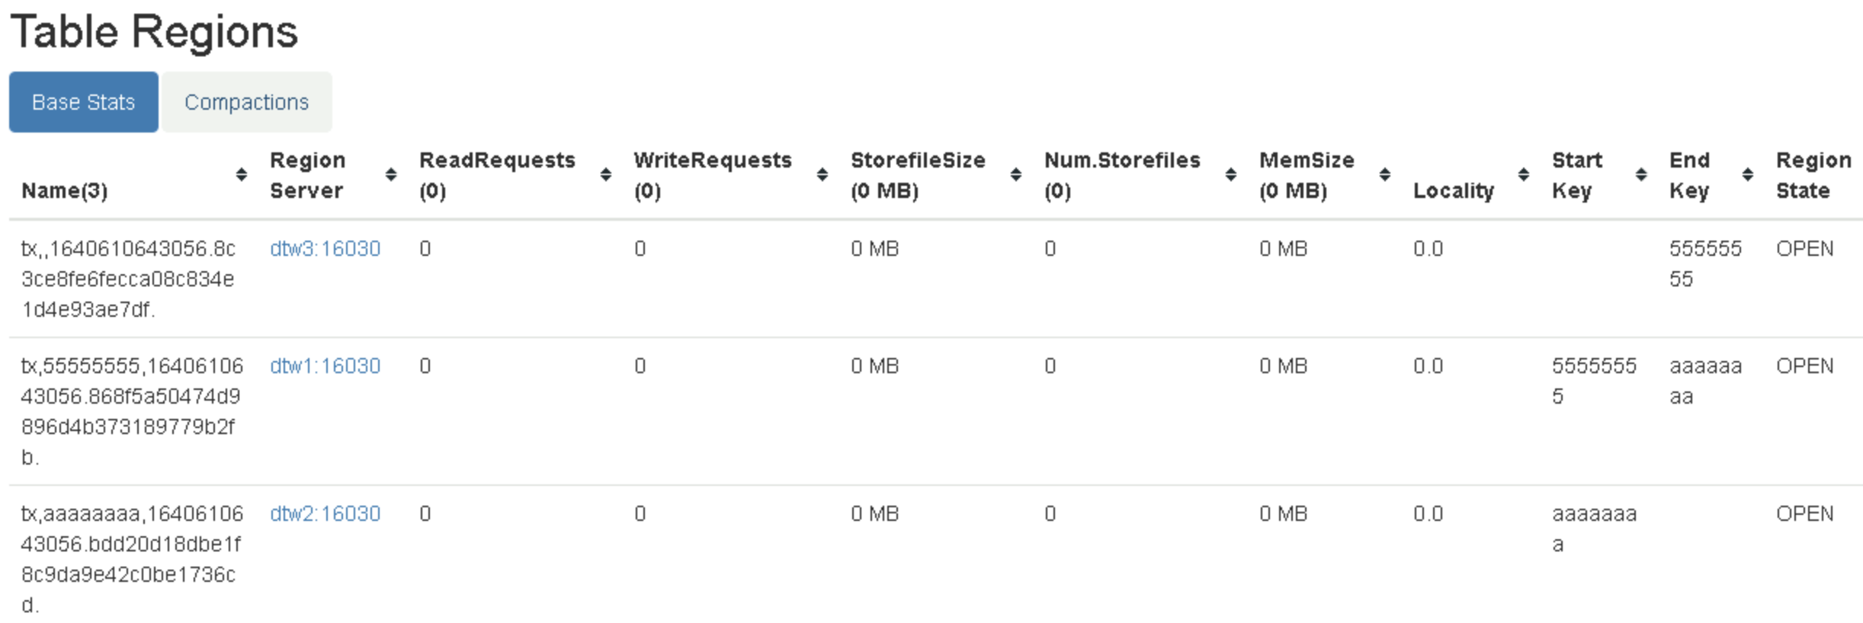
SPLIT TABLE
hbase(main):021:0> create 'tx', {NAME => 'pf', COMPRESSION => 'SNAPPY'}, {NUMREGIONS => 3, SPLITALGO => 'HexStringSplit', DURABILITY => 'ASYNC_WAL'}
Notes:
1. SPLIT TABLE 的三種方法
https://tsai-cookie.blogspot.com/2018/10/hbase-split-table.html

Slide 16
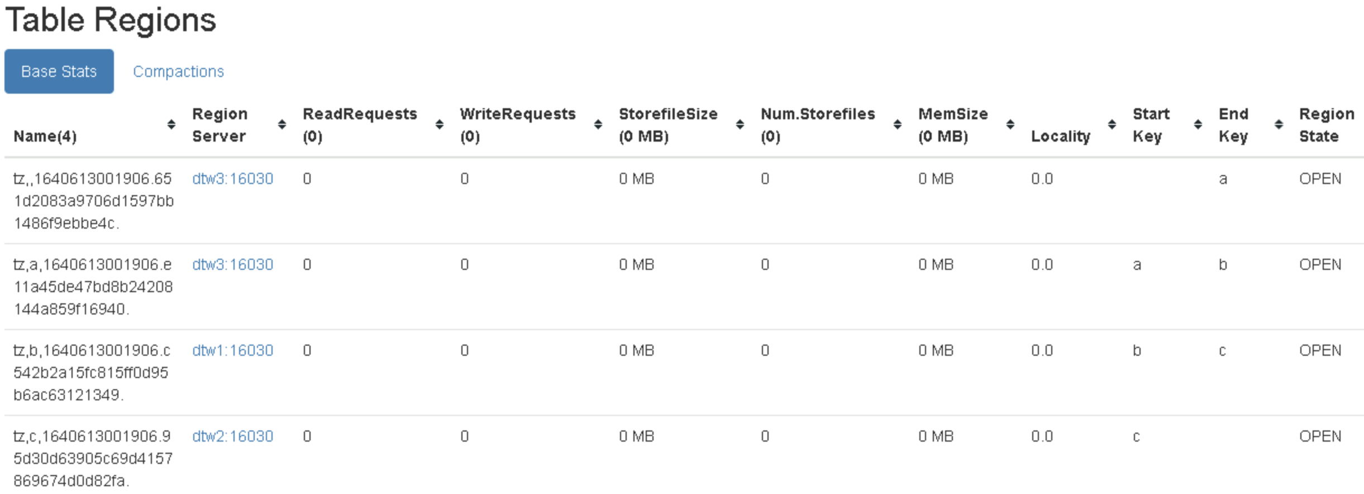
管理資料表 (四)
hbase(main):026:0> create 'tz', 'f1', {SPLITS => ['a', 'b', 'c']}
Notes:
Hbase 管理網站
http://192.168.72.4:16010/

Slide 17
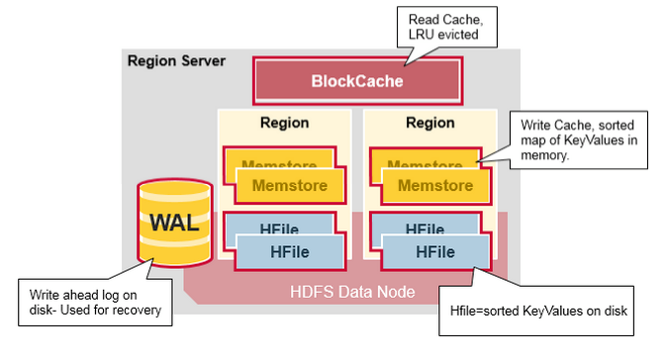
Region Server Components
Notes:
A Region Server runs on an HDFS data node and has the following components:
1. WAL: Write Ahead Log is a file on the distributed file system. The WAL is used to store new data that hasn't yet been persisted to permanent storage; it is used for recovery in the case of failure.
2. BlockCache: is the read cache. It stores frequently read data in memory. Least Recently Used data is evicted when full.
3. MemStore: is the write cache. It stores new data which has not yet been written to disk. It is sorted before writing to disk. There is one MemStore per column family per region.
4. Hfiles store the rows as sorted KeyValues on disk.

Slide 18
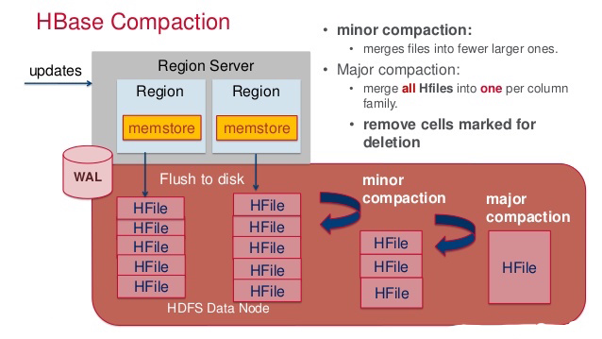
HBase Compaction
HBase Compaction
http://www.linuxstudies.com/index.php/2016/11/26/hbase-compaction/
Notes:
1. HBase Compaction and Data Locality in Hadoop
https://data-flair.training/blogs/hbase-compaction/
Disabling automatic major compactions (內定 7 天 執行一次 Major Compaction)
Usually, HBase users want to have a full control of a major compaction events and the only way to do this is to disable periodic automatic major compactions by setting hbase.hregion.majorcompaction to 0. But, unfortunately, this does not give you 100% control of major compactions, because, sometimes, minor compactions can be promoted to major ones by HBase automatically, but, fortunately, we have another configuration option, that can help in this case (below).
<property>
<name>hbase.hregion.majorcompaction</name>
<value>604800000</value>
<description>Time between major compactions, expressed in milliseconds. Set to 0 to disable
time-based automatic major compactions. User-requested and size-based major compactions will
still run. This value is multiplied by hbase.hregion.majorcompaction.jitter to cause
compaction to start at a somewhat-random time during a given window of time. The default value
is 7 days, expressed in milliseconds. If major compactions are causing disruption in your
environment, you can configure them to run at off-peak times for your deployment, or disable
time-based major compactions by setting this parameter to 0, and run major compactions in a
cron job or by another external mechanism.</description>
</property>
Maximum compaction selection size
We have another config option which can control compaction process:
hbase.hstore.compaction.max.size (by default value is set to LONG.MAX_VALUE)
In HBase 1.2+ we have as well:
hbase.hstore.compaction.max.size.offpeak
These choices control maximum size (in bytes) of compaction selection allowed. If you need to delay large compactions (major ones) until off-peak hours, you’ll set, for example:
hbase.hstore.compaction.max.size=500000000 (500MB)
hbase.hstore.compaction.max.size.offpeak= 500000000000 (500GB)
The idea is to not enable minor compaction promotions to major ones throughout peak hours. Compactions can still happen during peak hours, however, they’ll be restricted to 500MB in size (or to whatever you set). Certainly, if your region size < 500MB some major compactions can still happen. we care about not the majority or minority of compaction here but about compaction size.
Note: when you run manual major compaction requests those settings are ignored
Off peak compactions
If your deployment has off peak hours you can use off-peak configuration settings.
To enable off peak compaction following config options must be set :
hbase.offpeak.start.hour= 0..23
hbase.offpeak.end.hour= 0..23
Compaction file ratio for peak hours is 1.2, for off peak 5.0 (by default).
Both can be changed:
hbase.hstore.compaction.ratio
hbase.hstore.compaction.ratio.offpeak
Heigh the file ratio value – the more aggressive (frequent) compaction is going to be. Default values are fine for the majority of deployments.
Schedule Major Compaction Using Cron Job
Run major compaction on passed table or pass a region row to major compact an individual region. To compact a single
column family within a region specify the region name followed by the column family name.
Examples:
Compact all regions in a table:
hbase> major_compact ‘t1’
Compact a single column family within a region:
hbase> major_compact ‘r1’, ‘c1’
You can also use a standard cron implementation via Linux. e.g.
$ echo "major_compact 'FOO'" | hbase shell -n
建立 crontab 執行命令
$ crontab -e
# 此時會進入 vi 的編輯畫面讓您編輯工作！注意到，每項工作都是一行。
0 12 * * * mail -s "at 12:00" dmtsai < /home/dmtsai/.bashrc
#分 時 日 月 週 |<==============指令串========================>|

Slide 19
Major compact 資料表
建立 HBase 資料表
$ nano hbase.cmd
create 'xhbase', 'ratings'
put 'xhbase', 'row1', 'ratings:userid', 'user1'
put 'xhbase', 'row1', 'ratings:bookid', 'book1'
put 'xhbase', 'row1', 'ratings:rating', '1'
scan 'xhbase'
$ cat hbase.cmd | hbase shell -n 2>/dev/null
...........
ROW COLUMN+CELL
row1 column=ratings:bookid, timestamp=1504274480590, value=book1
row1 column=ratings:rating, timestamp=1504274480749, value=1
row1 column=ratings:userid, timestamp=1504274480299, value=user1
1 row(s) in 0.2760 seconds
$ echo "major_compact 'xhbase'" | hbase shell -n 2>/dev/null
Took 0.6526 seconds

