Slide 1

Speak Now Home Assignment

Slide 2




Traditional English Proficiency Scoring
Evaluators
Pool of Experts
 | E1 | E2 | .. | Response Score
M1 | 4 | 5 | 4 | 4.6
M2 | 3 | 3 | 3 | 3
. | . | . | . | .
Evaluator Scoring | . | . | . | .
Metrics
Evaluation

Slide 3






With Machine Learning
Evaluators
Pool of Experts
 | E1 | E2 | .. | Response Score
M1 | 4 | 5 | 4 | 4.6
M2 | 3 | 3 | 3 | 3
. | . | . | . | .
Evaluator Scoring | . | . | . | .
Metrics
Evaluation
Fewer Human Experts Several ML Models

Slide 4
Data Analysis

Slide 5
MetaData
The Dataset contains:
99 speakers
5 audio responses to questions per speaker
Text transcriptions of most of the audio responses
Looks like manual transcriptions
6 scores (average of responses?) for each speaker
Pronunciation: the way in which a word is pronounced
Vocabulary: the body of words known to an individual person
Fluency: continuity, smoothness, rate, and effort in speech production
Cohesion: the way in which words, phrases, sentences and paragraphs are logically linked together from beginning to end
Grammar: rules of English governing the sounds, words, and sentences with their combination and interpretation
CEFR Score: ratings related to the ability to perform certain language activities in increasing complexity: e.g. Cashier --> Customer Support --> PhD Study

Slide 6
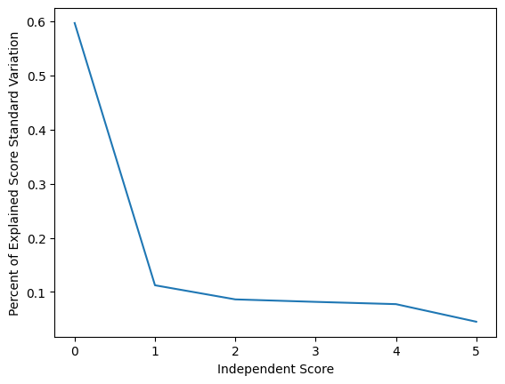
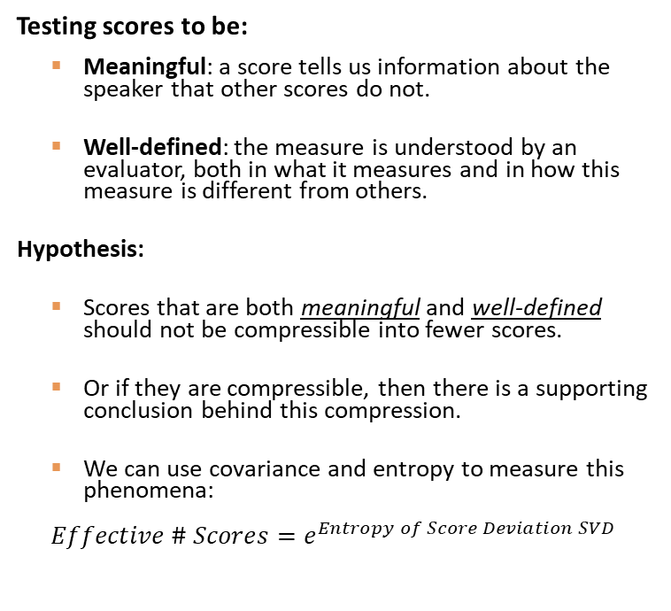
Relationship Between Scores
Testing scores to be:
Meaningful: a score tells us information about the speaker that other scores do not.
Well-defined: the measure is understood by an evaluator, both in what it measures and in how this measure is different from others.
Hypothesis:
Scores that are both meaningful and well-defined should not be compressible into fewer scores.
Or if they are compressible, then there is a supporting conclusion behind this compression.
We can use covariance and entropy to measure this phenomena:
$$Effective \# Scores=e^{Entropy of Score Deviation SVD}$$
Results (see data_analysis.ipynb):
Compressed Score: 3.7
Very high dispersion of scores across independent dimensions

Slide 7
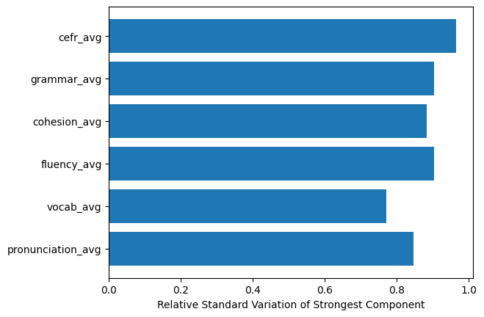
Relationship Between Scores (Cont’d)
Results (see data_analysis.ipynb):
The primary variation factor ~60% of the variation happens uniformly along all the scores.
We interpret this to mean that candidates, in general, will score well --> poorly across the board
However, each candidate will have slight, yet meaningful, variations between each score depending on their strengths and weakness - fluency, vocabular, etc...

Slide 8
Scoring Models

Slide 9
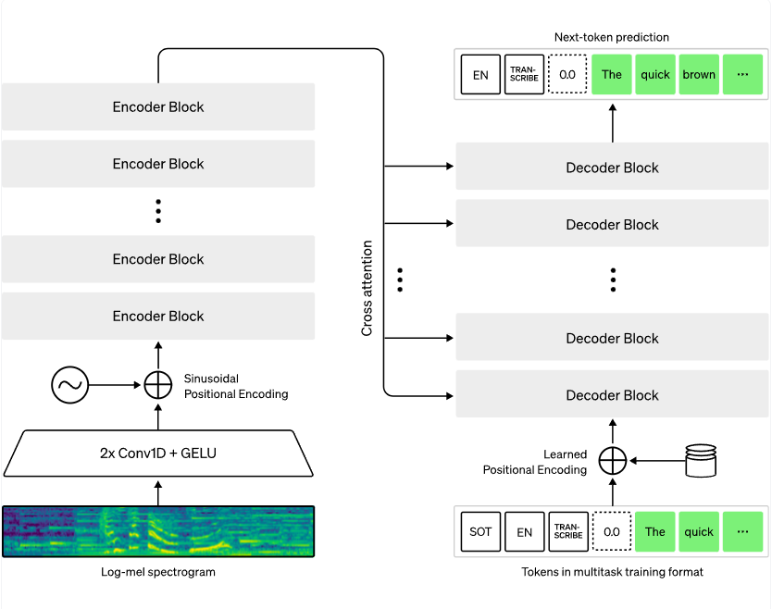
Open AI - Whisper
Encoder-Decoder Transformer Network:
Use case: Audio-to-Text transcription
Variations: Available in multiple sizes
Developed: Open AI and open-sourced
License: Apache 2.0 – free to use with no limits
Availability: Huggingface provides pretrained model along with a streamlined pipeline for inference and fine-tuning.

Slide 10
Whisper for Classification/Scoring
Fully Connected Layer
Classifier
Softmax
Finetuning:
Replace Decoder network with a Classifier Head
This is done easily through Huggingface’s packages
Train/Evaluate on an already available dataset
I show how we can take an already fine-tuned model to generate two measures and evaluate them:
Pronunciation Rating
Fluency Rating
I show how to fine-tune a measure on the SpeakNow dataset using Whisper’s decoder and a Classifier Head
Vocabulary Rating

Slide 11
Some Scoring/Rating Methods
Rating:
Mean:
Mean of label values weighted by their score
Argmax:
Label with highest score
Skewed Mean:
Weighted Standard Deviation is calculated similar to the Mean. Rating = Mean – Beta * Standard Deviation
Combining Rating from Multiple Speech Segments:
Confidence weighted mean Rating
Confidence:
Standard Deviation:
Standard Deviation of the Label values weighted by their scores is then transformed to a [0,1] domain: Confidence = 1 – 2 * StdDev/ValueDistance
Entropy:
Entropy of the Label scores transformed to a [0,1] domain, using a similar effective # predictions measure seen earlier: Confidence = 1 – (exp[Entropy] – 1)/[# labels]
Combining Confidence from Multiple Speech Segments:
Maximum Confidence value

Slide 12
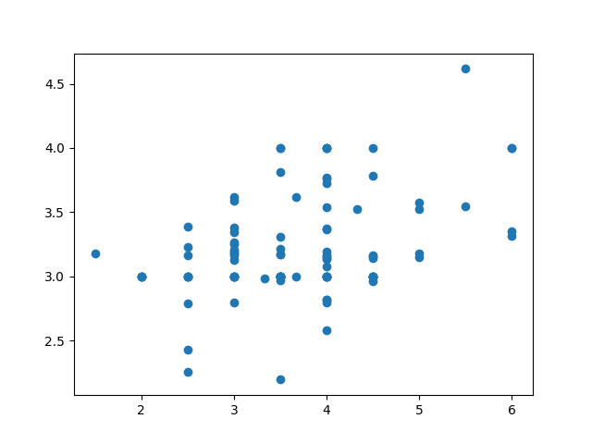
Pronunciation
Results:
Model: provided by unknown person trained on an unknown dataset
Rating Methodology: Argmax
Confidence Methodology: Entropy
Correlation with SpeakNow Rating: High
Comparison to SpeakNow Rating:
Inspecting these examples gives greater confidence in the model! (see model_analysis.ipynb)
Average Argmax Rating
Speaker | Model | SpeakNow
1679466431414415 | 3.3 | 6.0
1659856072110825 | 4.6 | 5.5
1691402791754115 | 2.2 | 3.5
1692751298358510 | 4.0 | 3.5
SpeakNow Rating

Slide 13
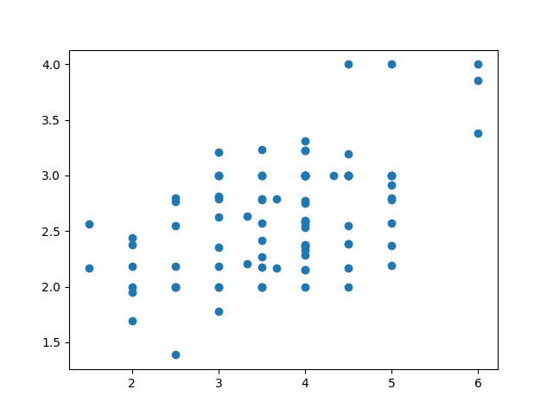
Fluency
Results:
Model: provided by unknown person trained on an unknown dataset
Rating Methodology: Argmax
Confidence Methodology: Entropy
Correlation with SpeakNow Rating: High
Comparison to SpeakNow Rating:
These examples gives the same conclusion as with pronunciation!
Average Argmax Rating
Speaker | Model | SpeakNow
1679466431414415 | 3.8 | 6.0
1692748253740131 | 4.0 | 6.0
1692849194520981 | 2.2 | 5.5
1692747394818154 | 1.9 | 2.5
1691402791754686 | 2.8 | 2.5
SpeakNow Rating

Slide 14
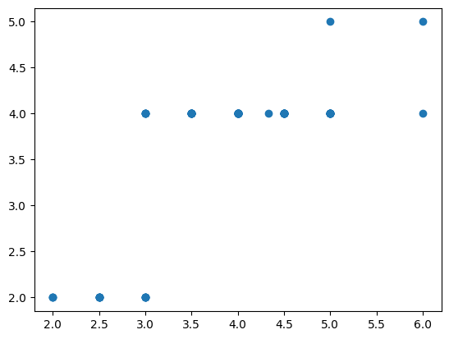
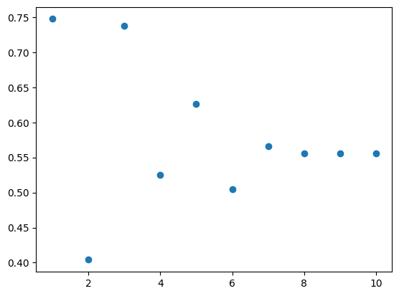

Training Vocabulary
Results (see finetune_whisper_vocabulary.py for script):
Dataset: Each audio segment was given the vocabulary score for that speaker from the SpeakNow CSV Note that there is very little data here to do proper training – 396 training and 99 validation segments, with only 1 speaker appearing in both 6 Ordinal Labels – ratings rounded to nearest integer value
Loss Function: Ordinal Cross Entropy $L\left(y,\hat{y}\right)=\left(\frac{\left|{argmax}_{i}\left[y\right]−{argmax}_{i}\left[\hat{y}\right]\right|}{5}+1\right)CrossEntropy\left(y,\hat{y}\right)$ Combines both distance and log-probabilities
Validation Accuracy over 10 Epochs:
Chosen Epoch: 3
Training Notes: Normally, 10 epochs (or less) is sufficient to fine-tune a transformer model like Whisper. However, with only 79 different speakers in the training set, with the rest for validation, 10 epochs is very little to get enough training iterations for such a large model. Still, we see that the trained rating is preserving some monotonicity on the validation set.
Validation Set Rating
Accuracy
SpeakNow Rating
Epoch

Slide 15
Speech to Text

Slide 16
MetaData
The Audio Data:
48k sampling frequency Human speech needs between 8k-16k
The audio isn’t preprocessed for clarity This can make it difficult for human evaluators to rate It is less of a problem for our transformer models
The audio transcriptions given in the SpeakNow dataset carry filler words like ‘um’, ‘err’, etc… In processing spoken sentences, we generally discard this kind of information. However, these fillers can interfere with cohesion and probably should negatively influence the cohesion and fluency scores.
As such, processing the transcriptions as textual responses wouldn’t make much sense, because people generally to write filler words.
See cohesion.ipynb
In our models, we down-sample audio to 16k.
Samples like 1691402791754118 and 1692747394818154 require better preprocessing if the candidate should stand a chance.
In comparison to the dataset’s transcription, we show that Whisper can extract a textual response that does not have these fillers.
We use Whisper to transcribe the audio, and show that the low volume responses are much easier to hear once you have these transcriptions (see 1691402791754118 and 1692747394818154)

Slide 17
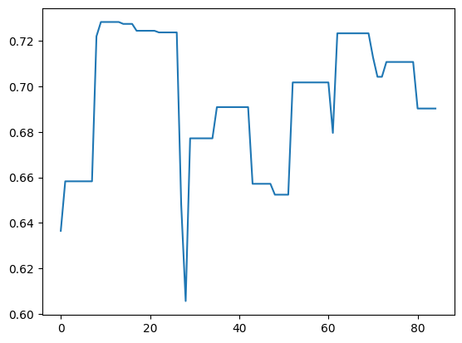
Cohesion (with Interpretability)
“So my favorite TV show would be the Firefly. It's an old sci-fi series about a group of interesting and different characters coming together on a journey first place. I really like it mainly because it's a sci-fi series which I genuinely enjoy and because of the cast of the aforementioned characters, the show is not really popular in my country because I don't think it has ever been translated to Russian, so I have only seen it in English and yeah, that's about it.”
So my favorite TV show would be…
…because of the cast of the aforementioned characters,…
Cohesion Score
…so I have only seen it in English and yeah, that's about it.
…together on a journey first place. I really…
SpeakNow Rating

Slide 18
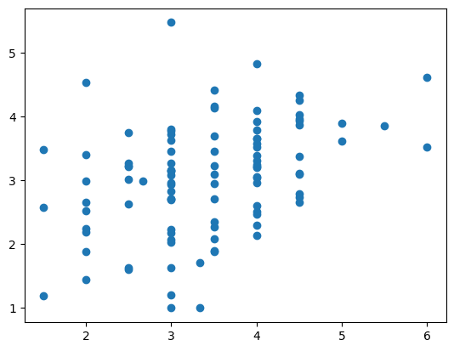
Cohesion (on Transcribed Text)
Results (see cohesion.ipynb for full details):
Model: finetuned RoBERTa on google wellformed query dataset
Rating Methodology: Mean of Timeseries Mean Using a heuristic technique to build a coherence timeseries from the model.
Confidence Methodology: None
Correlation with SpeakNow Rating: Medium
Comparison to SpeakNow Rating:
Unlike with the other measures, inspecting a few extremes of the model/speaknow coherence measures, it is hard to say which of these ratings are more deserved without consulting a linguist.
Mean Rating
SpeakNow Rating

Slide 19
Evaluating Subjectivity/Objectivity

Slide 20
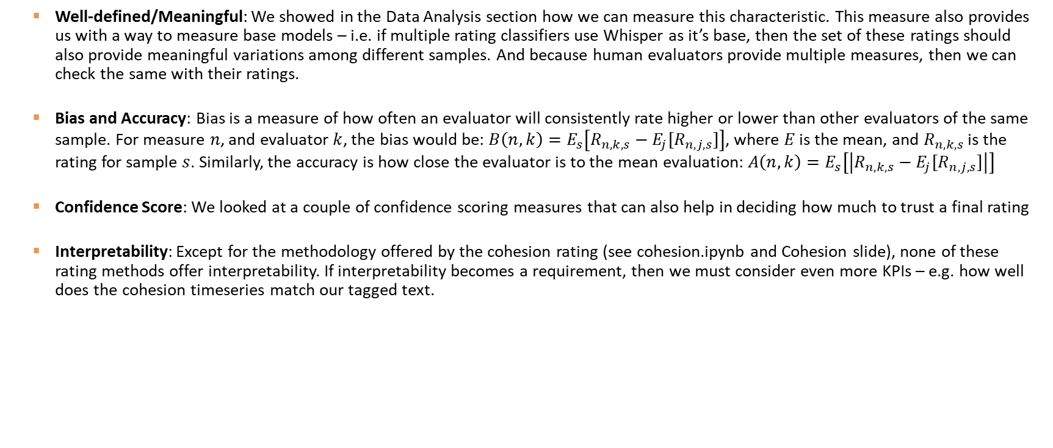
Assessing Evaluators
Well-defined/Meaningful: We showed in the Data Analysis section how we can measure this characteristic. This measure also provides us with a way to measure base models – i.e. if multiple rating classifiers use Whisper as it’s base, then the set of these ratings should also provide meaningful variations among different samples. And because human evaluators provide multiple measures, then we can check the same with their ratings.
Bias and Accuracy: Bias is a measure of how often an evaluator will consistently rate higher or lower than other evaluators of the same sample. For measure $n$, and evaluator $k$, the bias would be: $B\left(n, k\right)=E_{s}\left[R_{n,k,s}−E_{j}[R_{n,j,s}]\right]$, where $E$ is the mean, and $R_{n,k,s}$ is the rating for sample $s$. Similarly, the accuracy is how close the evaluator is to the mean evaluation: $A\left(n, k\right)=E_{s}\left[\left|R_{n,k,s}−E_{j}[R_{n,j,s}]\right|\right]$
Confidence Score: We looked at a couple of confidence scoring measures that can also help in deciding how much to trust a final rating
Interpretability: Except for the methodology offered by the cohesion rating (see cohesion.ipynb and Cohesion slide), none of these rating methods offer interpretability. If interpretability becomes a requirement, then we must consider even more KPIs – e.g. how well does the cohesion timeseries match our tagged text.

Slide 21
Scaling The Process

Slide 22

Model-Centric Pipeline (Functional Design)
Client
Scoring Models
Can use multiple models for each metric
Collect & Distribute
Scoring & Confidence Evaluation
Scoring
(e.g. Dynamo)
Pronunciation Model
Speech to Text Model
Vocabulary Model
Client
Analysis & Training
File Store (e.g. S3)
Grammar Model
MetaData
(e.g. Dynamo)
.
.
.
Portal DB
(e.g. Dynamo)
Expert Evaluation Portal
Model Store
(e.g.)
Audio/Text Enrichment for Human Evaluators

Slide 23
HuggingFace, Torch and Tensorflow
Good Integration w/ Production Pipelines: Kinesis, Airflow, etc… prep for batch processing
Huggingface: Easiest access to the best off-the-shelf pre-trained/fine-tuned transformers.
PyTorch: Heavily integrated with Huggingface
Tensorflow/Keras: Much faster training and inference. More custom Layers/Losses/Metrics.
Machines: Serverless API is not possible, as it will not scale, financially, at all. Additionally, transformers require TPUs – or at least GPUs.
Model Management: As basic as MLFlow or up to SageMaker Studio.

Slide 24

THANK YOU
Alon Kadashev
054-268-8595
alon.Kadashev@gmail.com

