Slide 1
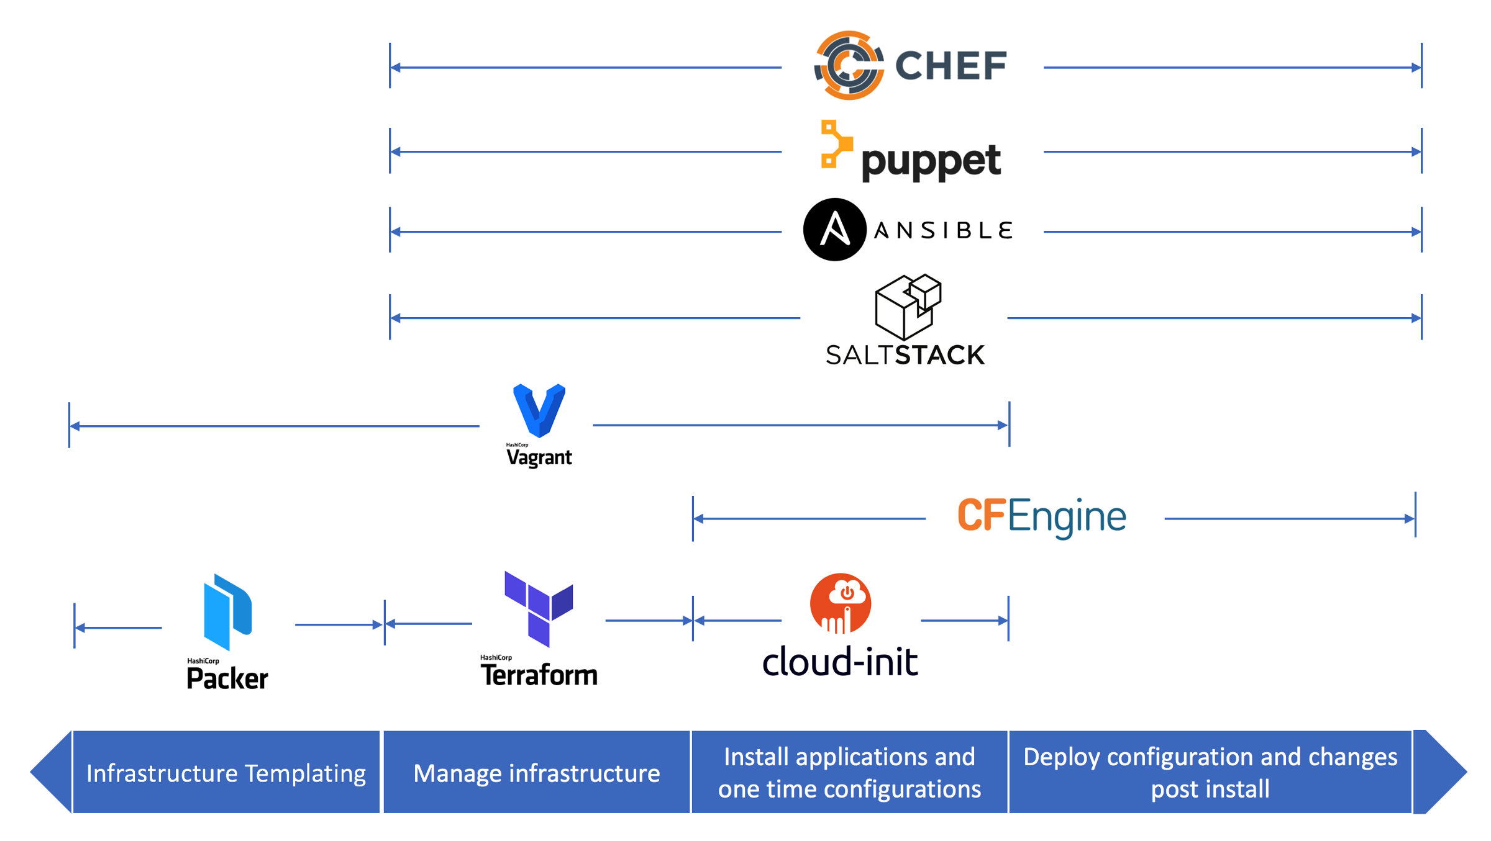
Automation as a Service | Cloud & DevOps
Zensar’s Business Need
Highlights
Purpose-Digital Transformation through end-to end automation of hybrid cloud environment in terms of provisioning, Configuration Management, Application Deployment, Security and Compliance, Integration with other ITSM tools
Delivery Model-Delivered as SaaS or White labelled tool
How Do I Choose my IaC tool?
Pick a multi purpose tool
Tools that make testing them easy. Most configuration management tools have supporting testing tools these days.
Find tool that support balance of operatabilty and developer flexibility
Popularity, GitHub Activity, Enterprise cost, Success stories are few other factors that should be considered
Tools compared/ Competitors
Configuration management tools
Puppet vs Chef vs SaltStack vs Ansible
The above tools can be chosen based on below parameter
Scalability
Ease of setup
Availability
Management
Interoperability

Slide 2






Tools | Scalability | Ease of setup | Availability | Management | Interoperability
Master-Agent
Puppet server runs on master machine and client runs as agent on each client machine
It has multi master architecture,if active master goes down other master takes the place
Puppet Master works only on Linux/Unix but Puppet Agent works on windows
Not easy to learn and manage the configuration
Puppet
Master-Node
It has only master running on server machine but no agents running on client machines.Client machine VM doesn’t require special setup hence faster setup
Runs with single active node called primary instance,if it goes down secondary instance takes the place
Ansible supports windows machine as well but Ansible server has to be Linux/Unix machine
Easy to learn and manage the configuration.
Immediate remote execution
Ansible
Master-Agent
Chef sever runs on Master machine and Chef client runs as a agent on each client machine
When there is a failure in primary server the backup server takes place of primary server
You need to be a programmer to manage the configuration. Client pulls configuration from Server
Chef server works only in Linux/Unix, but Chef Client and Workstation can be windows
Chef
Master-Agent
Here Server is called as master and client as minions which runs as agents in client machine
It has multiple masters if one master goes down agent connects with other master in the list
Easy to learn and manage the configuration.
Immediate remote execution
Salt Master works only in Linux/Unix, but Salt Minions can work on windows as well
SaltStack

