Slide 1
SRM LabReserve
SRM INSTITUTE OF SCIENCE AND TECHNOLOGY · TRICHY
22
campus labs and workshops you can book
Lab room and equipment booking with coordinator approval and a permanent audit trail
2
roles: student and lab coordinator
37
Harish V
Academic prototype · React, Express and SQLite
automated tests, all passing
Notes:
Open with the one-line pitch: SRM LabReserve lets students and researchers request lab rooms and instruments, and lets lab coordinators approve them, with every decision recorded. The campus inventory has 22 rooms. The 37 passing tests are on the last slides.

Slide 2
From booking chaos to one clear workflow
THE PROBLEM
Nobody can see which lab is free
WHAT LABRESERVE DOES
A free-room finder and a live timeline cover all 22 rooms
THE PROBLEM
Two groups ask for the same lab at the same time
WHAT LABRESERVE DOES
The server rejects overlaps, while back-to-back sessions are allowed
THE PROBLEM
Approvals and cancellations are hard to trace
WHAT LABRESERVE DOES
Coordinators approve or reject with reasons, and every action is logged
Notes:
Three everyday problems, three answers. Free rooms are visible in the finder and on the dashboard timeline. Conflicts are caught on the server, not just hidden in the interface. Every approval, rejection and cancellation records who did it, when, and why.

Slide 3
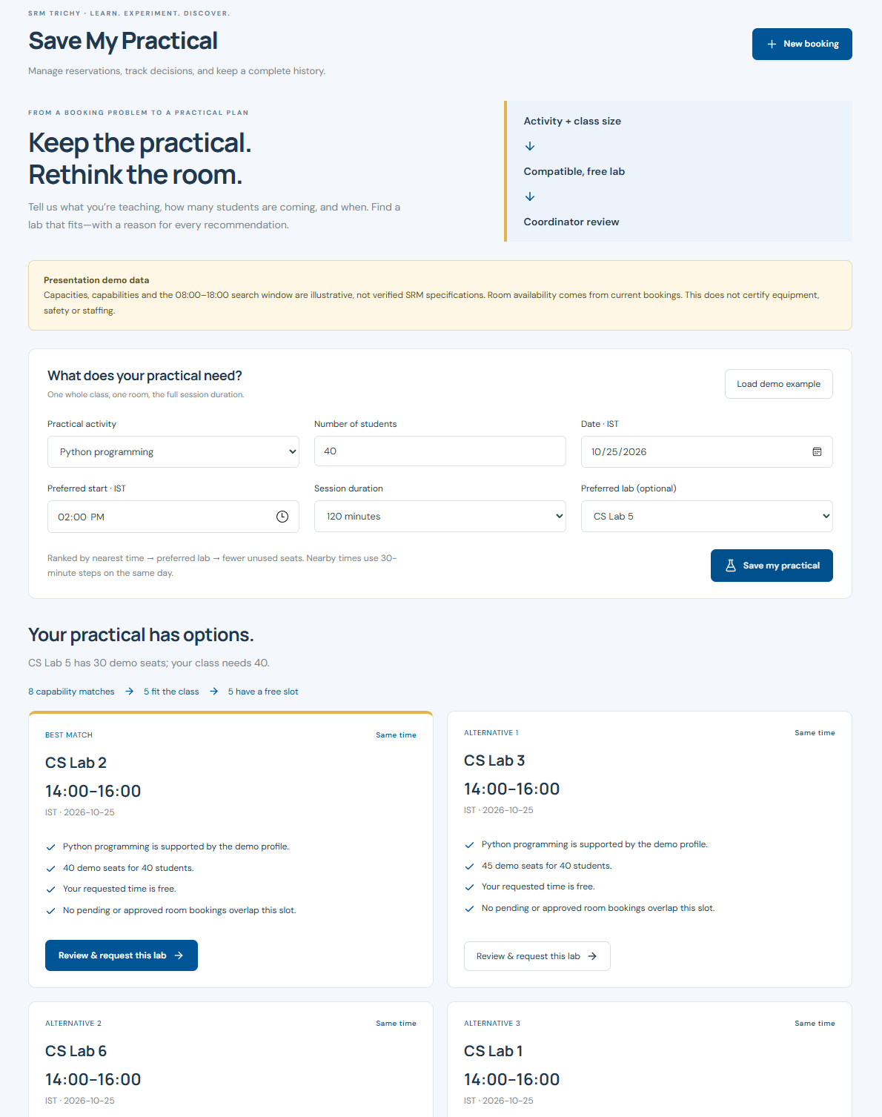
What students and coordinators can do
BOOK
Rooms and equipment
22 campus labs plus demo instruments, with a required reason
FIND
Free-room finder
Pick a time and see rooms with no overlapping booking
PLAN
Save My Practical
Class size and activity give ranked room and time options
TRACK
Student access
Individual or group headcount, project titles and durations
REPORT
Reports and CSV
Filter by date, type, status and purpose, then export
MANAGE
Coordinator tools
Approve or reject with reasons; set rooms to maintenance
Save My Practical, shown with demo data
Notes:
Walk through the six areas. Save My Practical is the distinctive one: a teacher enters the activity, class size and time, and gets ranked alternatives with reasons. Its lab capacities are illustrative demo data, not verified SRM specifications. Student counts are requested headcounts, not attendance.

Slide 4
How a booking moves through the system
BOOKING LIFECYCLE
1
Request
Pending; holds the slot
2
Check
Overlap test in a transaction
3
Review
Coordinator decides
4
Decision
Approved or rejected with a note
5
Cancel
Slot freed, history kept
ARCHITECTURE
THE OVERLAP RULE
new_start < existing_end
AND
new_end > existing_start
Only pending and approved bookings count, and the check repeats at approval.
React 19 + Vite
Screens, forms, timeline
Express 5 API
Login, roles, validation
SQLite
Users, rooms, bookings, events
One Node 24 process serves the API and the built frontend. SQLite ships with Node, so no database server is needed.
Notes:
A request is saved as pending and holds its slot straight away. The overlap check and the write happen in one SQLite transaction, so two simultaneous requests cannot both succeed. A booking that starts exactly when another ends is allowed. Approval repeats the check, and cancelling frees the slot while keeping the record.

Slide 5
Secure by design, proven by tests
Passwords
scrypt hashes with a random salt for every user
37
Sessions
Random tokens in HttpOnly, SameSite cookies that expire after 8 hours
automated tests passing
Access control
Roles and ownership are checked on the server; students see only their own bookings
Overlaps, adjacency, simultaneous requests
Roles, ownership and privacy
Approval re-checks and audit history
Upgrades that keep older bookings
CSV safety and access-tracking rules
Data safety
Parameterized SQL, escaped text, and CSV exports that neutralize formulas
Browser limits
Strict content security policy, blocked cross-origin writes, login rate limit
Tests run on a temporary database, never your real data.
Notes:
Security is enforced on the server: hiding a button is not the protection. The 37 tests use real HTTP requests, separate student and coordinator logins, and a temporary SQLite database. One test injects conflicting legacy data on purpose to prove approval rechecks conflicts.

Slide 6
Honest limits and what comes next
TODAY
Local academic prototype with fictional demo accounts
Room capacities and lab capabilities are unverified demo data
Student counts are requested headcounts, not attendance
No SSO, email notifications or recurring bookings
SQLite suits a demonstration, not campus-wide load
NEXT
Department-confirmed room details and equipment links
SRM single sign-on and faculty accounts
Email or SMS notifications
Recurring class timetables
Check-in and attendance for real utilization
Thank you · Questions?
github.com/ZeonArc/booking
Notes:
Be upfront about what this is: a working prototype, not a production SRM service. Lab capacities, equipment-to-room links and biotechnology specialization labels still need department confirmation. The next steps are the features that need real campus data or systems: SSO, notifications, timetables and attendance. The code is public on GitHub.

