Slide 1
OOPS MAJOR PROJECT
CYBER CAFE MANAGEMENT SYSTEM
Group No. 23
DASARI JAYANTH 2019BCS-016
THARI ZEPHANIAH 2019BCS-067

Slide 2
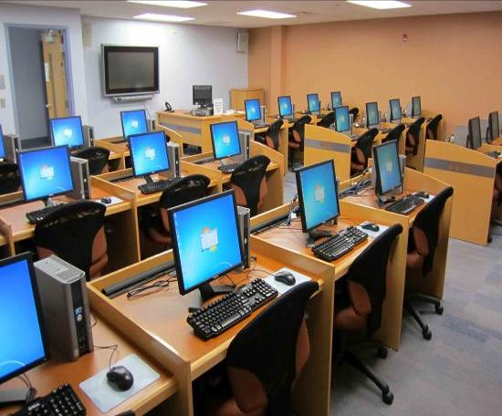
The Software is the solution for an internet cafe. The software provides you with a means to control the workstations, manage customer database, sell products and generate detailed reports and statistics. This is a powerful Cyber Cafe management software that helps with managing customers and employees, controlling computers and printers, securing systems, accounting and billing

Slide 3
BASIC DESIGN
This Project is based on OOPS(Object Oriented Prograaming) implemented in C++ Language.We included the Concept of Objects and Classes and
other C++ Concepts like
Inheritence
Encapsulation
Dynamic Memory Allocation
Abstraction
Polymorphism

Slide 4
Manual and Computer Based System
manual CAFÉ MANAGEMENT SYSTEM
Stresfull Work in inserting each session details
Paper Work (Not safe nowadays)
Manually have to calculate daily income
No limitation of Data to Customers which can result in data loss.
Should reset the Settings after each Session unlike Computer Based.
COMPUTER BASED CAFÉ MANAGEMENT SYSTEM
Completely Online
No need of Paper Work
Stressless Work
One Click to calculate Daily Profit
Can supervise the Data Limit of Each Session.

Slide 5
INTRODUCTION
Cybercafe management system keeps customer accounts, so that customerscan log in on their own using username and password
C++ with application development toolshas made it relatively easier for computer professionals to build severalprojects
The users of this system are required to feed up their own data givingup appropriate constraints to be able to manipulate the functioning ofvarious highlights of the system.
The basic task of our software is to provide operators and customerswith an accurate timing and billing information at any time.

Slide 6
FEATURES
Being of its ease of access and interface, this system can be used byany specialized or non-specialized users
Addition, deletion, modification of member records, machine recordsand surfing records are easily maintained
Reduce time, money and efforts of doing the work.
Provide fast retrieval of information.
Different pricing strategies for specialized and non-specialized Usersbased on the Level of Membership they avail.
Deleting all the Customers History and Data after he/she completes his Session.

Slide 7
IMPLEMENTATION
To implement this Design we require 3 Classes with various Member Functions, Classes include
Member Entry
Computer Entry
Cyber Cafe

Slide 8
1.Member Entry
This Class include Various Member Functions andData Members which involve creating Premium User Objects of CyberCafe using the concept of Inheritence.The Member Entry Consists of Various options
Add New Member
Show Member
Update Record
Delete Record
Search Record

Slide 9
2.Computer Entry
This Class include Functions which deal with theperformance of the Computers
The Computer Entry consists of Various options
Add New Computer
Show Computer
Update Record
Delete Record
Search Record

Slide 10
3.Cyber Café
This class deals with the Basic Tasks in the Softwarelike to book a session,show fares,etc. The Functions coming under thisclass are:
Show Charges
Book Session
Close Sesssion
Renewal Account

Slide 11


Thank You

