Slide 1
WK13-EAP写作期末复习

Slide 2
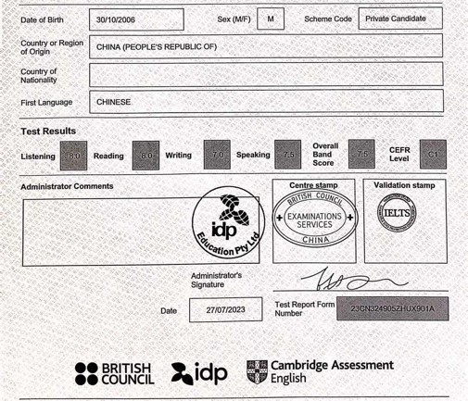
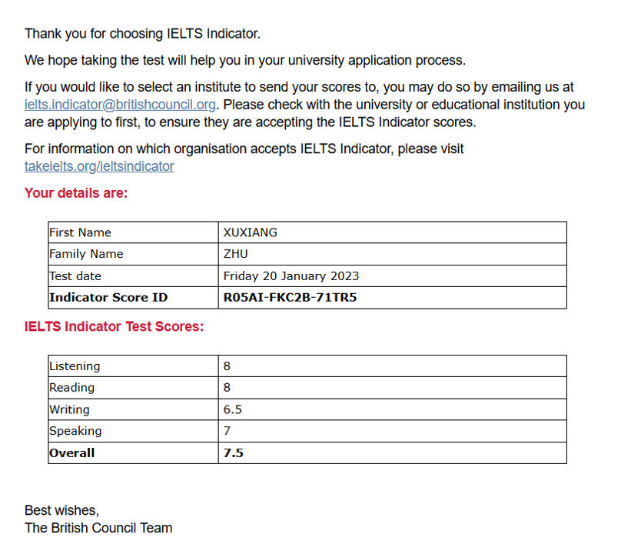
讲师介绍
雅思7.5

Slide 3
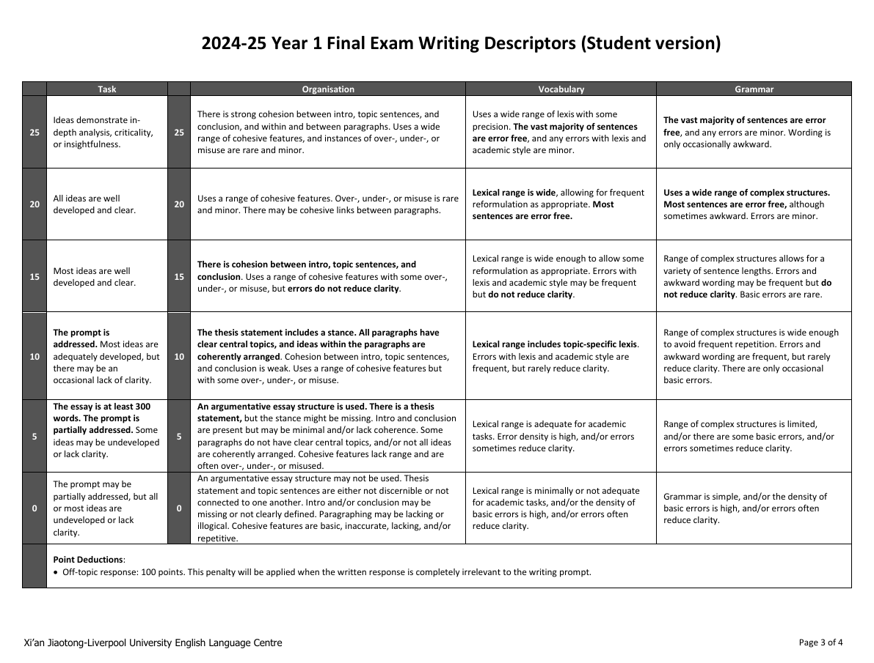

Slide 4
需要注意的写作学术规范细节
1.不要使用缩写（如don’t, can’t, shouldn’t等）
除所有格和特殊名词外，不允许出现’
2.避免出现主观臆断和不严谨的时间、范围、人群陈述（如 People in China are more focused on academic performance. ）需要注意描述的准确性
3.论文有两种格式：齐头式或缩进式

Slide 5
需要注意的写作学术规范细节
S1 10 academic style rules
Do not use informal vocabulary or abbreviations
Avoid vague or general terms
Do not state your opinion, personal feelings or being subjective
Avoid using personal pronouns
Do not use contractions
Do not use And, So or But at the beginning of a sentence
Avoid using strong or absolute statement
Do not ask rhetorical questions
Do not use proverbs or cliches
Do not write integers between 1-9 in paragraphs or in essays.

Slide 6
题型概述
EAP期末写作题型：
To what extent do you agree or disagree…?

Slide 7
文章结构
Structure recap:
Introduction(Paragraph 1): Background --- Bridge --- Thesis statement
BP: Controlling idea --- supporting details
Conclusion(Last paragraph): Thesis restatement, summary, recommendation

Slide 8
范文精析
Topic: Student should be allowed to use generative AI to do assignments. To what extent do you agree?

Slide 9
范文精析
In recent years, artificial intelligence(AI) has become an important tool for students. For example, generative AI tools such as ChatGPT or XipuAI have the ability to complete tasks for students, such as writing essays or solving math problems. While some educators assert that AI will help students learn more effectively, many disagree. This essay will argue that students should not use generative AI complete assignments because this could diminish learning and prevent them from learning about responsibility.
首段结构：交代背景---paraphrase----顺承----中心论点

Slide 10
范文精析
One reason students should not use generative AI is that this may decrease their ability to learn. First of all, it can reduce their ability to learn how to solve problems. For example, math students are often asked to prove Pythagorean Theorem using formulas they already know. This type of practice problem gives pupils valuable experience and prepares them to solve real problems in the future. However, if a student use AI to get the answer, they are skipping an important learning step which will enable them to handle such challenges in the future.
BP1：第一个分论点 --- 举例论证 --- 道理论证

Slide 11
范文精析
Secondly, it will reduce their creative development. For instance, university students learn how to write essays arguing for or against a certain topic. Producing a well-written essay requires creative skills such as formulating logical arguments and selecting the appropriate language to express these ideas. However, if students use an AI tool write an essay, they will not develop their creative expression.
First of all/Secondly 使文章逻辑更有条理

Slide 12
范文精析
Another reason why students should not use generative AI is that this might prevent from learning how to handle responsibilities. Apart from teaching knowledge, schools also help students learn how to balance responsibilities by assigning tasks and projects with deadlines. For instance, Year1 EAP students were asked to write a group proposal, which involved coordinating multiple tasks and meeting key deadlines.
BP2： 举例恰当

Slide 13
范文精析
However, if students simply used an AI tool to complete this proposal, they would not learn how to manage and prioritize these tasks. This is particularly true of students who are not intrinsically motivated. These are students who only study to achieve high scores or attain a degree, instead of viewing their education as a way to improve themselves. Such students might rely on AI because it can do much of the work for them, but they will not develop a sense of responsibility.
BP2：对象明确

Slide 14
范文精析
In conclusion, this essay has argued that students should not use generative AI to complete assignments. Not only can the use of AI reduce their capability to learn, but it might limit the development of responsibility. Therefore, universities should educate students on the downsides of relying on AI and closely monitor students to ensure that they are truly receiving an education that can help them develop key skills they will need in the future.
末段：重申中心论点（paraphrase）---- 提出解决方案/建议

Slide 15
范文精析
Please discuss the advantages and disadvantages of extreme sports.

Slide 16
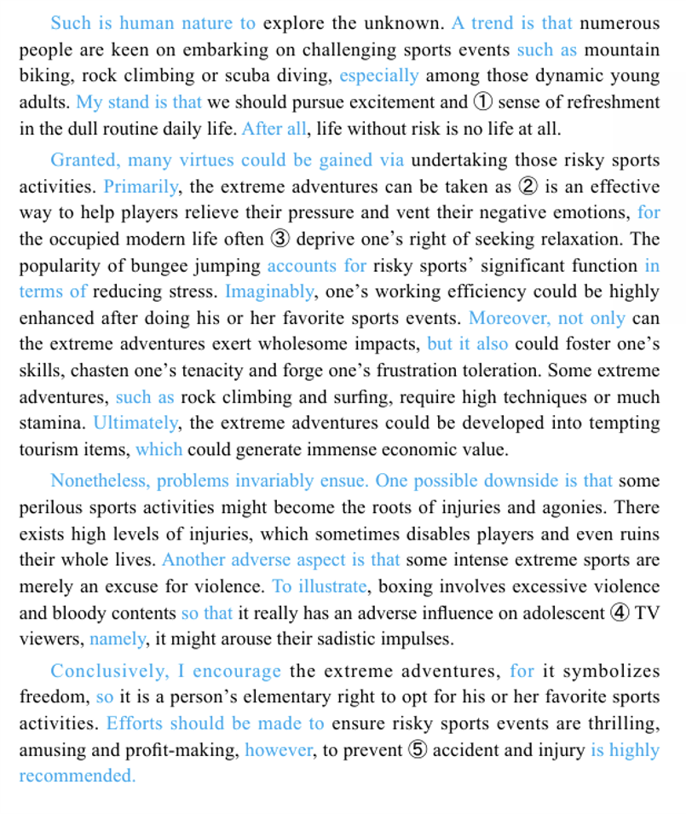
范文精析

Slide 17
范文精析
首段：
Such is human nature to explore the unknown. A trend is that numerous people are keen on embarking on challenging sports events such as mountain biking, rock climbing or scuba diving, especially among those dynamic adults.
分析：以社会现象作为背景，切入话题。
明确受众，锁定范围(dynamic adults and youngsters)
使用严谨、具有说服力的语言（A trend）

Slide 18
范文精析
首段：
Such is human nature to explore the unknown. A trend is that numerous people are keen on embarking on challenging sports events such as mountain biking, rock climbing or scuba diving, especially among those dynamic adults.
***分析：另一种广为人知的开头方式是通过调换语序、改变词汇和说法的形式重新表达一遍题意
（paraphrasing）。（建议在EAP写作中用这种方式）

Slide 19
范文精析
首段：
The essay mainly focuses on pursuing excitement and sense of refreshment in the dull routine daily life. After all, life without risk is no life at all.
分析：明确自身中心论点
*本篇论文没有在中心论点和背景之间加入论点顺承，但建议将其加入格式范式并根据具体情
况选择是否需要
论点顺承(bridge)参考格式: The proponents/some would believe/argue,
whilst/while others/the dissenters tend to agree/believe

Slide 20
范文精析
首段结构总结：
背景（社会，个人）引入并明确受众----双边观点（论点顺承）---- 中心论点

Slide 21
范文精析
Body paragraph 1:Granted, many virtues could be gained via undertaking those risky sports activities.
分析：以本文为例，在第一个主体段的第一句写“这样做有很多好处”有两个作用和好处。
1.构思时间短，你也没想好到底有哪几个好处，先占着位置再说。
2.你想好了有哪几个好处，但是你的词汇量不足以支撑你在主体段论点，主体段的论述部分
和总结段paraphrase三次。同时，这样会显得文章冗长，信息密度极低。

Slide 22
范文精析
Body paragraph 1: Primarily, the extreme adventures can be taken as an effective way to help players relieve their pressure and vent their negative emotions, for the occupied modern life often deprive one’s right of seeking relaxation.
分析：抛出第一个好处，值得注意的是，连接词（conjectural devices）应不落窠臼
此后连接的是一段道理论证。逻辑的严密性和解释的清晰性在论证过程中尤为重要

Slide 23
范文精析
Body paragraph 1:The popularity of bungee jumping accounts for risky sports’ significant function in terms of reducing stress. Imaginably, one’s working efficiency could be highly enhanced after doing his or her favorite sports events
分析：此处举例论证。在主体段论证时应恰当加入1-2个例子，篇幅不宜太长。需要再次强调的是
这个语段中的连接词同样适用地恰到好处，使行文连接顺畅。
***“could be highly enhanced”为被动语态。在essay中应将被动语态的优先级放在较
高位置。这是由语态的先天优劣势决定的，主动语态给人武断、主观的感觉，而被动语态
先天具有客观、严谨的色彩。

Slide 24
范文精析
Body paragraph 2：Moreover, not only can the extreme adventures exert wholesome impacts, but it also could foster one’s skills, chasten one’s tenacity and forge one’s frustration toleration.
分析：第二个分论点的阐述。
使用not only…but also…这类关系词时，应对语法正确性有较高把握，在不确定语法
正确与否的情况下贸然使用得不偿失
*foster, chasten, tenacity, forge 是一些值得记忆的单词

Slide 25
范文精析
Body paragraph 2：Some extreme adventures, such as rock climbing and surfing, require high techniques or much stamina.
分析：举例不需要完整的句子进行较长篇幅的阐述，也可以用少量单词和短语进行蜻蜓点水的
佐证。

Slide 26
范文精析
Body paragraph 2：Ultimately, the extreme adventures could be developed into tempting tourism items, which could generate immense economic value.
分析：这是正向主体段的最后一个分论点，连接词质量依旧可圈可点。
***如果主体论证有三个分论点，在篇幅分配上最合理的是1>3>2。切忌出现1>2>3的情况，
这会给考官头重脚轻、行文篇幅欠缺事先规划的感觉。如果实在没有足够的语言能力和论证
逻辑论证第三个观点，也可以只有两个分论点。
范文使用的行文技巧也值得学习，将第三个分论点和第二个分论点放在同一段，使阅读视觉
感相对舒适。

Slide 27
范文精析
主体段的结构基本遵循分论点1----逻辑论证----分论点2----举例论证1----逻辑论证----分论点3----逻辑论证的模式

Slide 28
范文精析
Concession paragraph: Nonetheless, problems invariably ensue. One possible downside is that some perilous sports activities might become the roots of injuries and agonies. There exists high levels of injuries, which sometimes disables players and even ruins their whole lives.
分析：让步段的基础论证结构与正向论点没有本质区别。但是需要注意的是，论证的语言应当
程度较轻（One possible downside），若论证性太强，相当于搬起石头砸自己的脚。

Slide 29
范文精析
Concession paragraph: Another adverse aspect is that some intense extreme sports are merely an excuse for violence. To illustrate, boxing involves excessive violence and bloody contents so that it really has an adverse influence on adolescent TV viewers, namely, it might arouse their sadistic impulses.
分析：这个语段范文所采用的连接词非常精彩。To illustrate 是 for example 和for instance的同
义词（关于同义词在写作中的运用，稍后会提到）。
***从结构上将，让步段最好只有一个分论点，篇幅不宜太长，相比正向主体段应当是“略”
的角色。范文存在的问题是让步段过于冗长。

Slide 30
范文精析
让步段结构：论点----逻辑/举例论证----尽管（反面论点），但是仍然（正面观点）

Slide 31
范文精析
Last paragraph: Conclusively, I encourage the extreme adventures, for it symbolizes freedom, so it is a person’s elementary right to opt for his or her favorite sports activities.
分析：和首段一样，末段首先要paraphrase自己的几个分论点。
范文运用的I believe/encourage 中心论点，for 分论点是较为自然的陈述方法。
连接词使用副词的效果会好很多。Conclusively就比in conclusion更自然。
需要注意的是，文章中使用的连接词，特别是较为关键的位置上使用的，应当保证其书面
性和学术性。To wrap it up, in a nutshell 这类较为随意和口语的表达不建议使用。

Slide 32
范文精析
Last paragraph: Efforts should be made to ensure risky sports events are thrilling, amusing and profit-making.
分析：Recommendation.
不建议展开太多论证，结尾段应当简明扼要

Slide 33
文章最终所得分数的两个决定性因素是语言(Organization, Language)和论点逻辑和思辨性（Idea development），接下来将从这两个方面分别给出建议。

Slide 34
遣词造句
同义词替换
使用恰当的同义词替换原有词汇，展示词汇丰富度（lexical resource）
范文实例： disadvantage-adverse aspect-downside
其他：condemn-reprimand
for example- for instance- to illustrate- as an apt illustration
solve-impart
develop-foster
puzzle-bewilder
……

Slide 35
遣词造句
练习： advantage-
damage-
standpoint-
important-
abate-
apply-
teach-
finish-
abandon-

Slide 36

遣词造句
主题相关词汇（有的放矢）：
EAP考试包括的几个主题是非常局限的，在刷过一定量真题后，应当总结出几个大主题，并背诵主题相关词汇
如，

Slide 37
遣词造句
这个题目是（青少年）犯罪(Ethics)相关的题目，如果背诵了主题相关词汇，如：
Juvenile delinquency 青少年犯罪 commit crime 犯罪 sentence 刑期
Exemption 豁免 jurisprudence 法院审判流程
再加以恰当使用，会让考官认为你有足够多的词汇量应对各类主题，是一个非常大的加分项。
常出现的主题包括但不限于： 教育、医疗、环境保护、动物保护、犯罪、司法正义、
科技、道德、交通、城市规划、文化多样性、国际化视野等。
虽然主题看起来多且杂，但做多题就会发现，每个主题的角度相对单一和固定。如科技主题大概率会问你一个新科技的进步性与对于传统事物、文化的冲击之间的矛盾。

Slide 38
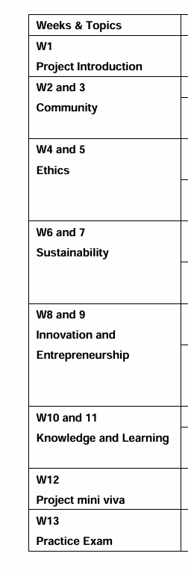
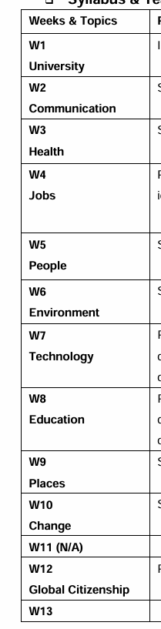
遣词造句
以下是过去两个学期EAP
课上所涉及到的主题

Slide 39
遣词造句
被动语态、句间介词和连接词相对更受欢迎，而虚拟语态、较为复杂和混乱的时态并不太受待见。同时，应当注意长短句的结合，避免长难句堆砌
主/被动语态对比：
Most people in this country welcome this new policy.
The new policy has been welcomed by the majority of people.
A wide range of people know the fact that aerial littering is illegal.
It is widely known that aerial littering is illegal.
从上例可以看出，被动语态明显更具有官方性、严谨性、客观性。

Slide 40
遣词造句
Scientists find it hard to prove such hypothesis.
The government should put this policy into practice.

Slide 41
遣词造句
句间关系词是文章逻辑的重要体现，这点也在之前的范文中反复强调。
表顺承：
Furthermore, Moreover, Additionally, Similarly, Likewise,
表转折：
However, yet, though, nevertheless, despite, whereas, nonetheless
表原因：
Because, since, due to, as

Slide 42
遣词造句
其他值得记忆的连接词：
Such is… , Imaginably, namely, primarily, …is that
你还能想到哪些句间关联词？

Slide 43
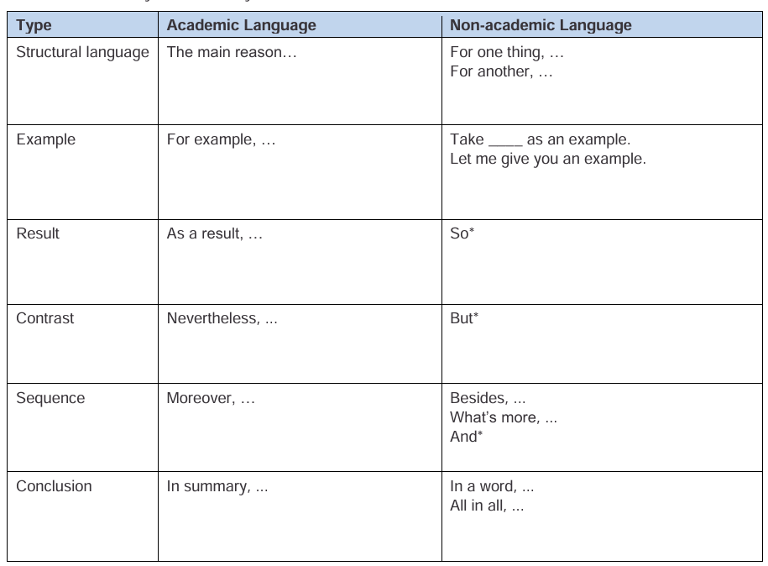
遣词造句

Slide 44
论点生成
EAP课本中建议的思考角度：
Cause to Effect:
e.g. In recent years, record numbers of tourists have visited scenic spots and national parks. This has led to… increased pollution at tourist destinations and damage to environmentally sensitive areas.
General to specific:
e.g. In recent years, mass tourism has caused serious problems at popular destinations. To illustrate …
Problem to solution:
e.g. In recent years, increased tourism has caused more pollution in national parks and other scenic areas. In order to deal with this problem, environmentalists have proposed…

Slide 45
论点生成
其他具有逻辑深度的思考方式：
在拿到题目后应该做的第二件事就是快速思考出2-3个能够很好佐证中心论点的分论点。
常见的几种思考方式是：个人-社会/公司-政府/政策 应该怎么做
过去-现在-未来 有什么区别
对环境-经济利益-道德-社会 有什么影响
其余scatter points： NGO，媒体，父母/家人
思考时应该从纵向、横向都想一遍问题，哪个角度更便于自己发挥、看起来更具有说服力就选取哪个方向。

Slide 46
论点生成
Let’s dive into it deeper.
Impacts on individuals:
Physical health
Mental health(Sense of belonging,
Depression)
Human rights
Occupation
Societal rule
Financial background
Educational background

Slide 47
论点生成
Impacts on the society:
Cultural diversity
Economy
Politics
Societal stability(National security)
Reputation

Slide 48

论点生成
例1 (Environment)经过权衡，这篇文章采用“对环境-经济利益-道德-社会 有什么影响”的模型比较合适。
对环境的正面影响： 减少了非法杀戮野生动物的可能性，增加了生物多样性。
对环境的负面影响：（暂时想不到）
对经济利益的正面影响：能发展其他制造业（合成物品），引领产业升级，使商品具有更高附加值
对经济利益的负面影响：对大量原有工厂和产业链是重大打击
道德一方面：杀害大量动物是不道德的
道德另一方面：为了保护动物而使大量工人失业同样是不道德的

Slide 49
论点生成
例2(Sustainability)：As countries develop, more and more people buy and use private cars. How should such phenomenon be restricted?
这篇文章就可以很顺畅地从个人-社会/公司-国家 的角度来思考。
个人：多乘坐公共交通/绿色出行
公司：承担社会责任，发展电车板块业务，通过技术研发实现低排放
政府：出台政策限制私家车出行（限号出行），给有高污染企业加税/关停，给产业链绿色的公司减税……

Slide 50
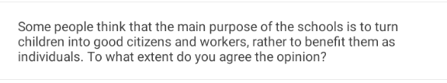
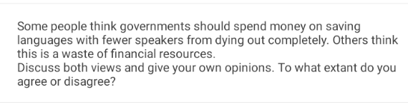
论点生成
(Education)
(People, Global citizenship)

Slide 51
论点生成
例3：可以有多种角度选取，这里选用个人-社会-国家的角度
个人好处：能够学习到适应社会需求的能力和知识
个人坏处：容易失去主见和个人想法
社会/国家好处：能够培育出一个好公民
社会/国家坏处：教育产物趋于平庸，各领域缺乏创新性、突破性人才

Slide 52
论点生成
例4：这里选取“对环境-经济利益-道德-社会 有什么影响”的思考方式
对经济的好处：将钱花在文化保护项目上可以使其成为国家/区域文化名片，带动旅游业
对经济的坏处：将钱花在注定要消亡的地方，浪费
文化一面：语言和文化的魅力在于其多样性，应当保护
文化另一面：语言的功能是用来沟通，这种小微语言已经失去该功能，注定消亡，不应该人为干预
从上例可以看出，模型并不应该生搬套，而是基于提供的思路实际情况实际分析

Slide 53
主体段内容
在确定了分论点后，需要做的是对其进行进一步论证，开枝散叶。需要培养的能力是看到分论点后快速构想处论证逻辑和主要结构的能力。
例：Juvenile delinquency can be stopped via…?
1.Education in schools
2.Positive promotions in artistic pieces
1.第一个分论点可以想到：学校教育方式？学校的教育频率？如何保证学校教育有效实施？
2.第二个分论点可以想到：哪些电影/影视剧/小说/艺术作品中涉及可能引导青少年犯罪的内容？
是否应该删减？如何保证青少年不被expose？

Slide 54
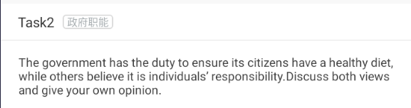
BP练习
(Health)

Slide 55
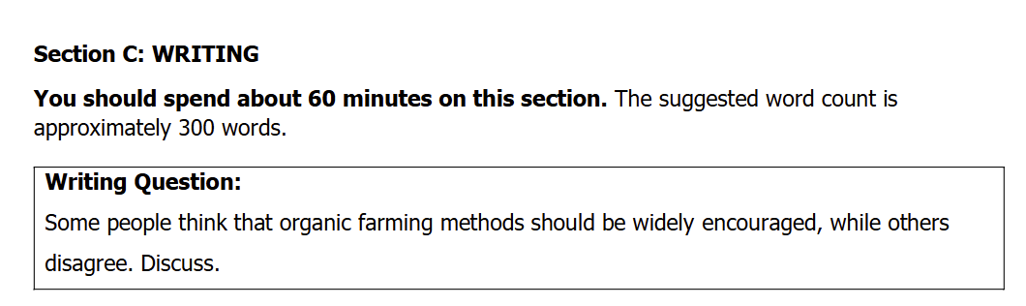
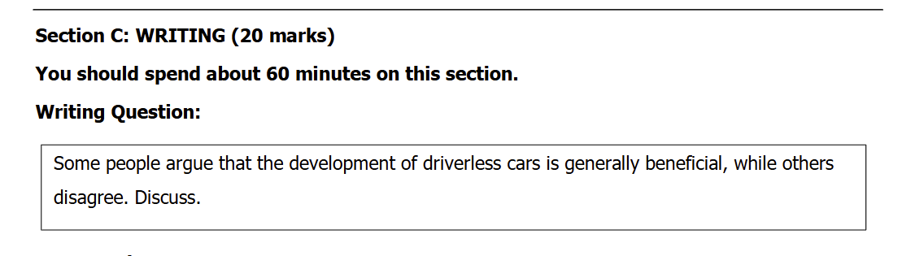
BP练习
(Environment)
(Technology)

Slide 56
BP练习
Organic farming 好处：
1.无农药（pesticide），更健康，有益食品安全
2.不污染环境
坏处：
1.产量下降、影响经济效益
2.政府监管所需成本大、难以落实实施

Slide 57
BP练习
无人驾驶好处：
1.杜绝人驾驶由于疲劳驾驶等原因导致的高事故率
2.解放人力，劳动力可从事更高脑力劳动的工作
坏处：
1.技术不成熟时可能事故率较高
2.取代大量岗位，增加失业

Slide 58
一些建议
对于英语写作题的练习有两个误区，一些人认为写作完全不存在刷题，也有人认为写作的刷题就是将一篇文章从头到尾一字不差地写完，这两种想法实际上是一样的。实际上，有效率的写作刷题方式是在看到题目后，思考出文章结构应该如何规划、分论点都是什么，快速想到要用哪些逻辑关系、哪些句间连接词。这个过程可以写下来，也可以完全不用动笔，全程3-5分钟最为适宜。同时，在参考范文时重点也应关注其逻辑关系，而相对忽略质量良莠不齐的论证语言和事例。在达到一定阅题量时，一定要自己总结出文章结构和行文逻辑的套路，行程自己的思维定式。

Slide 59
Q&A
Feel free to ask me any questions about EAP and IELTS test.

Slide 60
谢谢！

