Slide 1
High availability of BMP
Router1
(RR)
Characteristics:
Having two collectors daemon working in ACTIVE/STDBY mode based on their priority
Do produce message to kafka if having a higher priority, vice versa.
Signal machenism
Milestones:
Verify in the lab if the daemon state is stored in the cache, and if that when the daemon stopped, it will be removed from the cache (by setting a keepalive of 1 min)
Implement that the remote daemon is publishing/consuming from the redis cache.
Reorganize the key sent to redis:
daemon_name+daemon_version+cluster_name+cluster_id+cluster_priority
Implement that if the daemon has higher priority, do produce message to kafka, vice versa.
Implement that the received BMP metrics will be used as value to the key(in step 3).
Dest IP addr.+BMP metrics
If both daemon has BMP session to the same IP addr, and one daemon has higher priority than the other, do produce message to kafka.
(optional) Generat for all peer-up a hash and form a peer-group has for BMP metics and publish/consume to/from redis cache to compare. If different, report to the log. If both daemon has the same subscribtions and the same BMP session, the daemon with higher priority produce message to kafka.
BMP session2
BMP session1
BGP Peering
Collector 1
Collector 2
Router2
Redis cache:
Sync BMP session(BGP metrics)
Sync BMP session with peer-group hash(optional)
Other functionality:
Enable the collector to consume data from SW
Get and compare the peer-group hash of the two collectors, and return priorities to collectors respectively
Third partie SW:
1. Redis cache
(1) Sync BMP session(metrics)
(2) Sync BMP session with a
peer-group hash.
2. Other functionalities
(1) Enable the collector to consume BMP session state from the SW
(2) Return priority
Kafka

Slide 2
High availability of BMP
For nfacctd:
Before nfacctd enter its main loop, it will initiate the BMP daemon, the redis thread and the queue thread created by myself. This three threads belong to the core process.
BMP daemon produces the received BMP data to Kafka while the Kafka plugin produces the IPFIX data to Kafka.
To disable the effect of this project for IPFIX, we just need to identify whether the config.type is “core” or “kafka”
Start
nfacctd
Bmp_daemon_wrapper()
Main loop
p_redis_init()
queue_thread_wrapper()

Slide 3
High availability of BMP
Set collector timestamp
Sleep(1)
Redis thread
It has a main loop that is periodically setting record to redis. Initially it was writing clusterID, process type and daemon type to redis. I added writing the timestamp and increase the frequency to 1 second.
Timestamp is exclusive for each collector and is set at the establishment of redis connection
After entering the loop, redis thread produce the timestamp to redis with a timeout of 1s in each loop.
In each loop, redis thread also get all the timestamps from redis and make comparison between them and its timestamp and set the dump_flag accordingly.
If the dump_flag has been changed compared to that in the last loop, and this is also not the first time redis get a dump_flag, then set the queue_dump_flag.
Regenerate_timestamp_flag
true
Refresh timestamp to current time
false
SET config.name+config.cluster_id+attachment_time timestamp
dump_flag = false
KEYS *+config.cluster_id+attachment_time
dump_flag = true
If there is nothing under this query
If it has the smallest timestamp
If there is just its timestamp
If there is one timestamp that is smaller than its

Slide 4
High availability of BMP
Bmp daemon
It has a main loop that is producing one BMP data per loop(Regardless of the number of BMP peers). It calls the function p_kafka_produce_to_part() each time there is data to be sent.
In the function p_kafka_produce_to_part() before it can finally produce the data, I check with two flags: queue_dump_flag&dump_flag.
If queue_dump_flag is set, I dump the data in the queue first then I dump the data sent by bmp daemon.
If the dump_flag is not set, I skip the dumping and store the data into the data queue.
If the dump_flag is set, I dump the data normally.
Received BMP *data
p_kafk_produce_to_part()
Queue_dump_flag
true
false
While(q->count!=NULL)
{rd_kafka_produce(q->head)
Dequeue(q)}
(dump_flag || aa_flag) && !pp_flag
false
true
enqueue(data)
Pthread_cond_signal(&sig)
rd_kafka_produce(data)

Slide 5
High availability of BMP
Queue thread
Queue thread is used to manage the data queue. Due to the way of implementing, there are maximum 2 seconds of delay. So we need to preserve data which is to be sent in the previous 2 seconds in case failover happens.
The data queue is a time bounded queue. In its loop, it sleeps for 2 seconds and then check the timestamp of the node in the queue, if this node is expired, dequeue this node.
Sleep(2)
Get current timestamp
Pthread_cond_wait(&sig)
*d_ptr = q->head
false
while (timestamp-d_ptr->timestamp > 199999)
true
dequeue(q)
*d_ptr = q->head

Slide 6
High availability of BMP
Signals
Signal 34: regenerate_timestamp_flag = true
Signal 35: aa_flag = true
pp_flag = false
Signal 36: aa_flag = false
pp_flag = true
Signal 37: aa_flag = false
pp_flag = false
(dump_flag || aa_flag) && !pp_flag
(dump_flag||aa_flag)&&!pp_flag?"ACTIVE":"STANDBY"

Slide 7
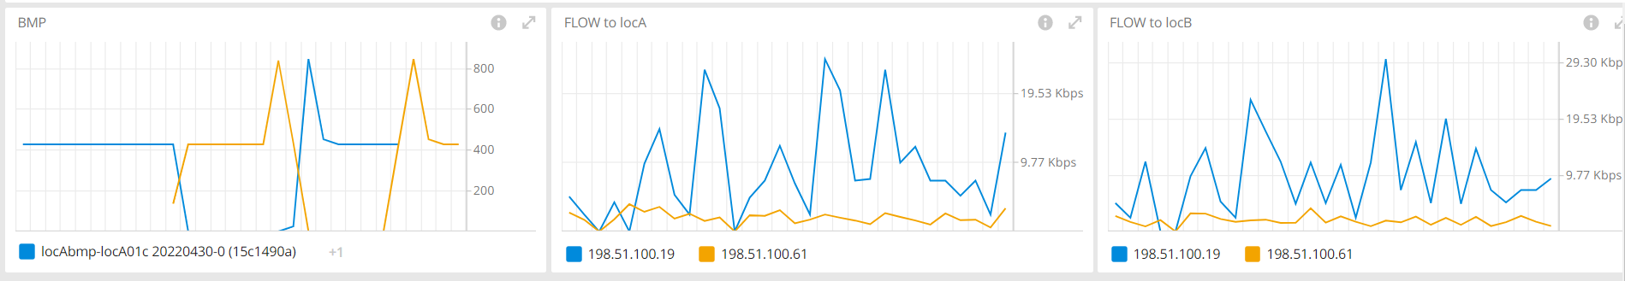
High availability of BMP TESTING
ACTIVE/STANDBY
Trigger failover

Slide 8
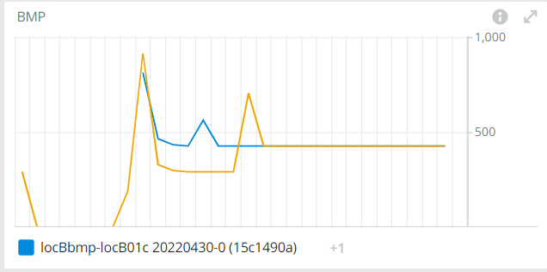
High availability of BMP TESTING
Redis Unavailable

Slide 9
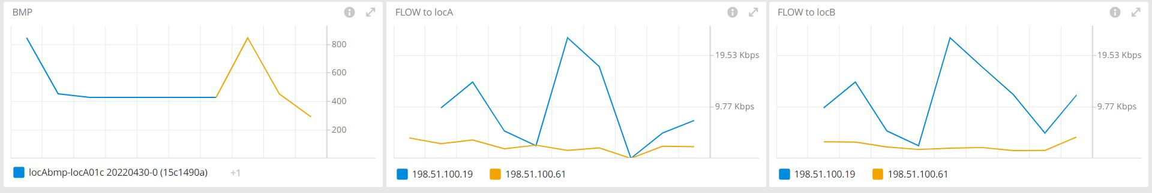
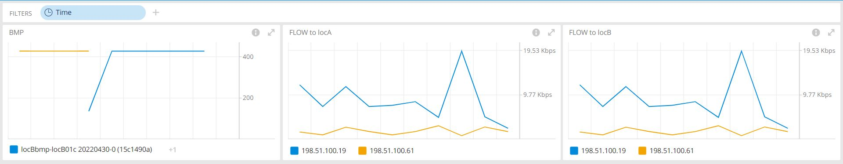
High availability of BMP TESTING
Impact to IPFIX

Slide 10
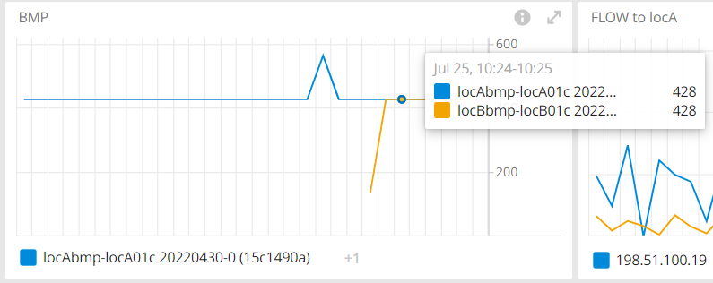
High availability of BMP TESTING
Sending signal 35 to standby collector B

Slide 11
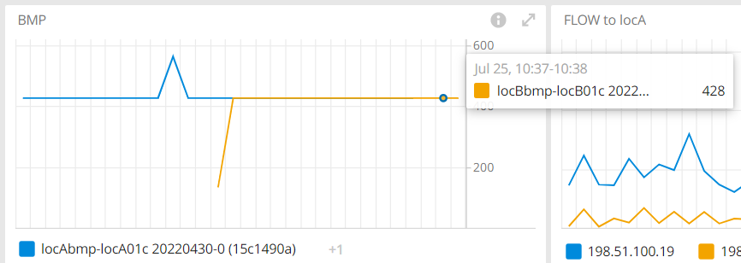
High availability of BMP TESTING
Sending signal 36 to active collector A

Slide 12
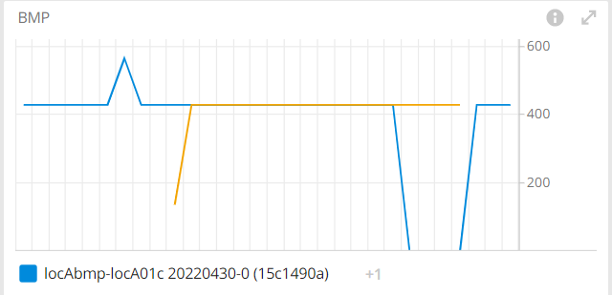
High availability of BMP TESTING
Sending signal 37 to collector A & B

