Slide 1
Computational Methods for Computer Science
Topic 1: Regular expressions & Automata

Slide 2
Compiler & Related Programs
A compiler – a computer program translates one language to another
Interpreters – Execute the source program immediately rather than generating object code
Assemblers – A translator for the assembly language of a particular computer
Linkers – Collect separate object files into a directly executable file
Loaders – Resolve all re-locatable address relative to a given base
Preprocessors – Delete comments, include other files, and perform macro substitutions
Source
Program
Target
Program
Compiler

Slide 3
The phases of a compiler
Source code
Scanner
Tokens
Six phases
Scanner (we focus on this)
Parser
Semantic Analyzer
Source code optimizer
Code generator
Target Code Optimizer
Parser
Syntax Tree
Semantics Analyzer
Annotated Tree
Source Code Optimizer
Code Generator
Target code
Target Code Optimizer
Target code

Slide 4
The Scanner
Lexical analysis: it collects sequences of characters into meaningful units called tokens.
An example: a[index]=4+2
a identifier
[ left bracket
index identifier
] right bracket
= assignment
4 number
+ plus sign
2 number

Slide 5
The Parser
Syntax analysis: it determines the structure of the program
The results of syntax analysis are a parse tree or a syntax tree
An example: a[index]=4+2
Parse tree
Syntax tree ( abstract syntax tree)
Assign-expression
subscript-expression additive-expression
identifier identifier number number
a index 4 2

Slide 6
The Semantic Analyzer
The semantics of a program are its “meaning”, as opposed to its syntax, or structure, that
determines some of its running time behaviors prior to execution.
Static semantics: declarations and type checking
An example:
a[index]=4=2
int x = 6.0

Slide 7
The Source Code Optimizer
The earliest point of most optimization steps is just after semantic analysis.
An example: Constant folding
a[index]=4+2

Slide 8
The Code Generate
Generates code for target machine
The properties of the target machine become the major factor:
Using instructions and representation of data
An example:
A possible code sequence
MOV R0, index
MUL R0,2
MOV R1,&a
ADD R1,R0
MOV *R1,6
a[index]=6

Slide 9
The Target Code Optimizer
It improves the target code generated by the code generator:
Address modes choosing
Instructions replacing
As well as redundant eliminating
An example:
MOV R0, index
MUL R0,2
MOV R1,&a
ADD R1,R0
MOV *R1,6
MOV R0, index
SHL R0
MOV &a[R1],6
a[index]=6

Slide 10
Scanning (Lexical Analysis)

Slide 11
Principle Data Structure in Scanning
TOKENS
A scanner collects characters into a token, as a value of an enumerated data type for tokens
May also preserve the string of characters or other derived information, such as name of identifier, value of a number token
A single global variable or an array of tokens
Lexical conventions (C-Minus)
Specify the token patterns of a language using regular expressions

Slide 12
The Categories of Tokens
RESERVED WORDS
Such as IF and THEN, which represent the strings of characters “if” and “then”
SPECIAL SYMBOLS
Such as PLUS and MINUS, which represent the characters “+” and “-“
OTHER TOKENS
Such as NUM and ID, which represent numbers and identifiers
Pattern with regular expression meta symbols is needed.

Slide 13
LEXEME
String value of a token
Some tokens have only one lexeme, such as reserved words
A token may have infinitely many lexemes, such as the token ID

Slide 14
Attributes
Any value associated to a token is called an attributes of a token
String value is an example of an attribute.
A NUM token may have a string value such as “32767” and actual value 32767
A PLUS token has the string value “+” as well as arithmetic operation +
The token can be viewed as the collection of all of its attributes
Only need to compute as many attributes as necessary to allow further processing
The numeric value of a NUM token needs not compute immediately
Wrapped in a class in Java.

Slide 15
Token Record in Java
public class Tokens{
public enum TokenType{
IF, ELSE, NUM, ID //etc.
}
}
public class TokenRecord {
Tokens.TokenType tokenval;
String stringval;
int numval;
}
public class CrunchifyEnumExample {
public enum Company {
EBAY(30), PAYPAL(10), GOOGLE(15), YAHOO(20), ATT(25); private int value; private Company(int value) { this.value = value; }
}
public static void main(String[] args) {
for (Company cName : Company.values()) {
System.out.println("Company Value: " + cName.value + " - Comapny Name: " + cName);
}
}

Slide 16
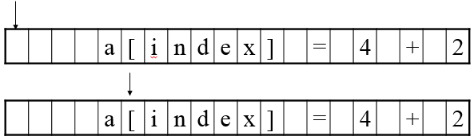
CMScanner
The scanner returns the token value only and places the other attributes in variables
Tokens.TokenType getToken(TokenRecord tr)
As an example of operation of getToken, consider the following line of C code.
A[index] = 4+2

Slide 17
Regular Expression

Slide 18
Some Relative Basic Concepts
Regular expressions
represent patterns of strings of characters.
A regular expression r
completely defined by the set of strings it matches.
The set is called the language of r written as L(r)
The set elements
referred to as symbols
This set of legal symbols
called the alphabet and written as the Greek symbol ∑

Slide 19
Some Relative Basic Concepts
A regular expression r
contains characters from the alphabet, indicating patterns, such a is the character a used as a pattern
A regular expression r
may contain special characters called meta-characters or meta-symbols
An escape character can be used to turn off the special meaning of a meta-character.
Such as backslash and quotes

Slide 20
Basic Regular Expressions
The single characters from alphabet matching themselves
a matches the character a by writing L(a)={ a }
ε denotes the empty string, by L(ε)={ε}
{} or Φ matches no string at all, by L(Φ)={ }

Slide 21
Regular Expression Operations
Choice among alternatives, indicated by the meta-character |
Concatenation, indicated by juxtaposition
Repetition or “closure”, indicated by the meta-character *

Slide 22
Choice Among Alternatives
If r and s are regular expressions, then r|s is a regular expression which matches any string that is matched either by r or by s.
In terms of languages, the language r|s is the union of language r and s, or L(r|s)=L(r)UL(s)
A simple example, L(a|b)=L(a)U (b)={a, b}
Choice can be extended to more than one alternative.

Slide 23
Concatenation
If r and s are regular expression, the rs is their concatenation which matches any string that is the concatenation of two strings, the first of which matches r and the second of which matches s.
In term of generated languages, the concatenation set of strings S1S2 is the set of strings of S1 appended by all the strings of S2.
A simple example, (a|b)c matches ac and bc
Concatenation can also be extended to more than two regular expressions.

Slide 24
Repetition
The repetition operation of a regular expression, called (Kleene) closure, is written r*, where r is a regular expression. The regular expression r* matches any finite concatenation of strings, each of which matches r.
A simple example, a* matches the strings epsilon, a, aa, aaa,…
In term of generated language, given a set of S of string, S* is a infinite set union, but each element in it is a finite concatenation of string from S

Slide 25
Precedence of Operation
The standard convention
Repetition * has highest precedence
Concatenation is given the next highest
| is given the lowest
A simple example
a|bc* is interpreted as a|(b(c*))
Parentheses is used to indicate a different precedence

Slide 26
Name for regular expression
Give a name to a long regular expression
digit = 0|1|2|3|4……|9
(0|1|2|3……|9)(0|1|2|3……|9)*
digit digit*

Slide 27
Definition of Regular Expression (RegEx)
A regular expression is one of the following:
(1) A basic regular expression, a single legal character a from alphabet ∑, or meta-character ε or Φ.
(2) The form r|s, where r and s are regular expressions
(3) The form rs, where r and s are regular expressions
(4) The form r*, where r is a regular expression
(5) The form (r), where r is a regular expression
Parentheses do not change the language (of the r in the parenthesis).

Slide 28
Examples Finding the RegEx for a pattern

Slide 29
Examples of Regular Expressions
Example 1:
∑={ a,b,c}
the set of all strings over this alphabet that contain exactly one b.
(a|c)*b(a|c)*
Example 2:
∑={ a,b,c}
the set of all strings that contain at most one b.
(a|c)*|(a|c)*b(a|c)* (a|c)*(b|ε)(a|c)*
the same language may be generated by many different regular expressions.

Slide 30
Examples of Regular Expressions
Example 3:
∑={ a,b}
the set of strings consists of a single b surrounded by the same number of a’s.
S = {b, aba, aabaa,aaabaaa,……} = { a^{n}ba^{n} | n≠0}
This set can not be described by a regular expression.
“regular expression can’t count ”
not all sets of strings can be generated by regular expressions.
a regular set : a set of strings that is the language for a regular expression is distinguished from other sets.

Slide 31
Examples of Regular Expressions
Example 4:
∑={ a,b,c}
The strings contain no two consecutive b’s
( (a|c)* | (b(a|c))* )*
( (a | c ) | (b( a | c )) )* or (a | c | ba | bc)*
Not yet the correct answer
The correct regular expression
(a | c | ba | bc)* (b |ε)
((b |ε) (a | c | ab| cb )*
(not b |b not b)*(b|ε) not b = a|c

Slide 32
Examples Describe the pattern for a RegEx

Slide 33
Examples of Regular Expressions
Example 5:
∑={ a,b,c}
((b|c)* a(b|c)*a)* (b|c)*
Determine a concise English description of the language
– The strings contain an even number of a’s
(nota* a nota* a)* nota*

Slide 34
Extensions to Regular Expression

Slide 35
List of New Operations
one or more repetitions
r+
any character
period “．”
a range of characters
[0-9], [a-zA-Z]
any character not in a given set
∼(a|b|c) a character not either a or b or c
[^abc] in Lex
optional sub-expressions
r? the strings matched by r
are optional

Slide 36
Examples of New Operations
~ is restricted to single characters
~(ab) is different from ~(a|b) and is actually not correct to represent not “ab”
One solution for not “ab” :
b*(a*∼(a|b)b*)*a*

Slide 37
Examples of New Operations
Numbers
nat = [0-9]+
signedNat = (+|-)?nat
number = signedNat(“.”nat)? (E signedNat)?
Reserved Words and Identifiers
reserved = if | while | do |………
letter = [a-z A-Z]
digit = [0-9]
identifier = letter(letter|digit)*

Slide 38
Regular Expressions for Programming Language Tokens (C-Minus)

Slide 39
Reserved Words & Special Symbols
reserved = if | else| int | return | void | while
special_symbols = + | - | * | / | < | <= | > | >= |
== | != | = | ; | , | ( | ) | [ | ] |
{ | } | /* | */

Slide 40
Identifiers and Numbers
letter = [a-z A-Z]
identifier = letter(letter)* or letter+
How about keywords? They are also matched by identifier.
digit = [0-9]
num = digit(digit)* or digit+

Slide 41
Comments
/* this is a C-minus comment */
Can not be written as ba(~(ab))*ab, since ~ is restricted to
single characters
One solution for ~(ab) : b*(a*∼(a|b)b*)*a*
ba(b*(a*∼(a|b)b*)*a*)*ab
/* this is still /*a valid C-minus comment */
Nested comments not allowed, but not recognized until later.
/* outer comment /*inner comment*/ outer comment*/

Slide 42
Ambiguity
Ambiguity: some strings can be matched by several different regular expressions.
either an identifier or a keyword, keyword interpretation preferred.
a single token or a sequence of several tokens, the single-token preferred.( the principle of longest sub-string.)

Slide 43
White Space and Lookahead
White space:
Delimiters: characters that are unambiguously part of other tokens are delimiters.
whitespace = ( newline | blank | tab | comment)+
free format or fixed format
Lookahead:
buffering of input characters , marking places for backtracking
DO99I=1,10
DO99I=1.10

Slide 44
FINITE AUTOMATA

Slide 45
Introduction
Finite automata (finite-state machines) are a mathematical way of describing particular kinds of algorithms.
A strong relationship between finite automata and regular expression
Identifier = letter (letter | digit)*
letter
letter
1
2
digit

Slide 46
Introduction
letter
letter
1
2
digit
Start state:
The recognition process begin
Drawing an unlabeled arrowed line to it coming “from nowhere”
Transition:
Record a change from one state to another upon a match of the character or characters by which they are labeled.
Accepting states:
Represent the end of the recognition process.
Drawing a double-line border around the state in the diagram

Slide 47
Deterministic Finite Automata (DFA)
DFA: Automata where the next state is uniquely given by the current state and the current input character.
Definition of a DFA:
A DFA (Deterministic Finite Automation) M consist of
(1) an alphabet ∑,
(2) A set of states S,
(3) a transition function T : S ×∑ → S,
(4) a start state s₀∈S,
(5)And a set of accepting states A ⊂ S

Slide 48
Language of a DFA
The language accepted by a DFA M, written L(M), is defined to be
the set of strings of characters c₁c₂c₃….c_{n} with each c_{i} ∈∑ such that there exist states s₁ = t(s₀,c₁),s₂ = t(s₁,c₂), s_{n} = T(s_{n-1},c_{n}) with s_{n} an element of A (i.e. an accepting state).
Accepting state s_{n} means the same thing as the diagram:
c₁ c₂ c_{n}
→ s₀ → s₁ → s₂ → ………s_{n-1} → s_{n}

Slide 49
Definition VS. Diagram
letter
letter
start
In-id
digit
1) The definition does not restrict the set of states to numbers
2) We have not labeled the transitions with characters but with names representing a set of characters
3) definitions T: S ×∑ → S , T(s, c) must have a value for every s and c.
In the diagram, T (start, c) defined only if c is a letter, T(in_id, c) is defined only if c is a letter or a digit.
Error transitions are not drawn in the diagram but are simply assumed to always exist.

Slide 50
Examples of DFA
Example 2.6: exactly accept one b
Example 2.7: at most one b
Not b
Not b
b
not b
not b
b

Slide 51
Examples of DFA
Example 2.8: digit = [0-9]
nat = digit +
signedNat = (+|-)? nat
Number = singedNat(“.”nat)?(E signedNat)?
A DFA of nat:
A DFA of signedNat:
digit
digit
digit
+
digit
digit
−
digit

Slide 52
Examples of DFA
Example 2.8:digit = [0-9]
nat = digit +
signedNat = (+|-)? nat
Number = singedNat(“.”nat)?(E signedNat)?
A DFA of Number:
digit
+
digit
.
digit
E
+
digit
－
E
－
digit
digit

Slide 53
Examples of DFA
Example 2.9 : A DFA of C-Minus Comments
(easier than writing down a regular expression)
Try: re-label the states
other
*
1
/
2
*
3
*
4
/
5
other

Slide 54
Principle of Longest Substring
letter
The error state (not drawn) represents the fact that either an identifier is not to be recognized (if came from the start state) or a delimiter has been seen and we should now accept and generate an identifier-token.
[other]: indicate that the delimiting character should be considered look-ahead, it should be returned to the input string and not consumed.
[other] – all possible characters from the alphabet other than the ones used in the previous step.
letter
start
In-id
digit
letter
start
letter
in_id
[other]
finish
return ID
digit

Slide 55
Start State
Reset the automata to “Start State” at the very beginning of scanning and every time a token is recognized.
The automata for different tokens actually share the same start state.
:
=
=
return ASSIGN
:
return ASSIGN
<
=
<
=
return LE
return LE
=
=
return EQ
return EQ

Slide 56
Non-deterministic Finite Automata (NFA)
Multiple tokens may also share the same “leading” sub-pattern.
Not a DFA DFA
Likely that we get NFA when combining the automata for tokens.
NFA can be turned into DFA which is what we need for scanning.
=
=
<
return LE
return LE
<
>
<
>
return NE
return NE
<
return LT
[other]
return LT

Slide 57
ε-transition
A transition that may occur without consulting the input string (and without consuming any characters)
It may be viewed as a "match" of the empty string.
ε

Slide 58
Two ways of using ε-transition
Express a choice of alternatives in a way without combining states
Advantage: keeping the original automata intact and only adding a new start state to connect them
Explicitly describe a match of the empty string.
:
=
ε
ε
<
=
ε
=
ε

Slide 59
Formal Definition of NFA
An NFA (non-deterministic finite automaton) M consists of
an alphabet Σ, a set of states S,
a transition function T: S x (Σ U{ε})→℘(S),
a start state s₀ from S, and a set of accepting states A from S
The language accepted by M, written L(M),
is defined to be the set of strings of characters c₁c₂…. c_{n} with
each c_{i} from Σ U{ε}such that there exist states s₁ in T(s₀ ,c₁), s₂ in (s₁, c₂),..., s_{n} in T(s_{n-1} , c_{n}) with s_{n} an element of A.
The string c₁c₂…. c_{n} may actually have fewer than n characters in it.
The sequence of transitions that accepts a particular string is not determined.

Slide 60
Examples of NFAs
Example 2.10
The string abb can be accepted by either of the following sequences of transitions:
a b ε b
→1→2→4→2→4
a ε ε b ε b
→1→3→4→2→4→2→4
This NFA accepts the languages as follows:
regular expression: (a|ε)b*
ab+|ab*|b*
The bottom DFA accepts the same language.
2
a
b
1
a
3
ε
4
ε
a
b
b
b

Slide 61
Examples of NFAs
Example 2.11
It accepts the string acab by making the following transitions:
(1)(2)(3)a(4)(7)(2)(5)(6)c(7)(2)(3)a(4)(7)(8)(9)b(10)
It accepts the same language as that generated by the regular expression :
(a | c) *b
3
a
4
ε
ε
1
ε
2
7
ε
8
ε
9
b
c
10
ε
5
6
ε
ε

Slide 62
Lexical Convention to Scanner
Regular
Expression
NFA
DFA
Program
Translating a regular expression into a DFA via NFA

Slide 63
From a Regular Expression to an NFA
Thompson’s Construction
Use ε-transitions
to “glue together” the machine of each piece of a regular expression to form a machine that corresponds to the whole expression
Basic regular expression
The NFAs for basic regular expression of the form a, ε,or φ
a
ε

Slide 64
From a Regular Expression to an NFA
Thompson’s Construction
Concatenation rs
Connect the accepting state of the machine of r to the start state of the machine of s by an ε-transition
r
ε
s
…
…

Slide 65
From a Regular Expression to an NFA
Thompson’s Construction
Choice among alternatives r|s
Add a new start state and a new accepting state and connected them as shown using ε-transitions.
r
ε
…
ε
ε
ε
s
…

Slide 66
From a Regular Expression to an NFA
Thompson’s Construction
Repetition r*
Add two new states, a start state and an accepting state.
The repetition is afforded by the new ε-transition from the accepting state of the machine of r to its start state.
Draw an ε-transition from the new start state to the new accepting state.
ε
ε
r
ε
…
ε

Slide 67
Examples of NFAs Construction
Translate regular expression ab|a into NFA
a
b
a
ε
b
a
ε
b
ε
ε
ε
ε
a

Slide 68
Examples of NFAs Construction
Translate regular expression letter(letter|digit)* into NFA
letter
letter
ε
ε
digit
ε
ε
digit
ε
ε
letter
ε
ε
ε
ε
digit
ε
ε
ε
ε
letter
ε
letter
ε
ε
ε
ε
digit
ε
ε

Slide 69
From an NFA to a DFA
Goal – Given an arbitrary NFA, construct an equivalent DFA that accepts precisely the same strings by:
Eliminating ε-transitions
Eliminating multiple transitions
Method:
Subset Construction

Slide 70
ε-closure
The ε-closure of a single state s is the set of states reachable by a series of zero or more ε-transitions, and we write this set as .
ε
1
ε
2
a
3
ε
4
ε

Slide 71
The Subset Construction Algorithm

Slide 72
Examples of Subset Construction
ε
1
ε
2
a
3
ε
4
ε
M | ε-closure of M ( S ) | S′_{a}
1 | 1,2,4 | 3
3 | 2,3,4 | 3
a
a
{1,2,4}
{2,3,4}

Slide 73
Examples of Subset Construction
2
a
3
ε
4
b
5
ε
ε
1
ε
ε
a
6
7
M | ε-closure of M (S) | S′_{a} | S′_{b}
1 | 1,2,6 | 3,7
3,7 | 3,4,7,8 |  | 5
5 | 5,8
{1,2,6}
a
b
{3,4,7,8}
{5,8}

Slide 74
Examples of Subset Construction
ε
5
letter
6
ε
ε
1
letter
2
ε
3
ε
4
9
ε
ε
ε
10
M | ε-closure of M (S) | S′_{letter} | S′_{digit}
1 | 1 | 2
2 | 2,3,4,5,7,10 | 6 | 8
6 | 4,5,6,7,9,10 | 6 | 8
8 | 4,5,7,8,9,10 | 6 | 8
7
digit
8
ε
letter
letter
{4,5,6,7,9,10}
{1}
letter
{2,3,4,5,7,10}
digit
letter
The resulting DFA may be more complex than necessary.
digit
{4,5,7,8,9,10}
digit

Slide 75
Minimizing the Number of States in a DFA

Slide 76
Why need Minimizing ?
The resulting DFA may be more complex than necessary.
For expression a*:
Given any DFA, there is an equivalent DFA containing a minimum number of states, and, that this minimum-state DFA is unique (except for renaming of states)
a
a
a

Slide 77
Minimizing Algorithm
1. It begins with the most optimistic assumption possible. Creates two sets: one consisting of all the accepting states and the other consisting of all the non-accepting states.
2. Given this partition of the states of the original DFA, consider the transitions on each charac­ter a of the alphabet.
(1) If all accepting states have transitions on a to accepting states, then this defines an a-transition from the new accepting state (the set of all the old accept­ing states) to itself.
(2) If all accepting states have transitions on a to non-accepting states, then this defines an a-transition from the new accepting state to the new non-accepting state (the set of all the old non-accepting states).

Slide 78
Minimizing Algorithm (cont.)
(3) On the other hand, if there are two accepting states s and t that have transitions on a that land in different sets, then no a-transition can be defined for this grouping of the states. We say that a distinguishes the states s and t
(4) We must also consider error transitions to an error state that is non-accepting. If there are accepting states s and t such that s has an a-transition to another accepting state, while t has no a-transition at all (i.e., an error transition), then a distinguishes s and t.
3. If any further sets are split, we must return and repeat the process from the beginning. This process continues until either all sets contain only one element (in which case, we have shown the original DFA to be minimal) or until no further splitting of sets occurs.

Slide 79
Examples of Minimizing DFA
Example 2.18: The regular expression letter(letter|digit)*
letter
letter
{4,5,6,7,9,10}
{1}
letter
{2,3,4,5,7,10}
digit
letter
digit
{4,5,7,8,9,10}
digit
The accepting sets | {2,3,4,5,7,10},{4,5,6,7,9,10},{4,5,7,8,9,10}
The nonaccepting sets | {1}
letter
1
letter
2
digit

Slide 80
Examples of Minimizing DFA
a
Example 2.18: the regular expression (a| ε)b*
a distinguishes state 1 from states 2 and 3,
and we must repartition the states into the sets {1} and {2,3}
1
2
b
b
3
b
The accepting sets | {1,2,3}
The non-accepting sets
a
b
{1}
b
{2,3}

Slide 81
Implementation of DFA (Explicit Control Method)

Slide 82
Example – Identifiers
Use a variable to maintain the current state and
Write the transitions as a doubly nested case statement inside a loop, where the first case statement tests the current state and the nested sec­ond level tests the input character.
state := 1; { start } while state = 1 or 2 do case state of 1: case input character of letter: advance the input : state := 2; else state := ….{ error or other }; end case; 2: case input character of letter , digit: advance the input; state := 2; else state := 3; end case; end case; end while; if state = 3 then accept else error;
letter
1
letter
2
[other]
3
digit

Slide 83
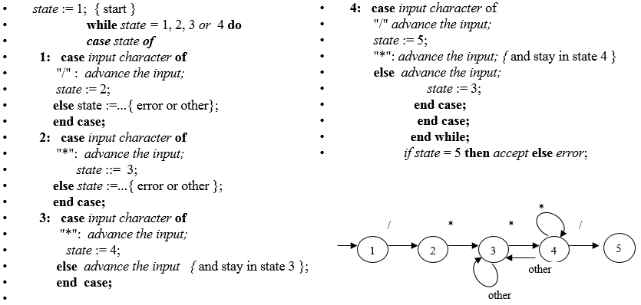
Example – C Comments

Slide 84
Implementation of DFA (Table Driven Method)

Slide 85
Example – Identifiers
Generic code:
Express the DFA as a data structure and then write "generic" code;
A transition table, or two-dimensional array, indexed by state and input character that expresses the values of the transition function T
letter
Input char state | letter | digit | other | Accepting
1 | 2 |  |  | no
2 | 2 | 2 | [3] | no
3 |  |  |  | yes
1
letter
2
[other]
3
digit
Brackets indicate “noninput-consuming” transitions
This column indicates accepting states
Assume: the first state listed is the start state

Slide 86
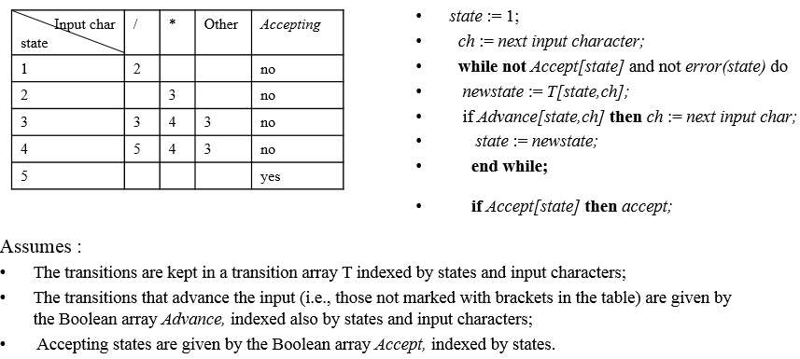
Example – C Comments
*
/
*
*
/
1
2
3
4
5
other
other

Slide 87
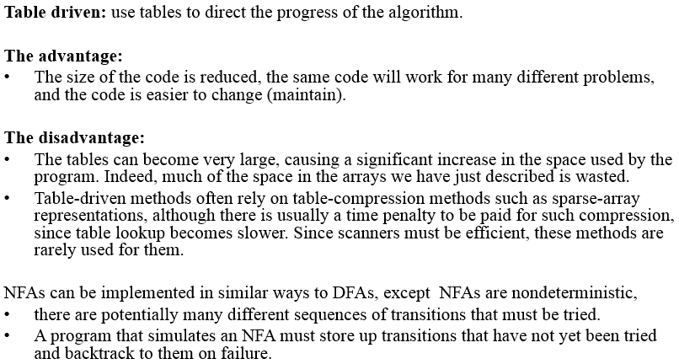
Features of Table-Driven Method

