Slide 1
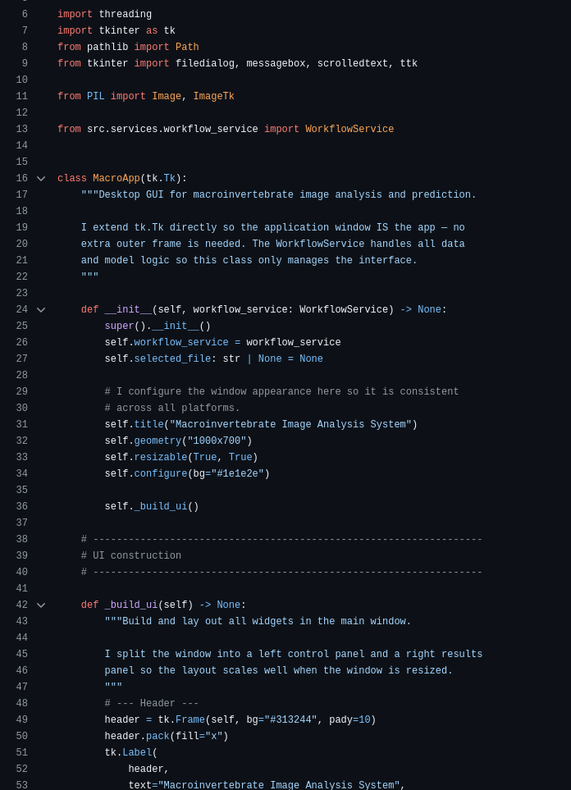
Macroinvertebrate
Image Analysis System
Software Technology 1 - Assignment 3
u3231515
u3321181
u3275790
Week 13 Presentation
Code Sample
Notes:
Title Welcome everyone. This is the Macroinvertebrate Image Analysis System, built for Software Technology 1 Assignment 3. The system solves a real environmental monitoring problem using Python, machine learning, and two deployment interfaces. We'll walk through the problem, our architecture, the packages we used, a live demo, our OO design decisions, and how the work was divided across the team.

Slide 2
01 | Project Introduction
The Problem
Images Indexed
Freshwater macroinvertebrates are key environmental health indicators. Manual classification from images is slow and error-prone.
Dataset
Kaggle Stream Macroinvertebrates
Pipeline Stages
Our Solution
3
A modular Python application that indexes a dataset, performs EDA, trains a Random Forest classifier, and deploys via both a console menu and Tkinter GUI.
EDA → Classification → Deployment
Interfaces
2
Console Menu + Tkinter GUI
Macroinvertebrate Image Analysis System
Notes:
Project Introduction Freshwater macroinvertebrates are biological indicators - their presence or absence tells us about water quality. Manual expert classification is slow and inconsistent, so we automated it. Our solution is a three-stage Python pipeline: Stage 1 does exploratory data analysis, Stage 2 trains a Random Forest classifier, and Stage 3 deploys it via a console app and a Tkinter GUI. The dataset is the Kaggle Stream Macroinvertebrates dataset, indexed using DatasetIndexer which scans the folder structure and builds a pandas DataFrame. The class label comes from the parent folder name, matching the Kaggle dataset layout.

Slide 3
02 | System Design Overview
Interface Layer
ConsoleApp
MacroApp (GUI)
Coordination Layer
WorkflowService
Service Layer
DatasetIndexer
EDAService
ImagePreprocessor
ClassifierService
Config / Models
config.py
ImageRecord
Both interfaces call WorkflowService. Services are injected at construction, no import leakage between layers.
Notes:
System Design The system is split into three layers. The interface layer has two entry points - ConsoleApp and MacroApp - both calling WorkflowService and nothing else. WorkflowService is the coordination layer: it constructs all services at startup, caches the dataset DataFrame so we only scan disk once per session, and exposes clean methods like show_summary, generate_eda, train_model, and predict_image. The service layer contains DatasetIndexer, EDAService, ImagePreprocessor, and ClassifierService, each with exactly one responsibility. The key design principle is that scikit-learn is only imported inside ClassifierService. Neither the GUI nor the console ever touch it directly.

Slide 4
03 | Python Packages & How We Used Them
pandas
matplotlib / seaborn
Image index as a structured DataFrame. EDA and training share the same table.
All EDA charts: distribution, histograms, scatter, confusion matrix heatmap.
numpy
tkinter
Feature matrix and label arrays for the classifier.
Stage 3 desktop GUI - buttons, image preview, threaded tasks, progress bar.
opencv-python
joblib
Read images from disk, convert to grayscale, resize to 128×128.
Persist and reload the trained model between sessions.
scikit-learn
Pillow
Train/test split, RandomForestClassifier, accuracy & confusion matrix.
Load and thumbnail images for display inside the Tkinter GUI.
Macroinvertebrate Image Analysis System
Notes:
Python Packages We used eight packages, each with a clear role. pandas holds the image index as a DataFrame that both EDA and training share. numpy builds the feature matrix and label arrays. opencv-python reads images, converts to grayscale, and resizes to 128x128. scikit-learn provides train/test split, RandomForestClassifier, and evaluation metrics. matplotlib and seaborn generate all five EDA charts. tkinter is the Stage 3 GUI - we used threading so long operations like training don't freeze the UI. joblib persists the trained model between sessions. Pillow loads and thumbnails images for the GUI preview panel.

Slide 5
04 | Live Demonstration
Console Demo
GUI Demo
1
Launch console app
1
Launch Tkinter GUI
2
Show dataset summary
2
Click Dataset Summary
3
Run Stage 1 EDA - view saved charts
3
Click Generate EDA
4
Train classifier
4
Click Train Classifier
5
Show accuracy + confusion matrix
5
Click Choose Image → preview loads
6
Predict a single image
6
Click Predict Class - result shown
7
Exit
7
Show progress bar and logs
Notes:
Live Demo We'll now do a live demo of both interfaces. Console: launch it, select Option 1 for dataset summary, Option 2 to run EDA and view saved charts, Option 3 to train the classifier and see accuracy and confusion matrix, Option 4 to predict a single image. GUI: launch the Tkinter window, click Dataset Summary, Generate EDA, Train Classifier, then Choose Image to load a preview, and Predict Class to get the result with confidence score. The progress bar runs during long operations. Both interfaces call identical WorkflowService methods - no logic is duplicated.

Slide 6
05 | Object-Oriented Design
Single Responsibility
Encapsulation
Each class has one job. EDAService only makes charts. ClassifierService only handles the model. Neither touches file paths outside its scope.
The sklearn import is only inside ClassifierService. No other module ever touches scikit-learn directly. If we swap to Keras, only one file changes.
Dependency Injection
Dataclass (ImageRecord)
WorkflowService receives an ImagePreprocessor and passes it to ClassifierService at construction time. Easy to test - swap a mock preprocessor without changing any other class.
A typed, self-documenting dataclass replaces a raw dict for image metadata. Provides __repr__ and type safety with no boilerplate.
Macroinvertebrate Image Analysis System
Notes:
OO Design We applied four key OO principles. Single Responsibility: every class has one job - EDAService only makes charts, ClassifierService only handles the model. Dependency Injection: WorkflowService receives an ImagePreprocessor and passes it to ClassifierService at construction time, making it easy to swap in a mock preprocessor for testing without changing any other class. Encapsulation: sklearn is only imported inside ClassifierService - if we swap to Keras, only one file changes. ImageRecord is a typed dataclass replacing a raw dict for image metadata, giving us repr and type safety with no boilerplate.

Slide 7
06 | Team Contribution Summary
Member 1
Member 2
Member 3
Data & Analysis
ML Pipeline
Deployment & QA
DatasetIndexer
ImagePreprocessor
ConsoleApp (6 menu options)
ImageRecord dataclass
ClassifierService
MacroApp Tkinter GUI
EDAService (5 charts)
WorkflowService coordinator
MANUAL_TESTING.md (10 tests)
config.py - central paths
Model persistence (joblib)
README.md & integration
Notes:
Team Contributions The three members each owned a distinct layer. Member 1 handled data and analysis: DatasetIndexer, the ImageRecord dataclass, EDAService with five charts, and config.py for centralised paths. Member 2 owned the ML pipeline: ImagePreprocessor, ClassifierService, WorkflowService as coordinator, and model persistence with joblib. Member 3 handled deployment and QA: ConsoleApp with six menu options, MacroApp Tkinter GUI, MANUAL_TESTING.md covering ten test scenarios, and the README. The layered architecture made this split clean - each member could work independently without blocking the others.

Slide 8
What We Built
Limitations
- Grayscale features only - loses colour info
Modular 3-stage pipeline in Python
- No cross-validation or hyperparameter tuning
5 EDA charts with meaningful insight
- Manual testing only - no automated tests
Random Forest classifier (balanced class weights)
Future Improvements
Console + Tkinter GUI deployment
+ CNN-based deep learning classifier
10 manual test scenarios - all passed
+ Colour feature extraction
+ Automated test suite (pytest)
+ Web-based deployment (Flask/Streamlit)
Thank you - questions welcome.
Notes:
Summary To summarise: a modular three-stage Python pipeline, five EDA charts, a Random Forest classifier with balanced class weights to handle imbalanced data, both console and GUI deployment, and ten manual test scenarios all passing. Limitations include grayscale-only features losing colour information, no cross-validation or hyperparameter tuning, and no automated tests. Future work would include a CNN-based classifier, colour feature extraction, a pytest suite, and web deployment using Flask or Streamlit. Thank you - happy to take questions.
Potential tutor questions and answers:
Why Random Forest and not a neural network? Random Forest was appropriate for a baseline classifier because it trains quickly, handles multi-class problems natively, requires no GPU, and is interpretable. It also works reasonably well on flattened pixel features without needing convolutional layers. A CNN is the obvious next step and we acknowledged it as a future improvement.
Why 128x128 grayscale? What do you lose? 128x128 is a balance between feature vector size and image detail. At that size each image produces 16,384 features, which is already large for a Random Forest. Going larger increases training time significantly. Grayscale reduces that to a single channel, keeping memory manageable. The trade-off is losing colour information, which matters for macroinvertebrates because some species are distinguished partly by colouration.
Why balanced class weights? The Kaggle dataset has unequal numbers of images per class. Without balancing, the classifier would be biased toward majority classes and underperform on rare ones. Setting class_weight="balanced" in scikit-learn makes the model penalise misclassifications on minority classes more heavily, which produces fairer per-class accuracy.
Why no cross-validation? We used a single 80/20 stratified split for time and simplicity. Cross-validation would give a more reliable accuracy estimate by averaging over multiple splits, but it multiplies training time by the number of folds. We flagged this as a known limitation.
What does stratify=y do in the train/test split? It ensures each class appears in the same proportion in both the training and test sets. Without it, a random split could place all images of a rare class entirely in one set, making evaluation unreliable.
Why joblib for model persistence instead of pickle? joblib is the scikit-learn recommended serialisation method for numpy arrays and estimators. It is more efficient than pickle for large arrays because it uses memory-mapped files internally, which speeds up both saving and loading.
How does the GUI stay responsive during training? Each long operation - EDA, training, prediction - is run in a daemon thread via Python's threading module. The Tkinter main loop continues running on the main thread, keeping the progress bar and UI interactive. Results are written back to the UI using widget update methods which are thread-safe in Tkinter when called carefully.
Why did you use a dataclass for ImageRecord instead of a plain dict? A dataclass gives named, typed fields with automatic repr and no manual init boilerplate. It makes the code self-documenting - anyone reading it knows exactly what fields an image record contains and what types they are. A raw dict would accept any key silently, making bugs harder to catch.

