Slide 1
SpaceX Falcon 9 landing analysis
Data Science Capstone Project Report
Yifan Chen
21 October 2026
https://github.com/Zeppelin567/ibm-spacex-capstone
IBM Skills Network course snapshots, accessed 21 Oct 2026
1
Notes:
IBM Skills Network course snapshots, accessed 21 Oct 2026
API: https://cf-courses-data.s3.us.cloud-object-storage.appdomain.cloud/IBM-DS0321EN-SkillsNetwork/datasets/dataset_part_1.csv
SQL: https://cf-courses-data.s3.us.cloud-object-storage.appdomain.cloud/IBM-DS0321EN-SkillsNetwork/labs/module_2/data/Spacex.csv

Slide 2
Executive summary
We analyzed API and Wikipedia snapshots with pandas and SQL, explored launch outcomes through charts, Folium and Dash, and compared four classifiers.
The API sample contains 90 launches and 60 successful first-stage outcomes (66.7%). Landing rates improved over the period.
A decision tree led training cross-validation at 90.4%. Its held-out test accuracy was 83.3% on 18 rows. These results need validation on recent launches.
IBM Skills Network course snapshots, accessed 21 Oct 2026
2
Notes:
IBM Skills Network course snapshots, accessed 21 Oct 2026
API: https://cf-courses-data.s3.us.cloud-object-storage.appdomain.cloud/IBM-DS0321EN-SkillsNetwork/datasets/dataset_part_1.csv
SQL: https://cf-courses-data.s3.us.cloud-object-storage.appdomain.cloud/IBM-DS0321EN-SkillsNetwork/labs/module_2/data/Spacex.csv

Slide 3
Introduction
Reusable first stages can influence launch economics. This project examines which observed launch characteristics relate to successful Falcon 9 first-stage landing.
The task is to collect launch records, describe patterns and predict the landing class.
Landing success differs from mission success. The historical sample cannot directly establish launch cost or operational safety.
IBM Skills Network course snapshots, accessed 21 Oct 2026
3
Notes:
IBM Skills Network course snapshots, accessed 21 Oct 2026
API: https://cf-courses-data.s3.us.cloud-object-storage.appdomain.cloud/IBM-DS0321EN-SkillsNetwork/datasets/dataset_part_1.csv
SQL: https://cf-courses-data.s3.us.cloud-object-storage.appdomain.cloud/IBM-DS0321EN-SkillsNetwork/labs/module_2/data/Spacex.csv

Slide 4
Data sources and populations
API analysis: 90 Falcon 9 records through 13 Nov 2020, after removing multi-core and multi-payload records.
Web collection: 121 numeric flight rows extracted from the lab’s specified Wikipedia revision.
SQL analysis: the separate official 101-row SpaceX CSV.
Dashboard: the official 56-row historical dashboard CSV.
Each result identifies its population. We do not combine these denominators.
IBM Skills Network course snapshots, accessed 21 Oct 2026
4
Notes:
IBM Skills Network course snapshots, accessed 21 Oct 2026
API: https://cf-courses-data.s3.us.cloud-object-storage.appdomain.cloud/IBM-DS0321EN-SkillsNetwork/datasets/dataset_part_1.csv
SQL: https://cf-courses-data.s3.us.cloud-object-storage.appdomain.cloud/IBM-DS0321EN-SkillsNetwork/labs/module_2/data/Spacex.csv

Slide 5
Data collection with the SpaceX API
1. Request the launches/past endpoint and normalize the JSON. The first static-fire date is in 2006.
2. Keep one-core, one-payload launches through 13 Nov 2020.
3. Enrich rocket, launchpad, payload and core IDs with metadata.
4. Remove Falcon 1, leaving 90 Falcon 9 records. LandingPad has 26 missing values.
The report reproduces filtering from the frozen API response and uses the official enriched CSV.
https://github.com/Zeppelin567/ibm-spacex-capstone/blob/main/SpaceX_Capstone_Analysis.ipynb
5
Notes:
IBM Skills Network course snapshots, accessed 21 Oct 2026
https://github.com/Zeppelin567/ibm-spacex-capstone/blob/main/SpaceX_Capstone_Analysis.ipynb
API: https://cf-courses-data.s3.us.cloud-object-storage.appdomain.cloud/IBM-DS0321EN-SkillsNetwork/datasets/dataset_part_1.csv
SQL: https://cf-courses-data.s3.us.cloud-object-storage.appdomain.cloud/IBM-DS0321EN-SkillsNetwork/labs/module_2/data/Spacex.csv

Slide 6
Data collection with web scraping
Request the exact Wikipedia revision specified in the lab: oldid=1027686922.
BeautifulSoup selects wikitable launch tables, then numeric flight rows with at least nine data cells.
Extract date/time, booster, site, payload, orbit, customer and both outcomes. Strip citation markers and normalize Unicode whitespace.
The saved extraction contains 121 unique flight rows. Raw HTML and extracted CSV support reproduction.
https://github.com/Zeppelin567/ibm-spacex-capstone/blob/main/SpaceX_Capstone_Analysis.ipynb
6
Notes:
IBM Skills Network course snapshots, accessed 21 Oct 2026
https://github.com/Zeppelin567/ibm-spacex-capstone/blob/main/SpaceX_Capstone_Analysis.ipynb
API: https://cf-courses-data.s3.us.cloud-object-storage.appdomain.cloud/IBM-DS0321EN-SkillsNetwork/datasets/dataset_part_1.csv
SQL: https://cf-courses-data.s3.us.cloud-object-storage.appdomain.cloud/IBM-DS0321EN-SkillsNetwork/labs/module_2/data/Spacex.csv

Slide 7
Data wrangling methodology
Convert dates, inspect nulls and retain explicit missing pad IDs. The course enriched snapshot already replaces missing payload mass with its mean.
Assign class 1 to True ASDS, True RTLS and True Ocean. All other first-stage outcomes receive class 0.
Encode Orbit, LaunchSite, LandingPad and Serial with get_dummies. The course feature matrix has 80 columns.
For modeling, fit preprocessing inside training folds. The upstream payload imputation remains a limitation.
https://github.com/Zeppelin567/ibm-spacex-capstone/blob/main/SpaceX_Capstone_Analysis.ipynb
7
Notes:
IBM Skills Network course snapshots, accessed 21 Oct 2026
https://github.com/Zeppelin567/ibm-spacex-capstone/blob/main/SpaceX_Capstone_Analysis.ipynb
API: https://cf-courses-data.s3.us.cloud-object-storage.appdomain.cloud/IBM-DS0321EN-SkillsNetwork/datasets/dataset_part_1.csv
SQL: https://cf-courses-data.s3.us.cloud-object-storage.appdomain.cloud/IBM-DS0321EN-SkillsNetwork/labs/module_2/data/Spacex.csv

Slide 8
EDA with data visualization
Scatter plots compare flight sequence and payload mass across launch sites and orbits, with points colored by landing class.
Bar charts compare observed landing rates. A yearly line chart shows historical change.
The 90-row API sample contains 55 CCAFS SLC 40, 22 KSC LC 39A and 13 VAFB SLC 4E launches.
Small groups and changes in hardware over time limit site and orbit comparisons.
https://github.com/Zeppelin567/ibm-spacex-capstone/blob/main/SpaceX_Capstone_Analysis.ipynb
8
Notes:
IBM Skills Network course snapshots, accessed 21 Oct 2026
https://github.com/Zeppelin567/ibm-spacex-capstone/blob/main/SpaceX_Capstone_Analysis.ipynb
API: https://cf-courses-data.s3.us.cloud-object-storage.appdomain.cloud/IBM-DS0321EN-SkillsNetwork/datasets/dataset_part_1.csv
SQL: https://cf-courses-data.s3.us.cloud-object-storage.appdomain.cloud/IBM-DS0321EN-SkillsNetwork/labs/module_2/data/Spacex.csv

Slide 9
Flight sequence and launch site
Successful landing outcomes become more common later in the sequence. This pattern can reflect improvements in hardware and operations.
Site codes: 1 = CCAFS SLC 40, 2 = KSC LC 39A, 3 = VAFB SLC 4E.
Blue = class 1. Orange = class 0.
https://github.com/Zeppelin567/ibm-spacex-capstone/blob/main/SpaceX_Capstone_Analysis.ipynb
9
Notes:
IBM Skills Network course snapshots, accessed 21 Oct 2026
https://github.com/Zeppelin567/ibm-spacex-capstone/blob/main/SpaceX_Capstone_Analysis.ipynb
API: https://cf-courses-data.s3.us.cloud-object-storage.appdomain.cloud/IBM-DS0321EN-SkillsNetwork/datasets/dataset_part_1.csv
SQL: https://cf-courses-data.s3.us.cloud-object-storage.appdomain.cloud/IBM-DS0321EN-SkillsNetwork/labs/module_2/data/Spacex.csv

Slide 10
Payload mass and launch site
Payloads span a wide range at the Florida sites. Successful and unsuccessful outcomes overlap, so payload alone does not separate the classes.
Site codes: 1 = CCAFS SLC 40, 2 = KSC LC 39A, 3 = VAFB SLC 4E.
Blue = class 1. Orange = class 0.
https://github.com/Zeppelin567/ibm-spacex-capstone/blob/main/SpaceX_Capstone_Analysis.ipynb
10
Notes:
IBM Skills Network course snapshots, accessed 21 Oct 2026
https://github.com/Zeppelin567/ibm-spacex-capstone/blob/main/SpaceX_Capstone_Analysis.ipynb
API: https://cf-courses-data.s3.us.cloud-object-storage.appdomain.cloud/IBM-DS0321EN-SkillsNetwork/datasets/dataset_part_1.csv
SQL: https://cf-courses-data.s3.us.cloud-object-storage.appdomain.cloud/IBM-DS0321EN-SkillsNetwork/labs/module_2/data/Spacex.csv

Slide 11
Flight sequence and orbit
Later VLEO flights mostly show successful landing outcomes. Orbit and launch time are associated in this sample.
Orbit codes 1-11: LEO, ISS, PO, GTO, ES-L1, SSO, HEO, MEO, VLEO, SO, GEO.
Blue = class 1. Orange = class 0.
https://github.com/Zeppelin567/ibm-spacex-capstone/blob/main/SpaceX_Capstone_Analysis.ipynb
11
Notes:
IBM Skills Network course snapshots, accessed 21 Oct 2026
https://github.com/Zeppelin567/ibm-spacex-capstone/blob/main/SpaceX_Capstone_Analysis.ipynb
API: https://cf-courses-data.s3.us.cloud-object-storage.appdomain.cloud/IBM-DS0321EN-SkillsNetwork/datasets/dataset_part_1.csv
SQL: https://cf-courses-data.s3.us.cloud-object-storage.appdomain.cloud/IBM-DS0321EN-SkillsNetwork/labs/module_2/data/Spacex.csv

Slide 12
Payload mass and orbit
Payload distributions differ across orbit groups. GTO includes both classes over a broad mass range.
Orbit codes follow first appearance in the dataset: LEO, ISS, PO, GTO, ES-L1, SSO, HEO, MEO, VLEO, SO, GEO.
Blue = class 1. Orange = class 0.
https://github.com/Zeppelin567/ibm-spacex-capstone/blob/main/SpaceX_Capstone_Analysis.ipynb
12
Notes:
IBM Skills Network course snapshots, accessed 21 Oct 2026
https://github.com/Zeppelin567/ibm-spacex-capstone/blob/main/SpaceX_Capstone_Analysis.ipynb
API: https://cf-courses-data.s3.us.cloud-object-storage.appdomain.cloud/IBM-DS0321EN-SkillsNetwork/datasets/dataset_part_1.csv
SQL: https://cf-courses-data.s3.us.cloud-object-storage.appdomain.cloud/IBM-DS0321EN-SkillsNetwork/labs/module_2/data/Spacex.csv

Slide 13
Landing success by orbit
VLEO: 85.7% across 14 launches.
ISS: 61.9% across 21 launches.
GTO: 51.9% across 27 launches.
Several groups have 100% success but only one observation. SSO has five. These groups do not establish a reliable ranking.
https://github.com/Zeppelin567/ibm-spacex-capstone/blob/main/SpaceX_Capstone_Analysis.ipynb
13
Notes:
IBM Skills Network course snapshots, accessed 21 Oct 2026
https://github.com/Zeppelin567/ibm-spacex-capstone/blob/main/SpaceX_Capstone_Analysis.ipynb
API: https://cf-courses-data.s3.us.cloud-object-storage.appdomain.cloud/IBM-DS0321EN-SkillsNetwork/datasets/dataset_part_1.csv
SQL: https://cf-courses-data.s3.us.cloud-object-storage.appdomain.cloud/IBM-DS0321EN-SkillsNetwork/labs/module_2/data/Spacex.csv

Slide 14
Yearly landing trend
The observed rate rose from zero in early years to 90.0% in 2019 and 84.2% in 2020.
The change is uneven: 2018 had 11 successes in 18 launches.
Yearly sample sizes vary. The 2020 sample stops on 13 Nov. This pattern supports further study of time and hardware effects.
https://github.com/Zeppelin567/ibm-spacex-capstone/blob/main/SpaceX_Capstone_Analysis.ipynb
14
Notes:
IBM Skills Network course snapshots, accessed 21 Oct 2026
https://github.com/Zeppelin567/ibm-spacex-capstone/blob/main/SpaceX_Capstone_Analysis.ipynb
API: https://cf-courses-data.s3.us.cloud-object-storage.appdomain.cloud/IBM-DS0321EN-SkillsNetwork/datasets/dataset_part_1.csv
SQL: https://cf-courses-data.s3.us.cloud-object-storage.appdomain.cloud/IBM-DS0321EN-SkillsNetwork/labs/module_2/data/Spacex.csv

Slide 15
EDA with SQL methodology
Load the official Spacex.csv into SQLite and trim string whitespace.
Use DISTINCT and LIKE for site queries, SUM and AVG for payloads, MIN for the first ground landing, and a subquery for maximum payload.
GROUP BY summarizes mission outcomes. Date filters and descending counts support temporal analysis.
All 11 executed queries and their result tables appear in the notebook.
https://github.com/Zeppelin567/ibm-spacex-capstone/blob/main/SpaceX_Capstone_Analysis.ipynb
15
Notes:
IBM Skills Network course snapshots, accessed 21 Oct 2026
https://github.com/Zeppelin567/ibm-spacex-capstone/blob/main/SpaceX_Capstone_Analysis.ipynb
API: https://cf-courses-data.s3.us.cloud-object-storage.appdomain.cloud/IBM-DS0321EN-SkillsNetwork/datasets/dataset_part_1.csv
SQL: https://cf-courses-data.s3.us.cloud-object-storage.appdomain.cloud/IBM-DS0321EN-SkillsNetwork/labs/module_2/data/Spacex.csv

Slide 16
SQL results: launch sites
The SQL snapshot retains four historical site labels.
The LIKE 'CCA%' query returns the first five Cape Canaveral records. Its earliest listed date is 4 Jun 2010.
Historical LC-40 and SLC-40 labels remain separate here, as in the source.
Launch site | Records
CCAFS LC-40 | 26
CCAFS SLC-40 | 34
KSC LC-39A | 25
VAFB SLC-4E | 16
https://github.com/Zeppelin567/ibm-spacex-capstone/blob/main/SpaceX_Capstone_Analysis.ipynb
16
Notes:
IBM Skills Network course snapshots, accessed 21 Oct 2026
https://github.com/Zeppelin567/ibm-spacex-capstone/blob/main/SpaceX_Capstone_Analysis.ipynb
API: https://cf-courses-data.s3.us.cloud-object-storage.appdomain.cloud/IBM-DS0321EN-SkillsNetwork/datasets/dataset_part_1.csv
SQL: https://cf-courses-data.s3.us.cloud-object-storage.appdomain.cloud/IBM-DS0321EN-SkillsNetwork/labs/module_2/data/Spacex.csv

Slide 17
SQL results: payload and first landing
NASA (CRS) payload total: 45,596 kg.
Average payload for F9 v1.1 boosters: 2,534.67 kg.
First successful ground-pad landing in the supplied SQL data: 22 Dec 2015.
These values come from SUM, AVG and MIN queries, with customer, booster and landing-outcome filters.
https://github.com/Zeppelin567/ibm-spacex-capstone/blob/main/SpaceX_Capstone_Analysis.ipynb
17
Notes:
IBM Skills Network course snapshots, accessed 21 Oct 2026
https://github.com/Zeppelin567/ibm-spacex-capstone/blob/main/SpaceX_Capstone_Analysis.ipynb
API: https://cf-courses-data.s3.us.cloud-object-storage.appdomain.cloud/IBM-DS0321EN-SkillsNetwork/datasets/dataset_part_1.csv
SQL: https://cf-courses-data.s3.us.cloud-object-storage.appdomain.cloud/IBM-DS0321EN-SkillsNetwork/labs/module_2/data/Spacex.csv

Slide 18
SQL results: drone-ship payload filter
Four booster records have successful drone-ship landings and payload mass strictly greater than 4,000 kg and strictly less than 6,000 kg.
The filter uses the explicit historical label Success (drone ship). Later generic Success labels remain outside this query.
Booster | Payload (kg)
F9 FT B1022 | 4696
F9 FT B1026 | 4600
F9 FT B1021.2 | 5300
F9 FT B1031.2 | 5200
https://github.com/Zeppelin567/ibm-spacex-capstone/blob/main/SpaceX_Capstone_Analysis.ipynb
18
Notes:
IBM Skills Network course snapshots, accessed 21 Oct 2026
https://github.com/Zeppelin567/ibm-spacex-capstone/blob/main/SpaceX_Capstone_Analysis.ipynb
API: https://cf-courses-data.s3.us.cloud-object-storage.appdomain.cloud/IBM-DS0321EN-SkillsNetwork/datasets/dataset_part_1.csv
SQL: https://cf-courses-data.s3.us.cloud-object-storage.appdomain.cloud/IBM-DS0321EN-SkillsNetwork/labs/module_2/data/Spacex.csv

Slide 19
SQL results: mission outcomes
The 101-row SQL dataset contains 99 ordinary successes, one success with unclear payload status and one in-flight failure.
These are mission outcomes. They cannot substitute for the first-stage landing class used by the predictive model.
Mission outcome | Records
Failure (in flight) | 1
Success | 99
Success (payload status unclear) | 1
https://github.com/Zeppelin567/ibm-spacex-capstone/blob/main/SpaceX_Capstone_Analysis.ipynb
19
Notes:
IBM Skills Network course snapshots, accessed 21 Oct 2026
https://github.com/Zeppelin567/ibm-spacex-capstone/blob/main/SpaceX_Capstone_Analysis.ipynb
API: https://cf-courses-data.s3.us.cloud-object-storage.appdomain.cloud/IBM-DS0321EN-SkillsNetwork/datasets/dataset_part_1.csv
SQL: https://cf-courses-data.s3.us.cloud-object-storage.appdomain.cloud/IBM-DS0321EN-SkillsNetwork/labs/module_2/data/Spacex.csv

Slide 20
SQL results: maximum payload boosters
The maximum payload mass is 15,600 kg. Twelve records share that maximum.
The subquery compares each record with SELECT MAX(PAYLOAD_MASS__KG_). All matching boosters appear at right.
Booster | Payload (kg)
F9 B5 B1048.4 | 15600
F9 B5 B1049.4 | 15600
F9 B5 B1051.3 | 15600
F9 B5 B1056.4 | 15600
F9 B5 B1048.5 | 15600
F9 B5 B1051.4 | 15600
F9 B5 B1049.5 | 15600
F9 B5 B1060.2 | 15600
F9 B5 B1058.3 | 15600
F9 B5 B1051.6 | 15600
F9 B5 B1060.3 | 15600
F9 B5 B1049.7 | 15600
https://github.com/Zeppelin567/ibm-spacex-capstone/blob/main/SpaceX_Capstone_Analysis.ipynb
20
Notes:
IBM Skills Network course snapshots, accessed 21 Oct 2026
https://github.com/Zeppelin567/ibm-spacex-capstone/blob/main/SpaceX_Capstone_Analysis.ipynb
API: https://cf-courses-data.s3.us.cloud-object-storage.appdomain.cloud/IBM-DS0321EN-SkillsNetwork/datasets/dataset_part_1.csv
SQL: https://cf-courses-data.s3.us.cloud-object-storage.appdomain.cloud/IBM-DS0321EN-SkillsNetwork/labs/module_2/data/Spacex.csv

Slide 21
SQL results: failures and timing
The explicit drone-ship failures in 2015 occur in January and April, both at CCAFS LC-40.
January: F9 v1.1 B1012.
April: F9 v1.1 B1015.
The table ranks landing outcomes between 4 Jun 2010 and 20 Mar 2017, inclusive. No attempt is the largest group.
Landing outcome | Records
No attempt | 10
Success (drone ship) | 5
Failure (drone ship) | 5
Success (ground pad) | 3
Controlled (ocean) | 3
Uncontrolled (ocean) | 2
Failure (parachute) | 2
Precluded (drone ship) | 1
https://github.com/Zeppelin567/ibm-spacex-capstone/blob/main/SpaceX_Capstone_Analysis.ipynb
21
Notes:
IBM Skills Network course snapshots, accessed 21 Oct 2026
https://github.com/Zeppelin567/ibm-spacex-capstone/blob/main/SpaceX_Capstone_Analysis.ipynb
API: https://cf-courses-data.s3.us.cloud-object-storage.appdomain.cloud/IBM-DS0321EN-SkillsNetwork/datasets/dataset_part_1.csv
SQL: https://cf-courses-data.s3.us.cloud-object-storage.appdomain.cloud/IBM-DS0321EN-SkillsNetwork/labs/module_2/data/Spacex.csv

Slide 22
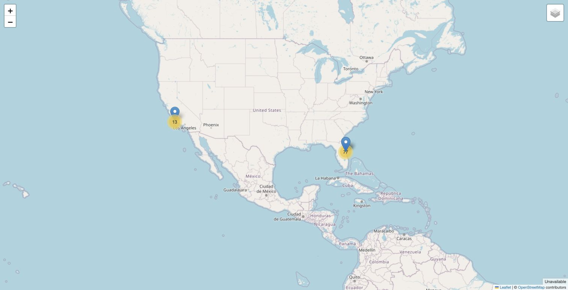
Interactive visual analytics with Folium
Site markers locate the three API launch sites on the US coasts. Clusters aggregate 90 launch records at shared coordinates.
Hover and popup text identify sites. Cluster markers prevent repeated coordinates from hiding all records.
The map uses OpenStreetMap tiles and the coordinates in the official dataset.
https://github.com/Zeppelin567/ibm-spacex-capstone/blob/main/SpaceX_Capstone_Analysis.ipynb
22
Notes:
IBM Skills Network course snapshots, accessed 21 Oct 2026
https://github.com/Zeppelin567/ibm-spacex-capstone/blob/main/SpaceX_Capstone_Analysis.ipynb
API: https://cf-courses-data.s3.us.cloud-object-storage.appdomain.cloud/IBM-DS0321EN-SkillsNetwork/datasets/dataset_part_1.csv
SQL: https://cf-courses-data.s3.us.cloud-object-storage.appdomain.cloud/IBM-DS0321EN-SkillsNetwork/labs/module_2/data/Spacex.csv

Slide 23
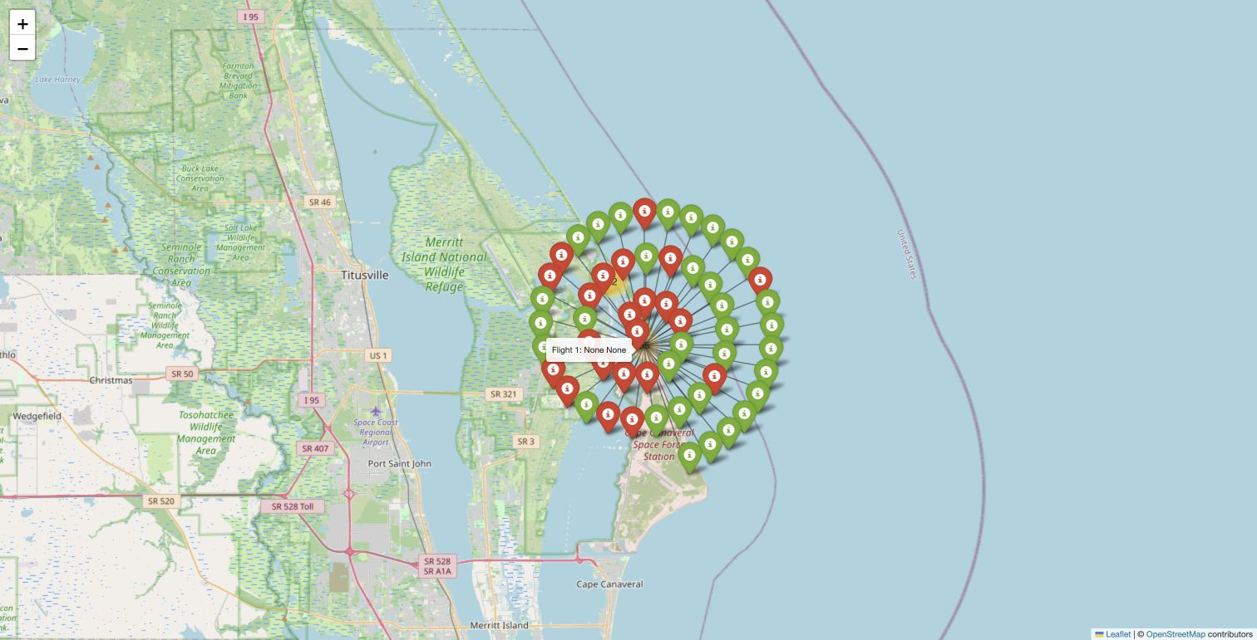
Folium launch records
Clicking the CCAFS cluster expands its 55 launch records. Green icons mark successful first-stage outcomes and red icons mark the other class.
The expanded icons spread around their shared launch location for readability. Their displayed offsets are artificial.
A hover tooltip identifies each flight and outcome.
https://github.com/Zeppelin567/ibm-spacex-capstone/blob/main/SpaceX_Capstone_Analysis.ipynb
23
Notes:
IBM Skills Network course snapshots, accessed 21 Oct 2026
https://github.com/Zeppelin567/ibm-spacex-capstone/blob/main/SpaceX_Capstone_Analysis.ipynb
API: https://cf-courses-data.s3.us.cloud-object-storage.appdomain.cloud/IBM-DS0321EN-SkillsNetwork/datasets/dataset_part_1.csv
SQL: https://cf-courses-data.s3.us.cloud-object-storage.appdomain.cloud/IBM-DS0321EN-SkillsNetwork/labs/module_2/data/Spacex.csv

Slide 24
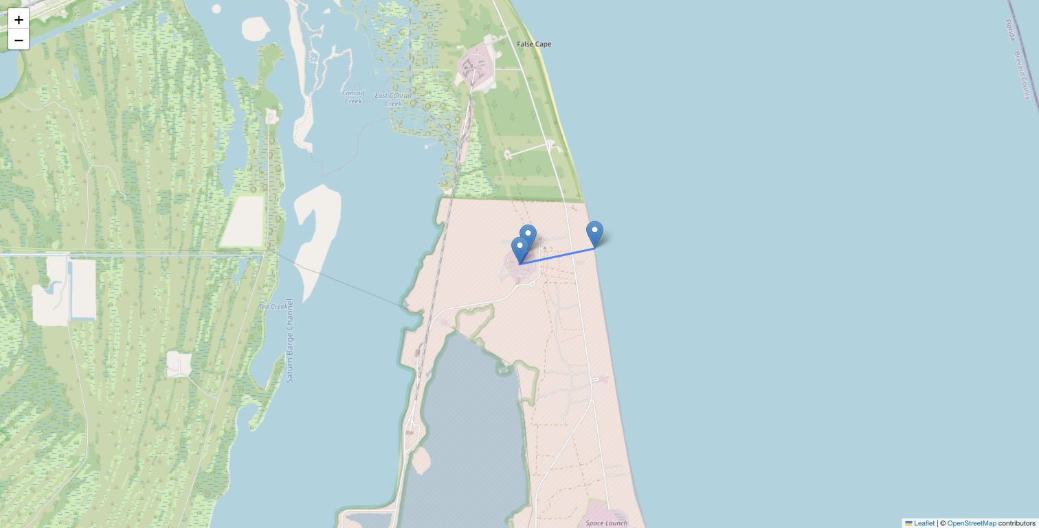
Folium proximity analysis
The CCAFS SLC 40 inset connects the launchpad to two approximate points selected from the basemap.
Coastline point: about 0.937 km.
Nearby road point: about 0.182 km.
Geodesic distances illustrate proximity to coast and access infrastructure. They are not surveyed distances or safety-clearance estimates.
https://github.com/Zeppelin567/ibm-spacex-capstone/blob/main/SpaceX_Capstone_Analysis.ipynb
24
Notes:
IBM Skills Network course snapshots, accessed 21 Oct 2026
https://github.com/Zeppelin567/ibm-spacex-capstone/blob/main/SpaceX_Capstone_Analysis.ipynb
API: https://cf-courses-data.s3.us.cloud-object-storage.appdomain.cloud/IBM-DS0321EN-SkillsNetwork/datasets/dataset_part_1.csv
SQL: https://cf-courses-data.s3.us.cloud-object-storage.appdomain.cloud/IBM-DS0321EN-SkillsNetwork/labs/module_2/data/Spacex.csv

Slide 25
Interactive visual analytics with Dash
The 56-row dashboard snapshot supplies four historical site labels.
A searchable dropdown selects all sites or one site. The pie chart switches between successful-launch counts by site and outcome counts within one site.
A payload range slider filters the scatter plot. Point colors identify booster versions. Two callback inputs update the figure.
Both controls were exercised in the running local application.
https://github.com/Zeppelin567/ibm-spacex-capstone/blob/main/spacex_dash_app.py
25
Notes:
IBM Skills Network course snapshots, accessed 21 Oct 2026
https://github.com/Zeppelin567/ibm-spacex-capstone/blob/main/spacex_dash_app.py
API: https://cf-courses-data.s3.us.cloud-object-storage.appdomain.cloud/IBM-DS0321EN-SkillsNetwork/datasets/dataset_part_1.csv
SQL: https://cf-courses-data.s3.us.cloud-object-storage.appdomain.cloud/IBM-DS0321EN-SkillsNetwork/labs/module_2/data/Spacex.csv

Slide 26
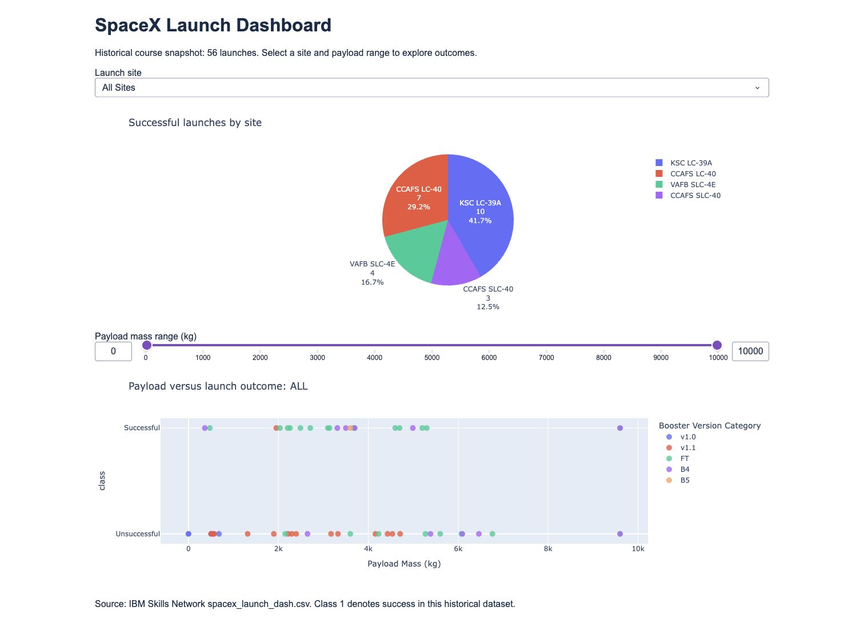
Dash results: all launch sites
KSC LC-39A contributes the largest count of successful launches in the dashboard snapshot: 10 of 24 successes (41.7%).
CCAFS LC-40 contributes 7, VAFB SLC-4E contributes 4 and CCAFS SLC-40 contributes 3.
The full dashboard combines the pie chart, dropdown and payload scatter.
https://github.com/Zeppelin567/ibm-spacex-capstone/blob/main/spacex_dash_app.py
26
Notes:
IBM Skills Network course snapshots, accessed 21 Oct 2026
https://github.com/Zeppelin567/ibm-spacex-capstone/blob/main/spacex_dash_app.py
API: https://cf-courses-data.s3.us.cloud-object-storage.appdomain.cloud/IBM-DS0321EN-SkillsNetwork/datasets/dataset_part_1.csv
SQL: https://cf-courses-data.s3.us.cloud-object-storage.appdomain.cloud/IBM-DS0321EN-SkillsNetwork/labs/module_2/data/Spacex.csv

Slide 27
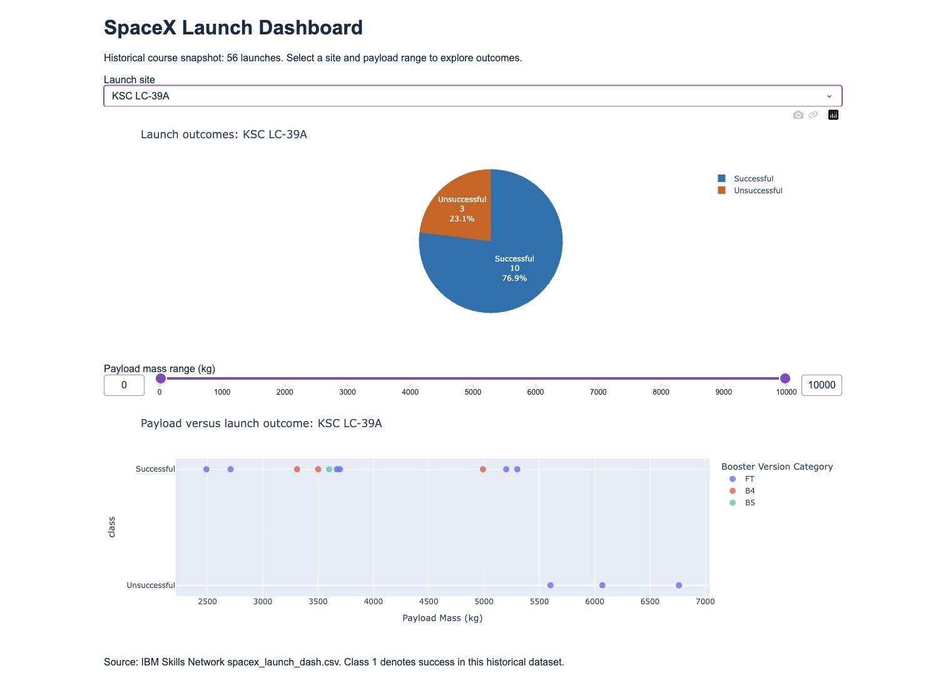
Dash results: KSC LC-39A
Selecting KSC LC-39A changes the pie to 10 successes and 3 unsuccessful launches, for a 76.9% observed success rate.
This is the highest site rate in the 56-row dashboard snapshot. It is separate from the 90-row API analysis.
The scatter plot now contains only the selected site.
https://github.com/Zeppelin567/ibm-spacex-capstone/blob/main/spacex_dash_app.py
27
Notes:
IBM Skills Network course snapshots, accessed 21 Oct 2026
https://github.com/Zeppelin567/ibm-spacex-capstone/blob/main/spacex_dash_app.py
API: https://cf-courses-data.s3.us.cloud-object-storage.appdomain.cloud/IBM-DS0321EN-SkillsNetwork/datasets/dataset_part_1.csv
SQL: https://cf-courses-data.s3.us.cloud-object-storage.appdomain.cloud/IBM-DS0321EN-SkillsNetwork/labs/module_2/data/Spacex.csv

Slide 28
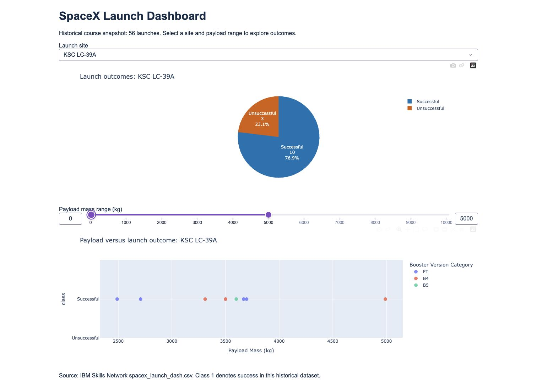
Dash results: payload and booster
A 0-5,000 kg range further filters KSC LC-39A points.
Across all dashboard sites, 2,000-4,000 kg has the highest observed success rate among the specified 2,000 kg bins: 13/21 (61.9%). The 6,000-8,000 kg bin has 0/4.
B5 shows 1/1 success, while FT shows 16/24. The single B5 observation cannot establish superiority.
https://github.com/Zeppelin567/ibm-spacex-capstone/blob/main/spacex_dash_app.py
28
Notes:
IBM Skills Network course snapshots, accessed 21 Oct 2026
https://github.com/Zeppelin567/ibm-spacex-capstone/blob/main/spacex_dash_app.py
API: https://cf-courses-data.s3.us.cloud-object-storage.appdomain.cloud/IBM-DS0321EN-SkillsNetwork/datasets/dataset_part_1.csv
SQL: https://cf-courses-data.s3.us.cloud-object-storage.appdomain.cloud/IBM-DS0321EN-SkillsNetwork/labs/module_2/data/Spacex.csv

Slide 29
Predictive analysis methodology
Train/test split: 72/18 rows, stratified, random_state=2.
Five-fold stratified cross-validation tunes logistic regression, SVM, a decision tree and KNN on training data.
Each pipeline imputes missing values, encodes categories and scales numerical features inside each fold.
Select the best mean CV accuracy, then report held-out performance. Upstream payload imputation limits evaluation. ReusedCount may reflect later reuse. Reconstruct features available at launch time before prospective prediction.
https://github.com/Zeppelin567/ibm-spacex-capstone/blob/main/SpaceX_Capstone_Analysis.ipynb
29
Notes:
IBM Skills Network course snapshots, accessed 21 Oct 2026
https://github.com/Zeppelin567/ibm-spacex-capstone/blob/main/SpaceX_Capstone_Analysis.ipynb
API: https://cf-courses-data.s3.us.cloud-object-storage.appdomain.cloud/IBM-DS0321EN-SkillsNetwork/datasets/dataset_part_1.csv
SQL: https://cf-courses-data.s3.us.cloud-object-storage.appdomain.cloud/IBM-DS0321EN-SkillsNetwork/labs/module_2/data/Spacex.csv

Slide 30
Predictive analysis results
The decision tree has the highest mean CV accuracy: 90.4%, with a fold standard deviation of 5.2 percentage points.
Its selected depth is 3 and minimum leaf size is 4. Test accuracy is 83.3%, with balanced accuracy of 75.0%.
The always-successful baseline is 66.7% on this test split.
Model | CV accuracy | Test accuracy
Decision tree | 90.4% | 83.3%
KNN | 89.1% | 66.7%
SVM | 86.3% | 77.8%
Logistic regression | 83.6% | 83.3%
https://github.com/Zeppelin567/ibm-spacex-capstone/blob/main/SpaceX_Capstone_Analysis.ipynb
30
Notes:
IBM Skills Network course snapshots, accessed 21 Oct 2026
https://github.com/Zeppelin567/ibm-spacex-capstone/blob/main/SpaceX_Capstone_Analysis.ipynb
API: https://cf-courses-data.s3.us.cloud-object-storage.appdomain.cloud/IBM-DS0321EN-SkillsNetwork/datasets/dataset_part_1.csv
SQL: https://cf-courses-data.s3.us.cloud-object-storage.appdomain.cloud/IBM-DS0321EN-SkillsNetwork/labs/module_2/data/Spacex.csv

Slide 31
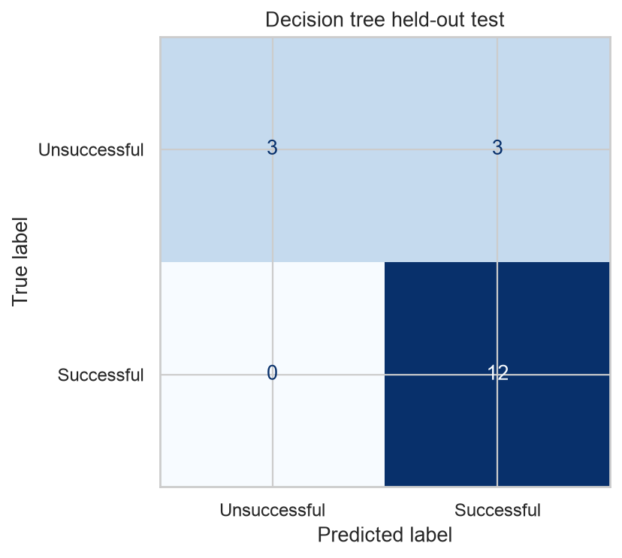
Confusion matrix and uncertainty
On 18 held-out rows, the tree correctly identifies 3 of 6 unsuccessful outcomes and all 12 successful outcomes.
Three unsuccessful outcomes receive successful predictions. This error matters for reuse planning.
One test error changes accuracy by 5.6 percentage points. A larger chronological holdout and calibration are needed.
https://github.com/Zeppelin567/ibm-spacex-capstone/blob/main/SpaceX_Capstone_Analysis.ipynb
31
Notes:
IBM Skills Network course snapshots, accessed 21 Oct 2026
https://github.com/Zeppelin567/ibm-spacex-capstone/blob/main/SpaceX_Capstone_Analysis.ipynb
API: https://cf-courses-data.s3.us.cloud-object-storage.appdomain.cloud/IBM-DS0321EN-SkillsNetwork/datasets/dataset_part_1.csv
SQL: https://cf-courses-data.s3.us.cloud-object-storage.appdomain.cloud/IBM-DS0321EN-SkillsNetwork/labs/module_2/data/Spacex.csv

Slide 32
Conclusion and next steps
Observed landing success improved over time. Payload, orbit, site and hardware are associated with outcomes, but the samples do not identify causal effects.
The decision tree provides a transparent starting point. A chronological evaluation should test whether its advantage survives changes in launch operations.
For economic decisions, distinguish ocean landing success from recovery suitable for reuse. Add weather, mission constraints and refurbishment data.
Publish the reproducible notebook, data provenance, dashboard and maps together.
IBM Skills Network course snapshots, accessed 21 Oct 2026
32
Notes:
IBM Skills Network course snapshots, accessed 21 Oct 2026
API: https://cf-courses-data.s3.us.cloud-object-storage.appdomain.cloud/IBM-DS0321EN-SkillsNetwork/datasets/dataset_part_1.csv
SQL: https://cf-courses-data.s3.us.cloud-object-storage.appdomain.cloud/IBM-DS0321EN-SkillsNetwork/labs/module_2/data/Spacex.csv

Slide 33
Project files and sources
https://github.com/Zeppelin567/ibm-spacex-capstone
SpaceX_Capstone_Analysis.ipynb contains executed collection, wrangling, EDA, SQL, mapping and modeling.
spacex_dash_app.py runs the interactive dashboard.
CSV, JSON and HTML snapshots preserve the inputs.
AI assistance supported preparation of the code and presentation. All reported calculations come from executed analysis.
Official IBM datasets and lab instructions. Wikipedia revision oldid=1027686922. Folium basemaps © OpenStreetMap contributors.
33
Notes:
Official IBM datasets and lab instructions. Wikipedia revision oldid=1027686922. Folium basemaps © OpenStreetMap contributors.
API: https://cf-courses-data.s3.us.cloud-object-storage.appdomain.cloud/IBM-DS0321EN-SkillsNetwork/datasets/dataset_part_1.csv
SQL: https://cf-courses-data.s3.us.cloud-object-storage.appdomain.cloud/IBM-DS0321EN-SkillsNetwork/labs/module_2/data/Spacex.csv

