Slide 1
FPGA
Entertainment
Syetem
PRESS ANY KEY
Group 18
Pengrui Tang · 1220031811
Xiaoyang Zhen ·1220034170

Slide 2

CONTENTS
00
Project Introduction
01
System Architecture
02
Demonstration
03
Discussion & Conclusion

Slide 3
Introduction
_______________________________________________________________________________
1

Slide 4
INTRODUCTION
Snake Game is a classic action game
The goal of the game is to eat apples as many as possible within the survival time
The apples will appear randomly in different position
Introduction

Slide 5


Feature
Tile based renderer
Unique Snake appearance
Snake increases length by eating apples
Key debounced
Using HDMI as output
Time and Score display
The Legend of Zelda NES fonts
Introduction

Slide 6
Architecture
_______________________________________________________________________________
2

Slide 7
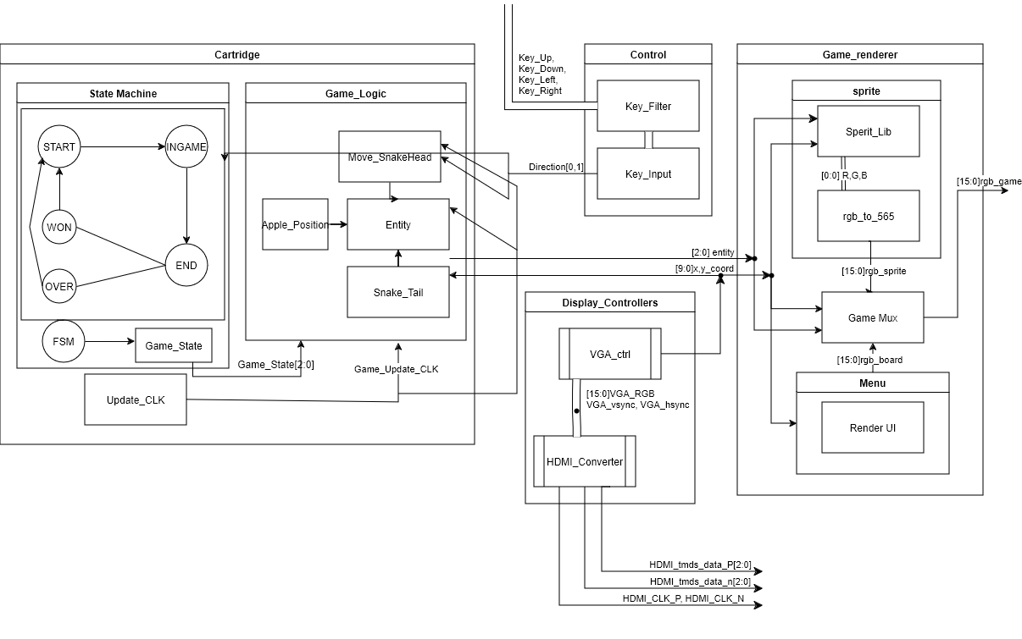
OVERVIEW
Cartridge system: game logic
Control system: control Input
Visual system: render pixel and output to port
Architecture

Slide 8
Cartage System
Architecture

Slide 9
Visual System
Architecture

Slide 10
Control System
Introduction

Slide 11
implementation
_______________________________________________________________________________
3

Slide 12
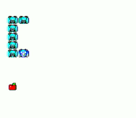
Overview
The code can be found on the project’s GitHub page
The demonstration video can be found on YouTube page
https://www.youtube.com/@seanz1668
Introduction

Slide 13
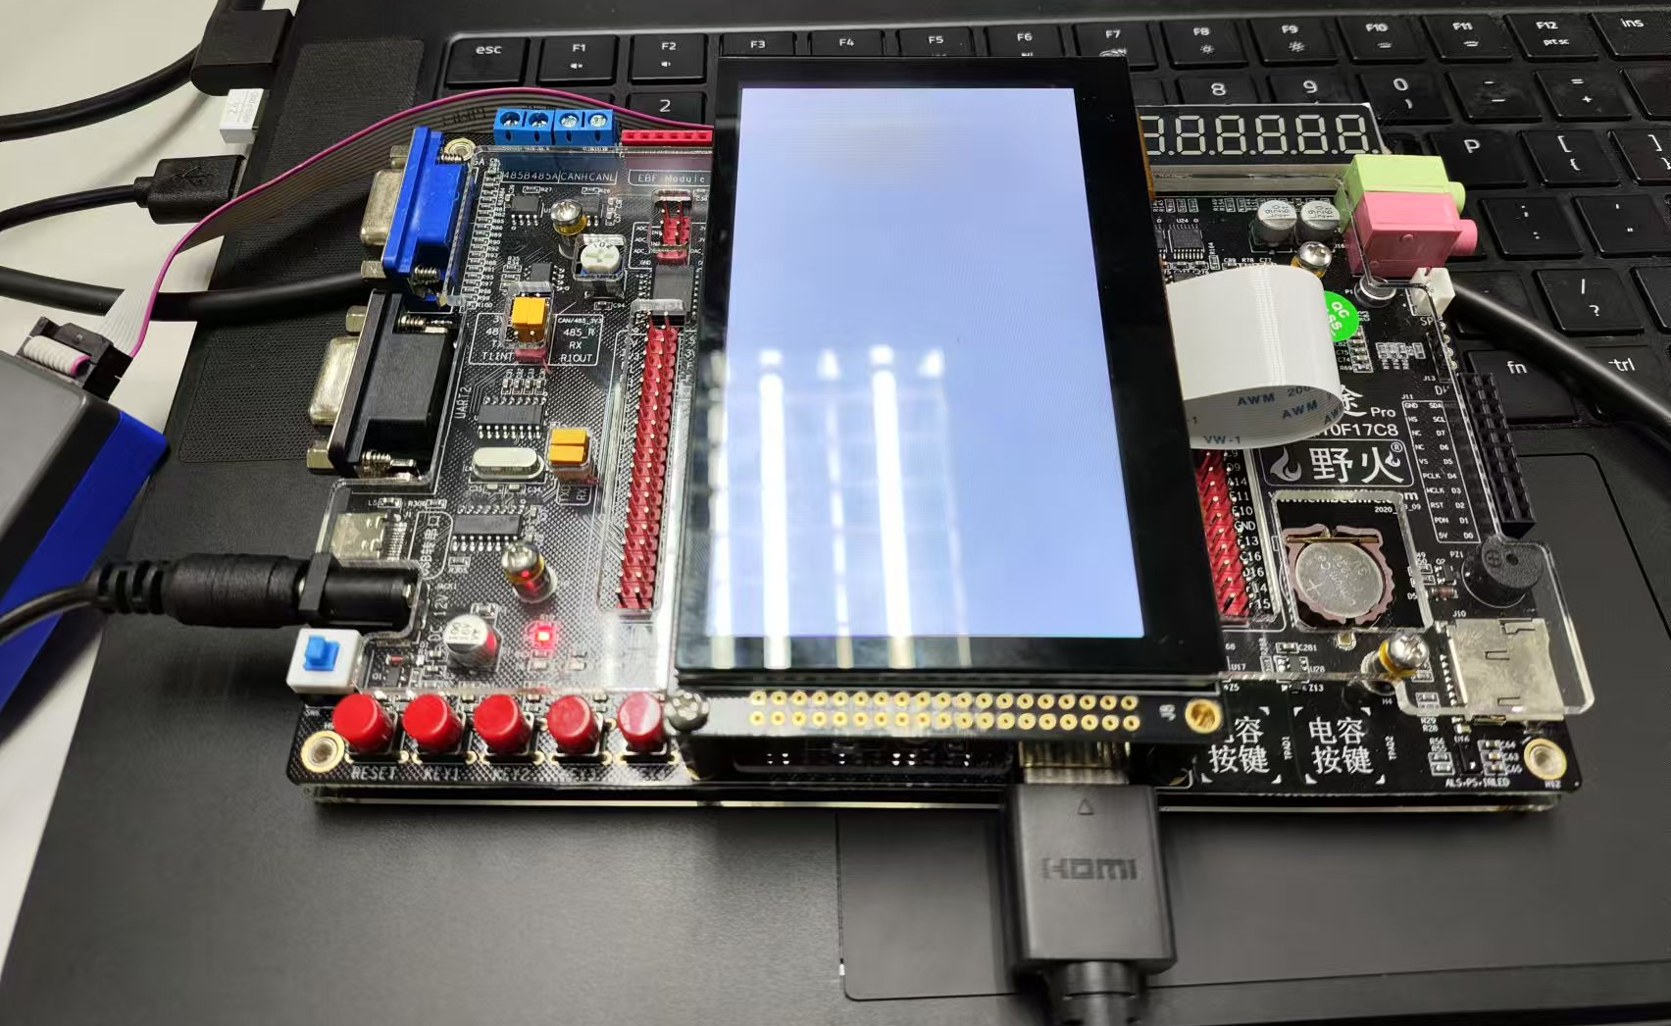
Key In
VIDRO OUT
implementation

Slide 14
CONCLUSION
_______________________________________________________________________________
4

Slide 15
Reflection
Design Before write
Multiblock design for easier test bench
Draw block diagram in advance for group coorperation
Use Branches in git to keep a working main file.
CONCLUSION

Slide 16
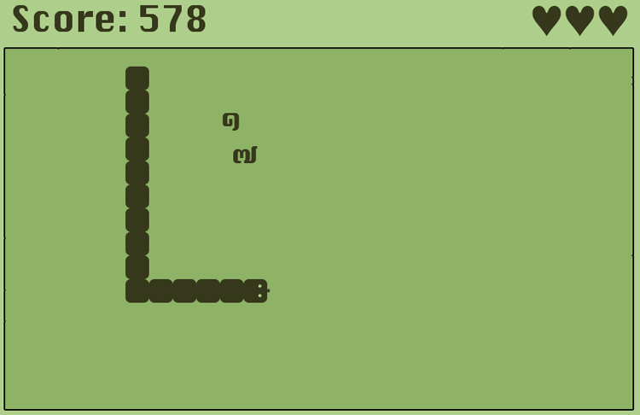
Conclusion
CONCLUSION

Slide 17
THE END
THE
realKarl.SCB@outlook.com
littlejun3004@gmail.com
END

