Slide 1
Building WinRT Apps with WinJS
Leveraging Your Web Front-End Development Experience to Create Windows 8, Windows 10, and Windows Phone Applications

Slide 2

Who is this guy?
Eric Dzikowski
Software Engineer at Applied Information Sciences
20+ years of experience
Focus on Microsoft web and cloud technologies
Passionate about modern design and development
Blogging at http://blog.appliedis.com

Slide 3
Agenda
What is WinRT (and UAP)?
What is WinJS?
Where to Get WinJS
Demo – Hello, WinJS
The Basics
Demo – Using WinJS Controls
Data Binding
ListView Control
Demo – Putting Everything Together
Q & A
What’s Next?

Slide 4
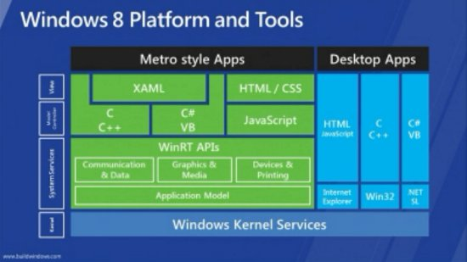
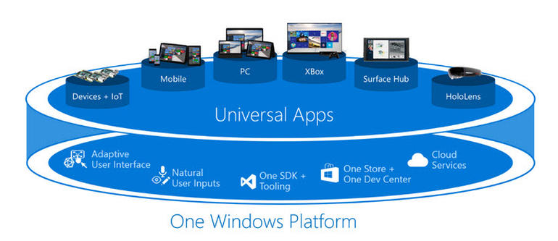
What is WinRT?
Windows Runtime library
Principal provider of system services for Windows 8+ apps
Doesn’t replace Win32
Preferred API for Windows Store apps
Unifies PC and phone app development
Allows for easy Windows 10 Universal App Platform (UAP) migration

Slide 5

What is WinJS?
Open-source JavaScript library
Create apps for Web, Windows and Phone
Build Windows Store apps with familiar HTML, CSS, and JS
Provides consistent look and performance across all Windows devices
Works in any browser
Can be used alone or with other JS frameworks (Knockout, AngularJS, etc.)
Still just JavaScript

Slide 6
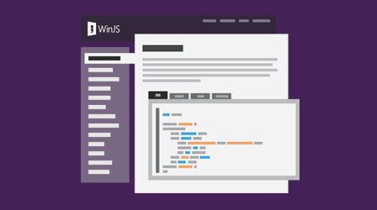
Where to Get WinJS
NPM:
> npm install winjs
NuGet:
> Install-Package WinJS
CDN:
http://cdnjs.com/libraries/winjs
GitHub:
https://github.com/winjs/winjs
Or just use Visual Studio templates

Slide 7
Demo
Hello, WinJS
Notes:
Show project templates
Run sample phone and desktop apps

Slide 8
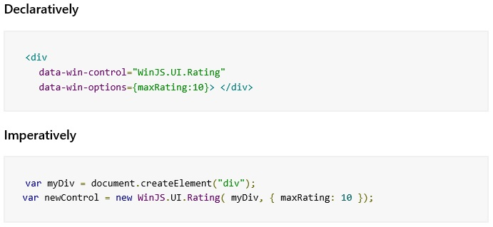
The Basics
Controls can be added declaratively or imperatively
Controls are added via custom attributes on standard HTML elements
Use data-win-control attribute to add WinJS control
Use data-win-options attribute to configure the control
Use WinJS.UI.processAll() to convert markup to WinJS controls
Runs the constructor for each control
Passes data-win-* attributes to constructor as options

Slide 9
Demo
Using WinJS Controls

Slide 10
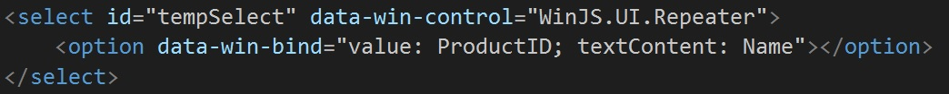
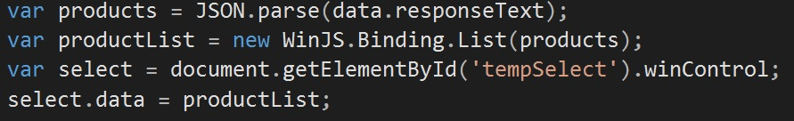
Data Binding
WinJS uses one-way binding
Binding target listens for changes to source
Established using custom data-win-bind attribute
Takes the form: <target>: <source> [<initializer>]
WinJS Binding Lists turn JS arrays into observable arrays
WinJS.Binding.List can contain any type of value, even complex objects
Repeater control is an easy way to repeat a single HTML root element

Slide 11
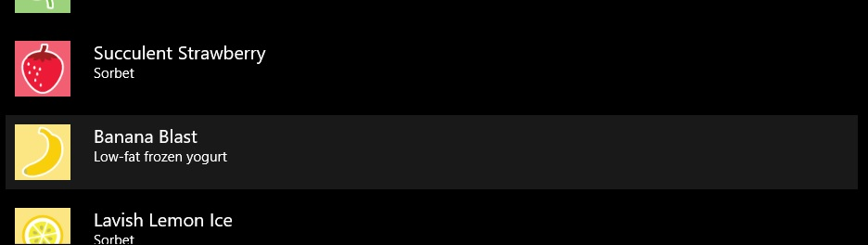
ListView Control
Very powerful control for displaying collections of data
Includes grouping features
Supports multiple layouts
Supports templates (WinJS.Binding.Template)
Can make the list look however you want using standard HTML/CSS
Can contain other WinJS controls

Slide 12
Demo
Putting Everything Together

Slide 13
Q & A

Slide 14
What’s Next?
Download My Samples and Slides:
https://github.com/Zer0fluX/WinJS-Win8.1-App
API Reference:
https://msdn.microsoft.com/en-us/library/windows/apps/br229773.aspx
Samples:
http://winjs.azurewebsites.net/
Stack Overflow:
http://stackoverflow.com/questions/tagged/winjs
WinJS on Twitter:
https://twitter.com/buildwinjs
Contribute:
https://github.com/winjs/winjs/

