Slide 1
IC-202P -Design Practicum
Project : Waste Collection management system for IIT Mandi
Faculty Mentor : Dr. Sarthak Nag and AD Infra
Student Buddy : Dipanshu Thakur (B22037)
TA : Yash Taneja (D23116)
Group-7
Arendra (B23394)
Dipanshu (B23126)
Anuj (B23339)
Keshav (B23076)
Utkarsh (B23056)
Navdheer (B23361)

Slide 2
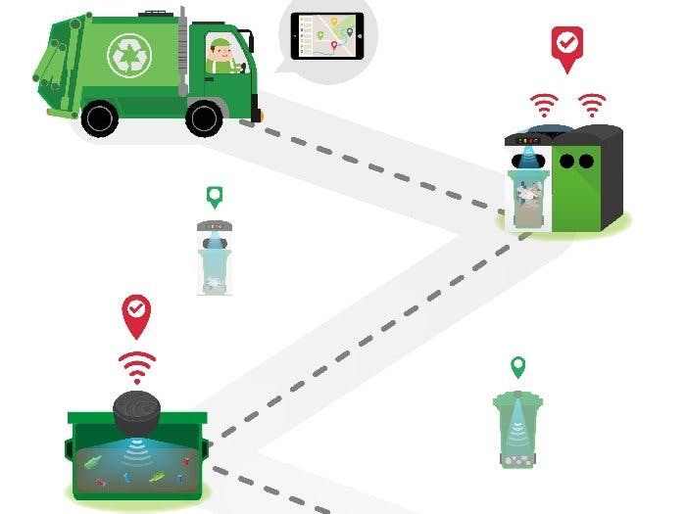
1.LOCATION BASED GARBAGE MANAGEMENT SYSTEM
Mechanism:
We should capture a picture of the filled trash bin and we should update
the location in which place the bin is full in an app or website.
By this we can get a notice from some one that bin is full then it will be
some what helpful to the campus.
For building this app we should use python,
php, Java script etc.
This app can handle both biodegradable and
non-biodegradable wastes
Cost may be 2100rs that also for
publishing app in google play store.
Source: https://www.youtube.com/watch?v=SufuG1l8cqA

Slide 3
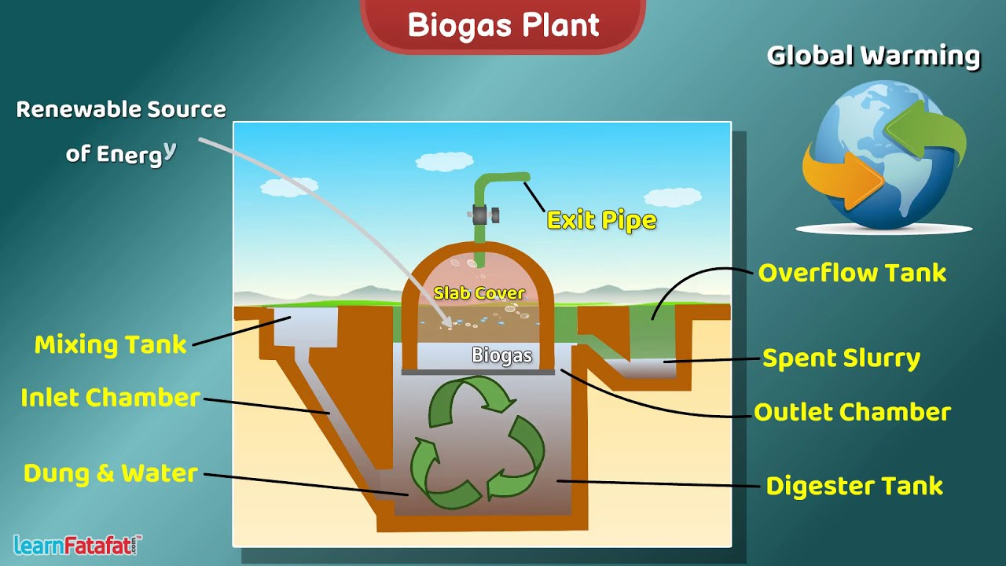
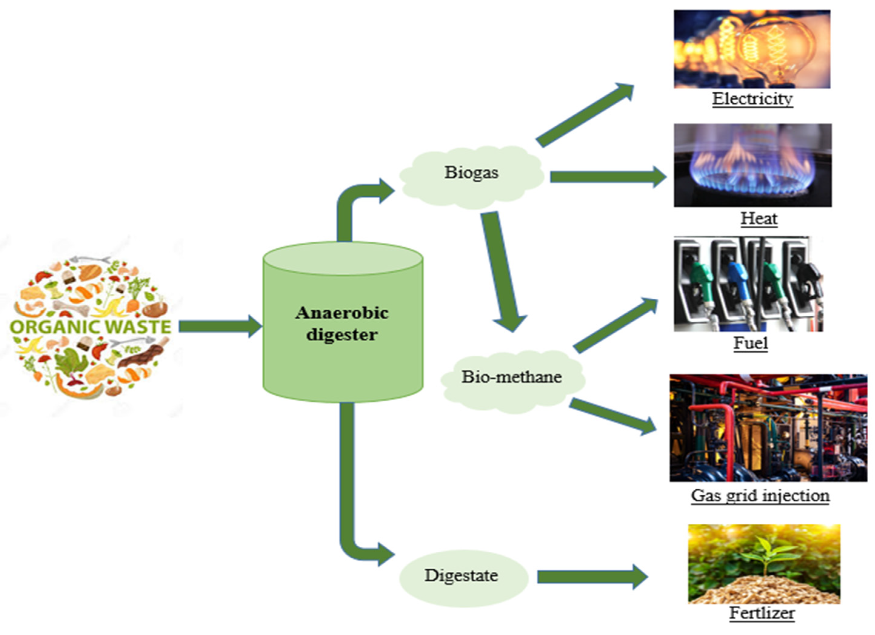
2. BIO GAS
Mechanism:
By decomposing organic waste , cow dung, dry leaves etc methane and carbondioxide is formed which can be flammable. This is called as Bio gas.
Materials needed are sealed drum, pvc pipes, L-joints, tank nipple , f-clamp, tube, hose reel, T-connectors, m-seal , valves etc.
This project mainly concentrates on organic wastes.
Cost may be approximately 10000 rupees.(Source: https://youtu.be/c_Jtl-VhkKI?si=UxSTXFdkw3E2UNyM)

Slide 4
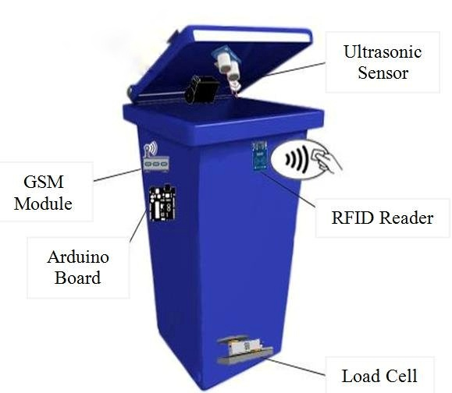
3.SMART BIN
Mechanism:
We will install a device to the dust bins which will detect when
bin is full it will directly sends an alert to the college
management to clean it.
Also it will make buzzer sound after bin is filled.
Essential things are EM310-UDL LoRaWAN ultra sonic
sensor or a normal ultrasonic sensor, batteries ,
connecting wires , buzzer etc.
Cost may be less than approximately 5000 to 6000 rupees.
This project can handle both biodegradable and
non biodegradable wastes
(Source: https://www.youtube.com/watch?v=fgr_UlKBz60)

Slide 5
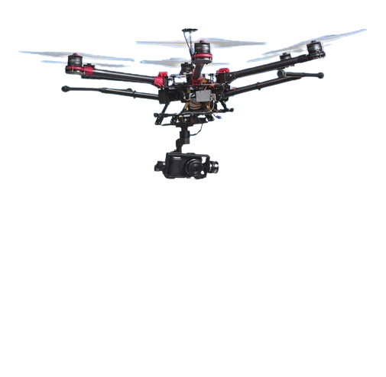
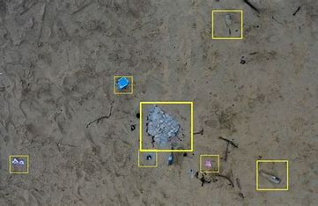
4.Drone Innovation in Litter Collection
Manual cleanup is labor-intensive, costly, and often insufficient, leaving many areas neglected and unclean.
Imagine a drone equipped with cutting-edge technology designed to detect and collect litter autonomously, tirelessly working for cleaner spaces.
Key Features:
AI Detection: Identifies and locates litter in real-time.
Automated Collection: Equipped with a grabber/vacuum system.
Eco-Friendly: Potential for solar power or efficient batteries.

Slide 6
5.Upcycling App at IIT Mandi
Requirements:
App Platform: A user-friendly interface for students to upload upcycling ideas or submit waste.
Content Moderation: System for reviewing and showcasing creative upcycling ideas.
Collaboration Tools: Features for students to collaborate on upcycling projects.
Marketplace Integration: A section where upcycled items can be bought, sold, or traded within the campus.
Benefits & Advantages:
Resource Reuse: Waste can be transformed into useful items, art projects, or even lab equipment, reducing campus waste.
Community Engagement: Fosters a culture of sustainability and collaboration among students and faculty.
Usefulness at IIT Mandi:
Student Innovation: Provides a platform for students to showcase their creativity, collaborate on projects, and contribute to campus sustainability.
Campus Projects: Upcycled materials can be used in campus art installations, lab equipment, furniture, or community spaces.
Marketplace: Facilitates the exchange or sale of upcycled items within the campus, encouraging a circular economy.

Slide 7
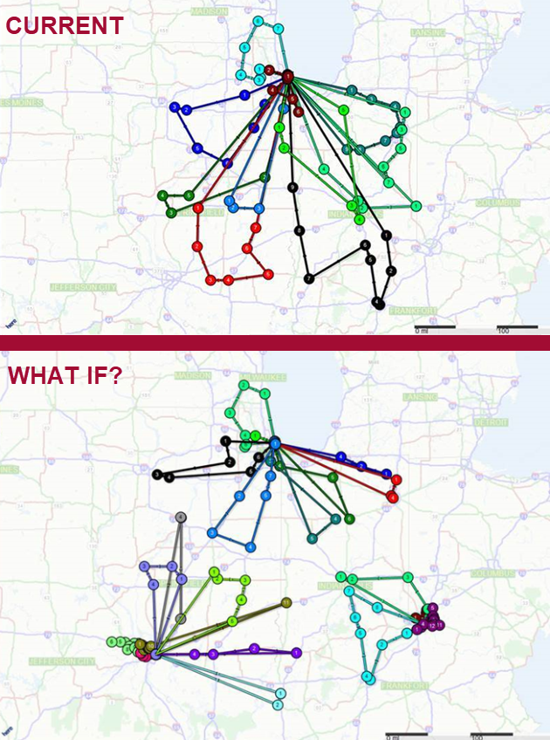
6.Waste Prediction System
Inefficient waste collection due to unpredictable waste volumes leads to higher operational costs and resource wastage.
An app that predicts waste generation based on historical data and trends, optimizing collection routes and schedules
Prediction Algorithm: Uses historical data and machine learning to forecast daily waste volumes.
Route Optimization: Dynamically adjusts routes for collection vehicles based on predicted waste levels.
Cost Savings: Lowers operational costs by minimizing fuel consumption and labor hours.
Scalability: Can be implemented in various regions and adapted for different waste types.

Slide 8
7.Waste management App (Scavenger)
The proposed system, where admin manage the garbage app for full online based monitoring and analyse the system. Its admin handle bins, driver, complaints from user and work report from driver like daily waste estimate and amount of reusable waste.
The garbage collection system includes tracking routine garbage trucks doing rounds daily or weekly, which may not only cover every zone of the college but also cause delay issues for the residents. This app will provide the residents their on-duty location access so as they may timely dump off the waste.
Based on the data collected, garbage trucks can be given routes generated through various algorithms and Google maps API to efficiently route through all necessary garbage bins and finally reach the dumping site
Cost estimate : Domain based-cost mostly
Most probable Requirements :
Django
Andorid Development
php

Slide 9
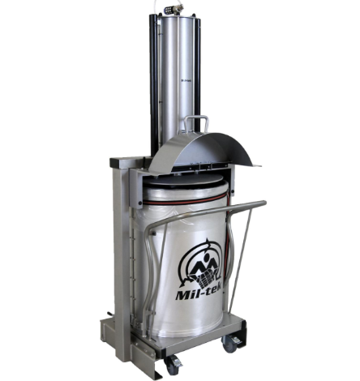
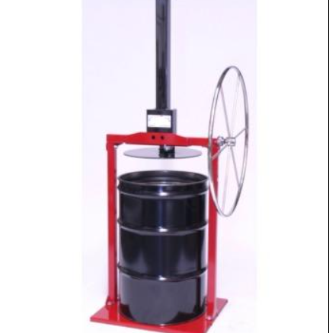
8.Compressed Trash Collection
Advantages of Using a Trash Compressor:
Space Efficiency: By reducing the volume of trash, it decreases the frequency of collection needed and optimizes storage space.
Cost Savings: Lowering the amount of trash to be transported can reduce fuel costs and labor associated with waste management.
Environmental Impact: Compressing trash reduces the number of trips required to transport waste, cutting down on emissions from vehicles
.
A trash compressor is a device designed to reduce the volume of waste by applying pressure to compact it. This process makes waste management more efficient by minimizing the space needed to store and transport trash. Here’s how it generally works:
Components of a Trash Compressor:
Compaction Chamber: The area where trash is placed for compression. It's designed to handle the forces exerted during the compression process.
Hydraulic Press: A system that applies force to the trash. Hydraulic systems use fluid pressure, while pneumatic systems use compressed air to drive a piston that compresses the waste.
Power Source: The compressor is typically powered by electricity, but in some designs, especially portable units, it could be powered by compressed air, gas, or even manual force.
Control System: This can be a simple lever or button for manual operation or a more complex system with sensors and automated controls for adjusting the pressure based on the type and amount of trash.
Output Mechanism: After compression, the compacted waste is either stored in the same chamber or pushed into a separate bin or bag for easy disposal.

Slide 10
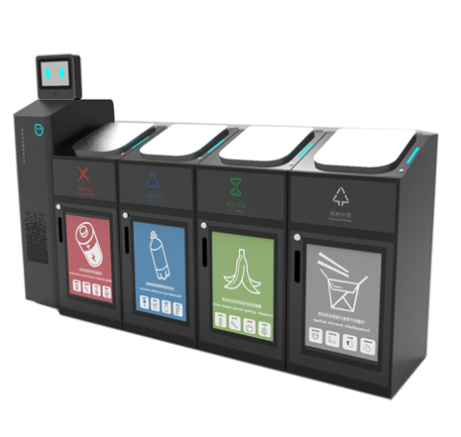
9.Waste Segregation Bins
Smart waste segregation bins are advanced waste management systems designed to automatically sort and segregate different types of waste, making recycling and disposal more efficient. These bins use a combination of sensors, AI, and IoT technology to identify, classify, and separate waste into categories like recyclables, organic waste, and general trash.
We can use Arduino microcontrollers and sensors to create bins that automatically open based on the type of waste (e.g., organic, recyclable, non-recyclable) detected by RFID tags or simple colour sensors. Here's how they typically work:
Sensors for material detection and fill level monitoring.
AI-based sorting using image recognition.
Compartmentalized design for different waste types.
Energy efficiency with solar power or low-energy systems
ESTIMATED COST – Rs.30,000
Sensors and Electronics: ₹5,000 - ₹10,000
Microcontroller: ₹2,000 - ₹5,000
Bin Structure and Assembly: ₹10,000 - ₹15,000
Miscellaneous (Wiring, Indicators, etc.): ₹3,000 - ₹5,000

Slide 11
10.Compost Pit System with Automated Aeration
Components of the System
1. Design: The compost pit is designed with proper drainage to prevent waterlogging and insulation to maintain a stable temperature.
2. Automated Aeration: The system includes fans and aerators that automatically provide consistent airflow throughout the compost pile.
This ensures that oxygen is evenly distributed, which is critical for the microbes that break down the waste.
3. Temperature and Moisture Sensors: Sensors are placed inside the compost pit to continuously monitor temperature and moisture levels.
.
Cost :
Compost Pit Construction:
Cost: ~₹10,000
Aeration System and Sensors:
Cost: ~₹15,000
Integration and Testing:
Cost: ~₹5,000

Slide 12
11.Plastic Waste in 3D Printing
Collection: Gather plastic waste from various sources like bottles and containers.
Cleaning: Wash the plastic to remove dirt and other impurities.
Shredding: Cut the cleaned plastic into small pieces to make it easier to handle
Extrusion: Melt the shredded plastic and push it through a mold to form long strands of filament.
Equipment Needed:-
Filament Extruder: A machine costing between ₹20,000 and ₹40,000 that melts and shapes the plastic into filament.

Slide 13
12.Waste-to-Brick Production
Components of the System
Waste Shredders:- Waste shredders are machines that break down large pieces of plastic and paper waste into smaller, more manageable particles.
It also helps in reducing the size of the waste material, making it easier to handle and process.
2. Brick Molds:- Molds are used to shape the shredded waste into brick forms. They come in various sizes and shapes depending on the desired final product.
3. Heating System:- The heating system cures the molded bricks by applying heat.
If possible, the system can use waste heat from other processes to reduce energy costs.
Cost Estimate :
Shredders and Molds:
Cost: ~₹15,000
Presses and Heating System:
Cost: ~₹15,000

Slide 14
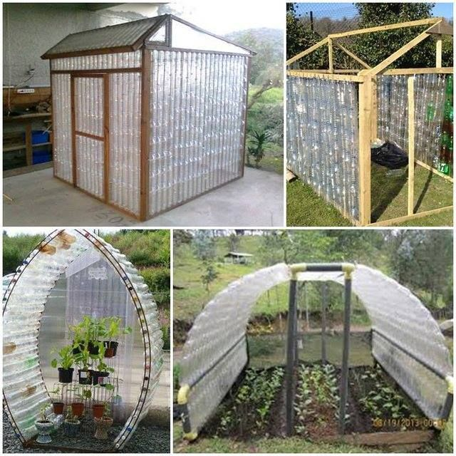
13.Plastic Bottle Green House
Advantages and Benefits
Sustainability: Diverts plastic waste from landfills, reduces campus waste.
Cost-Effective: Utilizes low-cost/recycled materials, minimal maintenance.
Thermal Efficiency: Plastic bottles provide insulation, ideal for Himachal Pradesh’s cold climate.
Technology Overview:
Construction: Bottles are cleaned, stacked, and bound within a wooden or metal frame to form greenhouse walls.
Environmental Impact: Reduces plastic waste on campus by repurposing used bottles.
Usefulness at IIT Mandi:
Climate Suitability: Helps maintain a warm microclimate for growing plants year-round, even in cold weather.
Educational Value: Demonstrates practical application of sustainability, engages students in hands-on learning.
Sustainability Initiative: Enhances IIT Mandi’s commitment to green technology and environmental conservation.

Slide 15
14.Three-Compartment Waste Bin with QR Code
Objective:
Ensure Proper Waste Segregation: Develop a waste bin with three compartments, each equipped with a dedicated opening and proper labeling, ensuring that waste is correctly sorted at the source.
Design Features:
Three Separate Compartments:
Details: Each bin has a distinct compartment for plastic, organic, and liquid waste. The compartments are designed to minimize cross-contamination and ensure waste is disposed of correctly.
Dustbin Mouths:
Details: Each compartment is equipped with a specifically designed mouth that is easy to open and close, similar to household dustbin lids. The design encourages users to select the correct compartment for their waste type.
Proper Capping and Labeling:
Details: The bin features clear, color-coded labels and icons on each mouth to guide users on where to dispose of specific waste types. The capping ensures that once closed, the waste is securely contained, reducing odors and maintaining hygiene.
Durable Construction:
Materials: Made from durable, eco-friendly materials that are easy to clean and maintain, ensuring long-term usability even in high-traffic areas like cafeterias and hostels.
5. Integration with a Waste Management App:
Details: Create a mobile app that connects with the smart bins. Users can scan a QR code on the bin to see details about how much waste has been collected, contribute ideas for waste reduction, or receive notifications about waste management initiatives

