Slide 1
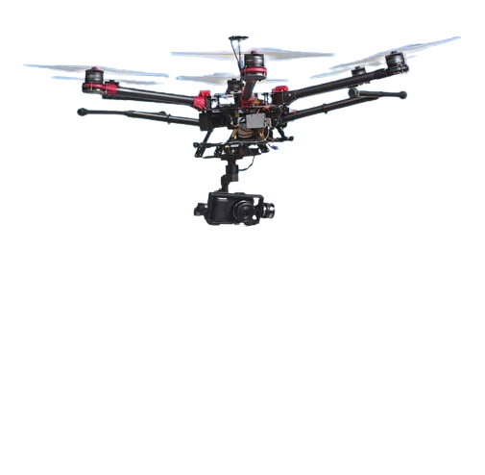
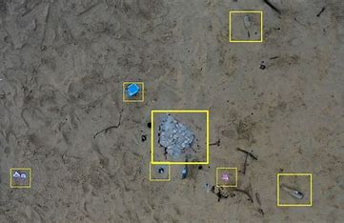
Drone Innovation in Litter Collection
Manual cleanup is labor-intensive, costly, and often insufficient, leaving many areas neglected and unclean.
Imagine a drone equipped with cutting-edge technology designed to detect and collect litter autonomously, tirelessly working for cleaner spaces.
Key Features:
AI Detection: Identifies and locates litter in real-time.
Automated Collection: Equipped with a grabber/vacuum system.
Eco-Friendly: Potential for solar power or efficient batteries.

