Slide 2
App-Based Reverse Vending System at IIT Mandi
App-Based Reverse Vending System at IIT Mandi
Requirements:
App: Users upload photos of their waste for scanning and identification.
Scanning Technology: Classifies mechanical, electrical, household, and student waste.
Rewards Integration: Offers benefits or tickets based on waste type.
Benefits & Advantages:
Versatile Waste Management: Effectively handles mechanical, electrical, household, and student waste.
Recycling & Reuse: Identified waste can be recycled or repurposed for college projects, reducing campus waste.
Usefulness at IIT Mandi:
Environmental Impact: Enhances recycling efforts across various waste types, supporting sustainable campus practices.
Resource Reuse: Recycled materials can be repurposed for student projects or maintenance needs within the campus.

Slide 3
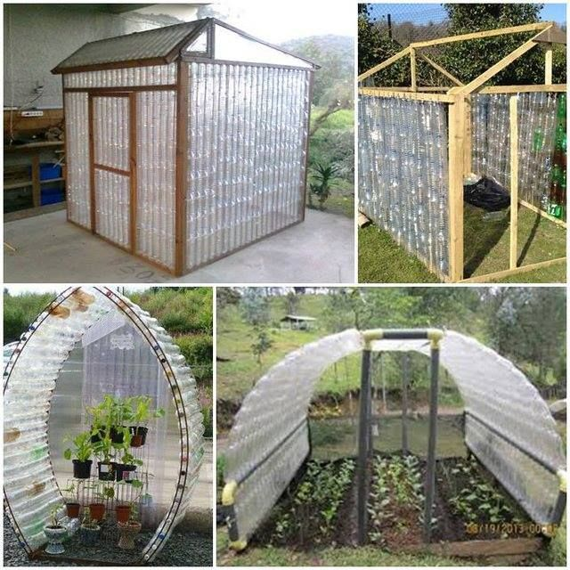
Plastic Bottle Green House
Advantages and Benefits
Sustainability: Diverts plastic waste from landfills, reduces campus waste.
Cost-Effective: Utilizes low-cost/recycled materials, minimal maintenance.
Thermal Efficiency: Plastic bottles provide insulation, ideal for Himachal Pradesh’s cold climate.
Technology Overview:
Construction: Bottles are cleaned, stacked, and bound within a wooden or metal frame to form greenhouse walls.
Environmental Impact: Reduces plastic waste on campus by repurposing used bottles.
Usefulness at IIT Mandi:
Climate Suitability: Helps maintain a warm microclimate for growing plants year-round, even in cold weather.
Educational Value: Demonstrates practical application of sustainability, engages students in hands-on learning.
Sustainability Initiative: Enhances IIT Mandi’s commitment to green technology and environmental conservation.

Slide 4
Upcycling App at IIT Mandi
Requirements:
App Platform: A user-friendly interface for students to upload upcycling ideas or submit waste.
Content Moderation: System for reviewing and showcasing creative upcycling ideas.
Collaboration Tools: Features for students to collaborate on upcycling projects.
Marketplace Integration: A section where upcycled items can be bought, sold, or traded within the campus.
Benefits & Advantages:
Resource Reuse: Waste can be transformed into useful items, art projects, or even lab equipment, reducing campus waste.
Community Engagement: Fosters a culture of sustainability and collaboration among students and faculty.
Usefulness at IIT Mandi:
Student Innovation: Provides a platform for students to showcase their creativity, collaborate on projects, and contribute to campus sustainability.
Campus Projects: Upcycled materials can be used in campus art installations, lab equipment, furniture, or community spaces.
Marketplace: Facilitates the exchange or sale of upcycled items within the campus, encouraging a circular economy.

Slide 5
Three-Compartment Waste Bin with QR Code
Objective:
Ensure Proper Waste Segregation: Develop a waste bin with three compartments, each equipped with a dedicated opening and proper labeling, ensuring that waste is correctly sorted at the source.
Design Features:
Three Separate Compartments:
Details: Each bin has a distinct compartment for plastic, organic, and liquid waste. The compartments are designed to minimize cross-contamination and ensure waste is disposed of correctly.
Dustbin Mouths:
Details: Each compartment is equipped with a specifically designed mouth that is easy to open and close, similar to household dustbin lids. The design encourages users to select the correct compartment for their waste type.
Proper Capping and Labeling:
Details: The bin features clear, color-coded labels and icons on each mouth to guide users on where to dispose of specific waste types. The capping ensures that once closed, the waste is securely contained, reducing odors and maintaining hygiene.
Durable Construction:
Materials: Made from durable, eco-friendly materials that are easy to clean and maintain, ensuring long-term usability even in high-traffic areas like cafeterias and hostels.
5. Integration with a Waste Management App:
Details: Create a mobile app that connects with the smart bins. Users can scan a QR code on the bin to see details about how much waste has been collected, contribute ideas for waste reduction, or receive notifications about waste management initiatives

