Slide 1
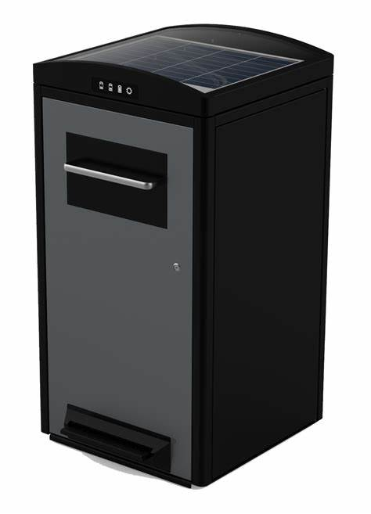
Solar-Powered Trash Compactor Bin
Overflowing bins and inefficient waste collection lead to unsanitary conditions and increased operational costs.
Introducing a solar-powered trash compactor bin that uses renewable energy to reduce waste volume and improve collection efficiency.
Solar-Powered: Harnesses solar energy to power the compactor.
Compactor Mechanism: Compresses waste, increasing bin capacity.
Smart Monitoring: Sensors detect when the bin is full, triggering alerts.
Cost-Effective: Lowers waste collection frequency, saving costs.
Efficiency: Prevents overflow, keeping the environment clean.

