Slide 1
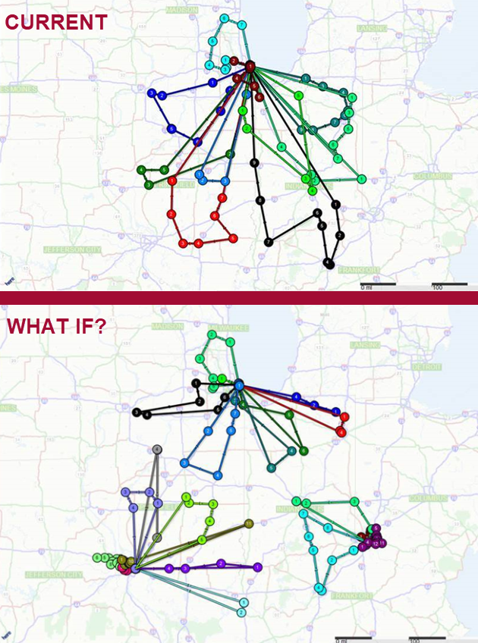
Waste Prediction System
Inefficient waste collection due to unpredictable waste volumes leads to higher operational costs and resource wastage.
An app that predicts waste generation based on historical data and trends, optimizing collection routes and schedules
Prediction Algorithm: Uses historical data and machine learning to forecast daily waste volumes.
Route Optimization: Dynamically adjusts routes for collection vehicles based on predicted waste levels.
Cost Savings: Lowers operational costs by minimizing fuel consumption and labor hours.
Scalability: Can be implemented in various regions and adapted for different waste types.

