Slide 1

Moody Bot
Java Project 2019
Erica Moisei

Slide 2
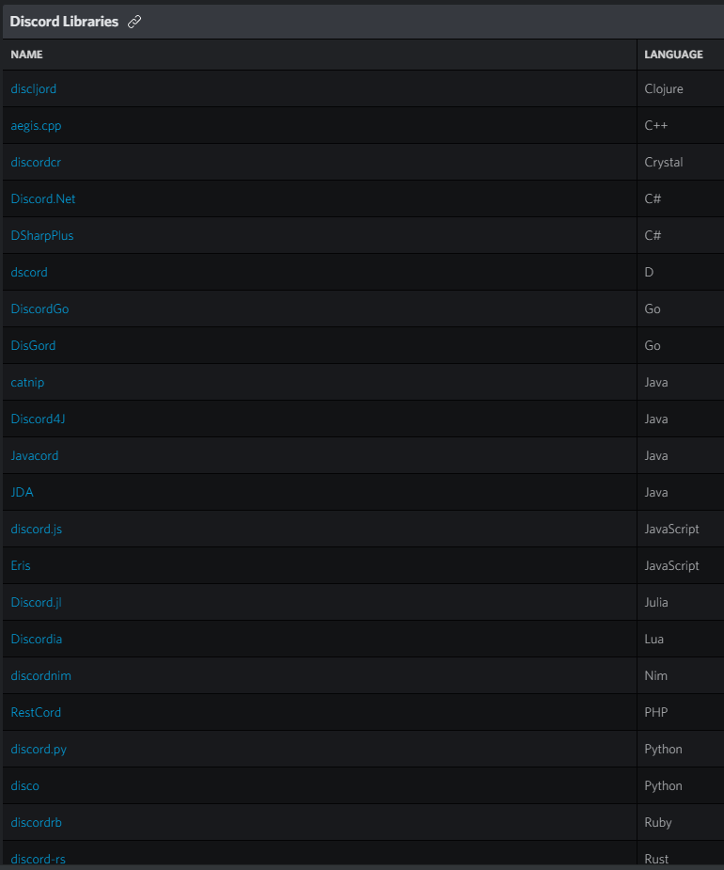

Moody Bot Chat Bot
Discord has many libraries that help to develop chat bots and other custom features.
For this project has been used JDA (Java Discord API) Library.
It strives to provide a clean and full wrapping of the Discord REST api and its Websocket-Events for Java.
Notes:
Moody Bot is a Discord chat bot.
To implement the functionality I choose JDA (Java Discord API) Library that uses web sockets for connection with the chat using TOKEN.
As you can see on the image Discord has many libraries written in different languages, which help to develop chat bot and a large variety of its functionality.
These libraries help to implement the functionality much easier.
The bot has different reactions on the specific events that are coaming from the chat.

Slide 3
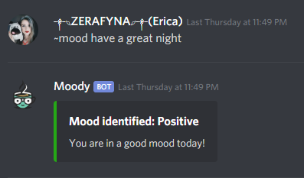
Initial Concept
Moody bot will identify user’s sentiments by analyzing their messages.
Mood Types: Very Positive, Positive, Neutral, Negative, Very Negative.
Response Messages: Randomly chosen from the provided list of responses per each mood type.
Bot is tracking the statistic of the analyzed messages when tracking config is ON.
When anonymous mode is ON the author of the message won’t be recorded.
Each message has its value, and the overall value can be calculated by request.
Analyzed message logs and bot’s configurations are saved to database (MySQL).
Notes:
The purpose of Moody Bot Application is to identify user’s sentiments by analyzing messages.
The bot will receive a message, analyze it, and reply with the identified mood, and a random response sentence according to the detected mood.
There are 5 types of the mood: Very Positive, Positive, Neutral, Negative, Very Negative.
Moody Bot is recording statistic of the analyzed messages when the tracking config is ON.
When anonymous mode is ON the author of the message won’t be recorded.
The logs are saved to the database (MySQL).
Each message has its value, and the overall value for the chat or user can be calculated by request.

Slide 4
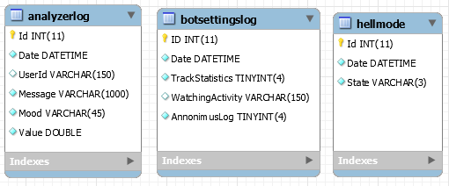
Database Schema
Notes:
Here is the database schema. As you can see I ended up implementing more functionality.

Slide 5
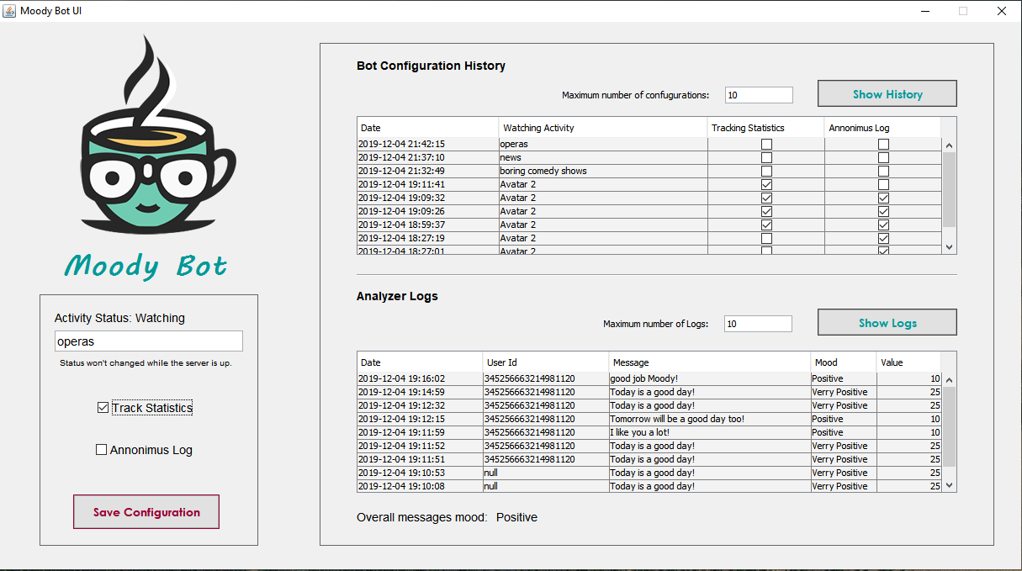
User Interface
Notes:
We have user interface application where the Bot can be configured. It is a different application. Its main purpose it to configure the bot and also see some database logs.
Add Watching Activity for the bot
Turn on Statistics
Turn off Anonymous for test

Slide 6
New Configuration Notification
Using UI, when saving bot’s configuration to database we need to notify the Server (Moody Bot App) about the new configurations.
TCP Server
TCP Client
TCP connection
Moody Bot App
Moody Bot UI
Database
Notes:
GRPC – Google open source framework

Slide 7
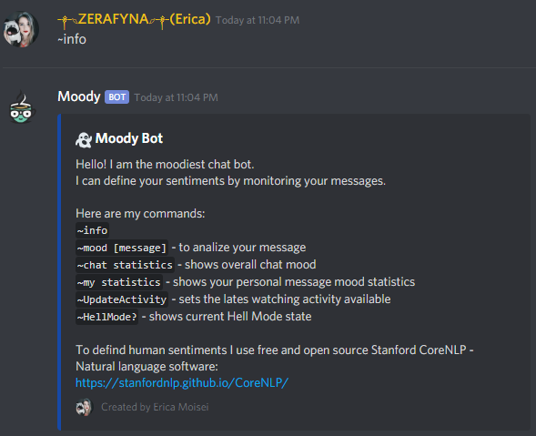
Chat commands
~info
~mood [message - one or more sentences]
~chat statistics
~my statistics
~UpdateActivity
~HellMode?
~HellMode [on/off] – admin only
Other features:
A notification message is sent to the chat on member join / leave.

Slide 8

HOW DOES THE ANALYZING WORK?
Notes:
Many of you probably already had this question: How does the analyzing works?

Slide 9
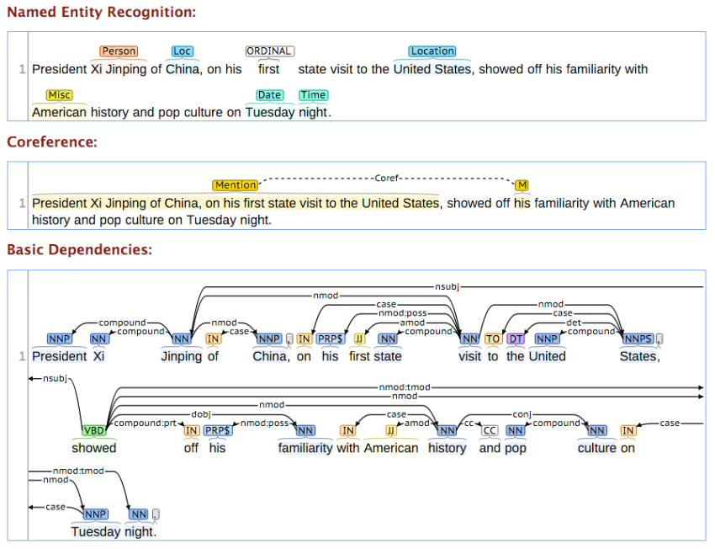
Stanford CoreNLP
About
Stanford CoreNLP provides a set of human language technology tools. It can give the base forms of words, their parts of speech, whether they are names of companies, people, etc., normalize dates, times, and numeric quantities, mark up the structure of sentences in terms of phrases and syntactic dependencies, indicate which noun phrases refer to the same entities, indicate sentiment, extract particular or open-class relations between entity mentions, get the quotes people said, etc.
Notes:
To analyse messages I used a free and open source Stanford Natural Language Processing library.
Stanford CoreNLP provides a set of human language technology tools. It can give the base forms of words, their parts of speech, whether they are names of companies, people, etc..
The library uses a Recursive Neural Tensor Network (RNTN), which algorithm first splits a sentence up into individual words, and then constructs a neural network where the nodes are the individual words. Finally, a tensor layer is added so that the model can properly adjust for interactions between the words and phrases.

Slide 10

More about CoreNLP
Human languages supported: English, Arabic, Chinese, French, German, and Spanish.
Stanford CoreNLP is written in Java; recent releases require Java 1.8+.
Stanford CoreNLP can be downloaded from their website or GitHub.
The application must be a Maven application.
Maven is a build automation tool used primarily for Java projects. Also can be used to build and manage projects written in C#, Ruby, Scala, and other languages.
Maven’s primary goal is to allow a developer to comprehend the complete state of a development effort in the shortest period of time.
License: The full Stanford CoreNLP is licensed under the GNU General Public License v3 or later.
Notes:
CoreNLP supports 5 human languages and is written in Java.
It can be downloaded from their website or GitHub.
To use the library we need to use a Maven application.
It is a build automation tool used primarily for Java projects, and its goal is to comprehend complete state of a development effort in the shortest period of time.

Slide 11
Time for Testing!
Get the invitation link
Students: Please check Discord seniors chat
Instructor: Please check email
or type in the browser the link below
https://discord.gg/mR4Gkkd
Notes:
I hope that you are ready for testing the Moody Bot. You will get the links shortly.

Slide 12

WARNING! HELL MODE
When the Hell Mode is ON the user will be given a role according to their overall mood statistics.
Statistic applies after five recorded messages sent by the same user. Custom colors are applied for each role.
Angels – personal statistics of 10 and more
Folks – personal statistics between -10 and 10
Devils – personal statistics of -10 and below
Devils chat restrictions: no emojis, no reactions, no sending files, no voice, no live.
Notes:
When the Hell Mode is ON the user will be given a role according to their overall mood statistics.
Statistic applies after five recorded messages sent by the same user. Custom colors are applied for each role.
Folks – personal statistics between -13 and 13.
Devils chat restrictions: no emojis, no reactions, no sending files, no voice, no live.

Slide 13
Chat commands
~info – general information about the bot
~mood [message - one or more sentences] – NLP
~chat statistics – overall chat mood
~my statistics – personal mood statistics
~UpdateActivity – updates watching activity from db
~HellMode? – shows current Hell Mode state
~HellMode [on/off] – turn on/off Hell Mode (admin only)
Notes:
Turn on Hell Mode
Update Watching activity

Slide 14
Q&A
SECTION

Slide 15
THANK YOU!
Erica Moisei & Moody Bot

