Slide 1

NAME AND SURNAME:ZARBALI HAKHVERDIYEV
GROUP:6224E
SUBJECT: STRUCTURE AND ALGORITHMS OF DATA
THEME: Music Playlist Organizer – Use Circular Linked List to manage songs in a looping playlist.

Slide 2
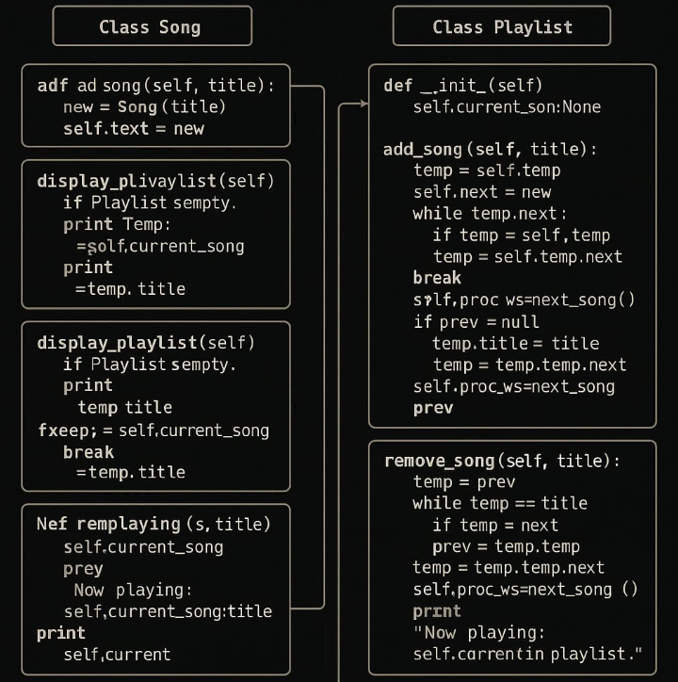

Slide 3
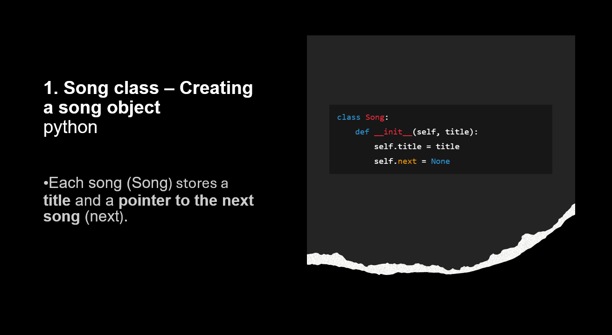

Slide 4
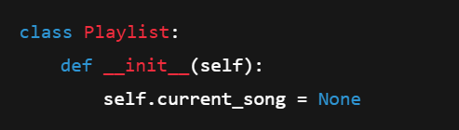

2. Playlist class – Managing the playlist
The Playlist holds a reference to the currently playing song (current_song).
Initially, the playlist is empty.

Slide 5

3. Beginning of add_song() function – Adding a new song
python
Creates a new Song object for the added song title.

Slide 6

4. Adding the first song (when playlist is empty)
python
If the playlist is empty:
The new song becomes the first song.
Its next pointer refers to itself (because it’s circular).

Slide 7
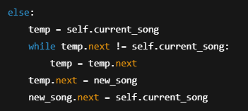
5. Adding a song when the playlist is not empty
python
If there are already songs:
It moves to the last song.
Links the new song at the end.
The new song’s next points back to the start of the playlist.

Slide 8
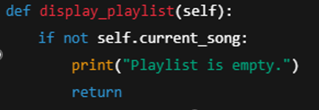
6. display_playlist() function – Showing the playlist
If the playlist is empty, it prints "Playlist is empty".

Slide 9
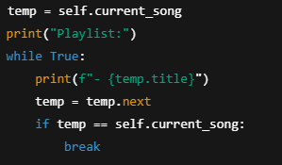
7. Printing all songs in the playlist
python
It traverses the playlist and prints all song titles.
When it loops back to the starting song, it stops.

Slide 10
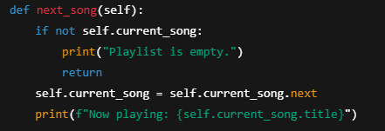
8. next_song() function – Moving to the next song
python
Changes current_song to the next song.
Prints the now playing song: "Now playing: ...".

Slide 11
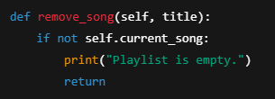
9. Beginning of remove_song() function – Removing a song
python
If the playlist is empty, removing is not possible.

Slide 12
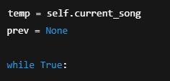
10. Starting the loop to find the song
python
temp → currently checked song.
prev → keeps track of the previous song.

Slide 13
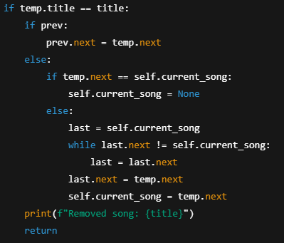
11. Removing the found song
python
If the song is found:
If it’s the first song, special handling is required.
Otherwise, just update the previous song’s next pointer.

Slide 14
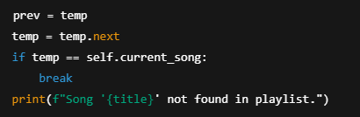
12. If not found, or after removing, exit
python
If the whole playlist is traversed and the song isn’t found:
Prints: "Song '...' not found".

Slide 15


