Slide 1








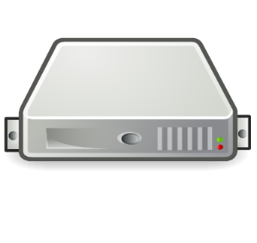

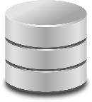
SDK or API Consumers
Connect to any node (or use loadbalancer)
Kvpbase Storage Server Nodes
Shared external database for metadata
Shared filesystem storage for data

