Slide 1



Coaching
PoseScreen
react-native-vision-camera
Youtube
videos of
players
frame
frame 1
frame n
FFmpeg
useFrameProcessor(
frame)
…
ref frame 1
ref frame n
frame
…
pose 1
…
pose n
detectPose(frame)
Skia /
SVG
frame
pose
poses
PoseDetection
native code (Kotlin / Objective C)
react-native-sqlite-storage
..
Yellow – player’s poses
Red – reference poses
reference
poses
ref pose 1
ref pose n
…
Phone storage
Store reference poses

Slide 2
How it works
PoseScreen uses react-native-vision-camera to capture video from the device’s camera and processes it frame by frame using the useFrameProcessor(frame) hook.
useFrameProcessor calls detectPose(frame), which invokes native code that uses Google’s MLKit Pose Detection to return pose data for each frame.
The Camera component from react-native-vision-camera is used to display the live video feed on the screen.
Skia or SVG is used to draw the detected poses over the video in real time.
Reference poses are retrieved from the phone’s local storage using the SQLite database API, and they are drawn on the screen alongside the live poses.
Offline, a script scrapes YouTube videos of professional players. It uses FFmpeg to extract video frames, then applies the same pose detection process to generate reference poses, which are stored in the SQLite database on the phone.

Slide 3
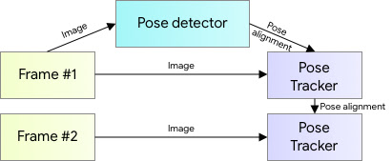
Google’s MLKit Pose Detection
See the blog
The first image is passed to Pose detector which identifies the face. It is then passed to Pose Tracker to calculate the initial pose. This pose serves as the reference for all subsequent poses.
All remaining images are passed directly to the Pose Tracker to calculate their corresponding poses based on this reference.

Slide 4
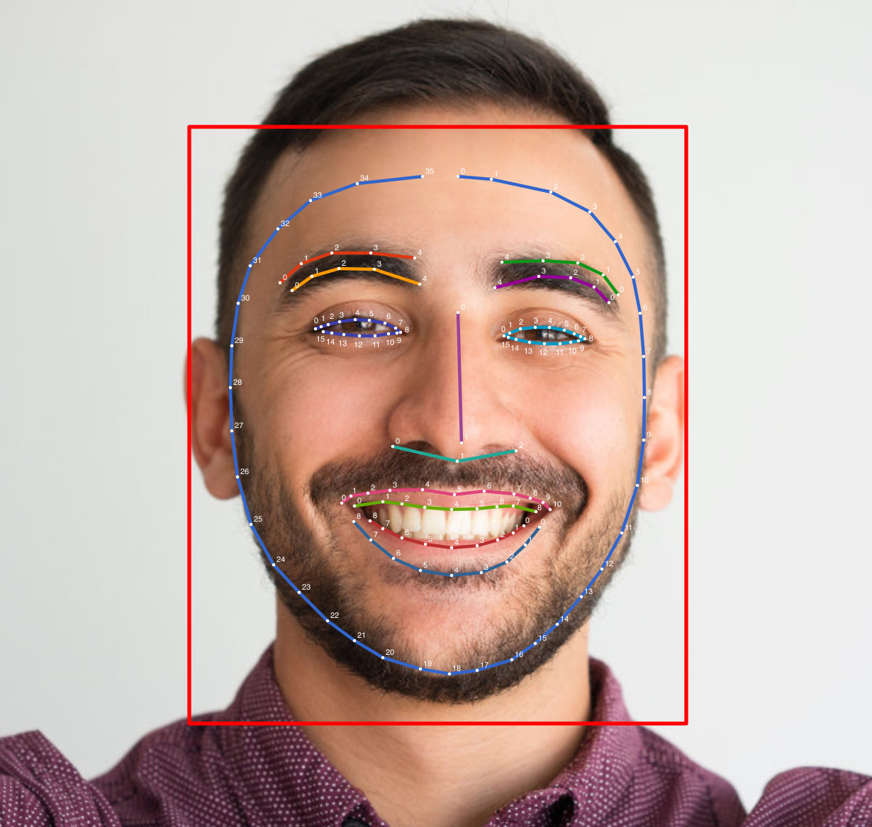
Face Detection
See the documentation
Look for face in the image or video frame
Find key points on the face (called landmarks) like:
Eyes
Nose
Mouth
Ears
…etc
Optionally, calculate points around each detected landmarks
Draw a rectangle bound box around each detected face
Use CNN for face detection
Copyright Google®

Slide 5
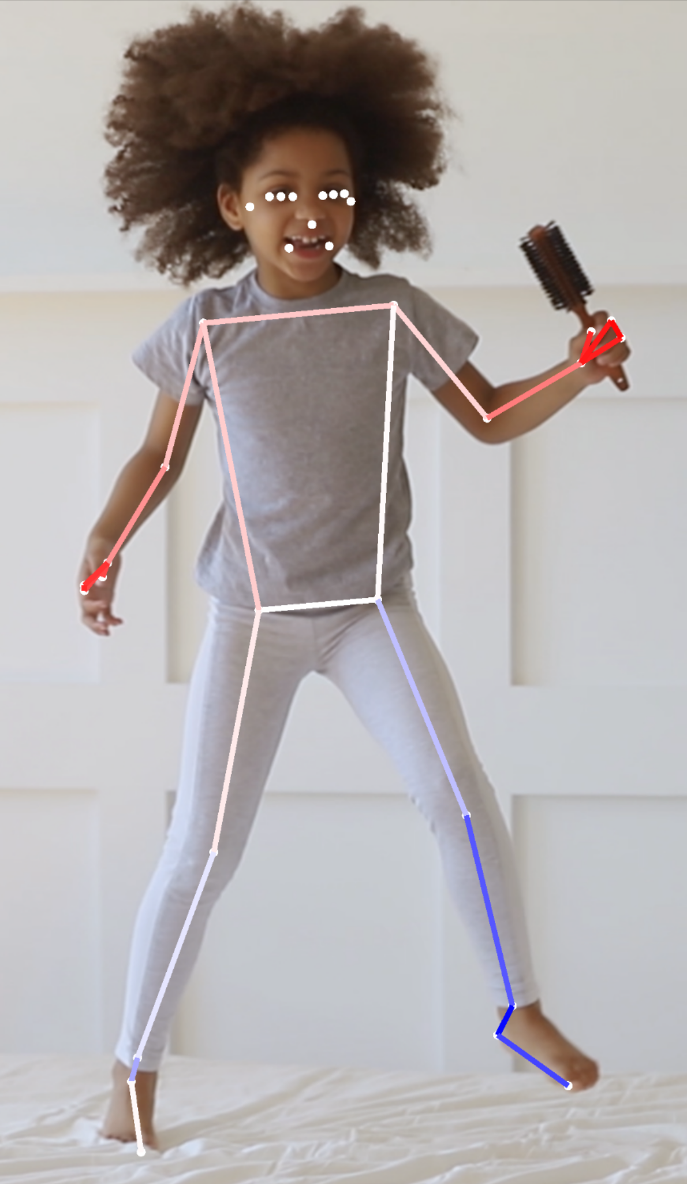
Pose Detection
Look for the person and location in the image or video frame
Find key locations of 33 key body points (called landmarks) like:
Head and face points
Shoulders, elbows, wrists
Torse (hips) and lower body (knees, ankles, heels, toes_
Each landmark comes with X, Y coordinates, confidence score (0-1) and less precise Z coordinate for relative depth
Use CNN models for feature extraction such as detecting edges, shapes, body parts and joints
Copyright Google®

