Slide 1

Human Action Recognition
Computer Vision Project
Aman Pandey
Amit Srivastava

Slide 2
Dataset : UCF 101
UCF101 is an action recognition data set of realistic action videos, collected from YouTube, having 101 action categories. This data set is an extension of UCF50 data set which has 50 action categories. It consists of 13,320 videos of 101 action categories!

Slide 3
Method Used : CNN + RNN
Extract frames.
Extract features.
Pass through RNN.
Training.

Slide 4
Extract Frames
Split the dataset into train and test. (From UCF101 website)
Maintain a CSV file for holding information
Extract frame
Sub-sampled to 40 frames for each video
Pass to Inception V3 model

Slide 5
Extract Features
Inception V3 model is a pre-trained model on image-net dataset.
Processing :
1. Convolution Layer
2. Max Pooling
3. Relu-Layer (for thresholding)
4. Flattening
Output : 40 * 2048 matrix for each video!
Pass it to Recurrent Neural Network

Slide 6
Recurrent Neural Network
LSTM model provided by Keras
Passed features to this LSTM model
Added a few more layers
Finally a layer with soft max activation gives the predicted class

Slide 7
Results
Our model reached about 75% test accuracy and loss is 1.006
Top 5 categorical accuracy is about 93%

Slide 8
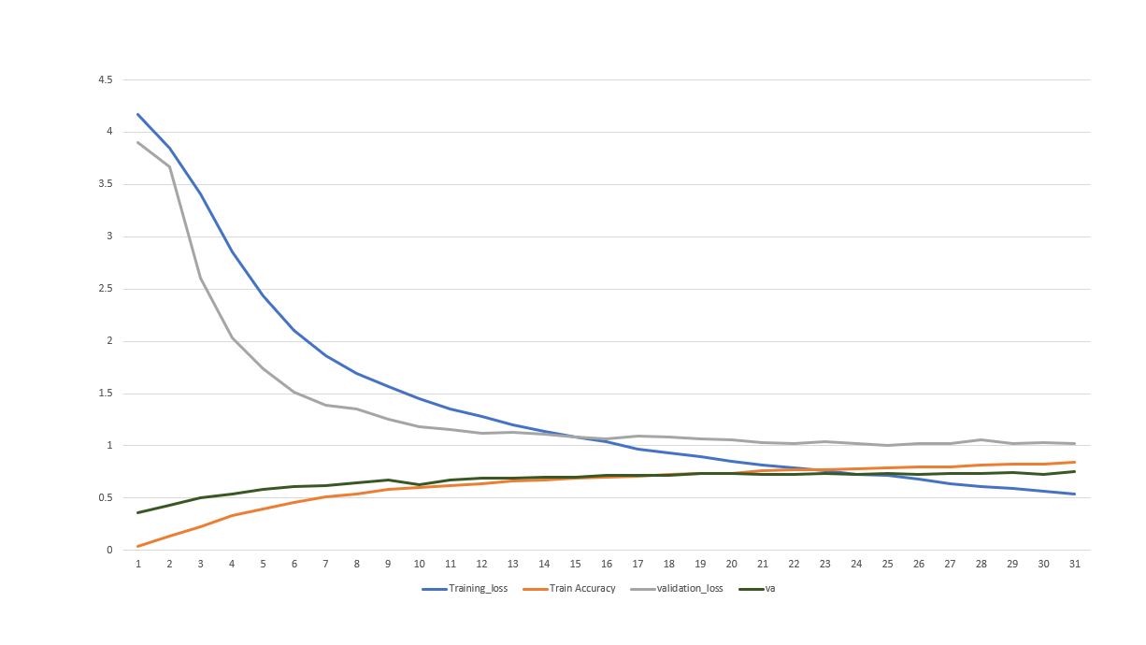

Slide 10
Why Inception V3?
In an Image Classification size of salient features can considerably vary within image frame.
Hence, deciding on fixed kernel size is rather difficult.
Larger kernels preferred for more global features that are distributed over large area of image.
Smaller kernels provide good results in detecting area specific features that are distributed across the image frame. That’s why we need kernel of variable size. Multiple kernels of different sizes are implemented within the same layer.

Slide 11
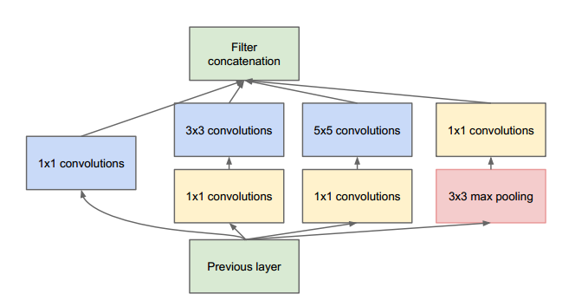
Consist of 4 options in parallel.
1*1 : depth reduction
5*5 : global features
Max-pool : low level features

