Slide 1

Final Project: Automatic Plant Watering system
By Abdulrahman Abdulbari

Slide 2
Raspberry Pi 2
Python – CoAPThon
Liquid Pump with Silicone Tubing
FC-28 Soil Moisture Sensor
N-Channel Power MOSFET – 30V / 60A
MCP3008 ADC

Slide 3
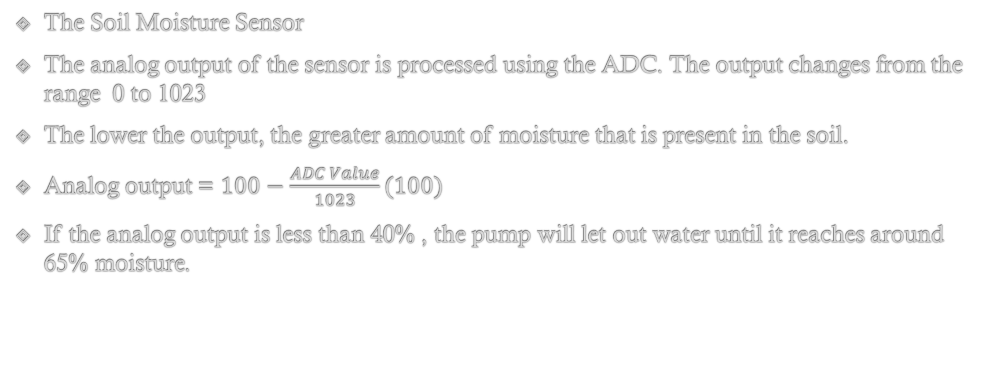
Soil Moisture Sensor Output
The Soil Moisture Sensor
The analog output of the sensor is processed using the ADC. The output changes from the range 0 to 1023
The lower the output, the greater amount of moisture that is present in the soil.
Analog output = $100−\frac{ADC Value}{1023}(100)$
If the analog output is less than 40% , the pump will let out water until it reaches around 65% moisture.

Slide 4
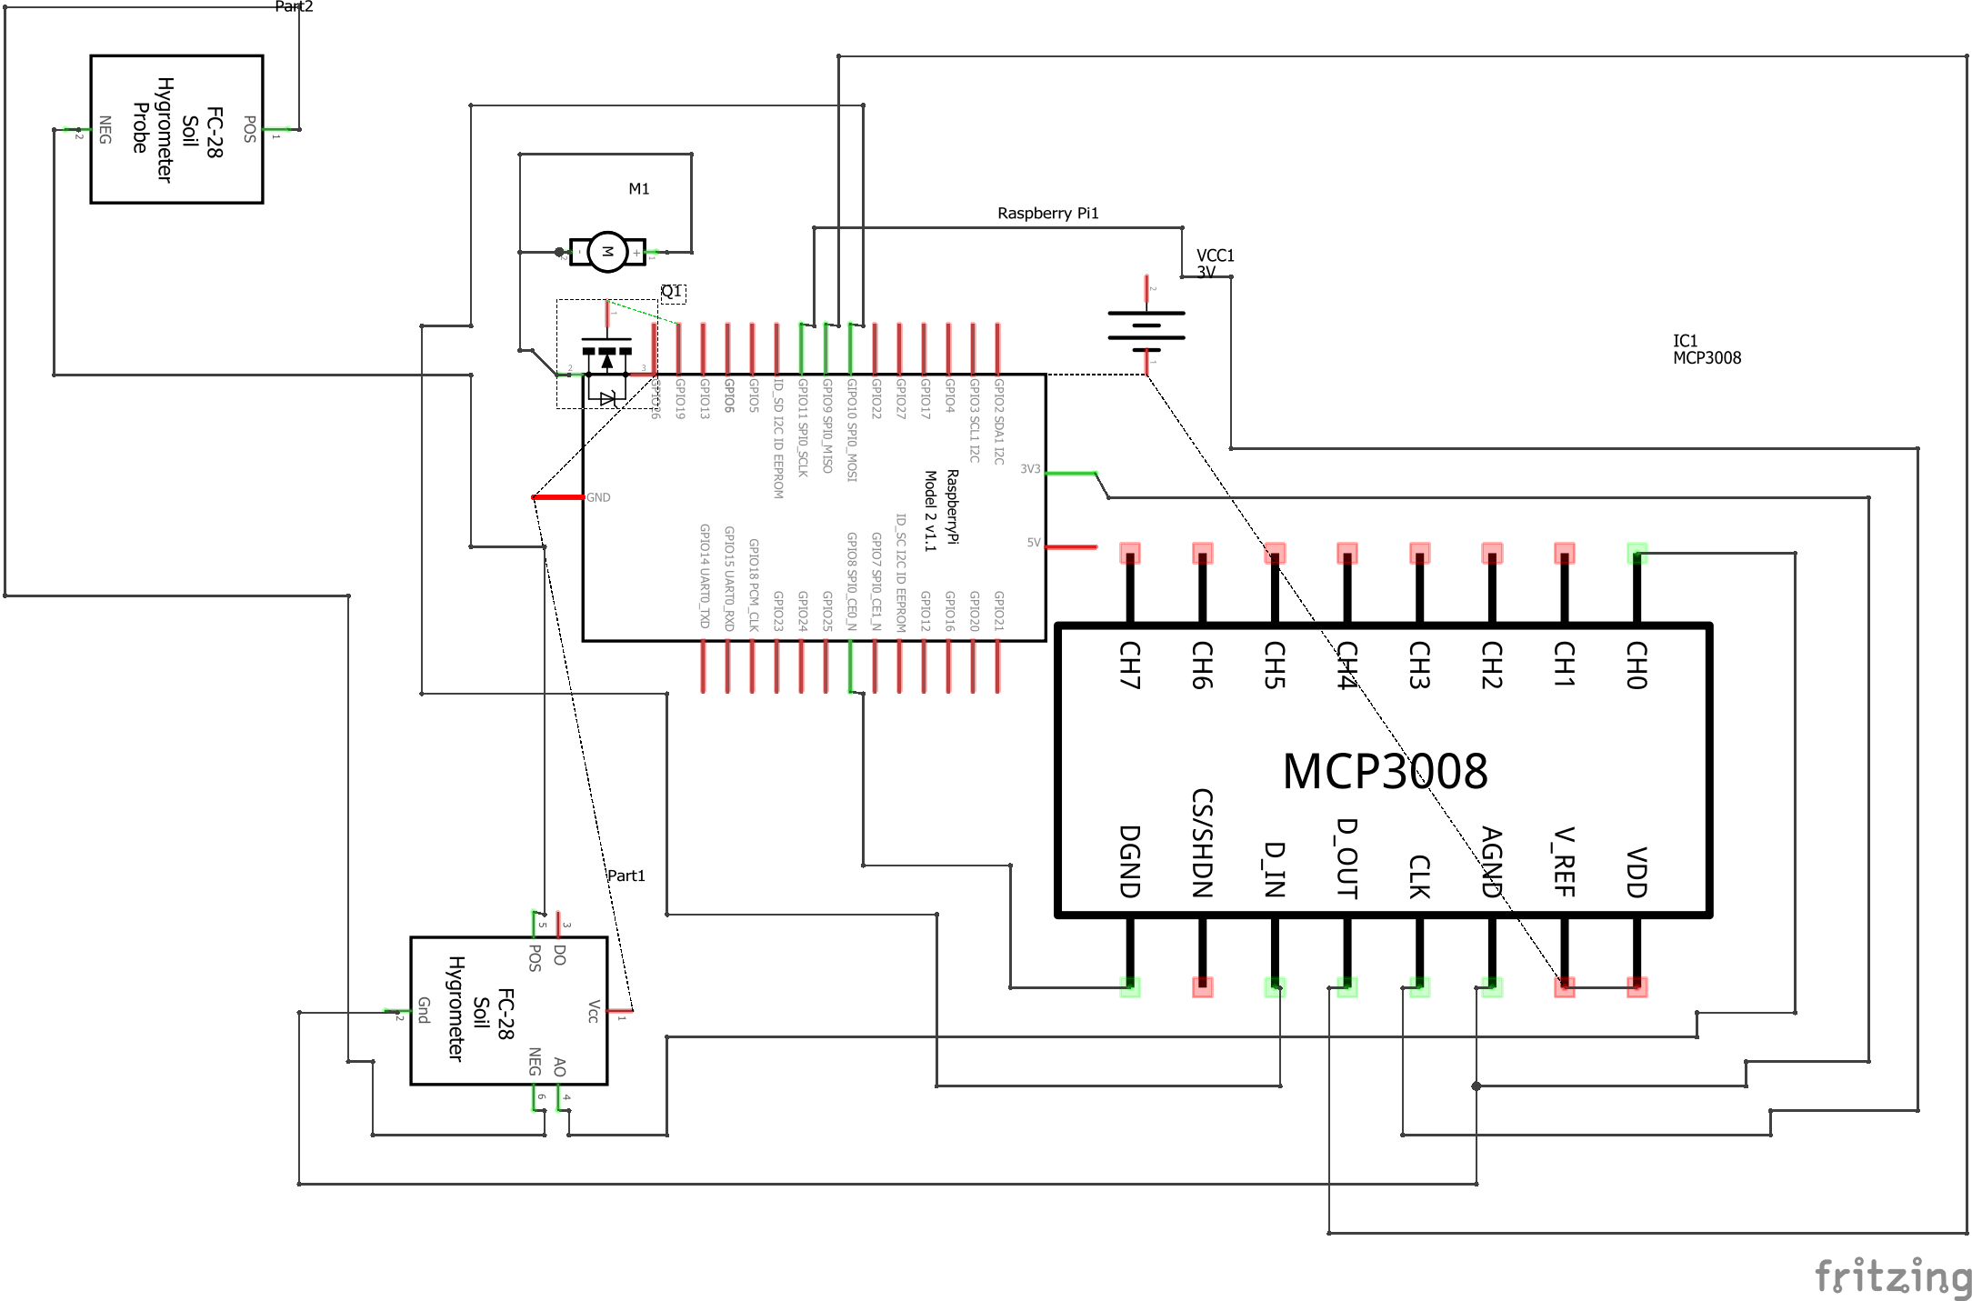

Slide 5
