Slide 1
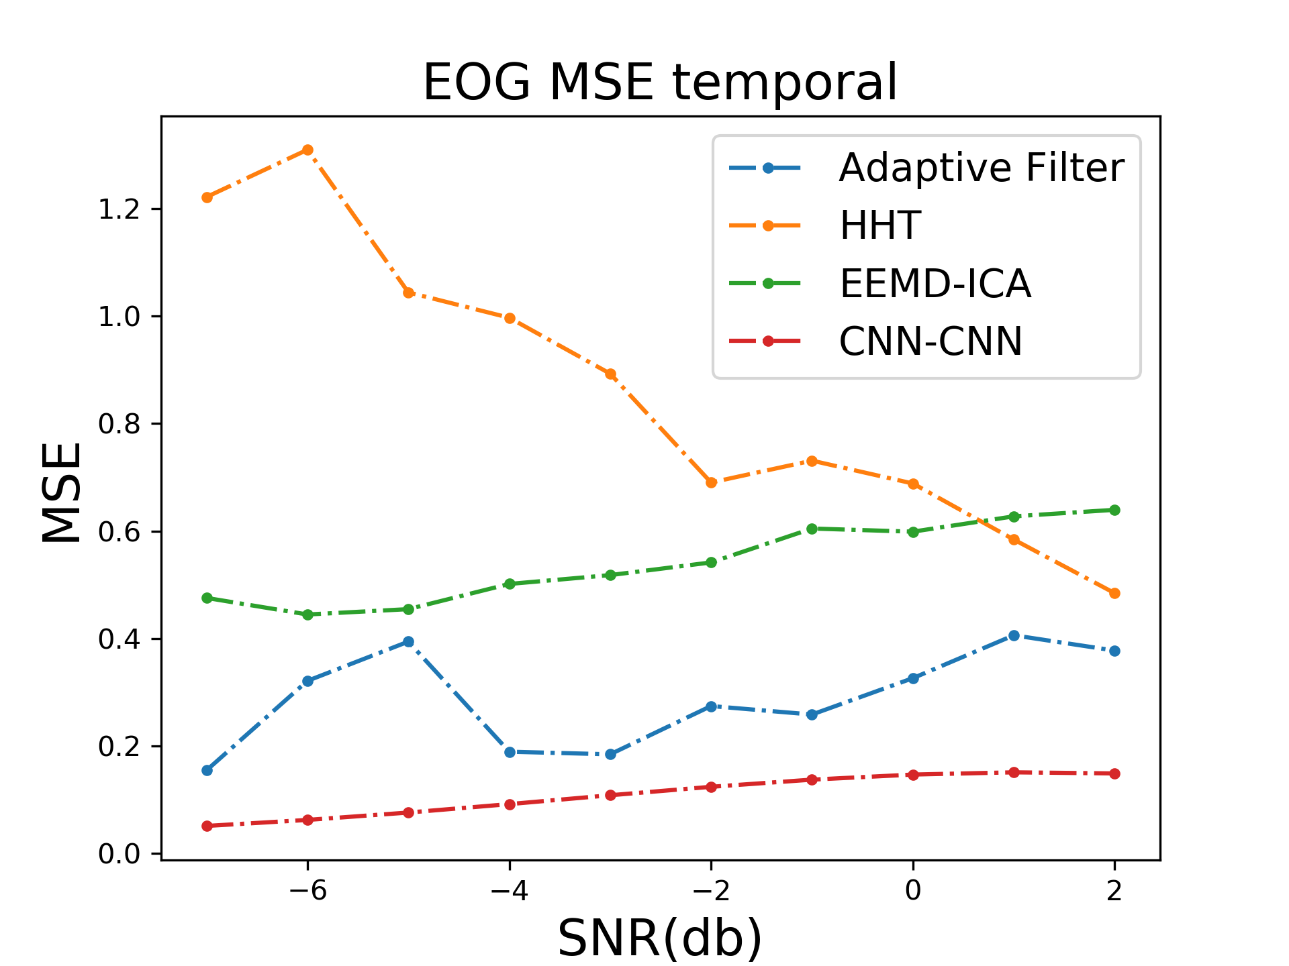
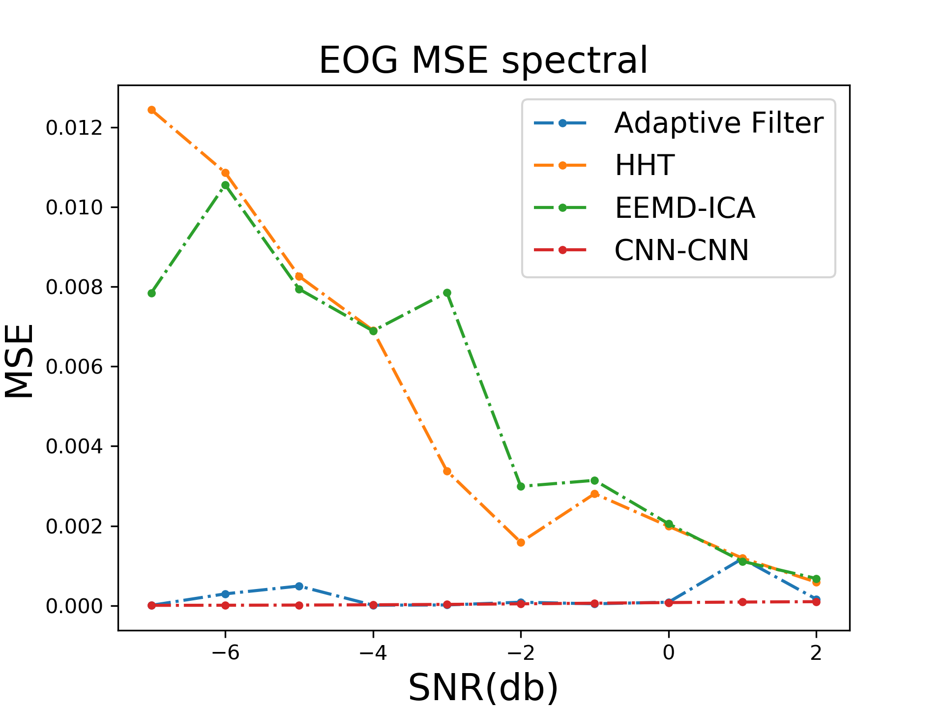
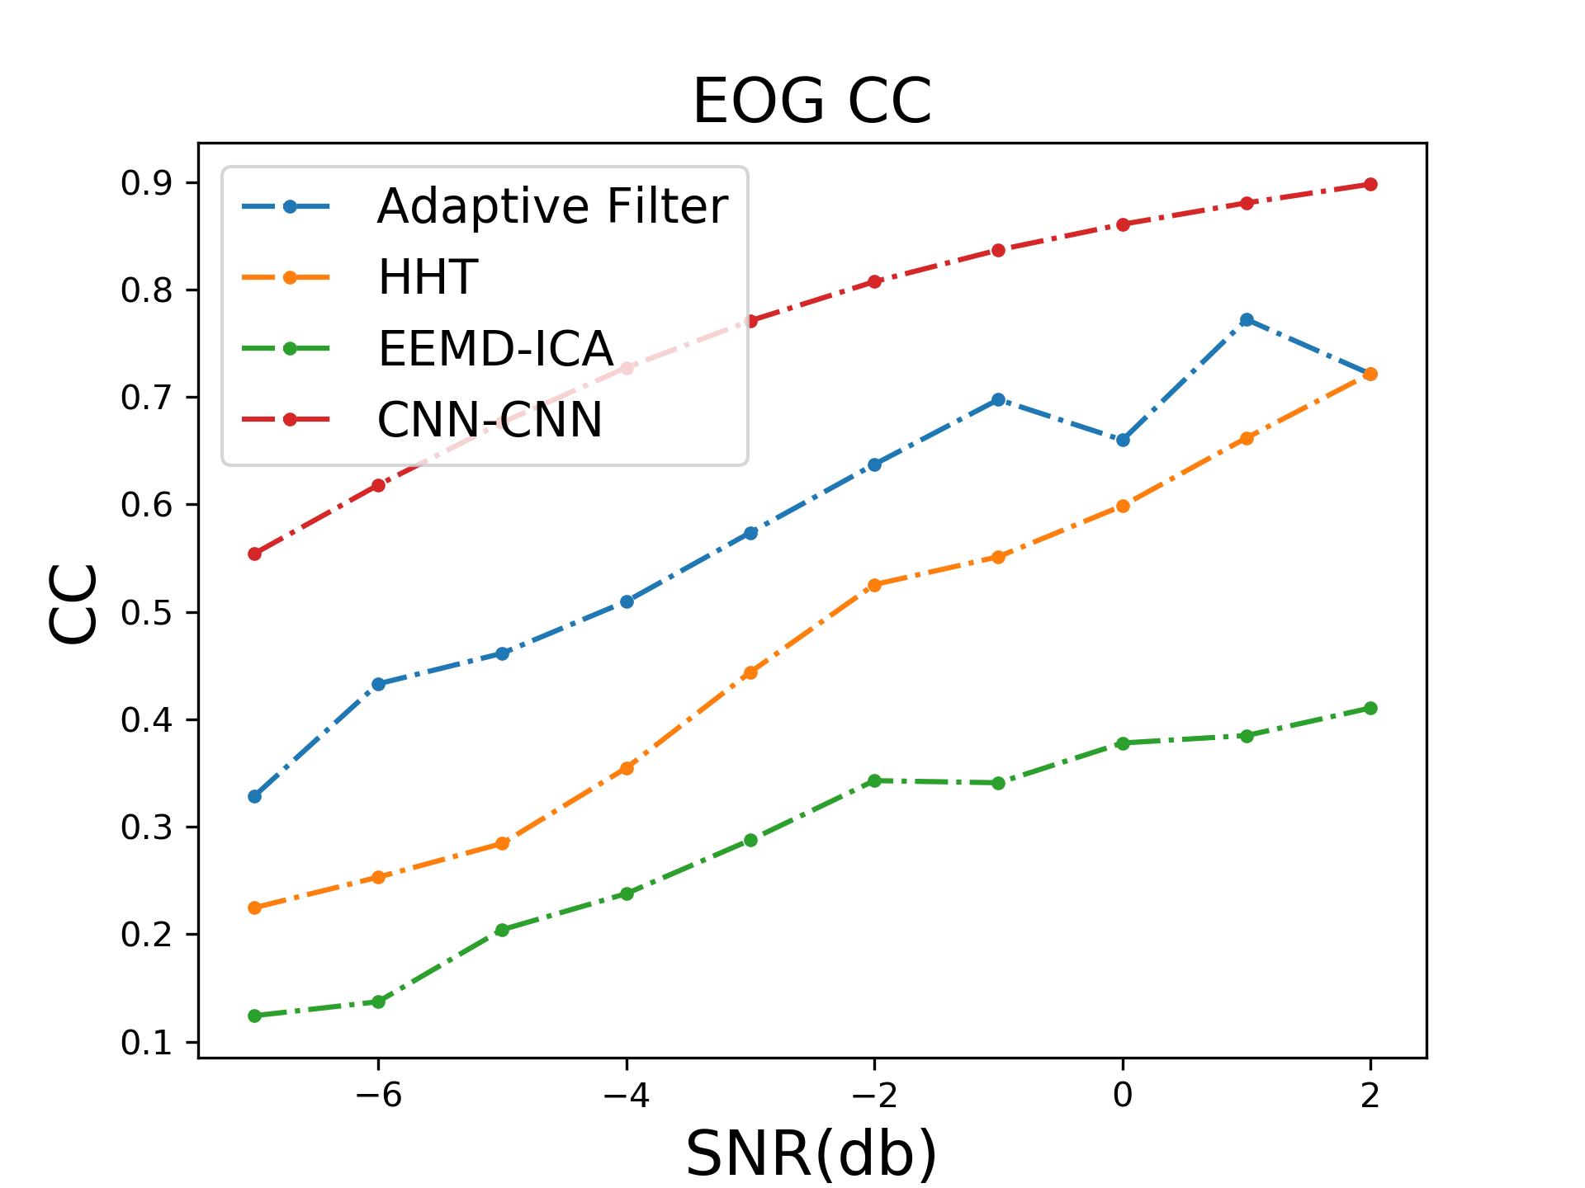
(a) EOG MSE temporal
(b) EOG MSE temporal
(c) EOG MSE CC

Slide 2
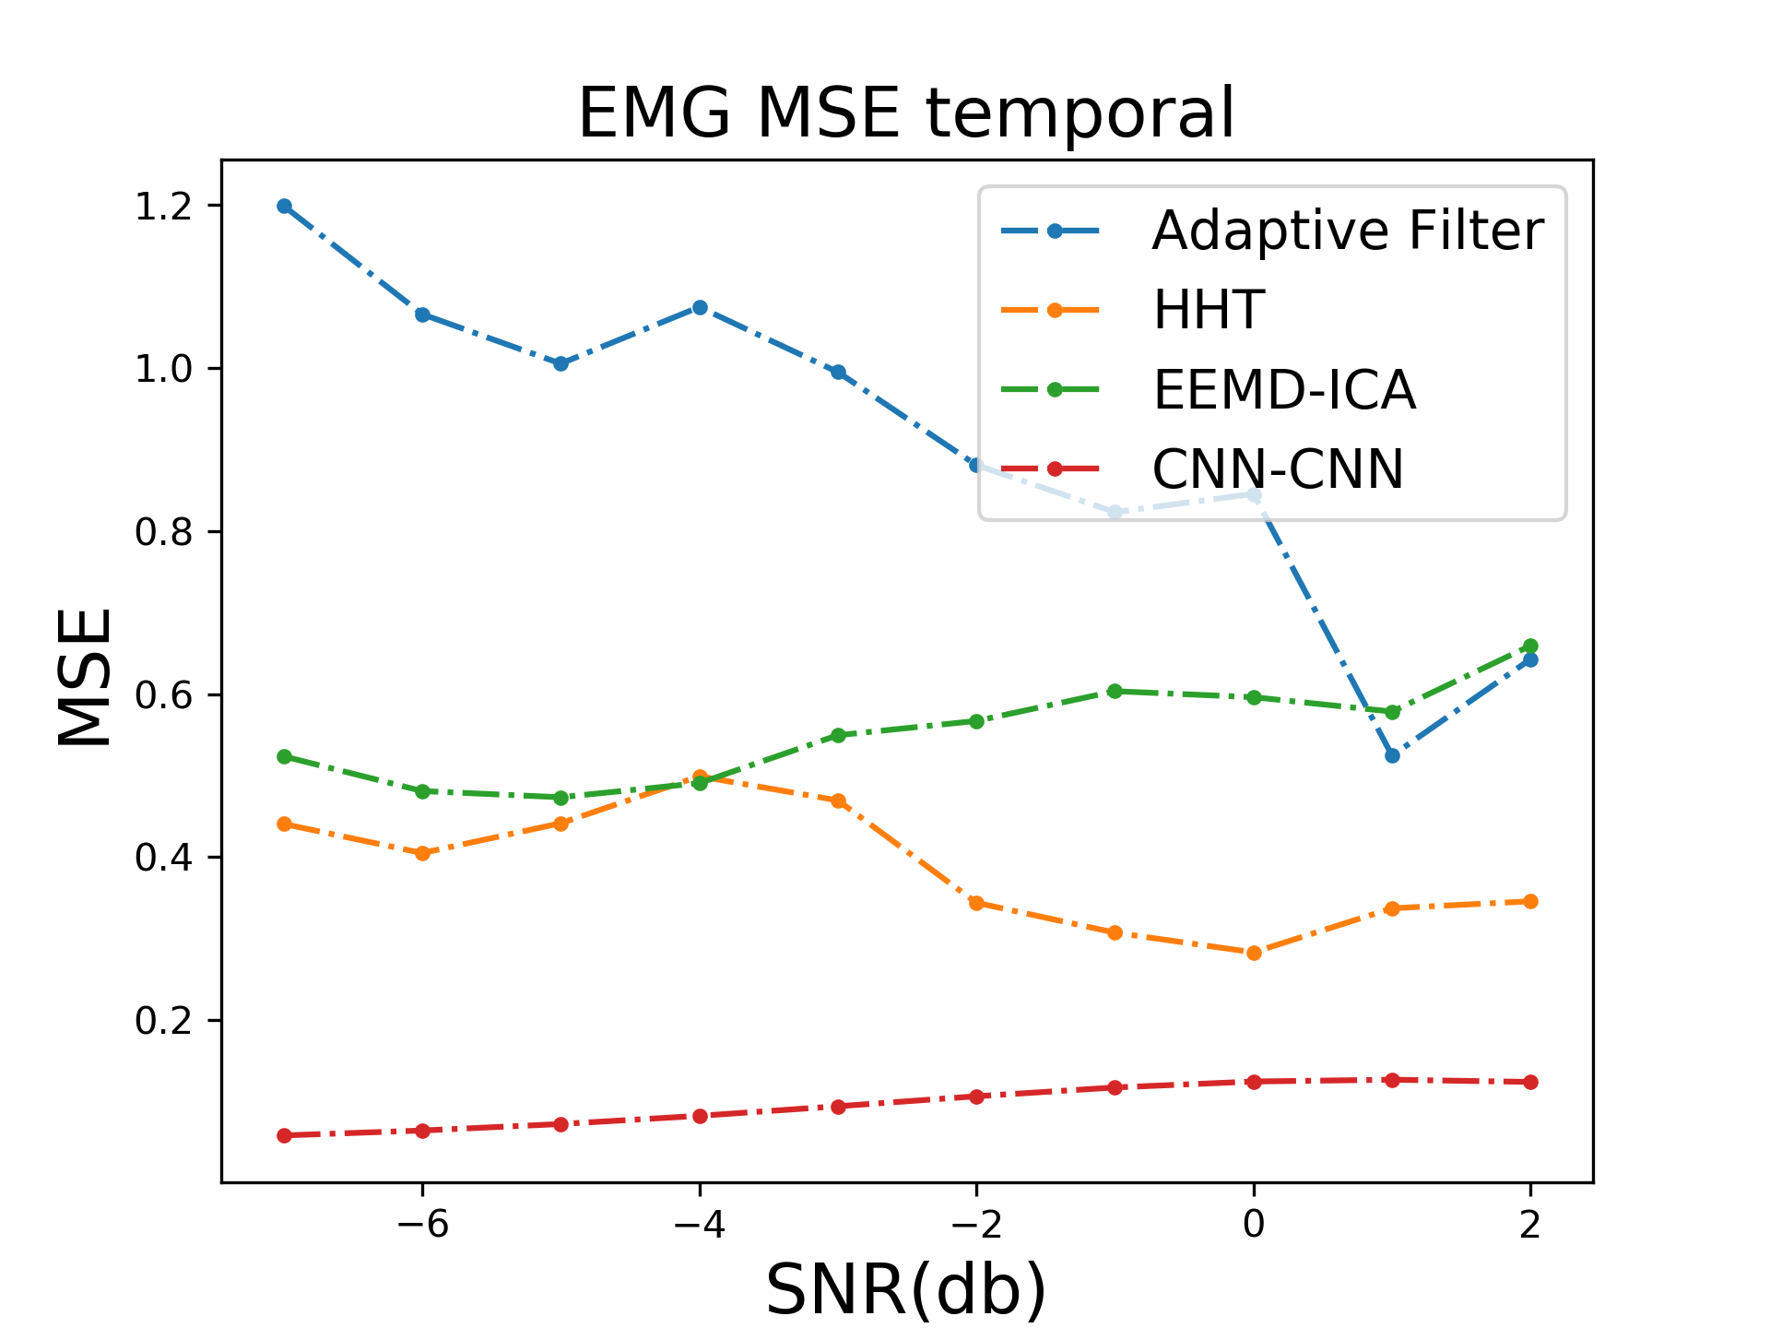
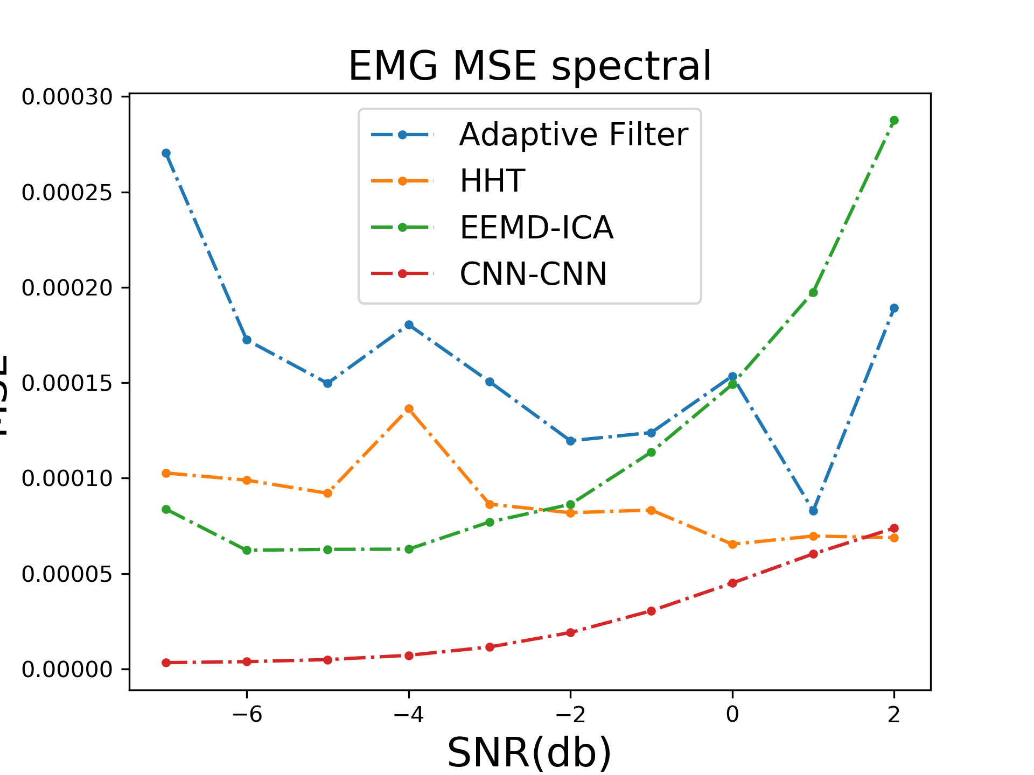
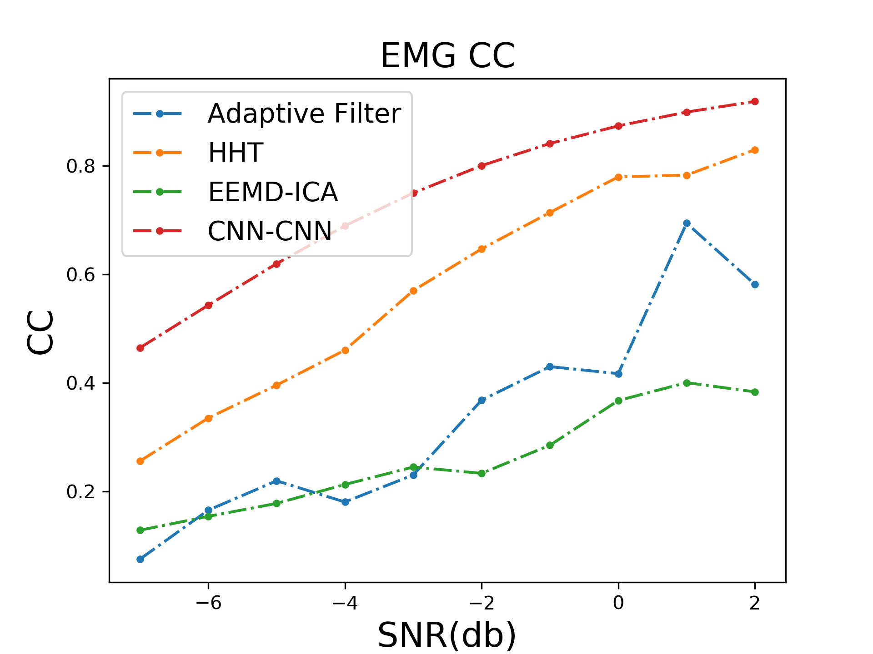
(a) EMG MSE temporal
(b) EMG MSE temporal
(c) EMG MSE CC

Slide 3
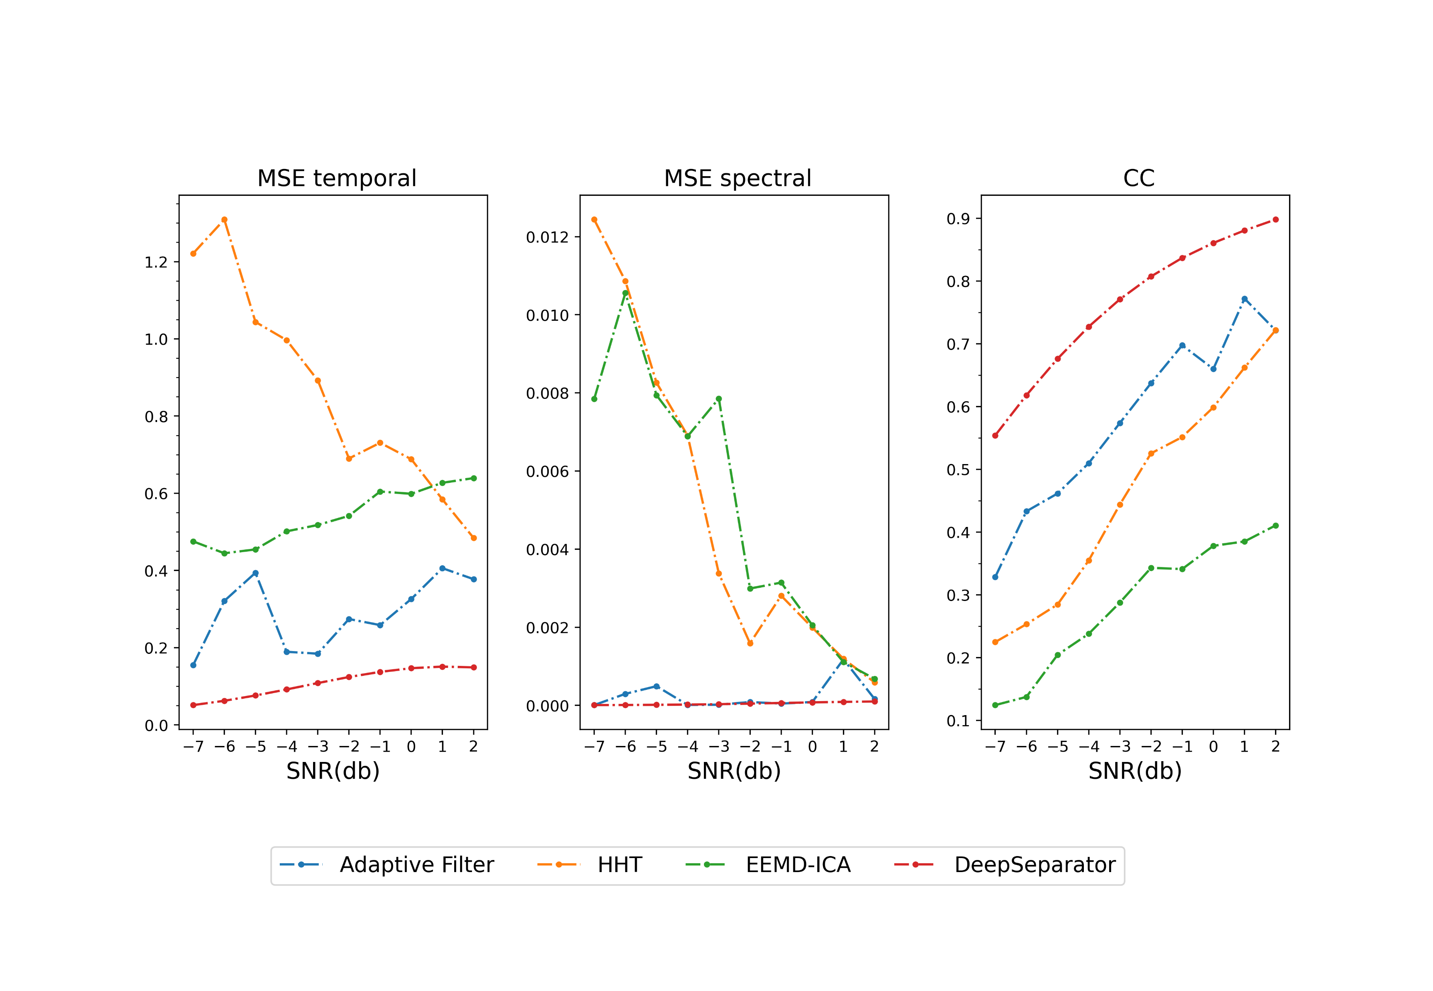
(a) Ocular artifact removal

Slide 4
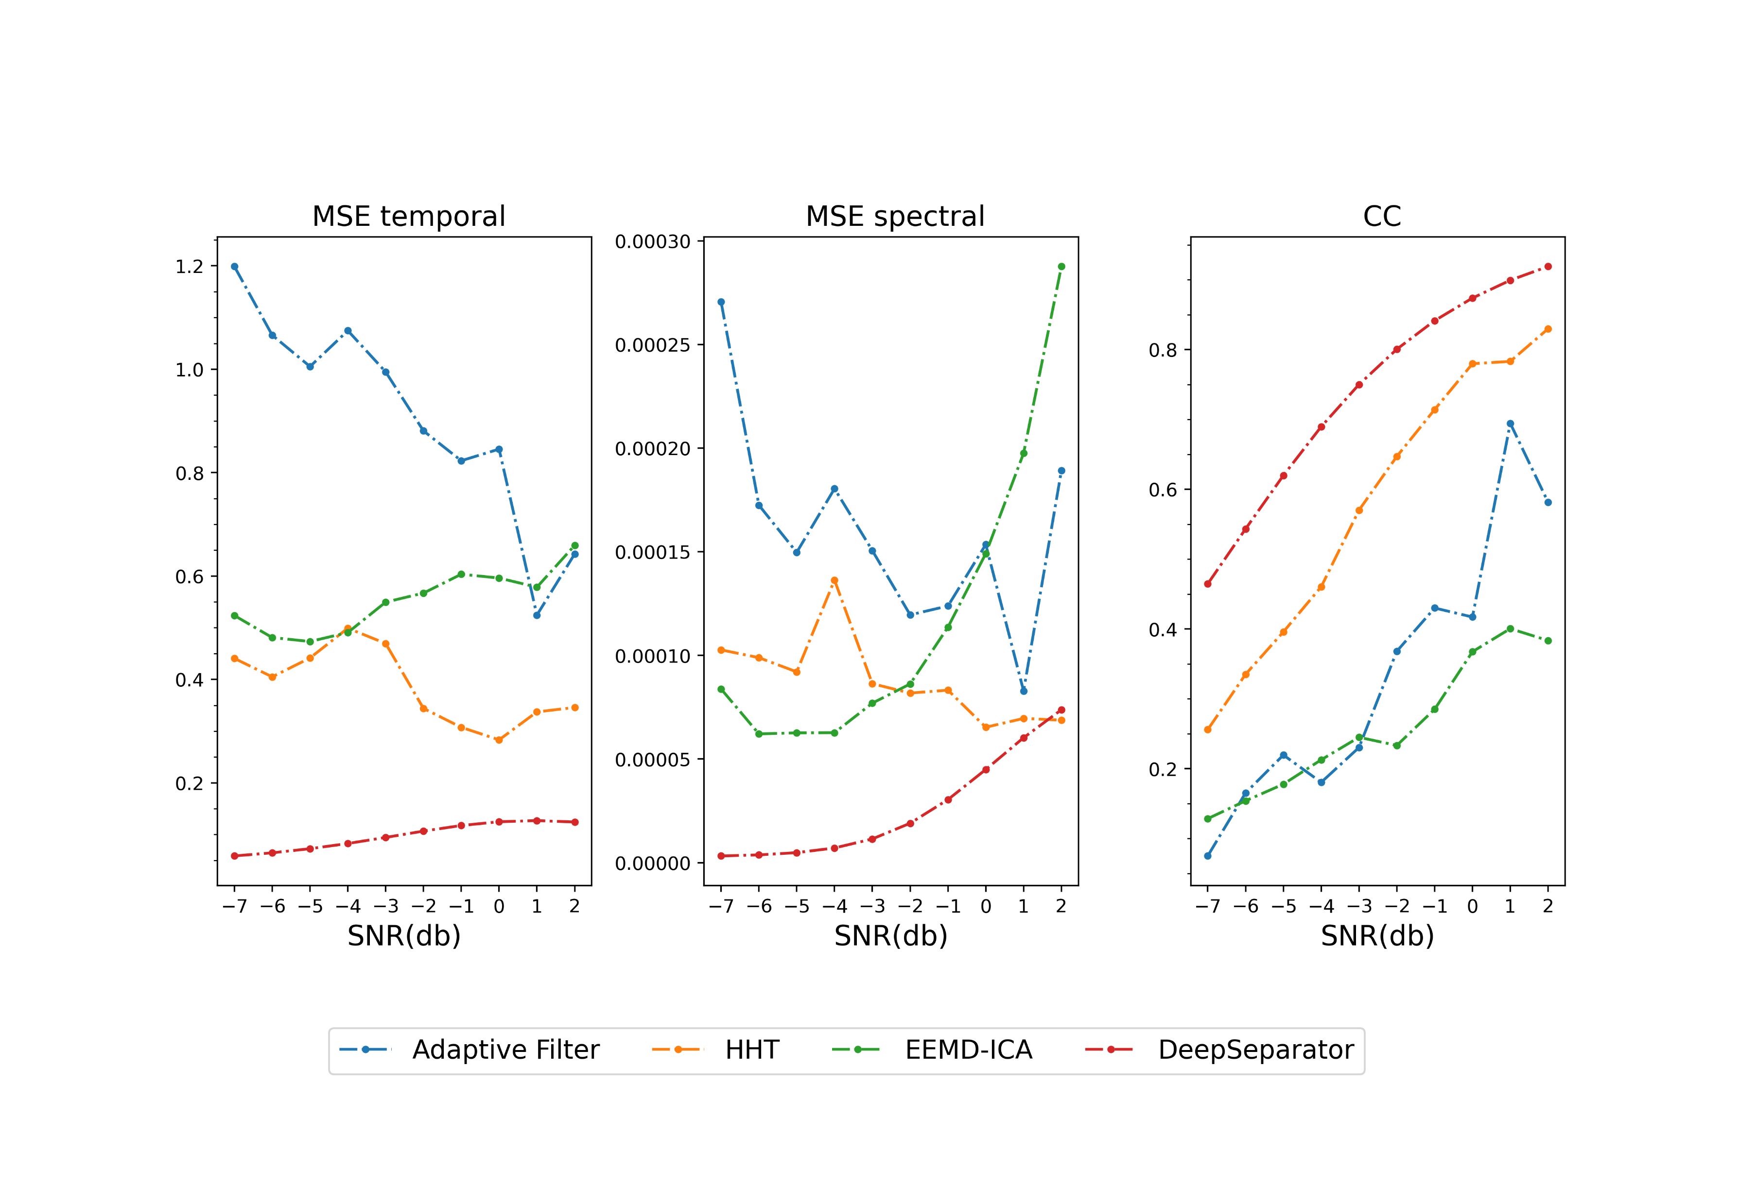
(b) Myogenic artifact removal

