Slide 1
__init__ HBNB – Console (v1)
BY CHRIS STAMPER FT. BEN ‘TIGER PAWS’ Sbanotto

Slide 2
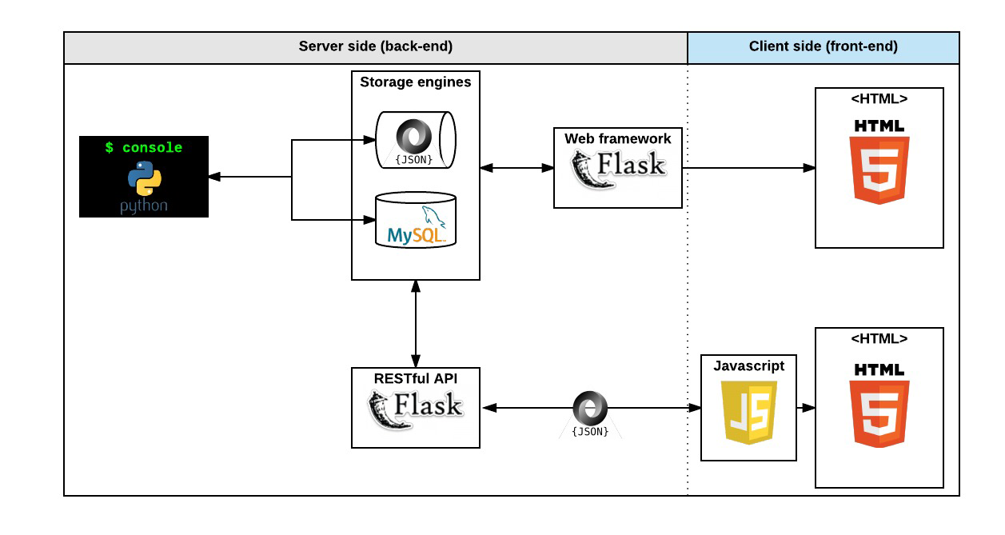
Ben Party Time

Slide 3
Ben Party Time

Slide 4
Ben Party Time

Slide 5
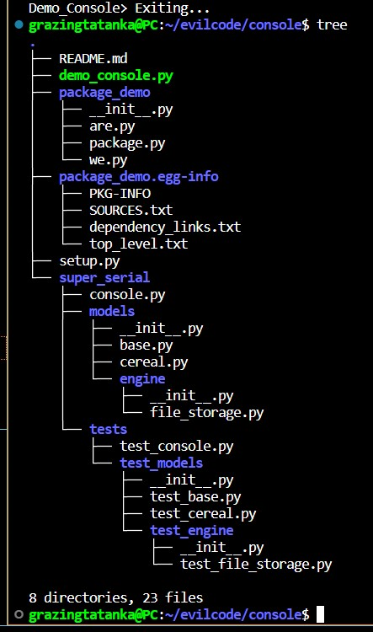
PyPack
Python packages help us stay organized! This way, similar tools, files, features, etc. can be grouped together. Packages are distinquished from directories by their __init__.py files; these files can either contain initialization code or be blank. Packages can be used in multiple separate scripts simultaneously.

Slide 6
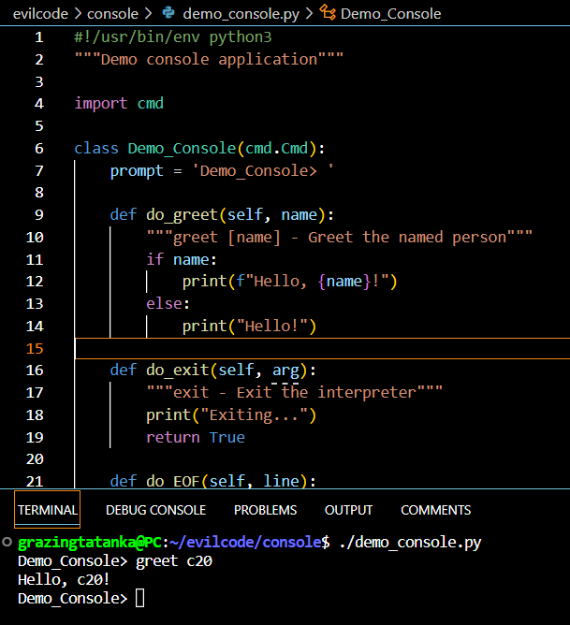
cmd Module
First import the cmd module
Create a class that inherits from the cmd.Cmd
Create a .cmdloop() of said class (class_here.cmdloop())
Set the prompt to be displayed based on tty mode
Returning True breaks us out of the loop!
EOF (End of File) signal shortcut remains Ctrl+D (do_EOF)
You now have a CLI similar to Simple Shell >:D

Slide 7
Testing test tests
Your ‘tests’ directory usually goes at the base of your project repo.
Tests directory files mirror project architecture (e.g. /models/base.py is tested in /tests/test_models/test_base.py)
REMEMBER to make a ‘tests/test_console.py’ even if it’s empty
Utilize setup && teardown methods to govern behavior before and/or following a test (e.g. reset storage)
Have fun! Testing for test tests can be frustrating, so try to enjoy it.
python3 -m unittest discover tests

Slide 8
Meet Jason!
JSON stands for JavaScript Object Notation
JSON is a lightweight data-interchange format
It is easy for humans to read and write
It's easy for machines to parse and generate
JSON is a text format that is completely language independent
Python has built in json support (import json)

Slide 9
I’m Super Serial-izing
<class 'BaseModel'> -> to_dict() -> <class 'dict'> -> JSON dump -> <class 'str'> -> FILE -> <class 'str'> -> JSON load -> <class 'dict'> -> <class 'BaseModel'>
{"Cereal.0b7b815f-137e-4d05-85db-95f8d4c840a7":
{"id": "0b7b815f-137e-4d05-85db-95f8d4c840a7",
"created_at": "2023-06-07T06:04:43.109009", "updated_at": "2023-06-07T06:04:43.109159", "name": "Cereal 19", "sugar_content": 99.99,
"fiber_content": 199.99, "is_gluten_free": true,
"expiration_date": "Neva Witches", "shelf_life_days": 365,
"flavor_complexity": "(2+3j)", "other_cereals": [], "__class__": "Cereal"}}

Slide 10
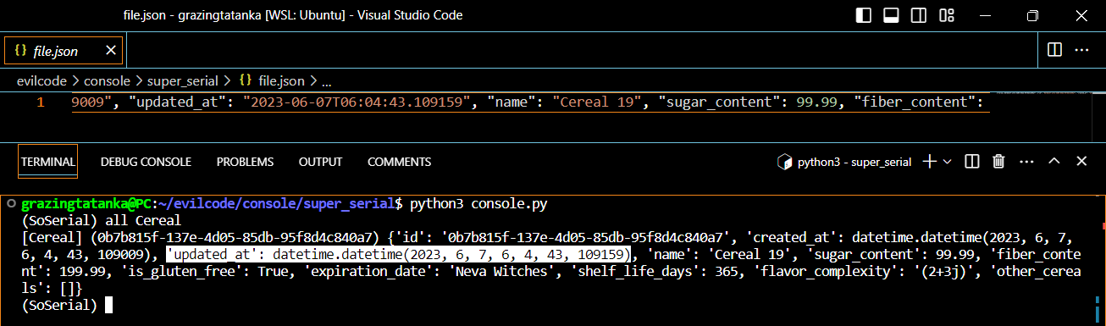
What datetime is it?
Time data is present in nearly all data sets
Enables tracking changes over time, analyzing trends
Datetime object can be created with datetime class built in .now() method
They can converted / saved to string using .isoformat()
To make new datetimes on reload, you can use .strptime(...)

Slide 11
UWUID
UUID === ‘Universally Unique Identifier’
Format: 8-4-4-4-12 for a total of 36 characters
From uuid import uuid4 ← random number based
Helps us differentiate similar, but not the same, class instances e.g. [Cereal] (0b7b815f-137e-4d05-85db-95f8d4c840a7) {'id': '0b7b815f-137e-4d05-85db-95f8d4c840a7', 'created_at': datetime.datetime(2023, 6, 7, 6, 4, 43, 109009), 'updated_at': datetime.datetime(2023, 6, 7, 6, 4, 43, 109159), 'name': 'Cereal 19', 'sugar_content': 99.99, 'fiber_content': 199.99, 'is_gluten_free': True, 'expiration_date': 'Neva Witches', 'shelf_life_days': 365, 'flavor_complexity': '(2+3j)', 'other_cereals': []}
[Cereal] (f1f8ea78-d3ed-4b5f-8e88-ec31d9fcafba) {'id': 'f1f8ea78-d3ed-4b5f-8e88-ec31d9fcafba', 'created_at': datetime.datetime(2023, 6, 7, 6, 25, 10, 97766), 'updated_at': datetime.datetime(2023, 6, 7, 6, 25, 10, 98069), 'name': 'Cereal 19', 'sugar_content': 99.99, 'fiber_content': 199.99, 'is_gluten_free': True, 'expiration_date': 'Neva Witches', 'shelf_life_days': 365, 'flavor_complexity': (2+3j), 'other_cereals': []}

