Slide 1
Living sHell
BY PID == 5580

Slide 2
The beginning of the End-of-File
EOF (End-of-File) condition represented by specific value
In C this value is (-1); in python it is const. (None)
<CTRL>+<D> used to indicate EOF in Unix/like systems
EOF shortcut entered into CLI (Command Line Interface) tells system to send end-of-file character to app or process
App or process receives this EOF character and performs specific action (typically cleans up and exits)

Slide 3
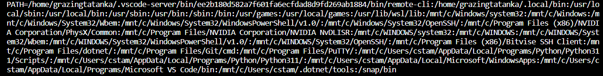
Finding the PATH
PATH is an environmental variable (use ‘env’ in bash to see)
Executable files are presumed to be contained in these directories
Note that the directories in the PATH are delimited (separated) by colons (:)
By default, a shell should check each directory in the PATH for a specified executable…
UNLESS: 1) the specified command is a ‘built-in’ (has special meaning to the shell like cd)
OR: 2) an absolute file path is specified (absolute paths begin with root dir (/))

Slide 4
Which main is the main main?
Your program/application should have an entry point (a main)
There are multiple prototypes for main:
int main()
int main(int argc, char *argv[])
int main(int argc, char **argv)
You can also specify an additional argument – envp! Like so
int main(int argc, char *argv[], char *envp[])
The envp can be thought of as an array of strings, preloaded from environmental variables
and in the form of ‘name=value’ (e.g. SHELL=/bin/bash)
That said, it’s often more convenient/practical to simply use getenv()
e.g. path = getenv("PATH");

Slide 5
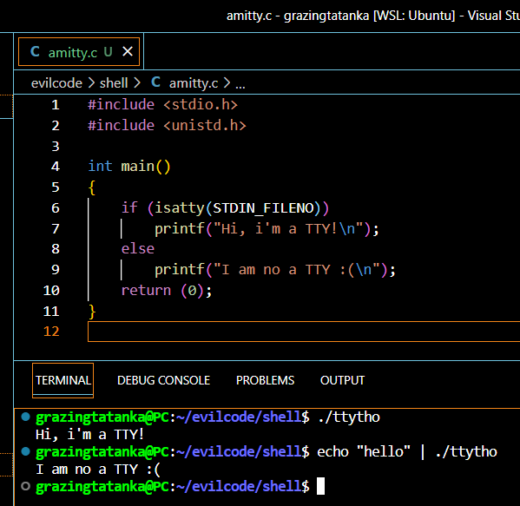
WTF is a TTY?
TTY is shorthand for a Teletype (used in the before-time)
Today TTY is used to refer to any terminal device that allows a user to interact with a computer system through a command-line interface (CLI)
Isatty(FILE_DESCRIPTOR_HERE) in C checks whether the FILE_DESCRIPTOR_HERE is associated with a terminal or not
Different actions can then be taken depending on the outcome, e.g. printing a prompt message
This is useful, since it lets us differentiate interactive vs. non-interactive mode use

Slide 6
Function vs. System calls
Function calls:
A function call is a way to execute a block of code that has been defined elsewhere in the program.
The function call transfers control from the current point in the program to the function being called.
The function is executed, and then control returns to the point in the program immediately following the function call.
Function calls are synchronous, meaning that the program waits for the function to complete before continuing.
System calls:
A system call is a request made by a program to the operating system for a specific service, such as reading or writing to a file or creating a new process.
System calls are made using special functions provided by the operating system, such as open(), read(), write(), fork(), execve(), etc.
The system call transfers control from the program to the operating system kernel, which performs the requested service on behalf of the program.
Once the service is complete, control returns to the program, which continues executing.
System calls are asynchronous, meaning that the program does not wait for the service to complete before continuing. Instead, the operating system notifies the program when the service is complete.
SYNOPSIS: function calls are used to execute code that has already been defined in the program, while system calls are used to request services from the operating system

Slide 7
execve won’t let met me be me; instead it wants me to be its ppid
fork() creates a new process that process is a copy execve() replaces the current process (copy from fork) with whatever it runs the parent process waits to reap the bb process

Slide 8
Which PID is me?
PID < 0
PID == 0
PID > 0
Bad fork process
EXITS
EXIT STATUS SHOULD BE NON-0
EXIT ERROR PRINTS TO STDOUT
Child process
EXECUTES
EXEC FAM CALLED HERE
STATUS OF THIS PROCESS EXEC
SHOULD BE RELAYED TO PARENT
REAPED FOLLOWING EXEC
Parent process
WAITS
WAIT FUN FAM USED TO DETERMINE WHEN TO RESUME
RECEIVES EXIT STATUS FROM CHILD PROCESS
REAPS CHILD PROCESS

