Slide 1
Unit 12: LDPC Codes
EL-GY 6013: Digital communications
Prof. Sundeep rangan

Slide 2

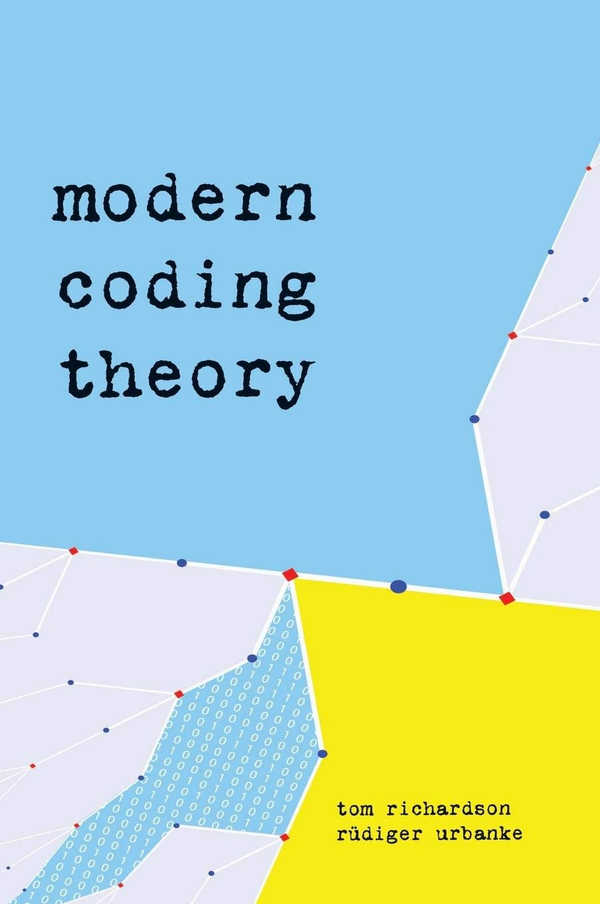
References
Extensive tutorial presentation:
An Introduction to Low-Density Parity-Check Codes, Paul Siegel
https://cmrr-star.ucsd.edu/static/presentations/ldpc_tutorial.pdf
Bishop, Pattern Recognition and ML
General book on ML from 2006
Excellent chapter (Chapter 8) on graphical models
Modern Coding Theory, Richardson and Urbanke
From 2008
By two pioneers in the field
Extensive math
Richardson, Tom, and Shrinivas Kudekar. "Design of low-density parity check codes for 5G new radio." IEEE Communications Magazine 56.3 (2018): 28-34.

Slide 3
Outline
LDPC Codes: Basics and Motivation
LDPC Encoding
Graphical Models
Inference via Belief Propagation
LDPC Decoding
5G LDPC codes

Slide 4

Generator Matrices
Consider $(n,k)$ binary linear code
$k$ information bits $b=(b_{1},…, b_{k})$
$n$ coded bits $c=(c_{1},…, c_{n})$
Described by a generator matrix $c=bG$
Example: $(7,4)$ Hamming Code: $G=\left[\begin{matrix}\begin{matrix}1 & 0 \\ 0 & 1\end{matrix} & \begin{matrix}0 & 0 \\ 0 & 0\end{matrix} & \begin{matrix}1 & 1 & 1 \\ 1 & 1 & 0\end{matrix} \\ \begin{matrix}0 & 0 \\ 0 & 0\end{matrix} & \begin{matrix}1 & 0 \\ 0 & 1\end{matrix} & \begin{matrix}1 & 0 & 1 \\ 0 & 1 & 1\end{matrix}\end{matrix}\right]$

Slide 5
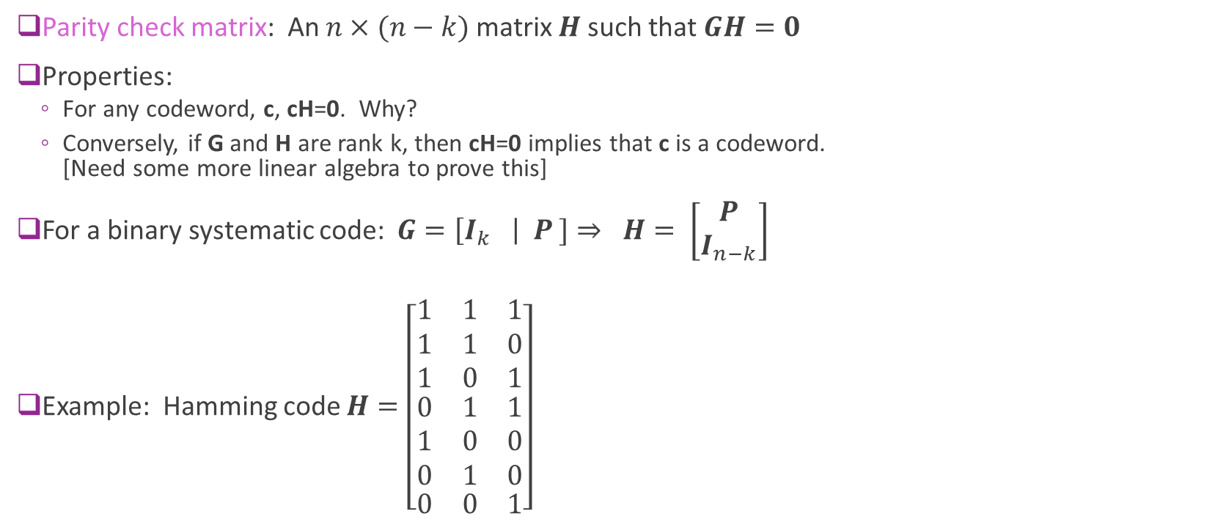
Parity Check Matrix
Parity check matrix: An $n×(n−k)$ matrix $H$ such that $GH=0$
Properties:
For any codeword, c, cH=0. Why?
Conversely, if G and H are rank k, then cH=0 implies that c is a codeword. [Need some more linear algebra to prove this]
For a binary systematic code: $G=\left[I_{k} \right| P ]⇒ H= \left[\begin{matrix}P \\ I_{n−k}\end{matrix}\right]$
Example: Hamming code $H=\left[\begin{matrix}\begin{matrix}1 & 1 & 1 \\ 1 & 1 & 0 \\ 1 & 0 & 1\end{matrix} \\ \begin{matrix}0 & 1 & 1 \\ 1 & 0 & 0 \\ 0 & 1 & 0\end{matrix} \\ \begin{matrix}0 & 0 & 1\end{matrix}\end{matrix}\right]$

Slide 6
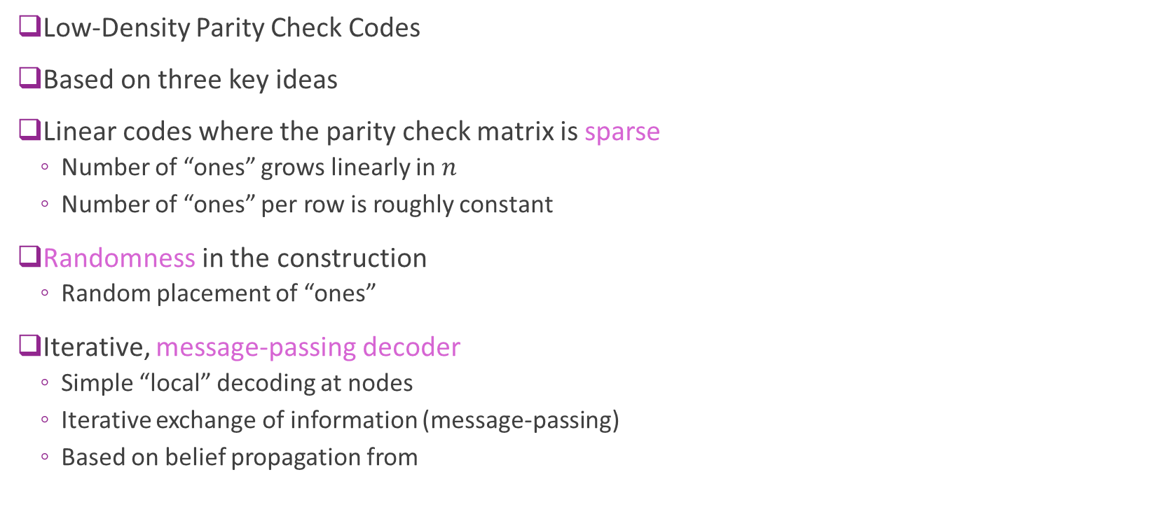
LDPC Codes
Low-Density Parity Check Codes
Based on three key ideas
Linear codes where the parity check matrix is sparse
Number of “ones” grows linearly in $n$
Number of “ones” per row is roughly constant
Randomness in the construction
Random placement of “ones”
Iterative, message-passing decoder
Simple “local” decoding at nodes
Iterative exchange of information (message-passing)
Based on belief propagation from

Slide 7
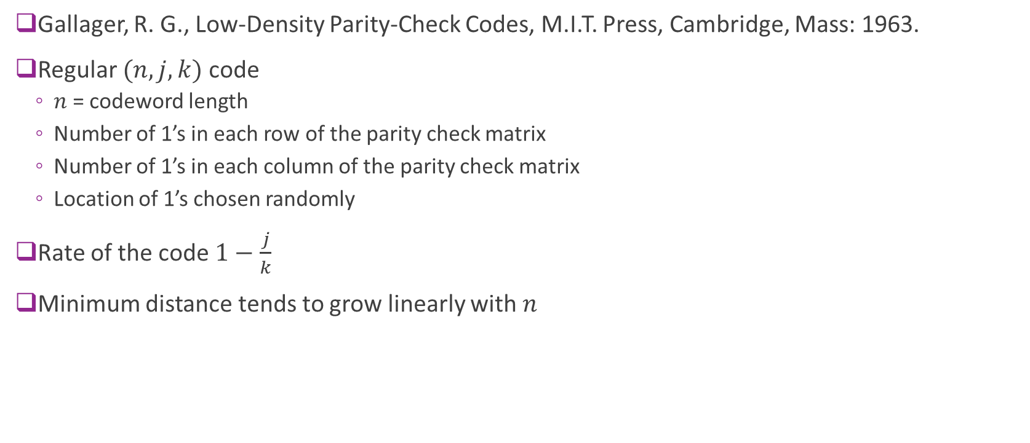
First LDPC codes
Gallager, R. G., Low-Density Parity-Check Codes, M.I.T. Press, Cambridge, Mass: 1963.
Regular $(n,j,k)$ code
$n$ = codeword length
Number of 1’s in each row of the parity check matrix
Number of 1’s in each column of the parity check matrix
Location of 1’s chosen randomly
Rate of the code $1−\frac{j}{k}$
Minimum distance tends to grow linearly with $n$

Slide 8
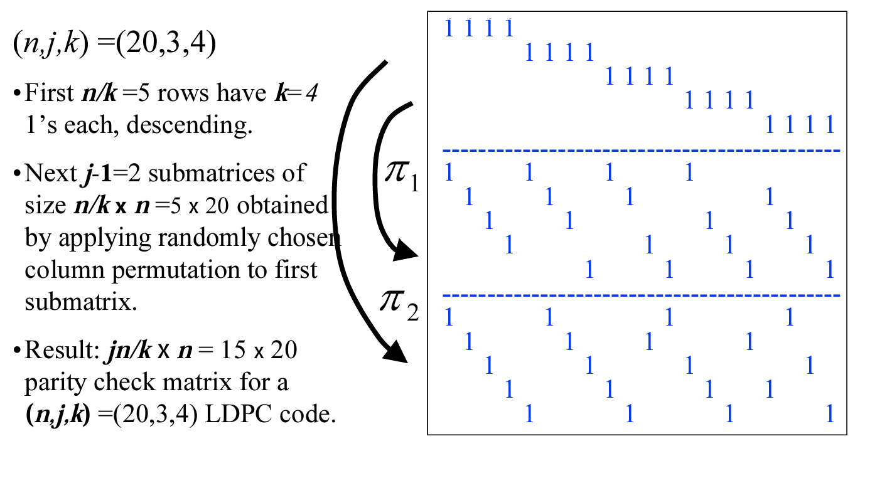
Gallager’s Original Regular Code
From Siegel, An Introduction to Low-Density Parity-Check Codes

Slide 9
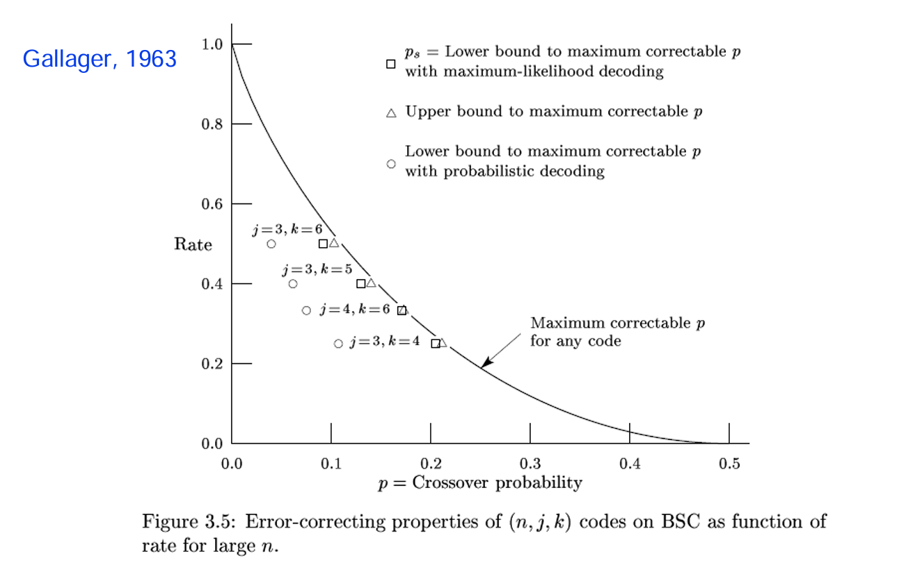
Performance of Regular Codes on BSC

Slide 10
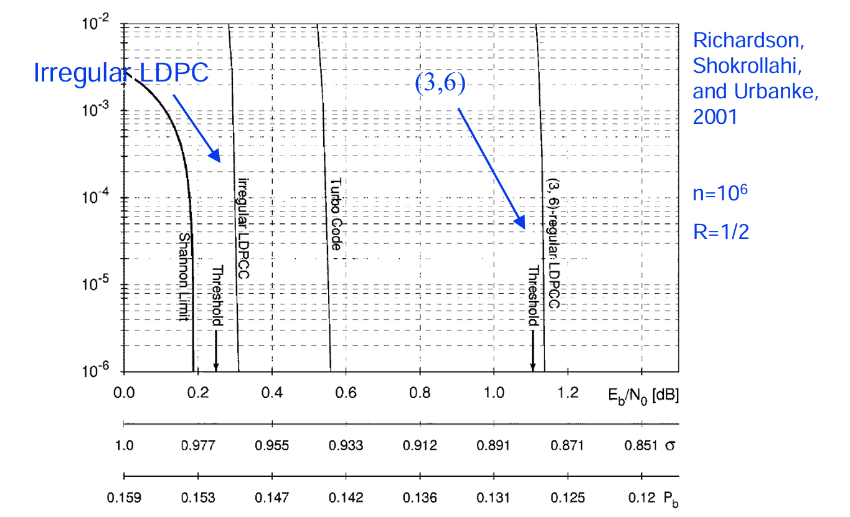
Enter Irregular Codes
Irregular codes
Began work in 2001
Showed significant improvement
On BSC channel at infinite lengths:
Theoretically hits capacity
At practical code lengths:
Very close to capacity

Slide 11
Outline
LDPC Codes: Basics and Motivation
LDPC Encoding
Graphical Models
Inference via Belief Propagation
LDPC Decoding
5G LDPC codes

Slide 12
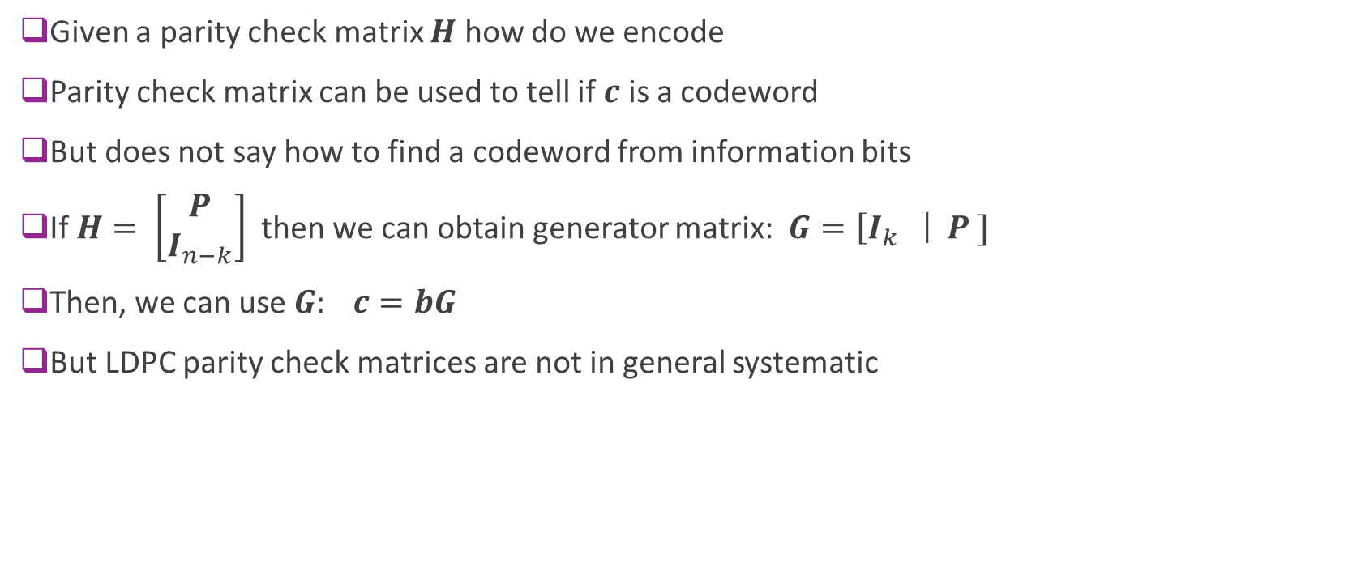
Encoding with a Parity Check Matrix
Given a parity check matrix $H$ how do we encode
Parity check matrix can be used to tell if $c$ is a codeword
But does not say how to find a codeword from information bits
If $H= \left[\begin{matrix}P \\ I_{n−k}\end{matrix}\right]$ then we can obtain generator matrix: $G=\left[I_{k} \right| P ]$
Then, we can use $G: c=bG$
But LDPC parity check matrices are not in general systematic

Slide 13
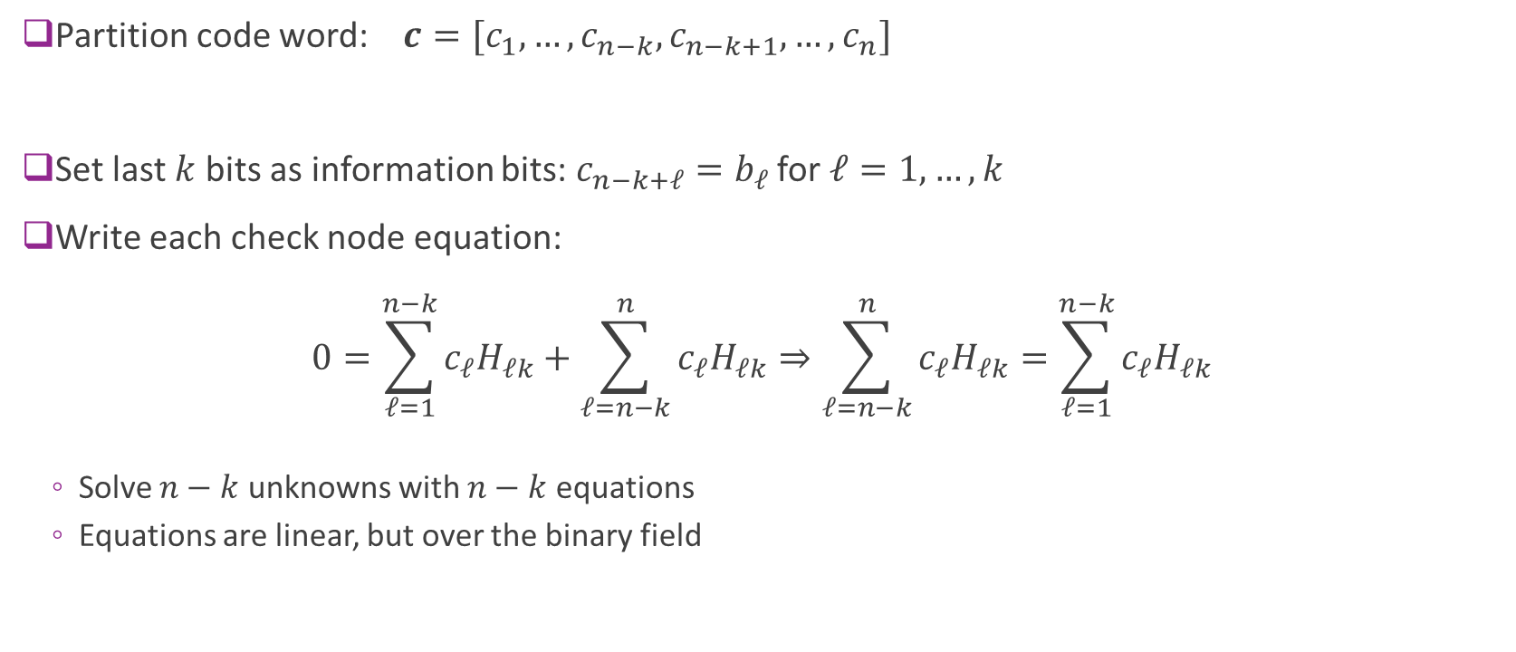
Encoding via Equation Solving
Partition code word: $c=[c_{1},…, c_{n−k}, c_{n−k+1},…, c_{n}]$
Set last $k$ bits as information bits: $c_{n−k+ℓ}=b_{ℓ}$for $ℓ=1,…,k$
Write each check node equation: $0=\sum_{ℓ=1}^{n−k}{c_{ℓ}H_{ℓk}}+\sum_{ℓ=n−k}^{n}{c_{ℓ}H_{ℓk}}⇒\sum_{ℓ=n−k}^{n}{c_{ℓ}H_{ℓk}}=\sum_{ℓ=1}^{n−k}{c_{ℓ}H_{ℓk}}$
Solve $n−k$ unknowns with $n−k$ equations
Equations are linear, but over the binary field
Parity
Info

Slide 14
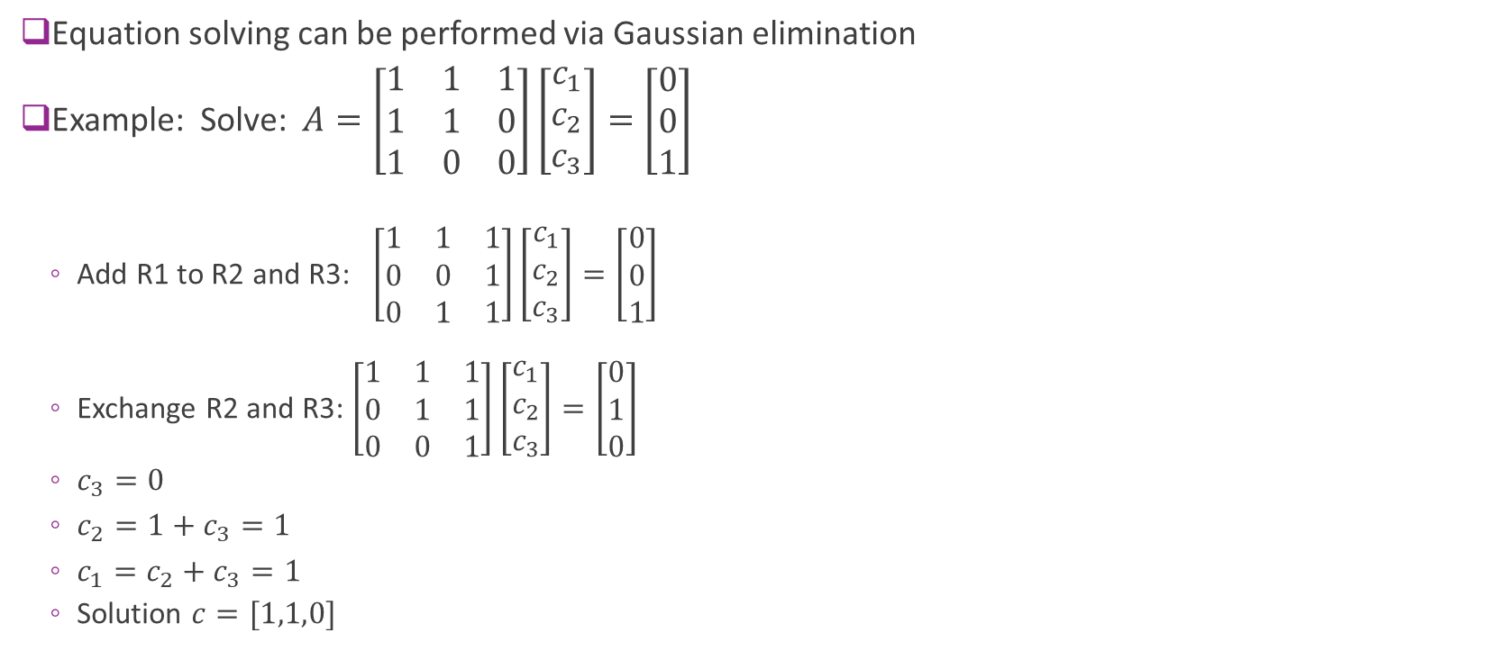
Gaussian Elimination
Equation solving can be performed via Gaussian elimination
Example: Solve: $A=\left[\begin{matrix}1 & 1 & 1 \\ 1 & 1 & 0 \\ 1 & 0 & 0\end{matrix}\right]\left[\begin{matrix}c_{1} \\ c_{2} \\ c_{3}\end{matrix}\right]=\left[\begin{matrix}0 \\ 0 \\ 1\end{matrix}\right]$
Add R1 to R2 and R3: $\left[\begin{matrix}1 & 1 & 1 \\ 0 & 0 & 1 \\ 0 & 1 & 1\end{matrix}\right]\left[\begin{matrix}c_{1} \\ c_{2} \\ c_{3}\end{matrix}\right]=\left[\begin{matrix}0 \\ 0 \\ 1\end{matrix}\right]$
Exchange R2 and R3: $\left[\begin{matrix}1 & 1 & 1 \\ 0 & 1 & 1 \\ 0 & 0 & 1\end{matrix}\right]\left[\begin{matrix}c_{1} \\ c_{2} \\ c_{3}\end{matrix}\right]=\left[\begin{matrix}0 \\ 1 \\ 0\end{matrix}\right]$
$c_{3}=0$
$c_{2}=1+c_{3}=1$
$c_{1}=c_{2}+c_{3}=1$
Solution $c=[1,1,0]$

Slide 15
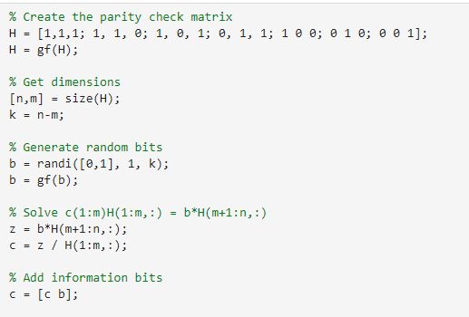
MATLAB
MATLAB can also perform binary arithmetic
Define arrays with elements in GF(2)
The binary field
Solve equations just as if they were real numbers

Slide 16


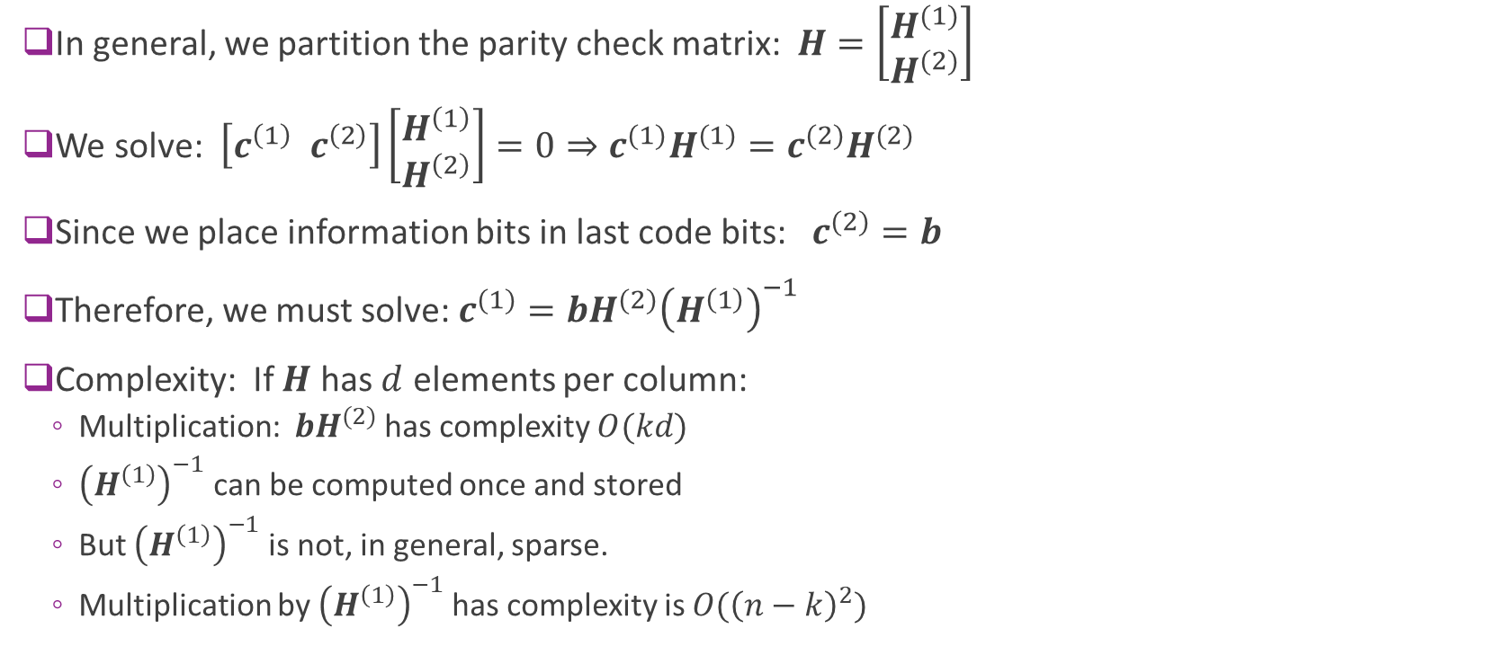
Complexity
In general, we partition the parity check matrix: $H=\left[\begin{matrix}H^{(1)} \\ H^{(2)}\end{matrix}\right]$
We solve: $\left[c^{\left(1\right)} c^{\left(2\right)}\right]\left[\begin{matrix}H^{\left(1\right)} \\ H^{\left(2\right)}\end{matrix}\right]=0⇒c^{(1)}H^{(1)}=c^{(2)}H^{(2)}$
Since we place information bits in last code bits: $c^{(2)}=b$
Therefore, we must solve: $c^{(1)}=bH^{(2)}{\left(H^{\left(1\right)}\right)}^{−1}$
Complexity: If $H$ has $d$ elements per column:
Multiplication: $bH^{(2)}$ has complexity $O(kd)$
${\left(H^{\left(1\right)}\right)}^{−1}$ can be computed once and stored
But ${\left(H^{\left(1\right)}\right)}^{−1}$ is not, in general, sparse.
Multiplication by ${\left(H^{\left(1\right)}\right)}^{−1}$has complexity is $O({\left(n−k\right)}^{2})$

Slide 17
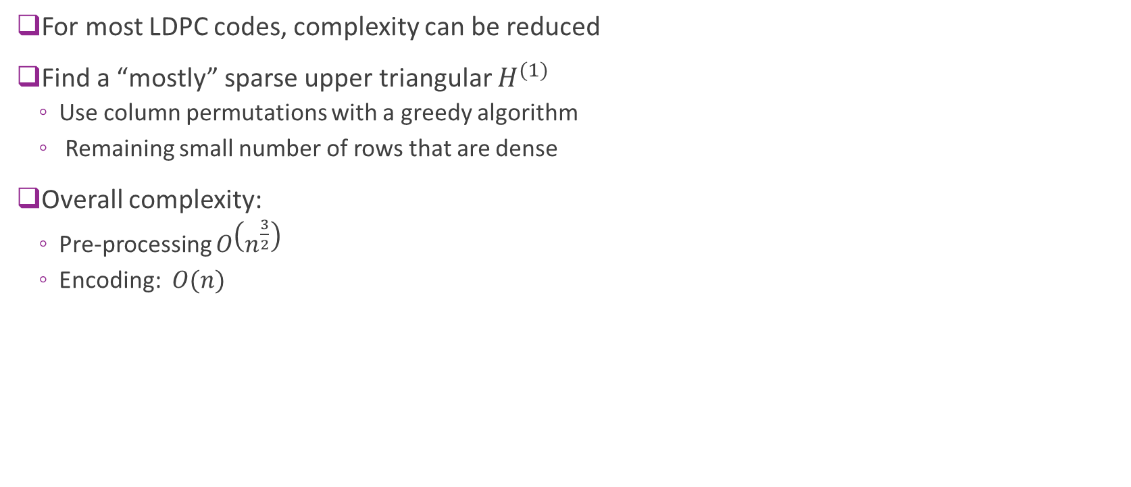
Reducing Complexity
For most LDPC codes, complexity can be reduced
Find a “mostly” sparse upper triangular $H^{(1)}$
Use column permutations with a greedy algorithm
Remaining small number of rows that are dense
Overall complexity:
Pre-processing $O\left(n^{\frac{3}{2}}\right)$
Encoding: $O(n)$

Slide 18
Outline
LDPC Codes: Basics and Motivation
LDPC Encoding
Graphical Models
Inference via Belief Propagation
LDPC Decoding
5G LDPC codes

Slide 19
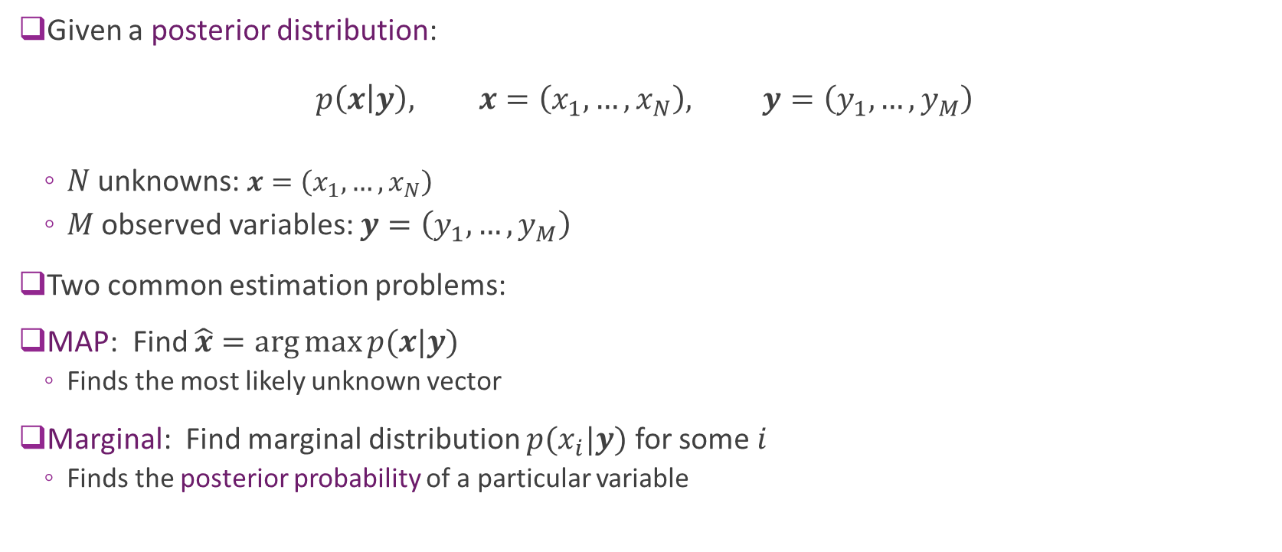
MAP and Marginal Estimation
Given a posterior distribution: $p\left(x | y\right), x=\left(x_{1}, …,x_{N}\right), y=\left(y_{1},…,y_{M}\right)$
$N$ unknowns: $x=\left(x_{1}, …,x_{N}\right)$
$M$ observed variables: $y=\left(y_{1},…,y_{M}\right)$
Two common estimation problems:
MAP: Find $\hat{x}=\arg{\max{p(x|y)}}$
Finds the most likely unknown vector
Marginal: Find marginal distribution $p(x_{i}|y)$ for some $i$
Finds the posterior probability of a particular variable

Slide 20
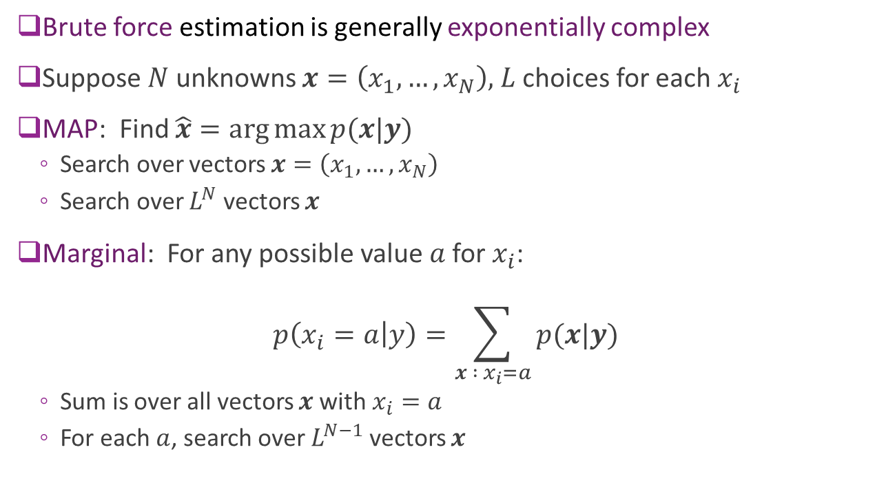
Complexity is Generally Exponential
Brute force estimation is generally exponentially complex
Suppose $N$ unknowns $x=\left(x_{1}, …,x_{N}\right),$ $L$ choices for each $x_{i}$
MAP: Find $\hat{x}=\arg{\max{p(x|y)}}$
Search over vectors $x=\left(x_{1}, …,x_{N}\right)$
Search over $L^{N}$ vectors $x$
Marginal: For any possible value $a$for $x_{i}$:
$$p\left(x_{i}=a | y\right)=\sum_{x : x_{i}=a}{p(x|y)}$$
Sum is over all vectors $x$with $x_{i}=a$
For each $a$, search over $L^{N−1}$ vectors $x$
Need structure for tractable estimation

Slide 21
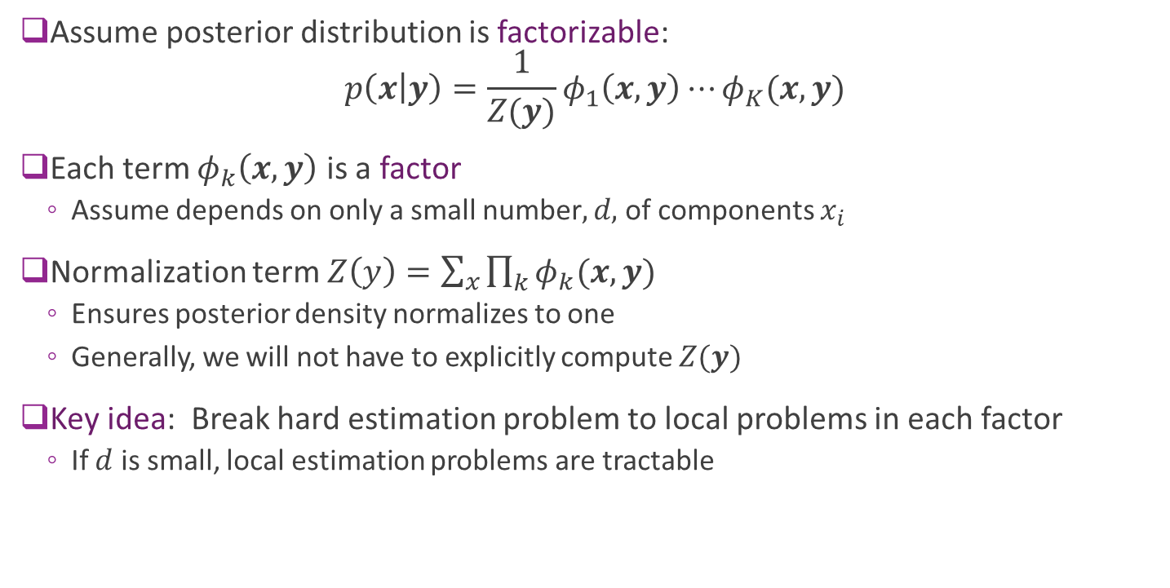
Factorizable Distributions
Assume posterior distribution is factorizable: $p\left(x | y\right)=\frac{1}{Z(y)}φ_{1}\left(x,y\right)⋯φ_{K}(x,y)$
Each term $φ_{k}\left(x,y\right)$ is a factor
Assume depends on only a small number$, d,$ of components $x_{i}$
Normalization term $Z\left(y\right)=\sum_{x}{\prod_{k}{φ_{k}(x,y)}}$
Ensures posterior density normalizes to one
Generally, we will not have to explicitly compute $Z(y)$
Key idea: Break hard estimation problem to local problems in each factor
If $d$ is small, local estimation problems are tractable

Slide 22




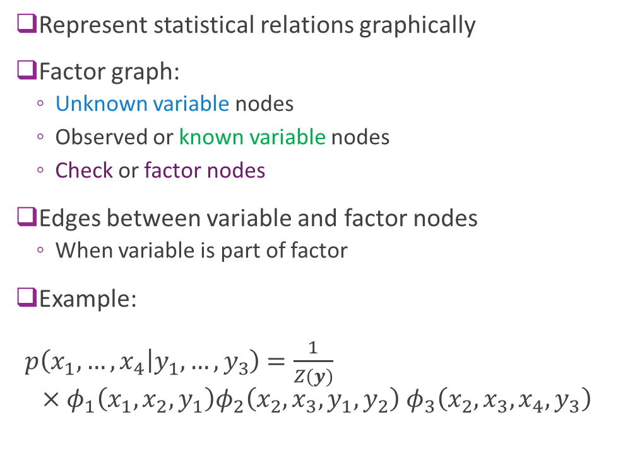






Factor Graph
Represent statistical relations graphically
Factor graph:
Unknown variable nodes
Observed or known variable nodes
Check or factor nodes
Edges between variable and factor nodes
When variable is part of factor
Example: $p\left(x_{1},…,x_{4} | y_{1},…,y_{3}\right)$ $=\frac{1}{Z(y)}$ $×φ_{1}\left(x_{1},x_{2},y_{1}\right)φ_{2}\left(x_{2},x_{3},y_{1},y_{2}\right)$ $φ_{3}\left(x_{2},x_{3},x_{4},y_{3}\right)$
$$y_{1}$$
$$y_{2}$$
$$y_{3}$$
$$φ_{1}$$
$$φ_{2}$$
$$φ_{3}$$
$$x_{1}$$
$$x_{2}$$
$$x_{3}$$
$$x_{4}$$

Slide 23
















Example: Hidden Markov Chain
Markov chain:
$p\left(x\right)=p\left(x_{0}\right)p\left(x_{1} | x_{0}\right)⋯p\left(x_{T} | x_{T−1}\right)$
Observations
$p\left(y | x\right)=p\left(y_{0} | x_{0}\right)⋯p\left(y_{T−1} | x_{T−1}\right)$
Hidden Markov chain problem:
Estimate state sequence $x=(x_{0},…,x_{T})$
Use observations $y=(y_{0},…,y_{T−1})$
Posterior: $p\left(x | y\right)=\frac{1}{p(y)}p\left(x\right)p(y|x)$
$$y_{0}$$
$$y_{1}$$
$$y_{T−1}$$
$${P(x_{1}|x}_{0})$$
$${P(x_{2}|x}_{1})$$
$${P(x_{T}|x}_{T−1})$$
$$⋯$$
$$x_{0}$$
$$x_{1}$$
$$x_{2}$$
$$x_{T}$$
$${P(x}_{0})$$
$${P(x}_{1})$$
$${P(x}_{2})$$
$${P(x}_{T})$$

Slide 24
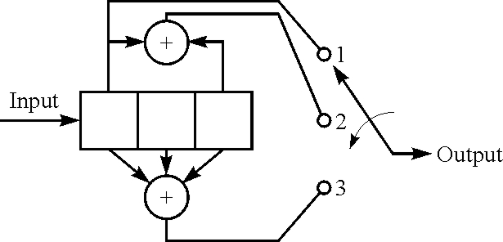
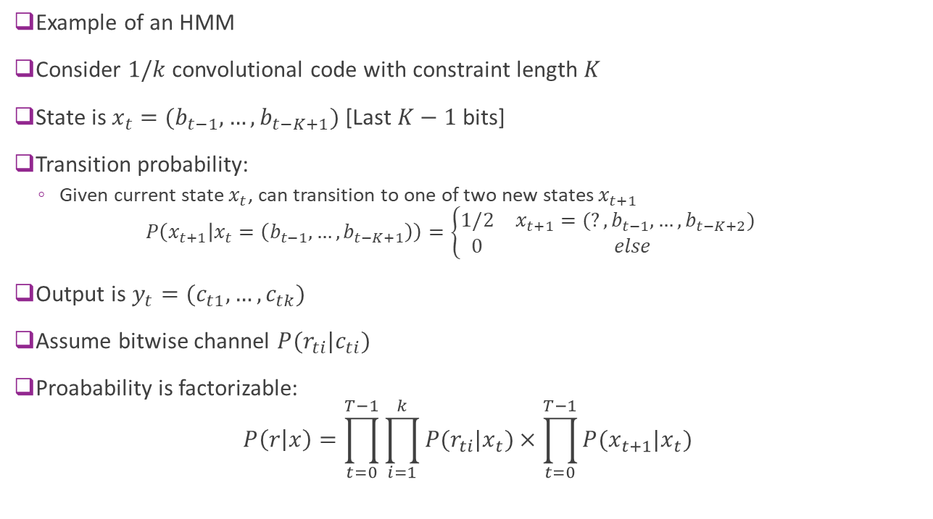
Convolutional Codes
Example of an HMM
Consider $1/k$ convolutional code with constraint length $K$
State is $x_{t}=(b_{t−1},…,b_{t−K+1})$ [Last $K−1$ bits]
Transition probability:
Given current state $x_{t}$, can transition to one of two new states $x_{t+1}$ $P\left(x_{t+1} | x_{t}=\left(b_{t−1},…,b_{t−K+1}\right)\right)=\left\{\begin{matrix}1/2 & x_{t+1}=(?,b_{t−1},…,b_{t−K+2}) \\ 0 & else \end{matrix}\right.$
Output is $y_{t}=(c_{t1},…,c_{tk})$
Assume bitwise channel $P(r_{ti}|c_{ti})$
Proabability is factorizable: $P\left(r | x\right)=\prod_{t=0}^{T−1}{\prod_{i=1}^{k}{P(r_{ti}|x_{t})}}×\prod_{t=0}^{T−1}{P(x_{t+1}|x_{t})}$

Slide 25
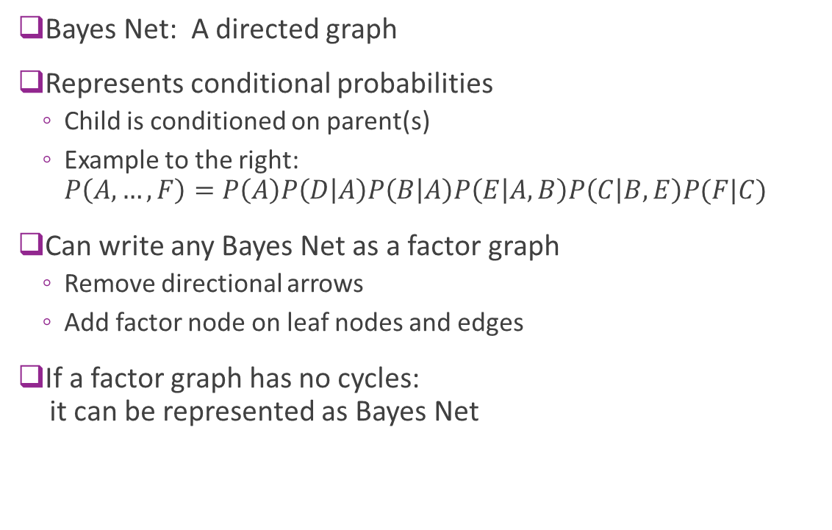
Bayes Net Representation
Bayes Net: A directed graph
Represents conditional probabilities
Child is conditioned on parent(s)
Example to the right: $P\left(A,…,F\right)=P\left(A\right)P\left(D | A\right)P\left(B | A\right)P\left(E | A,B\right)P\left(C | B,E\right)P(F|C)$
Can write any Bayes Net as a factor graph
Remove directional arrows
Add factor node on leaf nodes and edges
If a factor graph has no cycles: it can be represented as Bayes Net
A
B
C
D
E
F

Slide 26














Plate Notation
Simplify graphical representation
Write repeated nodes in a “plates”
Example:
HMM with parameter $θ$
$P\left(x,θ\right)=P\left(x_{0}\right)P\left(θ\right)∏P\left(x_{t+1} | x_{t},θ\right)P(y_{t}|x_{t},θ)$
Put update maps in a plate
Standard Representation
Plate Representation
$$θ$$
$$θ$$
$$⋯$$
$$x_{0}$$
$$x_{1}$$
$$x_{T−1}$$
$$x_{T}$$
$$x_{t}$$
$$T$$
$$y_{0}$$
$$y_{1}$$
$$y_{T−1}$$
$$y_{t}$$

Slide 27
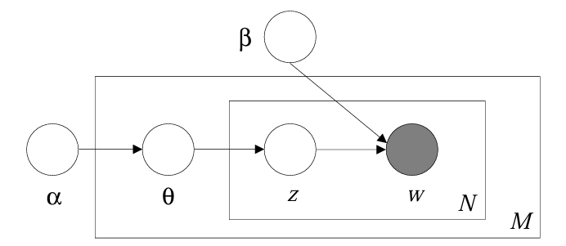
Examples in ML
Graphical model descriptions were used in many ML fields
Document modeling
Image segmentation
…
Allows “explainable” models
See example to right
Not used much any more
Modern deep NN methods outperform graphical models
Topic
Word in doc
Topic distribution
Document in corpus
Blei, David M., Andrew Y. Ng, and Michael I. Jordan. "Latent dirichlet allocation." Journal of machine Learning research 3.Jan (2003): 993-1022.

Slide 28
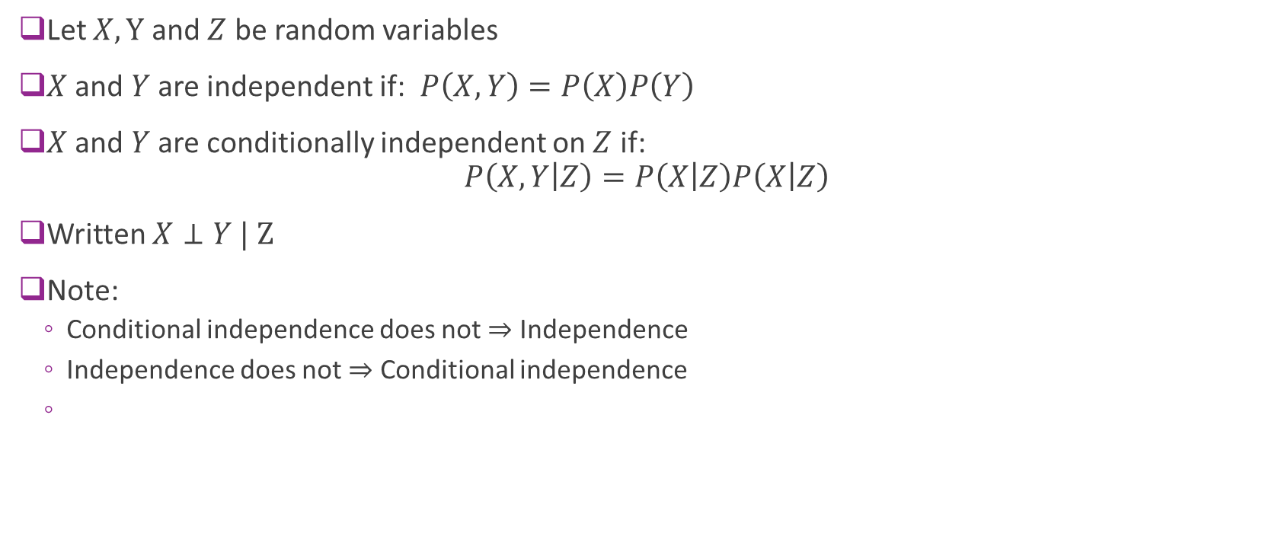
Conditional Independence
Let $X, Y$ and $Z$ be random variables
$X$ and $Y$ are independent if: $P\left(X,Y\right)=P\left(X\right)P\left(Y\right)$
$X$ and $Y$ are conditionally independent on $Z$ if: $P\left(X,Y | Z\right)=P\left(X | Z\right)P\left(X | Z\right)$
Written $X⊥Y | Z$
Note:
Conditional independence does not $⇒$ Independence
Independence does not $⇒$ Conditional independence

Slide 29
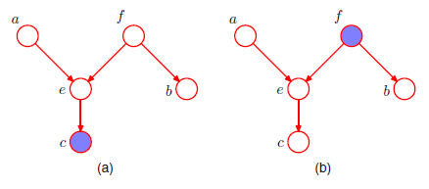
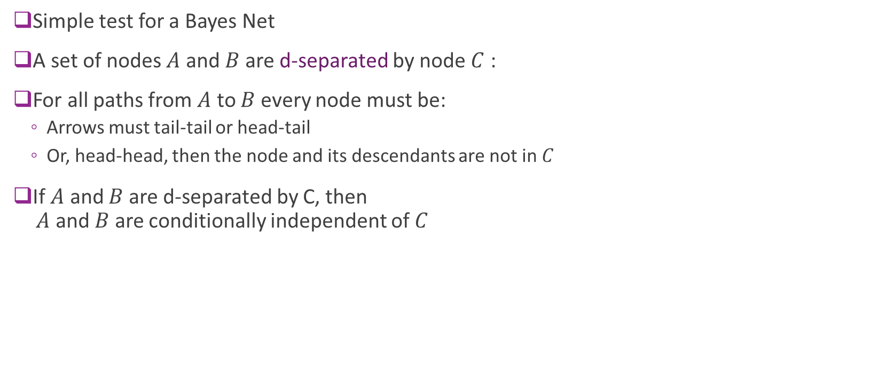


D-Separation
Simple test for a Bayes Net
A set of nodes $A$ and $B$ are d-separated by node $C$ :
For all paths from $A$ to $B$ every node must be:
Arrows must tail-tail or head-tail
Or, head-head, then the node and its descendants are not in $C$
If $A$ and $B$ are d-separated by C, then $A$ and $B$ are conditionally independent of $C$
False: $a⊥b | c$
True: $a⊥b | c$

Slide 30
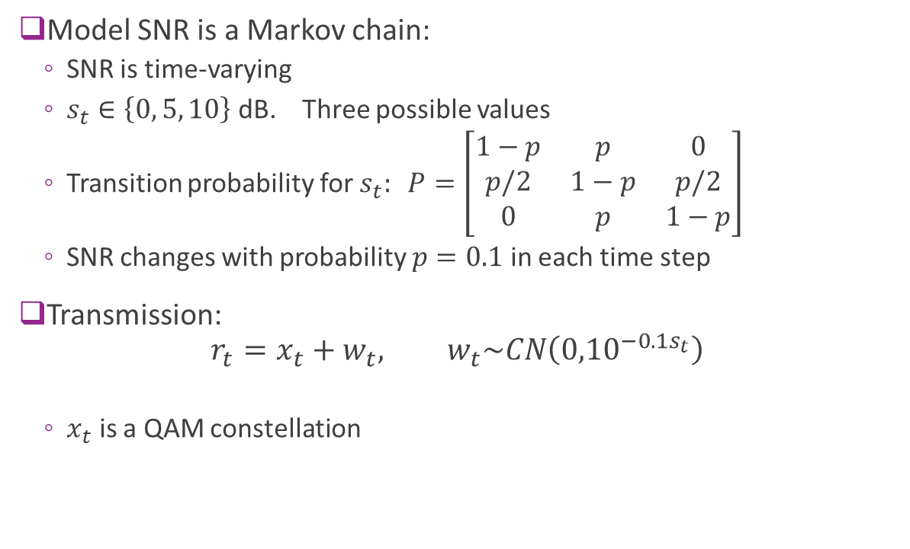
Example: Time-Varying Noise
Model SNR is a Markov chain:
SNR is time-varying
$s_{t}∈\left\{0, 5, 10\right\}$ dB. Three possible values
Transition probability for $s_{t}: P=\left[\begin{matrix}1−p & p & 0 \\ p/2 & 1−p & p/2 \\ 0 & p & 1−p\end{matrix}\right]$
SNR changes with probability $p=0.1$ in each time step
Transmission: $r_{t}=x_{t}+w_{t}, w_{t}\sim CN\left({0,10}^{−0.1s_{t}}\right)$
$x_{t}$ is a QAM constellation

Slide 31
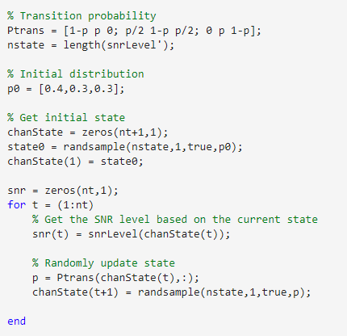
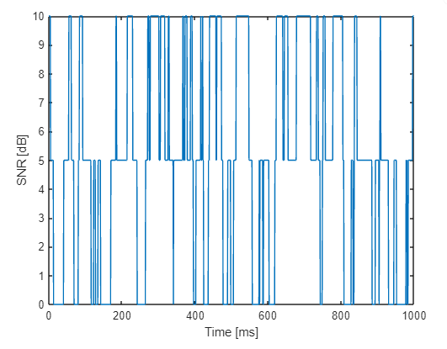
MATLAB code
Markov chain simulation
Use randsample function

Slide 32
Outline
LDPC Codes: Motivation and History
LDPC Encoding
Graphical Models
Inference via Belief Propagation
LDPC Decoding
5G LDPC codes

Slide 33
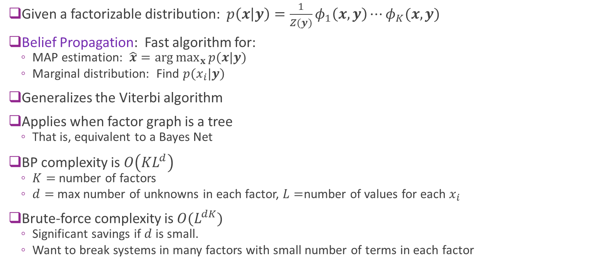
Belief Propagation
Given a factorizable distribution: $p\left(x | y\right)=\frac{1}{Z(y)}φ_{1}\left(x,y\right)⋯φ_{K}(x,y)$
Belief Propagation: Fast algorithm for:
MAP estimation: $\hat{x}=\arg{\max_{x}{p(x|y)}}$
Marginal distribution: Find $p(x_{i}|y)$
Generalizes the Viterbi algorithm
Applies when factor graph is a tree
That is, equivalent to a Bayes Net
BP complexity is $O\left(KL^{d}\right)$
$K=$ number of factors
$d=$ max number of unknowns in each factor, $L=$number of values for each $x_{i}$
Brute-force complexity is $O(L^{dK})$
Significant savings if $d$ is small.
Want to break systems in many factors with small number of terms in each factor

Slide 34



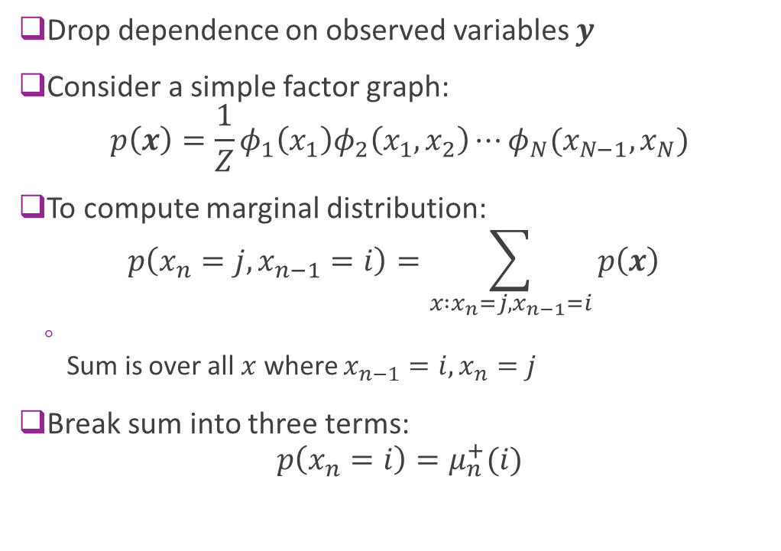




BP on a Chain
Drop dependence on observed variables $y$
Consider a simple factor graph: $p\left(x\right)=\frac{1}{Z}φ_{1}\left(x_{1}\right)φ_{2}\left(x_{1},x_{2}\right)⋯φ_{N}(x_{N−1},x_{N})$
To compute marginal distribution: $p\left(x_{n}=j,x_{n−1}=i\right)=\sum_{x :x_{n}=j, x_{n−1}=i}{p\left(x\right)}$
Sum is over all $x$ where $x_{n−1}=i, x_{n}=j$
Break sum into three terms: $p\left(x_{n}=i\right)=μ_{n}^{+}(i)$
$$x_{1}$$
$$φ_{1}$$
$$x_{2}$$
$$φ_{2}$$
$$x_{3}$$
$$φ_{3}$$
$$x_{4}$$

Slide 35



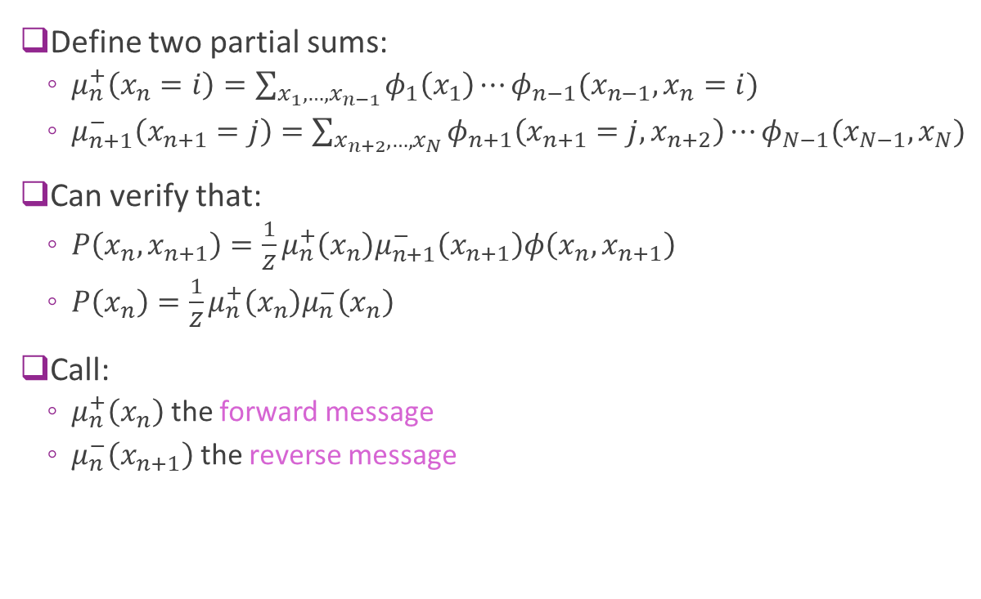






Forward and Reverse Messages
Define two partial sums:
$μ_{n}^{+}\left(x_{n}=i\right)=\sum_{x_{1},…,x_{n−1}}{φ_{1}\left(x_{1}\right)⋯φ_{n−1}(x_{n−1},x_{n}=i)}$
$μ_{n+1}^{−}\left(x_{n+1}=j\right)=\sum_{x_{n+2},…,x_{N}}{φ_{n+1}\left(x_{n+1}=j,x_{n+2}\right)⋯φ_{N−1}(x_{N−1},x_{N})}$
Can verify that:
$P\left(x_{n},x_{n+1}\right)=\frac{1}{Z}μ_{n}^{+}\left(x_{n}\right)μ_{n+1}^{−}\left(x_{n+1}\right)φ\left(x_{n},x_{n+1}\right)$
$P\left(x_{n}\right)=\frac{1}{Z}μ_{n}^{+}\left(x_{n}\right)μ_{n}^{−}\left(x_{n}\right)$
Call:
$μ_{n}^{+}\left(x_{n}\right)$ the forward message
$μ_{n}^{−}\left(x_{n+1}\right)$ the reverse message
$$x_{1}$$
$$φ_{1}$$
$$x_{2}$$
$$μ_{2}^{+}(i)$$
$$φ_{2}$$
$$μ_{3}^{−}(j)$$
$$x_{3}$$
$$φ_{3}$$
$$x_{4}$$

Slide 36
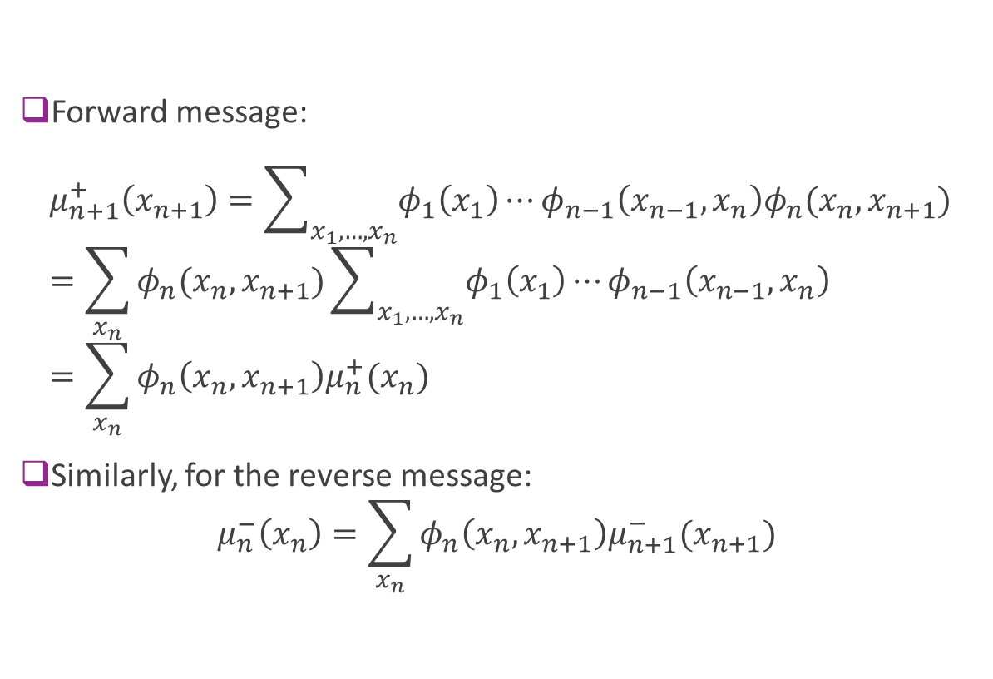

Recursive Updates
Forward message: $μ_{n+1}^{+}\left(x_{n+1}\right)=\sum_{x_{1},…,x_{n}}{φ_{1}\left(x_{1}\right)⋯φ_{n−1}\left(x_{n−1},x_{n}\right)φ_{n}(x_{n},x_{n+1})}$ $=\sum_{x_{n}}{φ_{n}(x_{n},x_{n+1})\sum_{x_{1},…,x_{n}}{φ_{1}\left(x_{1}\right)⋯φ_{n−1}\left(x_{n−1},x_{n}\right)}}$ $=\sum_{x_{n}}{φ_{n}\left(x_{n},x_{n+1}\right)μ_{n}^{+}(x_{n}) }$
Similarly, for the reverse message: $μ_{n}^{−}\left(x_{n}\right)=\sum_{x_{n}}{φ_{n}\left(x_{n},x_{n+1}\right)μ_{n+1}^{−}(x_{n+1}) }$
$$x_{1}$$
$$φ_{1}$$
$$x_{2}$$
$$μ_{2}^{+}(i)$$
$$φ_{2}$$
$$μ_{2}^{−}(j)$$
$$x_{3}$$
$$φ_{3}$$
$$x_{4}$$

Slide 37
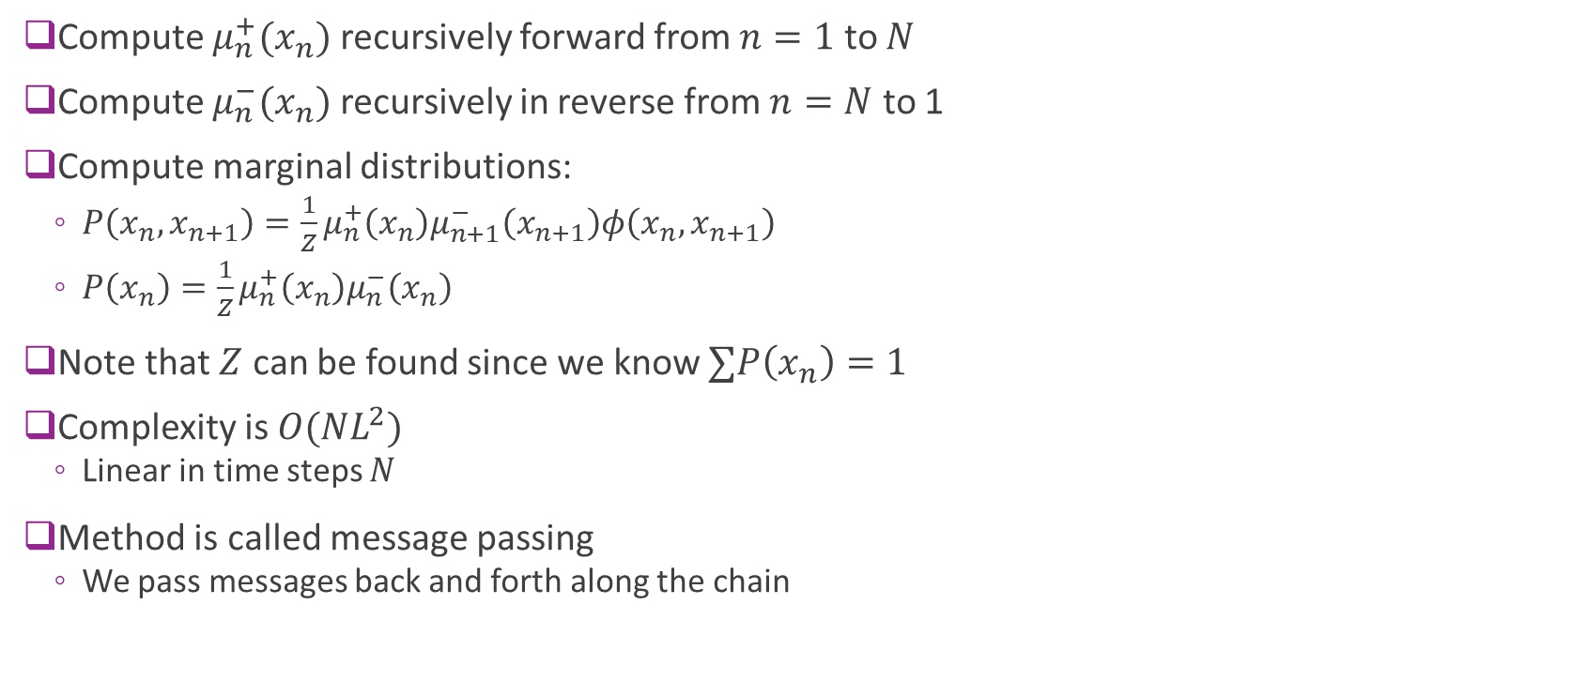
Summary: BP on a Chain
Compute $μ_{n}^{+}(x_{n})$ recursively forward from $n=1$ to $N$
Compute $μ_{n}^{−}(x_{n})$ recursively in reverse from $n=N$ to 1
Compute marginal distributions:
$P\left(x_{n},x_{n+1}\right)=\frac{1}{Z}μ_{n}^{+}\left(x_{n}\right)μ_{n+1}^{−}\left(x_{n+1}\right)φ\left(x_{n},x_{n+1}\right)$
$P\left(x_{n}\right)=\frac{1}{Z}μ_{n}^{+}\left(x_{n}\right)μ_{n}^{−}\left(x_{n}\right)$
Note that $Z$ can be found since we know $∑P\left(x_{n}\right)=1$
Complexity is $O(NL^{2})$
Linear in time steps $N$
Method is called message passing
We pass messages back and forth along the chain

Slide 38
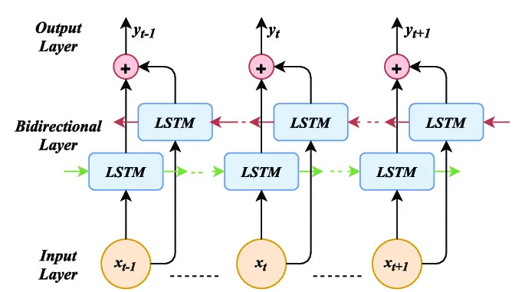
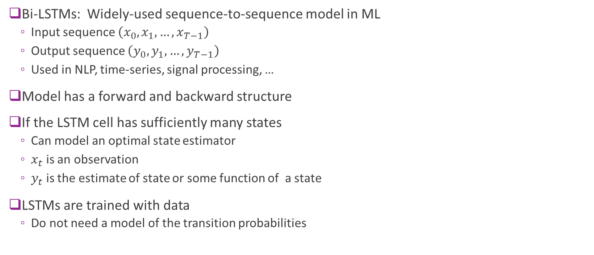
Relation to Bi-LSTMs
Bi-LSTMs: Widely-used sequence-to-sequence model in ML
Input sequence $\left(x_{0},x_{1},…,x_{T−1}\right)$
Output sequence $\left(y_{0},y_{1},…,y_{T−1}\right)$
Used in NLP, time-series, signal processing, …
Model has a forward and backward structure
If the LSTM cell has sufficiently many states
Can model an optimal state estimator
$x_{t}$ is an observation
$y_{t}$ is the estimate of state or some function of a state
LSTMs are trained with data
Do not need a model of the transition probabilities

Slide 39











Extensions to a Tree
$$x_{1}$$
BP can be easily extended to trees
Select any node as the root of the tree
Can be a variable or factor node
Given any factor $φ_{i}$ define:
$x^{(i)}=$ set of variables in factor node $i$
Ex: $x^{(1)}=\left(x_{1},x_{2},x_{3}\right),$ $x^{(3)}=(x_{3},x_{6})$
Given any edge $(x_{j},φ_{i})$, define:
$C^{+}\left(x_{j},φ_{i}\right)≔$ set of factors on the “root side” of the edge
$C^{−}\left(x_{j},φ_{i}\right)≔$ set of factors on the “leaf side” of the edge
Ex: $C^{+}\left(x_{3},φ_{1}\right)=\left\{φ_{1},φ_{2},φ_{4}\right\}, C^{−}\left(x_{3},φ_{1}\right)=\{φ_{3}\}$
$$φ_{1}$$
$$φ_{2}$$
$$x_{5}$$
$$x_{2}$$
$$x_{4}$$
$$φ_{4}$$
$$x_{3}$$
$$φ_{3}$$
$$x_{6}$$

Slide 40












Forward Messages
$$x_{1}$$
Generalize the forward messages on chain:
Message towards the tree root
When $x_{j}$ is a parent of $φ_{i}$:
$μ_{φ_{i}→x_{j}}\left(a\right)=\sum_{x:x_{j}=a}{\prod_{φ_{k}∈C^{−}(φ_{i})}{φ_{k}(x^{\left(k\right)})}}$
Sum is over variables that on the “leaf side” of $φ_{i}$
Ex: $μ_{φ_{1}→x_{1}}\left(a\right)=\sum_{x_{2},x_{3},x_{6}}{φ_{1}\left(x_{1}=a,x_{2},x_{3}\right)φ_{3}(x_{3},x_{6}) }$
When $φ_{i}$ is a parent of $x_{j}$
$μ_{x_{j}→φ_{i}}\left(a\right)=\sum_{x:x_{j}=a}{\prod_{φ_{k}∈C^{−}(x_{3})}{φ_{k}(x^{\left(k\right)})}}$
Sum is over variables that on leaf side of $x_{j}$
Ex: $μ_{x_{3}→φ_{1}}\left(a\right)=\sum_{ x_{6}}{φ_{3}\left(x_{3}=a,x_{6}\right) }$
$$μ_{φ_{1}→x_{1}}$$
$$φ_{2}$$
$$φ_{1}$$
$$μ_{φ_{1}→x_{1}}$$
$$x_{2}$$
$$x_{3}$$
$$x_{4}$$
$$x_{5}$$
$$φ_{4}$$
$$φ_{3}$$
$$x_{6}$$

Slide 41

Reverse Messages
$$x_{1}$$
Generalize the reverse messages on chain:
Message towards the leaves of the tree
When $x_{j}$ is a child of $φ_{i}$:
$μ_{φ_{i}→x_{j}}\left(a\right)=\sum_{x:x_{j}=a}{\prod_{φ_{k}∈C^{+}(φ_{i})}{φ_{k}(x^{\left(k\right)})}}$
Sum is over variables on “root” side of $φ_{i}$
Ex: $μ_{φ_{1}→x_{3}}\left(a\right)=\sum_{x_{1},x_{4},x_{5}}{φ_{1}\left(x_{1},x_{3}=a\right) φ_{2}\left(x_{1},x_{4}\right)φ_{4}(x_{5})}$
When $φ_{i}$ is a parent of $x_{j}$
$μ_{x_{j}→φ_{i}}\left(a\right)=\sum_{x:x_{j}=a}{\prod_{φ_{k}∈C^{+}(x_{3})}{φ_{k}(x^{\left(k\right)})}}$
Sum is over variables on “root side” of $x_{j}$
Ex: $μ_{x_{1}→φ_{1}}\left(a\right)=\sum_{ x_{4},x_{5}}{φ_{2}\left(x_{1}=a,x_{4}\right)φ_{4}(x_{5})}$
$$φ_{1}$$
$$φ_{2}$$
$$x_{5}$$
$$x_{2}$$
$$x_{4}$$
$$φ_{4}$$
$$x_{3}$$
$$φ_{3}$$
$$x_{6}$$

Slide 42

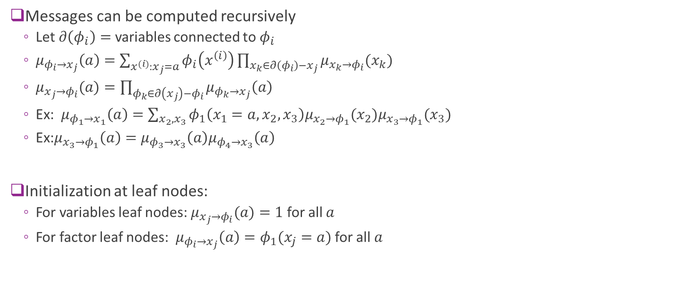

Recursive Updates
$$x_{1}$$
Messages can be computed recursively
Let $∂\left(φ_{i}\right)=$ variables connected to $φ_{i}$
$μ_{φ_{i}→x_{j}}\left(a\right)=\sum_{x^{(i)}:x_{j}=a}{φ_{i}\left(x^{\left(i\right)}\right)\prod_{x_{k}∈∂\left(φ_{i}\right)−x_{j}}{μ_{x_{k}→φ_{i}}(x_{k})}}$
$μ_{x_{j}→φ_{i}}(a)=\prod_{φ_{k}∈∂\left(x_{j}\right)−φ_{i}}{μ_{φ_{k}→x_{j}}\left(a\right)}$
Ex: $μ_{φ_{1}→x_{1}}\left(a\right)=\sum_{x_{2},x_{3}}{φ_{1}\left(x_{1}=a,x_{2},x_{3}\right)μ_{x_{2}→φ_{1}}(x_{2})μ_{x_{3}→φ_{1}}(x_{3})}$
Ex:$μ_{x_{3}→φ_{1}}\left(a\right)=μ_{φ_{3}→x_{3}}\left(a\right)μ_{φ_{4}→x_{3}}\left(a\right)$
Initialization at leaf nodes:
For variables leaf nodes: $μ_{x_{j}→φ_{i}}(a)=1$ for all $a$
For factor leaf nodes: $μ_{φ_{i}→x_{j}}\left(a\right)=φ_{1}(x_{j}=a)$ for all $a$
$$φ_{1}$$
$$φ_{2}$$
$$x_{5}$$
$$x_{2}$$
$$x_{4}$$
$$φ_{4}$$
$$x_{3}$$
$$φ_{3}$$
$$φ_{4}$$
$$x_{6}$$
$$x_{7}$$

Slide 43
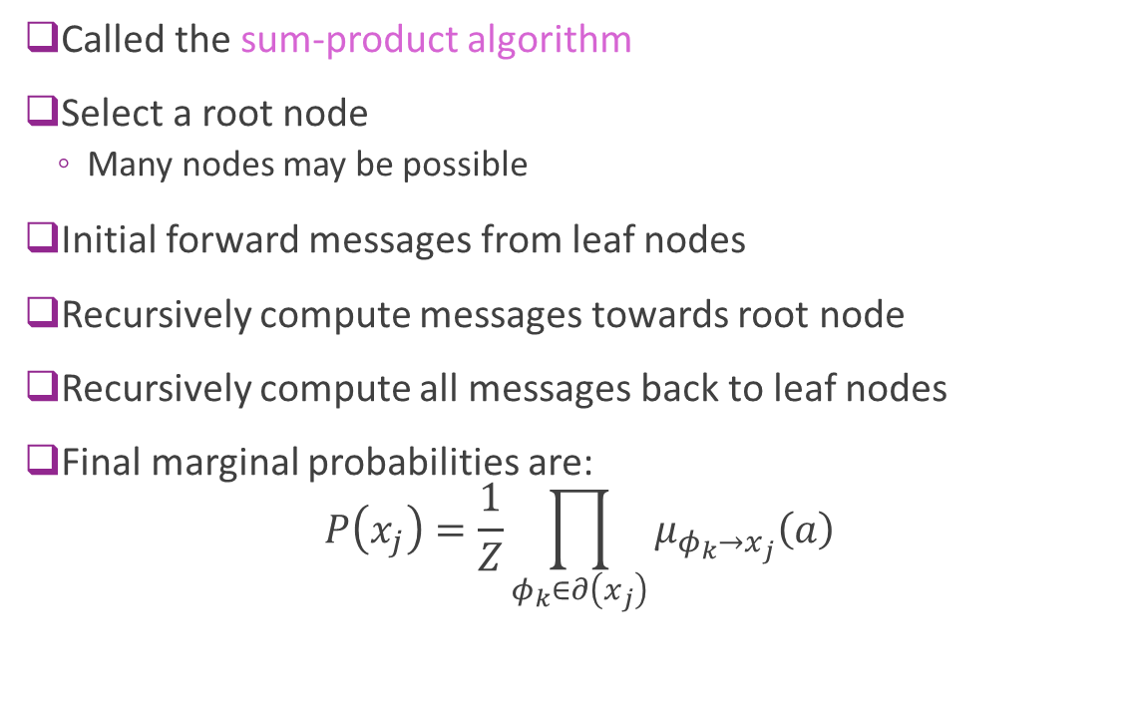
BP Algorithm Summary
Called the sum-product algorithm
Select a root node
Many nodes may be possible
Initial forward messages from leaf nodes
Recursively compute messages towards root node
Recursively compute all messages back to leaf nodes
Final marginal probabilities are: $P\left(x_{j}\right)=\frac{1}{Z}\prod_{φ_{k}∈∂\left(x_{j}\right)}{μ_{φ_{k}→x_{j}}\left(a\right)}$
$$x_{1}$$
$$φ_{1}$$
$$φ_{2}$$
$$x_{5}$$
$$x_{2}$$
$$x_{4}$$
$$φ_{4}$$
$$x_{3}$$
$$φ_{3}$$
$$φ_{4}$$
$$x_{6}$$
$$x_{7}$$

Slide 44
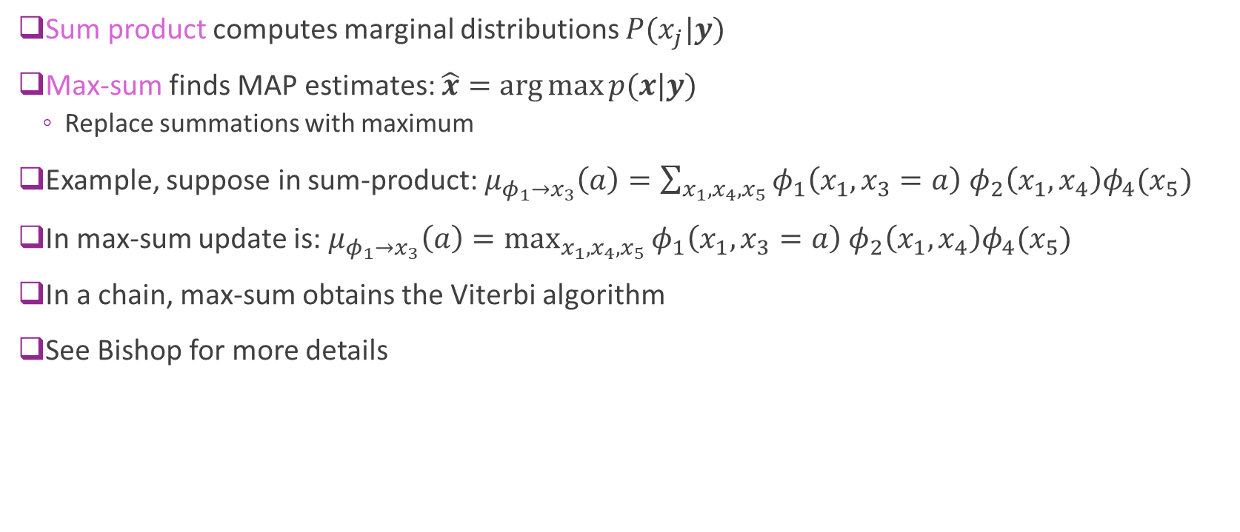
Max-Sum
Sum product computes marginal distributions $P(x_{j}|y)$
Max-sum finds MAP estimates: $\hat{x}=\arg{\max{p(x|y)}}$
Replace summations with maximum
Example, suppose in sum-product: $μ_{φ_{1}→x_{3}}\left(a\right)=\sum_{x_{1},x_{4},x_{5}}{φ_{1}\left(x_{1},x_{3}=a\right) φ_{2}\left(x_{1},x_{4}\right)φ_{4}(x_{5})}$
In max-sum update is: $μ_{φ_{1}→x_{3}}\left(a\right)=\max_{x_{1},x_{4},x_{5}}{φ_{1}\left(x_{1},x_{3}=a\right) φ_{2}\left(x_{1},x_{4}\right)φ_{4}(x_{5})}$
In a chain, max-sum obtains the Viterbi algorithm
See Bishop for more details

Slide 45

Implementation Details
Often easier to use $\log{μ_{x→φ}}$ instead of $μ_{x→φ}$.
Provides better conditioning
Can rescale weights
Constant multiplicative factors will not influence result

Slide 46
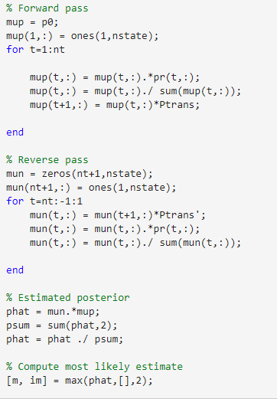
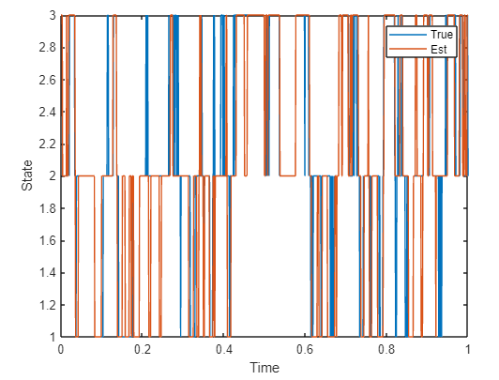
HMM Example:
Return to the time varying noise problem
Simple to implement in MATLAB

Slide 47
Outline
LDPC Codes: Motivation and History
Graphical Models
Inference via Belief Propagation
LDPC Encoding
LDPC Decoding
5G LDPC codes

Slide 48
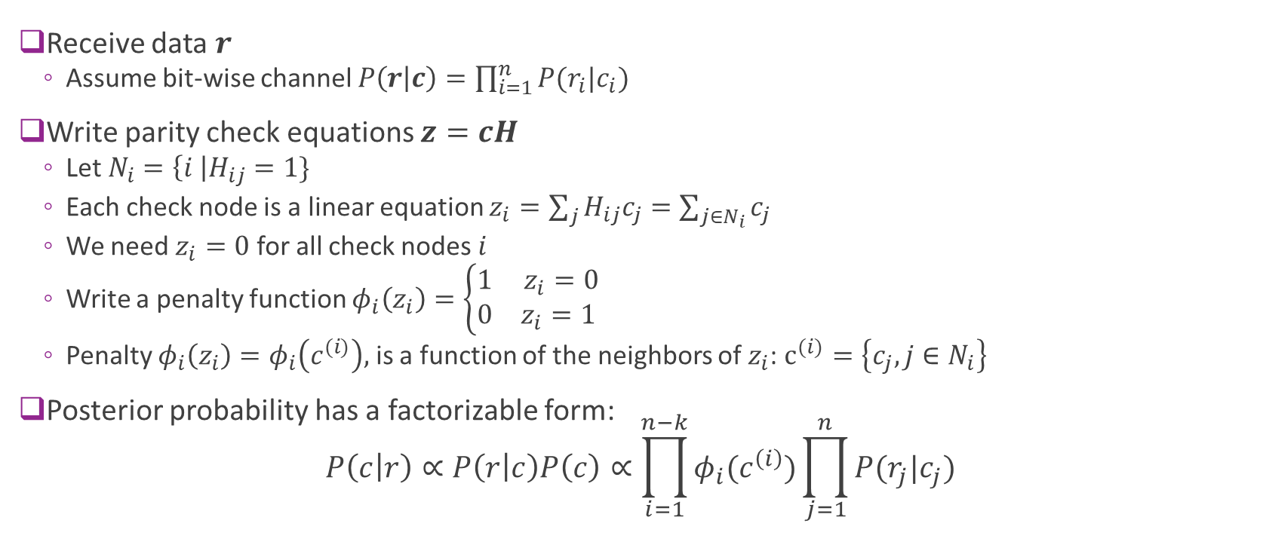
Factorizing the Posterior
Receive data $r$
Assume bit-wise channel $P\left(r | c\right)=\prod_{i=1}^{n}{P(r_{i}|c_{i})}$
Write parity check equations $z=cH$
Let $N_{i}=\left\{i \right|H_{ij}=1\}$
Each check node is a linear equation $z_{i}=\sum_{j}{H_{ij}c_{j}}=\sum_{j∈N_{i}}{c_{j}}$
We need $z_{i}=0$ for all check nodes $i$
Write a penalty function $φ_{i}\left(z_{i}\right)=\left\{\begin{matrix}1 & z_{i}=0 \\ 0 & z_{i}=1 \end{matrix}\right.$
Penalty $φ_{i}\left(z_{i}\right)=φ_{i}\left(c^{(i)}\right),$is a function of the neighbors of $z_{i}$: $c^{(i)}=\left\{c_{j}, j∈N_{i}\right\}$
Posterior probability has a factorizable form: $P\left(c | r\right)∝P\left(r | c\right)P\left(c\right)∝\prod_{i=1}^{n−k}{φ_{i}(c^{\left(i\right)})}\prod_{j=1}^{n}{P(r_{j}|c_{j})}$

Slide 49









Factor Graph
$$c_{1}$$
Also called the Tanner Graph
Variable nodes:
One for each coded bit $c_{j}$
Factor nodes
One for each $P(r_{j}|c_{j})$ [These are often not shown]
One for each check node $z_{i}$
Example: Hamming
$H=\left[\begin{matrix}\begin{matrix}1 & 1 & 1 \\ 1 & 1 & 0 \\ 1 & 0 & 1\end{matrix} \\ \begin{matrix}0 & 1 & 1 \\ 1 & 0 & 0 \\ 0 & 1 & 0\end{matrix} \\ \begin{matrix}0 & 0 & 1\end{matrix}\end{matrix}\right]$
${P(r_{1}|c}_{1}$)
$$z_{1}$$
$$⋮$$
$$z_{2}$$
$$z_{3}$$
${P(r_{7}|c}_{7}$)
$$c_{7}$$

Slide 50



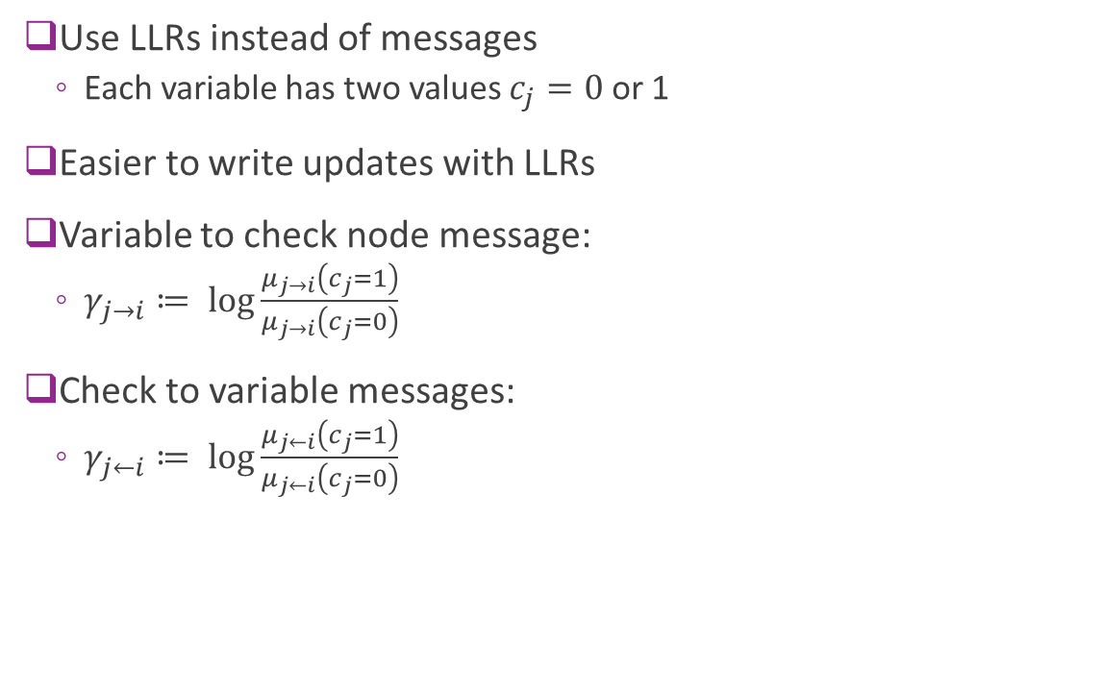



Message Passing Decoding with LLRs
Use LLRs instead of messages
Each variable has two values $c_{j}=0$ or 1
Easier to write updates with LLRs
Variable to check node message:
$γ_{j→i}≔ \log{\frac{μ_{j→i}\left(c_{j}=1\right)}{μ_{j→i}\left(c_{j}=0\right)}}$
Check to variable messages:
$γ_{j←i}≔ \log{\frac{μ_{j←i}\left(c_{j}=1\right)}{μ_{j←i}\left(c_{j}=0\right)}}$
$$γ_{j→i}$$
$$z_{1}$$
$$z_{2}$$
$$z_{3}$$
$$c_{7}$$
$$γ_{j←i}$$

Slide 51

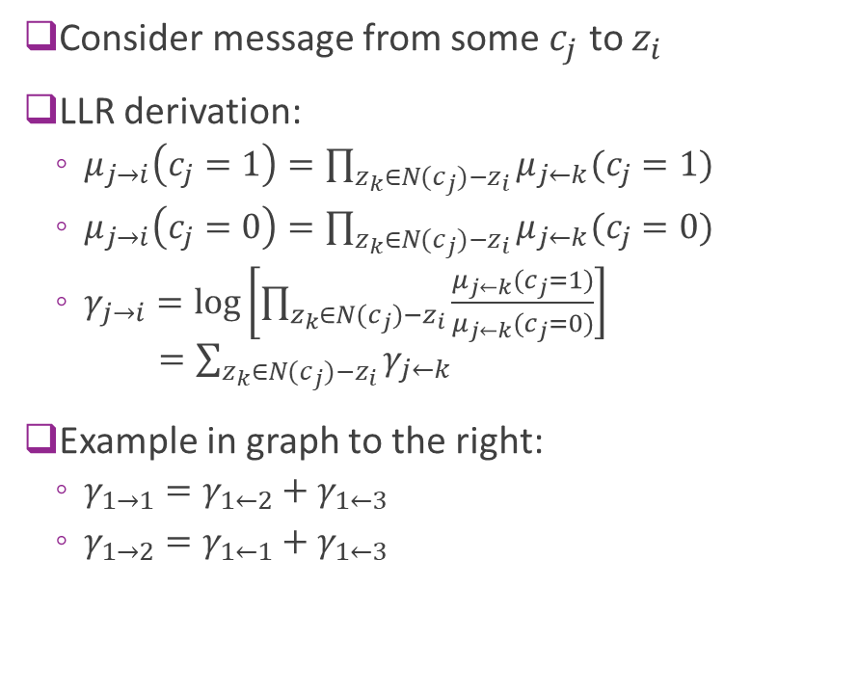



Variable Node Update
Consider message from some $c_{j}$ to $z_{i}$
LLR derivation:
$μ_{j→i}\left(c_{j}=1\right)=\prod_{z_{k}∈N(c_{j})−z_{i}}{μ_{j←k}(c_{j}=1)}$
$μ_{j→i}\left(c_{j}=0\right)=\prod_{z_{k}∈N(c_{j})−z_{i}}{μ_{j←k}(c_{j}=0)}$
$γ_{j→i}=\log\left[\prod_{z_{k}∈N(c_{j})−z_{i}}{\frac{μ_{j←k}(c_{j}=1)}{μ_{j←k}(c_{j}=0)}}\right]$ $=\sum_{z_{k}∈N(c_{j})−z_{i}}{γ_{j←k}}$
Example in graph to the right:
$γ_{1→1}=γ_{1←2}+γ_{1←3}$
$γ_{1→2}=γ_{1←1}+γ_{1←3}$
$$z_{1}$$
$$c_{1}$$
$$z_{2}$$
$$z_{3}$$

Slide 52





Factor Node Update 1
Consider message from $z_{i}$ to $c_{j}$
We know$z_{i}=\sum_{k∈N_{i}}{c_{k}=0}$
Define:
$A_{0}=\left\{ c^{(i)} \right| \sum_{k∈N_{i}}{c_{k}=0}, c_{j}=0\},$
$A_{1}=\left\{ c^{(i)} \right| \sum_{k∈N_{i}}{c_{k}=0}, c_{j}=1\},$
Example, in message from $z_{1}$ to $c_{1}$ in graph to right:
We want $c_{1}+c_{2}+c_{3}=0$
$A_{0}=\left\{\left(c_{2},c_{3}\right)=\left(0,0\right), \left(1,1\right)\right\}$
$A_{1}=\left\{\left(c_{2},c_{3}\right)=\left(1,0\right), \left(0,1\right)\right\}$
$$c_{1}$$
$$c_{2}$$
$$z_{1}$$
$$c_{3}$$

Slide 53






Factor Node Update 2
Then $μ_{j←i}\left(c_{j}=0\right)=\sum_{c^{(i)}∈A_{0}}{\prod_{c_{k}}{μ_{k→i}(c_{k})}}$
Since $γ_{j→i}≔ \log{\frac{μ_{j→i}\left(c_{j}=1\right)}{μ_{j→i}\left(c_{j}=0\right)}}$
$μ_{j←i}\left(c_{j}=0\right) =B\sum_{c^{(i)}∈A_{0}}{\exp\left[\sum{c_{k}γ_{k→i}}\right]}$
$B=\prod_{k}{μ_{k→i}(0)}$
Similarly, $μ_{j←i}\left(c_{j}=1\right) =B\sum_{c^{(i)}∈A_{1}}{\exp\left[\sum{c_{k}γ_{k→i}}\right]}$
LLR message is: $γ_{i→j}≔ \log{\frac{μ_{i→j}\left(c_{j}=1\right)}{μ_{i→j}\left(c_{j}=0\right)}}$ $=\log\left[\frac{\sum_{c^{\left(i\right)}∈A_{1}}{\exp\left[\sum{c_{k}γ_{k→i}}\right]}}{\sum_{c^{(i)}∈A_{0}}{\exp\left[\sum{c_{k}γ_{k→i}}\right]}}\right]$
$$c_{1}$$
$$c_{2}$$
$$z_{1}$$
$$c_{3}$$
$$γ_{1→1}=\log\left[\frac{e^{γ_{2→1}}+e^{γ_{3→1}}}{1+e^{γ_{3→1}+γ_{2→1}}}\right]$$

Slide 54
Outline
LDPC Codes: Motivation and History
Graphical Models
Inference via Belief Propagation
LDPC Encoding
LDPC Decoding
5G LDPC codes

Slide 55

LDPC vs. Turbo
Move for Turbo (4G) to LDPC (5G)
Slight performance improvement
Complexity is lower

Slide 56

Structure
Base graph:
A small LDPC graph
Two base graphs supported in 5G
Lifting:
Used to create longer block lengths
Number of columns and rows adjustable:
To support different rates
Support incremental redundancy
We will discuss IR in the wireless class

