Slide 1

DATA SCIENCE PROJECT
Analysis of Video Game Sales
Group 10

Slide 2
Name | ID | Contribution | E-mail
Ahmed Khaled | 185272 | data encoding ,aggregation, Data Visualization - answer the remaining questions with visualizations and formulate hypothesis | ahmed185272@bue.edu.eg
Ahmed Ramie | 217380 | Web Scraping, Clean and tidy the Data sets - , Clean and Tidy Datasets, Integrate all relevant datasets | ahmed217380@bue.edu.eg
Mariam | 196292 | data encoding ,aggregation, Data Visualization - answer the remaining questions with visualizations and formulate hypothesis | mariam196292@bue.edu.eg
Mohamed Hany | 206457 | Clean and tidy the data set - - answer the remaining questions with visualizations and formulate hypothesis | Mohamed206457@bue.edu.eg
Notes:
Notes to presenter:
What is your purpose for sharing this reflection?
Is it at the end of a unit or project?
Are you sharing this reflection, at the attainment of a learning goal you set for yourself?
Is it at the end of a course?
State your purpose for the reflection or even the purpose of the learning experience or learning goal. Be clear and be specific in stating your purpose.

Slide 3

Introduction
The dataset found at https://www.kaggle.com/code/upadorprofzs/eda-video-game-sales is a collection of video game sales data spanning several years and regions. The data contains information about various video games, including their titles, release dates, platforms, genres, publishers, and sales figures. The dataset consists of a single CSV file, which can be loaded into a data analysis tool or programming language for analysis.
Notes:
Notes to presenter:
Description of what you learned in your own words on one side.
Include information about the topic
Details about the topic will also be helpful here.
Tell the story of your learning experience. Just like a story there should always be a beginning, middle and an end.
On the other side, you can add a graphic that provides evidence of what you learned.
Feel free to use more than one slide to reflect upon your process. It also helps to add some video of your process.

Slide 4
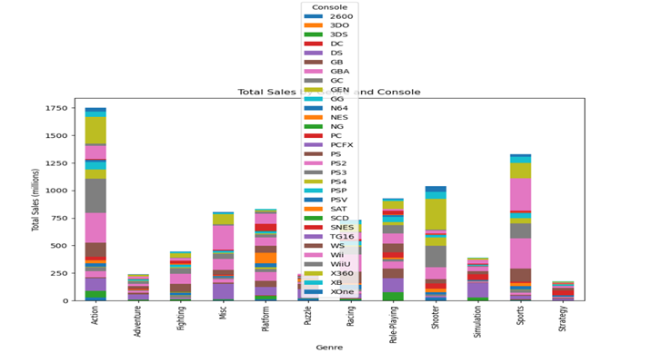
Q.1 What is the top-selling game genres across different consoles?
First, the code groups the cleaned and encoded data set by genre and console and aggregates the total sales for each group. The resulting table is then pivoted to reshape the data, with genres as the index and consoles as the columns.
Finally, a stacked bar chart is created using the pivoted table, where each stack represents the total sales of a console for a particular genre. The chart is plotted with the title "Total Sales by Genre and Console", x-axis labeled as "Genre", y-axis labeled as "Total Sales (millions)", and a size of 10x6.
The stacked bar chart can reveal which genres and consoles have higher total sales compared to others and can help identify trends or patterns in the video game market.

Slide 5
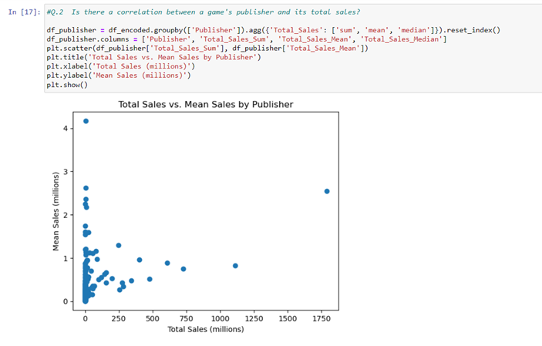
Q.2 Is there a correlation between a game's publisher and its total sales?
This code loads the cleaned and encoded video game sales dataset, groups the data by publisher and calculates the total sales, mean and median of the sales for each publisher. Then it creates a scatter plot to visualize the correlation between the total sales and mean sales for each publisher.

Slide 6
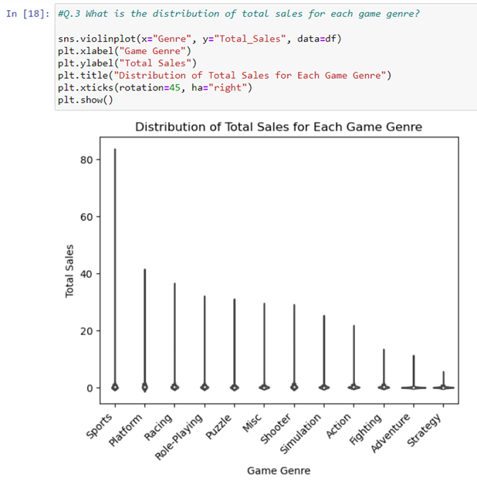
Q.3 What is the distribution of total sales for each game genre?
This code creates a box plot using Seaborn library to show the distribution of total sales for each game genre in the dataset. The x-axis represents the game genre, and the y-axis represents the total sales. The plot shows the median value, the interquartile range, and any potential outliers for each game genre. The rotation and horizontal alignment of the x-axis labels are adjusted using plt.xticks() function. The labels and title are set using plt.xlabel(), plt.ylabel(), and plt.title() functions.

Slide 7
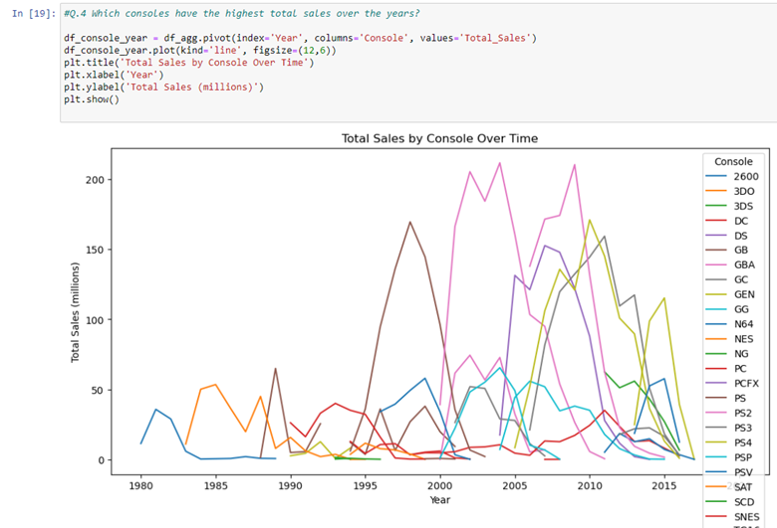
Q.4 Which consoles have the highest total sales over the years?
This code first groups the cleaned and aggregated video game sales data by console and year, and then calculates the sum of total sales for each console and year combination. It then pivots the resulting table to create a new table with years as rows, consoles as columns, and total sales as values. Finally, it creates a line plot to visualize the total sales by console over time. The resulting plot shows how total sales have changed over time for each console. The x-axis shows the years, and the y-axis shows the total sales in millions of units. Each console is represented by a different colored line on the plot. The plot can help identify trends or patterns in the release of video games over time for each console.

Slide 8
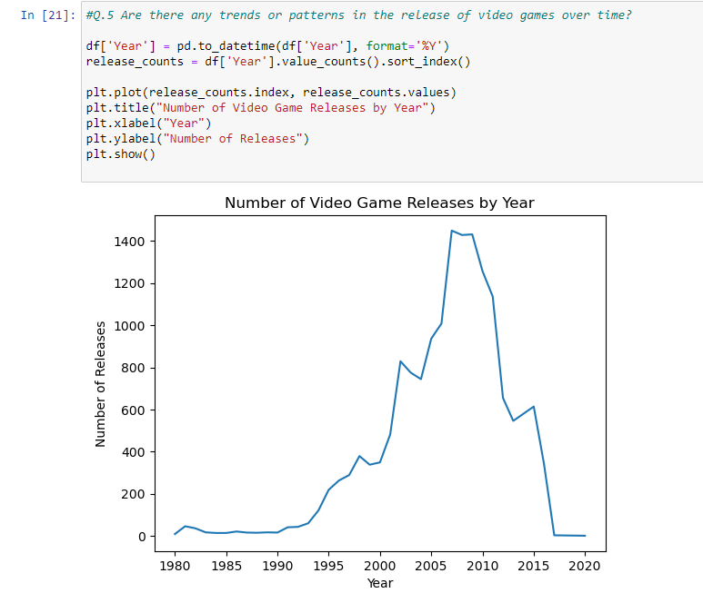
Q.5 Are there any trends or patterns in the release of video games over time?
This code reads in a pandas dataframe from a CSV file and then converts the 'Year' column to a datetime object using the pd.to_datetime() function. It then counts the number of video game releases by year using the value_counts() function and plots the results using plt.plot(). The resulting plot displays the number of video game releases over time.

Slide 9
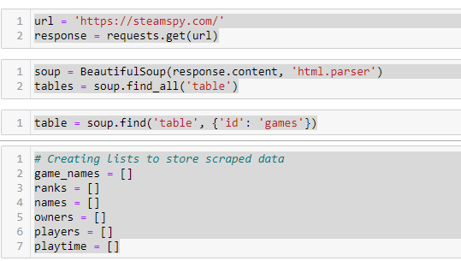
SteamSpy Scrapping with Beautiful Soup
This code uses Python to extract data from a website using web scraping techniques, then it imports the requests and BeautifulSoup libraries, which are used to send HTTP requests to the website and parse the HTML content of the response, respectively. The website being scraped is SteamSpy, which provides information about video games on the Steam platform. The code sends a GET request to the SteamSpy website using the requests.get() method and stores the response content in a variable called "response".
Then creates a BeautifulSoup object called "soup" by passing the response content and a parser to the BeautifulSoup() function.
The code then uses the find() method of the soup object to extract the table with an id attribute of "games".
Then it iterates over the rows of the table using a for loop, and extracts the game name, rank, owner, number of players, and playtime for each row.
The extracted data is stored in separate lists to be analyzed and visualized

Slide 10
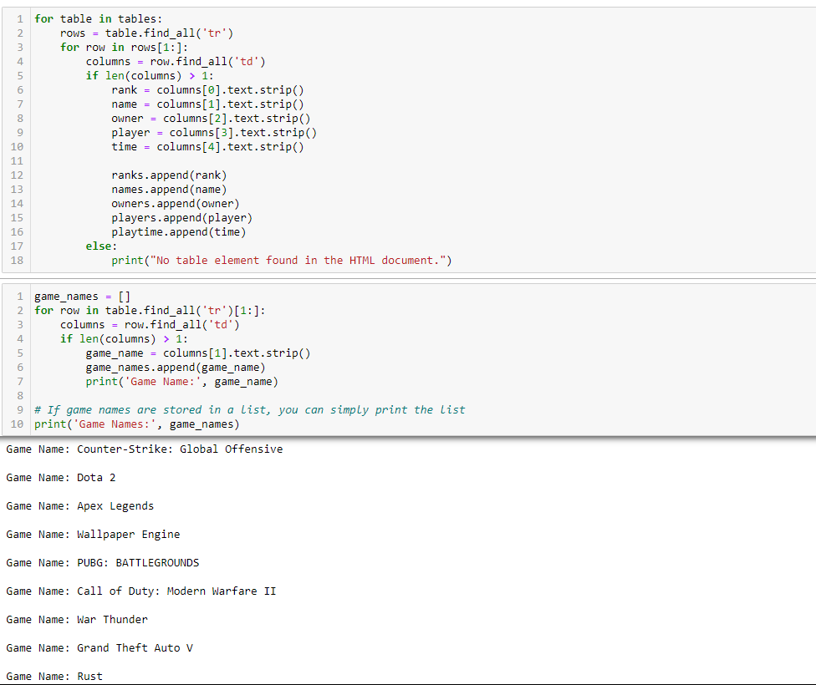
Storing the extracted Data.
The code iterates through all the tables on a webpage and extracts data from their rows and columns. Specifically, it extracts the rank, name, owner, number of players, and playtime data for each game listed on the webpage. The extracted data is stored in separate lists, including ranks, names, owners, players, and playtime.
Then it checks that each row has at least two columns before extracting data to avoid errors, and uses the strip() method to remove any leading or trailing whitespace from the extracted data.

Slide 11
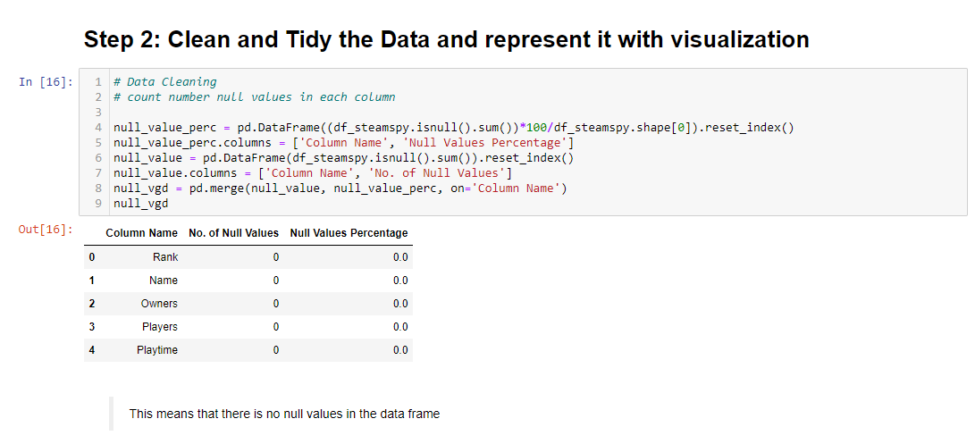
Cleaning Data with Pandas
This code snippet demonstrates how to use pandas, a popular data analysis library in Python, to count the number of null values in each column of a dataframe. The isnull() method is used to identify the null values in the dataframe, and the sum() method is used to count the number of null values in each column. To calculate the percentage of null values in each column, the count of null values is multiplied by 100 and divided by the total number of rows in the dataframe.
Two dataframes are created to store the results: one containing the percentage of null values in each column and the other containing the total number of null values in each column.
The merge() method is used to combine the two dataframes based on the common column 'Column Name'.
This information can be useful in determining how to handle the missing values in the dataset, such as imputing or removing them, depending on the analysis goals and the amount and nature of missing data.
By using pandas to count the null values, we were able to efficiently and accurately to find that there’s no null values.

Slide 12
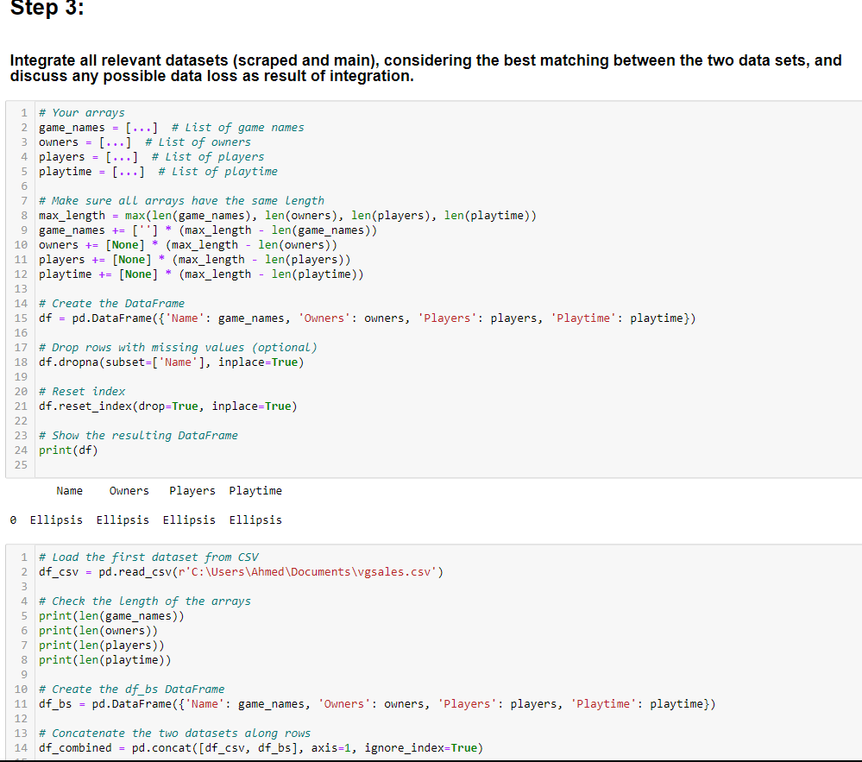
Integrating Datasets
This code creates a Pandas DataFrame from four separate lists, making sure all arrays have the same length before doing so. It then drops any rows with missing values (if desired), resets the index, and outputs the resulting DataFrame. Additionally, it loads another dataset from a CSV file and concatenates it with the first DataFrame along the columns, creating a combined DataFrame.

Slide 13
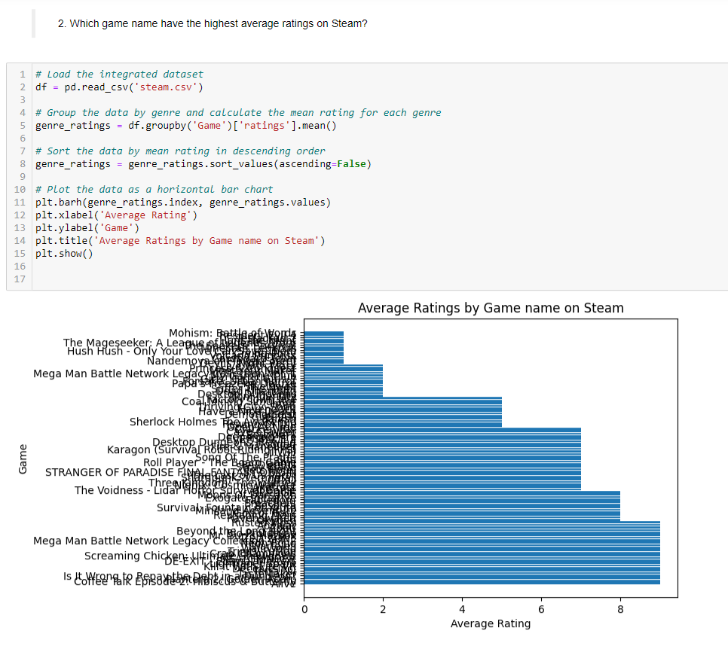
Use the integrated dataset and visuals to answer remaining questions.
This code loads a dataset of game ratings on Steam, groups the data by game genre, calculates the mean rating for each genre, and sorts the data in descending order based on the mean rating. It then visualizes the data as a horizontal bar chart showing the average rating for each game. This chart can help identify which game genres are generally more popular among Steam users.

Slide 14
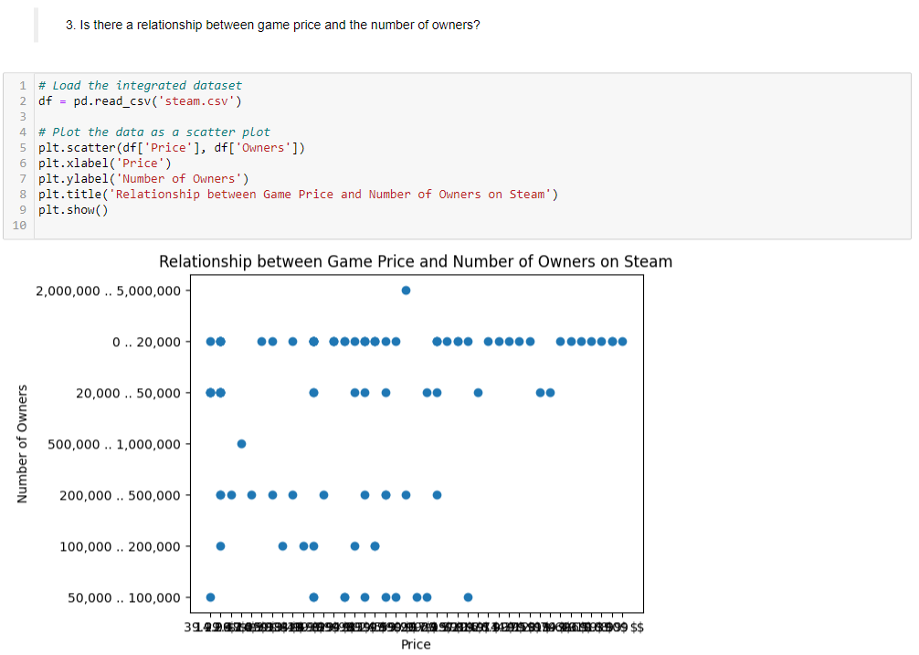
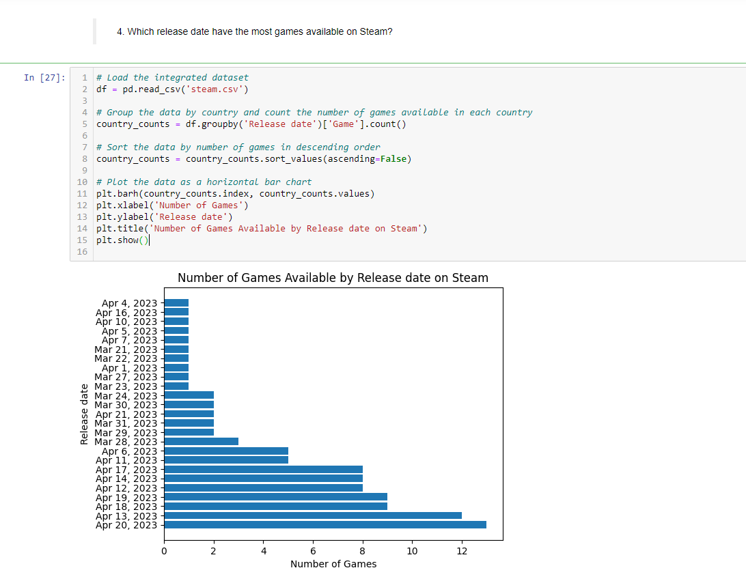
Use the integrated dataset and visuals to answer remaining questions.

Slide 15
Conclusion
We first cleaned and visualized data from Kaggle and used it to represent and answer questions like “What is the top-selling game genres across different consoles?” then we scrapped data from SteamSpy.com which has data related to Steam.com, tidied it then we integrated it with the data from Kaggle and answered questions like “Are there any relationships between game ratings and the number of owners, playtime, or price?” and visualized the merged data.
Notes:
Notes to presenter:
Description of what you learned in your own words on one side.
Include information about the topic
Details about the topic will also be helpful here.
Tell the story of your learning experience. Just like a story there should always be a beginning, middle and an end.
On the other side, you can add a graphic that provides evidence of what you learned.
Feel free to use more than one slide to reflect upon your process. It also helps to add some video of your process.

Slide 16
References:
1. https://www.crummy.com/software/BeautifulSoup/bs4/doc/
2. https://www.kaggle.com/code/upadorprofzs/eda-video-game-sales
3. https://pandas.pydata.org/docs/
4. https://matplotlib.org/stable/index.html
5. https://steamspy.com/
6. https://numpy.org/
7. https://seaborn.pydata.org/
8. https://amueller.github.io/word_cloud/index.html

Slide 17
Thank you <3

