Slide 1



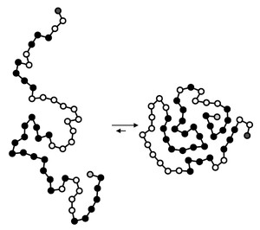
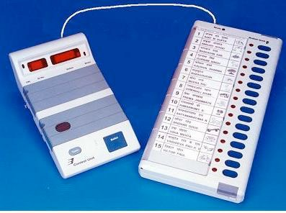

Why study algorithms?
Their impact is broad and far-reaching.
Internet. Web search, packet routing, distributed file sharing, ... Biology. Human genome project, protein folding, ...
Computers. Circuit layout, file system, compilers, ... Computer graphics. Movies, video games, virtual reality, ... Security. Cell phones, e-commerce, voting machines, ...
Multimedia. MP3, JPG, DivX, HDTV, face recognition, ...
Social networks. Recommendations, news feeds, advertisements, ... Physics. N-body simulation, particle collision simulation, ...
⋮

Slide 2

Why study algorithms?
Old roots, new opportunities.
・Study of algorithms dates at least to Euclid.
300 BCE
1920s
1930s
1940s
1950s
1960s
1970s
1980s
1990s
2000s
・Formalized by Church and Turing in 1930s.
・Some important algorithms were discovered by undergraduates in a course like this!

Slide 3

Why study algorithms?
To solve problems that could not otherwise be addressed.
Ex. Network connectivity. [stay tuned]

Slide 4

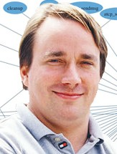
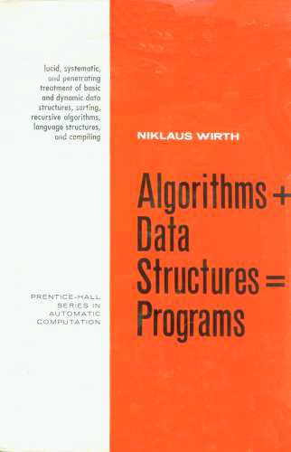

Why study algorithms?
To become a proficient programmer.
“ I will, in fact, claim that the difference between a bad programmer and a good one is whether he considers his code or his data structures more important. Bad programmers worry about the code. Good programmers worry about data structures and their relationships. ”
— Linus Torvalds (creator of Linux)
“ Algorithms + Data Structures = Programs. ” — Niklaus Wirth

Slide 5


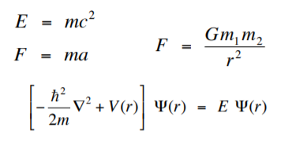
Why study algorithms?
They may unlock the secrets of life and of the universe.
Computational models are replacing math models in scientific inquiry.
= mc²
= ma
for (double t = 0.0; true; t = t + dt) for (int i = 0; i < N; i++)
{
bodies[i].resetForce();
for (int j = 0; j < N; j++) if (i != j)
bodies[i].addForce(bodies[j]);
}
F =
Gm₁ m_{2 r}2
⎡⎡
!2
⎤⎤
2
⎢⎢− _{2m} ∇ + V (r)⎥⎥ Ψ(r)
= E Ψ(r)
⎣⎣
⎦⎦
20th century science (formula based)
21st century science (algorithm based)
“ Algorithms: a common language for nature, human, and computer. ” — Avi Wigderson

Slide 6



Why study algorithms?
・Their impact is broad and far-reaching.
・Old roots, new opportunities.
・To solve problems that could not otherwise be addressed.
・For intellectual stimulation.
・To become a proficient programmer.
・They may unlock the secrets of life and of the universe.
・For fun and profit.
Why study anything else?
6

Slide 7

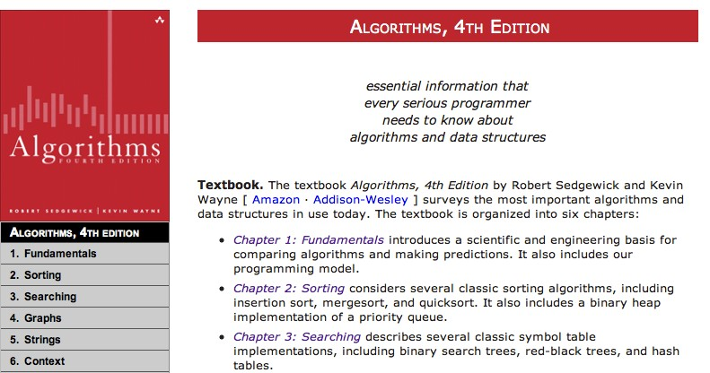

・Lecture slides.
Resources
Booksite.
・Download code.
・Summary of content.
http://algs4.cs.princeton.edu
Textbook (optional).
・Algorithms, 4th edition by Sedgewick and Wayne.
・More extensive coverage of topics.
Algorithms
・More topics.
F O U R T H E D I T I O N
R O B E R T S E D G E W I C K
K E V I N W A Y N E
ISBN 0-321-57351-X
7

