Slide 1
Subtext of today’s lecture
Steps to developing a usable algorithm.
・Model the problem.
・Find an algorithm to solve it.
・Fast enough? Fits in memory?
・If not, figure out why.
・Find a way to address the problem.
・Iterate until satisfied.
The scientific method. Mathematical analysis.
2

Slide 2
・Union command: connect two objects.
Dynamic connectivity
Given a set of N objects.
・Find/connected query: is there a path connecting the two objects?
union(4, | 3)
union(3, | 8)
union(6, | 5)
union(9, | 4)
union(2, | 1)
0
1
2
3
4
connected(0, 7)
connected(8, 9)
5
6
7
8
9
✔
union(5, | 0)
union(7, | 2)
union(6, | 1)
union(1, | 0)
connected(0, 7)
✔
2

Slide 3

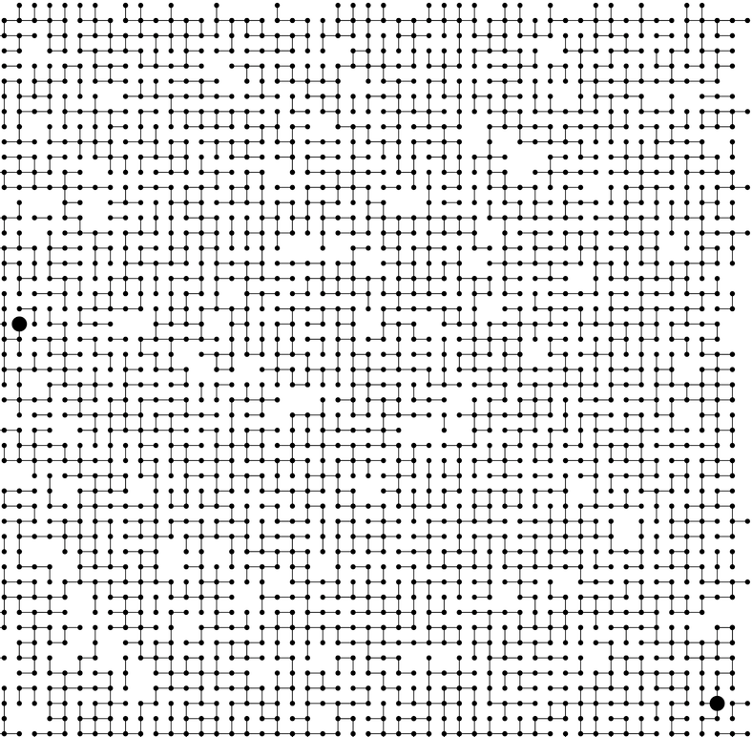
Connectivity example
Q. Is there a path connecting p and q ?
p
q
A. Yes.
3

Slide 4
Modeling the objects
Applications involve manipulating objects of all types.
・Pixels in a digital photo.
・Computers in a network.
・Friends in a social network.
・Transistors in a computer chip.
・Elements in a mathematical set.
・Variable names in Fortran program.
・Metallic sites in a composite system.
When programming, convenient to name objects 0 to N –1.
・Use integers as array index.
・Suppress details not relevant to union-find.
4

Slide 5
Modeling the connections
We assume "is connected to" is an equivalence relation:
・Reflexive: p is connected to p.
・Symmetric: if p is connected to q, then q is connected to p.
・Transitive: if p is connected to q and q is connected to r, then p is connected to r.
Connected components. Maximal set of objects that are mutually connected.
0
1
2
3
4 5
6
7
{ 0 } { 1 4 5 } { 2 3 6 7 }
3 connected components
5

Slide 6
Implementing the operations
Find query. Check if two objects are in the same component.
Union command. Replace components containing two objects with their union.
0
1
2
3
0
1
2
3
union(2, 5)
4 5
6
7
4 5
6
7
{ 0 } { 1 4 5 } { 2 3 6 7 }
{ 0 } { 1 2 3 4 5 6 7 }
3 connected components
2 connected components

Slide 7
Union-find data type (API)
Goal. Design efficient data structure for union-find.
・Number of objects N can be huge.
・Number of operations M can be huge.
・Find queries and union commands may be intermixed.
public class UF
 | UF(int N) |  |  | initialize union-find data structure with N objects (0 to N – 1)
void | union(int p, int | q) |  | add connection between p and q
boolean | connected(int p, | int | q) | are p and q in the same component?
int | find(int p) |  |  | component identifier for p (0 to N – 1)
int | count() |  |  | number of components

Slide 8


Dynamic-connectivity client
・Read in number of objects N from standard input.
・Repeat:
– read in pair of integers from standard input
– if they are not yet connected, connect them and print out pair
public static void main(String[] args)
{
int N = StdIn.readInt(); UF uf = new UF(N);
while (!StdIn.isEmpty())
{
int p = StdIn.readInt(); int q = StdIn.readInt(); if (!uf.connected(p, q))
{
uf.union(p, q); StdOut.println(p + " " + q);
}
}
}
% more tinyUF.txt 10
4 3
3 8
6 5
9 4
2 1
8 9
5 0
7 2
6 1
1 0
6 7

Slide 9



Slide 10

Quick-find [eager approach]
Data structure.
・Integer array id[] of length N.
if and only if
・Interpretation: p and q are connected iff they have the same id.
0
1
2
3
4
5
6
7
8
9
0, 5 and 6 are connected
1, 2, and 7 are connected
3, 4, 8, and 9 are connected
id[]
0 | 1 | 1 | 8 | 8 | 0 | 0 | 1 | 8 | 8
0
1
2
3
4
5
6
7
8
9

Slide 11
Quick-find [eager approach]
Data structure.
・Integer array id[] of length N.
・Interpretation: p and q are connected iff they have the same id.
0
1
2
3
4
5
6
7
8
9
id[]
0 | 1 | 1 | 8 | 8 | 0 | 0 | 1 | 8 | 8
Find. Check if p and q have the same id.
id[6] = 0; id[1] = 1
6 and 1 are not connected
Union. To merge components containing p and q, change all entries whose id equals id[p] to id[q].
0
1
2
3
4
5
6
7
8
9
after union of 6 and 1
id[]
1 | 1 | 1 | 8 | 8 | 1 | 1 | 1 | 8 | 8
problem: many values can change

Slide 12
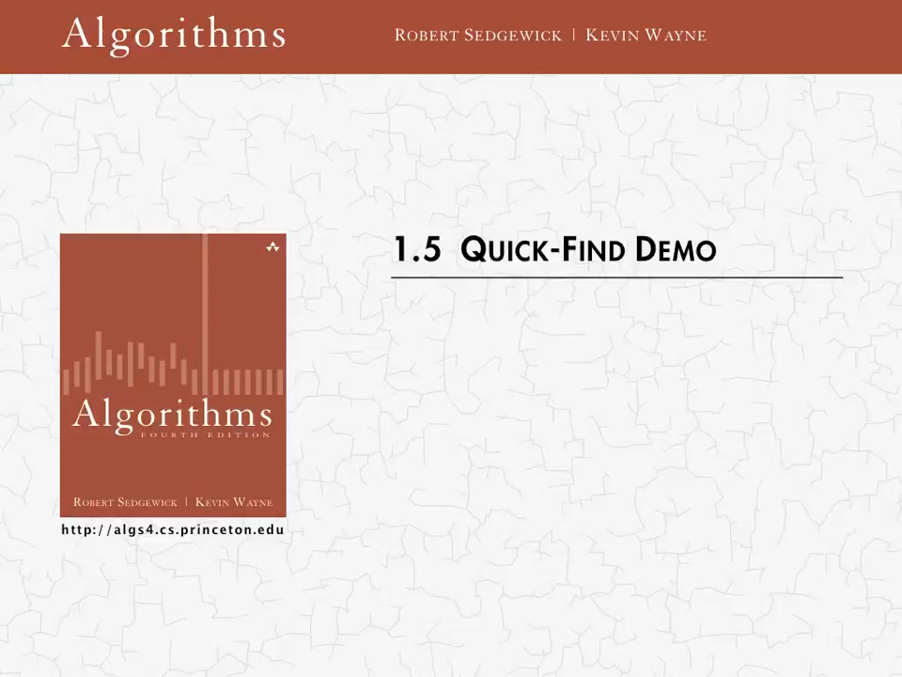


Quick-find demo
0
1
2
3
4
5
6
7
8
9
0
1
2
3
4
5
6
7
8
9
id[]
0 | 1 | 2 | 3 | 4 | 5 | 6 | 7 | 8 | 9

Slide 13
Quick-find demo
0
1
2
3
4
5
6
7
8
9
0
1
2
3
4
5
6
7
8
9
id[]
1 | 1 | 1 | 8 | 8 | 1 | 1 | 1 | 8 | 8

Slide 14

Quick-find: Java implementation
public class QuickFindUF
{
private int[] id;
public QuickFindUF(int N)
{
id = new int[N];
for (int i = 0; i < N; i++) id[i] = i;
set id of each object to itself (N array accesses)
}
check whether p and q
are in the same component (2 array accesses)
public boolean connected(int p, int q)
{ return id[p] == id[q]; }
public void union(int p, int q)
{
int pid = id[p]; int qid = id[q];
for (int i = 0; i < id.length; i++) if (id[i] == pid) id[i] = qid;
}
change all entries with id[p] to id[q] (at most 2N + 2 array accesses)
}

Slide 15


Quick-find is too slow
Cost model. Number of array accesses (for read or write).
algorithm | initialize | union | find
quick-find | N | N | 1
order of growth of number of array accesses
quadratic
Union is too expensive. It takes N ² array accesses to process a sequence of
N union commands on N objects.

Slide 16
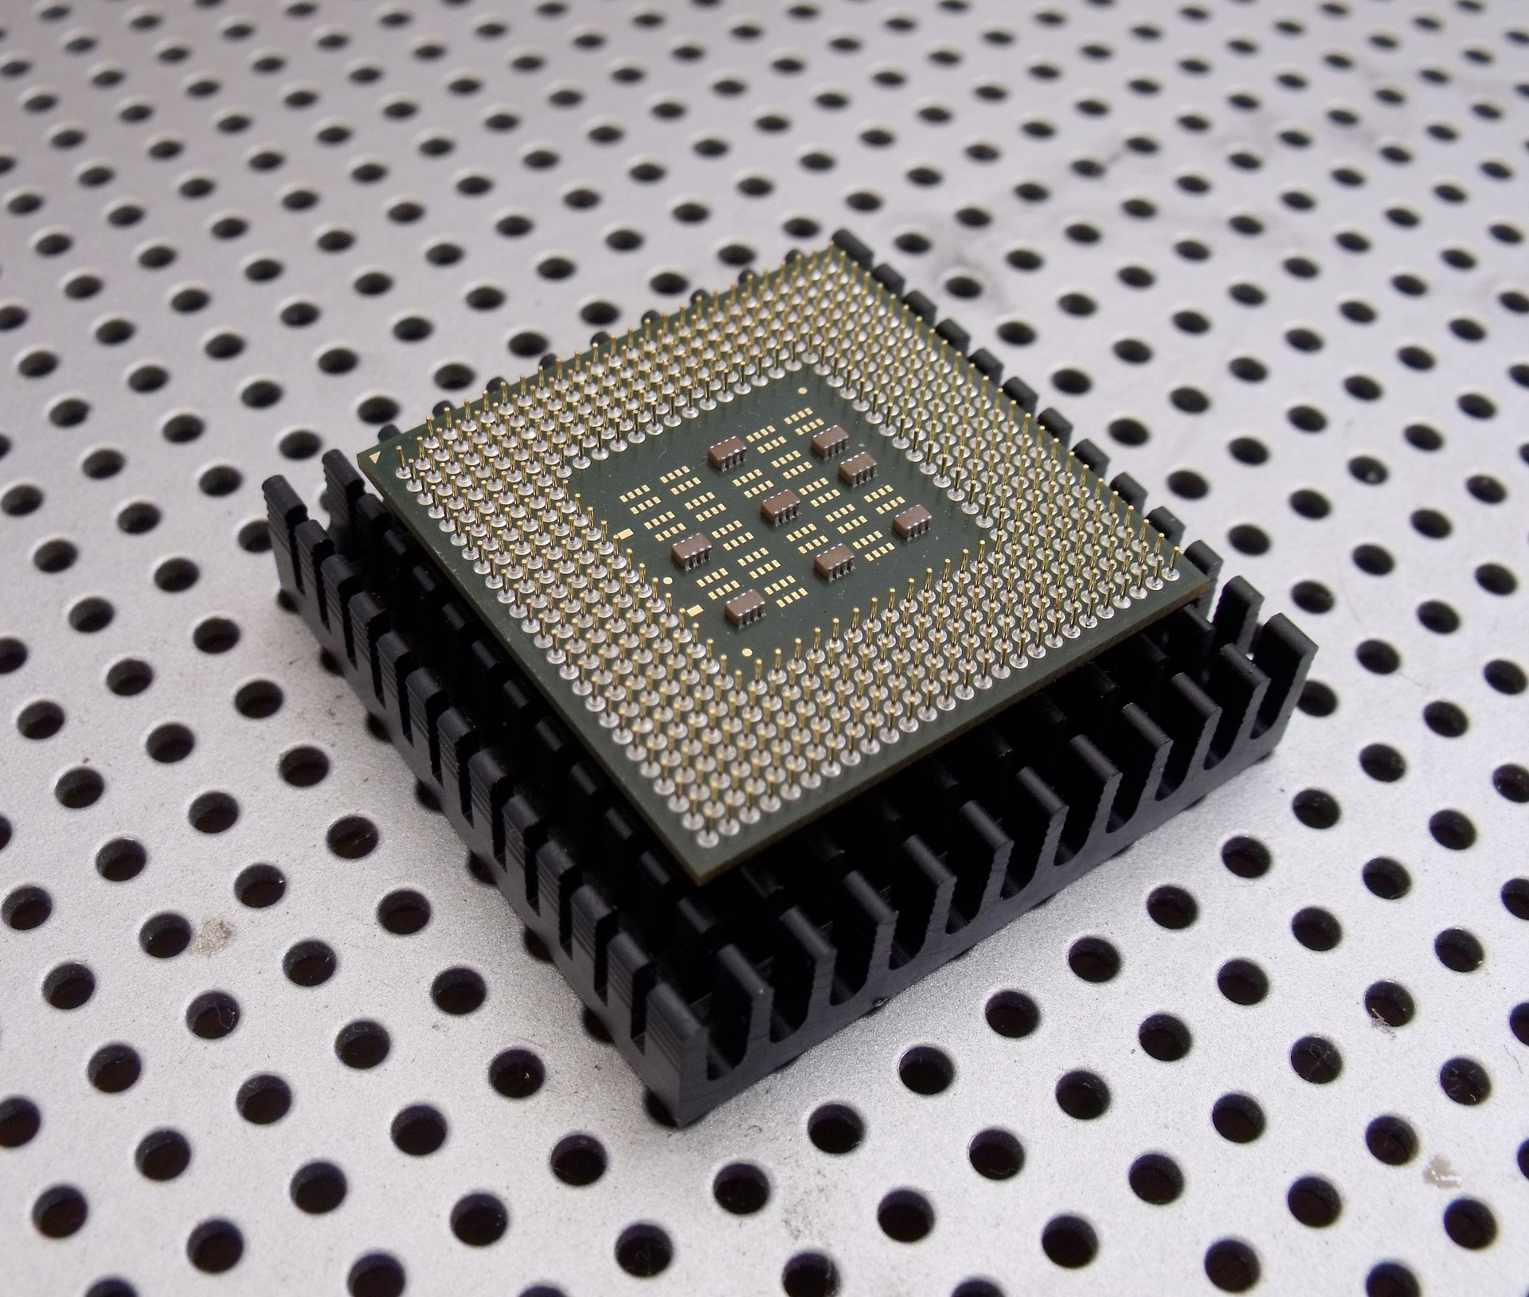

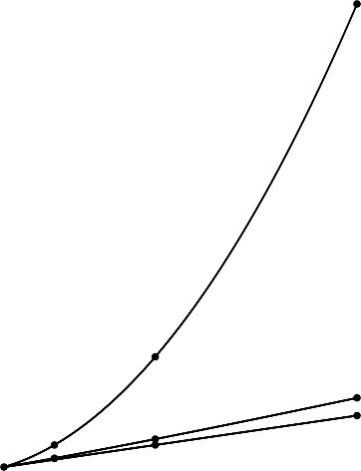
Quadratic algorithms do not scale
Rough standard (for now).
・
10⁹ operations per second.
a truism (roughly) since 1950!
・10⁹ words of main memory.
・Touch all words in approximately 1 second.
Ex. Huge problem for quick-find.
・ 10⁹ union commands on 10⁹ objects.
・Quick-find takes more than 10¹⁸ operations.
・30+ years of computer time!
time
quadratic
64T
Quadratic algorithms don't scale with technology.
・New computer may be 10x as fast.
・But, has 10x as much memory ⇒
want to solve a problem that is 10x as big.
32T
・
With quadratic algorithm, takes 10x as long!
16T
linearithmic
8T
linear
size
1K 2K
4K
8K

Slide 17
Quick-union [lazy approach]
Data structure.
・Integer array id[] of length N.
・Interpretation: id[i] is parent of i.
keep going until it doesn’t change (algorithm ensures no cycles)
・Root of i is id[id[id[...id[i]...]]].
0
1
9
6
7
8
0
1
2
3
4
5
6
7
8
9
id[]
0 | 1 | 9 | 4 | 9 | 6 | 6 | 7 | 8 | 9
2
4
5
3
root of 3 is 9

Slide 18

i 0 1 2 3 4 5 6 7 8 9
-------------------------------------
id[i] 0 9 6 5 4 2 6 1 0 5
Which are the roots of 3 and 7, respectively?

Slide 19
Quick-union [lazy approach]
Data structure.
・Integer array id[] of length N.
・Interpretation: id[i] is parent of i.
・Root of i is id[id[id[...id[i]...]]].
0
1
9
6
7
8
0
1
2
3
4
5
6
7
8
9
id[]
0 | 1 | 9 | 4 | 9 | 6 | 6 | 7 | 8 | 9
2
4
5
q
p 3
root of 3 is 9
root of 5 is 6
3 and 5 are not connected
Find. Check if p and q have the same root.
Union. To merge components containing p and q,
set the id of p's root to the id of q's root.
0
1
7
8
6
0
1
2
3
4
5
6
7
8
9
9
id[]
0 | 1 | 9 | 4 | 9 | 6 | 6 | 7 | 8 | 6
5
q
2
4
only one value changes
p
3

Slide 20

Quick-union demo
0
1
2
3
4
5
6
7
8
9
0
1
2
3
4
5
6
7
8
9
id[]
0 | 1 | 2 | 3 | 4 | 5 | 6 | 7 | 8 | 9

Slide 21
Quick-union demo
8
1
3
9
0
2
7
4
5
0
1
2
3
4
5
6
7
8
9
6
id[]
1 | 8 | 1 | 8 | 3 | 0 | 5 | 1 | 8 | 8

Slide 22

Quick-union: Java implementation
public class QuickUnionUF
{
private int[] id;
public QuickUnionUF(int N)
{
id = new int[N];
for (int i = 0; i < N; i++) id[i] = i;
set id of each object to itself (N array accesses)
}
private int root(int i)
{
while (i != id[i]) i = id[i]; return i;
chase parent pointers until reach root (depth of i array accesses)
}
public boolean connected(int p, int q)
{
check if p and q have same root (depth of p and q array accesses)
return root(p) == root(q);
}
public void union(int p, int q)
{
int i = root(p); int j = root(q); id[i] = j;
}
}
change root of p to point to root of q (depth of p and q array accesses)

Slide 23

Quick-union is also too slow
Cost model. Number of array accesses (for read or write).
algorithm | initialize | union | find
quick-find | N | N | 1
quick-union | N | _{N} † | N
worst case
† includes cost of finding roots
Quick-find defect.
・Union too expensive (N array accesses).
・Trees are flat, but too expensive to keep them flat.
Quick-union defect.
・Trees can get tall.
・Find too expensive (could be N array accesses).

Slide 24







Improvement 1: weighting
Weighted quick-union.
・Modify quick-union to avoid tall trees.
・Keep track of size of each tree (number of objects).
・Balance by linking root of smaller tree to root of larger tree.
reasonable alternatives:
quick-union
q
smaller tree
union by height or "rank"
p
smaller tree
larger tree
larger tree
might put the larger tree lower
weighted
p
always chooses the better alternative
q
smaller tree
larger tree
smaller tree
larger tree

Slide 25
Weighted quick-union demo
0
1
2
3
4
5
6
7
8
9
0
1
2
3
4
5
6
7
8
9
id[]
0 | 1 | 2 | 3 | 4 | 5 | 6 | 7 | 8 | 9

Slide 26
Weighted quick-union demo
6
4
0
2
5
3
8
9
1
7
0
1
2
3
4
5
6
7
8
9
id[]
6 | 2 | 6 | 4 | 6 | 6 | 6 | 2 | 4 | 4

Slide 27

Quick-union and weighted quick-union example
quick-union
average distance to root: 5.11
weighted
average distance to root: 1.52
Quick-union and weighted quick-union (100 sites, 88 union() operations)

Slide 28


Weighted quick-union: Java implementation
Data structure. Same as quick-union, but maintain extra array sz[i]
to count number of objects in the tree rooted at i.
Find. Identical to quick-union.
return root(p) == root(q);
Union. Modify quick-union to:
・Link root of smaller tree to root of larger tree.
・Update the sz[] array.
int i = root(p); int j = root(q);
if (i == j) return;
if (sz[i] < sz[j]) { id[i] = j; sz[j] += sz[i]; } else { id[j] = i; sz[i] += sz[j]; }

Slide 29

Weighted quick-union analysis
Running time.
・Find: takes time proportional to depth of p and q.
・Union: takes constant time, given roots.
lg = base-2 logarithm
Proposition. Depth of any node x is at most lg N.
x
N = 10
depth(x) = 3 ≤ lg N

Slide 30


Weighted quick-union analysis
Running time.
・Find: takes time proportional to depth of p and q.
・Union: takes constant time, given roots.
Proposition. Depth of any node x is at most lg N. Pf. When does depth of x increase?
Increases by 1 when tree T1 containing x is merged into another tree T2.
・The size of the tree containing x at least doubles since | T 2 | ≥ | T 1 |.
・Size of tree containing x can double at most lg N times. Why?
T2
T1
x

Slide 31

Weighted quick-union analysis
Running time.
・Find: takes time proportional to depth of p and q.
・Union: takes constant time, given roots.
Proposition. Depth of any node x is at most lg N.
algorithm | initialize | union | connected
quick-find | N | N | 1
quick-union | N | _{N} † | N
weighted QU | N | lg N † | lg N
† includes cost of finding roots
Q. Stop at guaranteed acceptable performance?
A. No, easy to improve further.

Slide 32
Improvement 2: path compression
Quick union with path compression. Just after computing the root of p, set the id of each examined node to point to that root.
0
root
1
2
3
4
5
6
7
p
8
x 9
10
11
12

Slide 33
Improvement 2: path compression
Quick union with path compression. Just after computing the root of p, set the id of each examined node to point to that root.
0
root
p
9
1
2
11
12
3
4
5
x 6
7
8
10

Slide 34
Improvement 2: path compression
Quick union with path compression. Just after computing the root of p, set the id of each examined node to point to that root.
0
root
p
9
6
1
2
11
12
8
x 3
4
5
10
7

Slide 35
Improvement 2: path compression
Quick union with path compression. Just after computing the root of p, set the id of each examined node to point to that root.
0
root
p
9
6
3
x 1
2
11
12
8
7
4
5
10

Slide 36
Improvement 2: path compression
Quick union with path compression. Just after computing the root of p, set the id of each examined node to point to that root.
x
0
root
p
9
6
3
1
2
11
12
8
7
4
5
10

Slide 37

Weighted quick-union with path compression: amortized analysis
Proposition. [Hopcroft-Ulman, Tarjan] Starting from an empty data structure, any sequence of M union-find ops on N objects makes ≤ c ( N + M lg* N ) array accesses.
・Analysis can be improved to N + M α(M, N).
・Simple algorithm with fascinating mathematics.
N | lg* N
1 | 0
2 | 1
4 | 2
16 | 3
65536 | 4
₂65536 | 5
Linear-time algorithm for M union-find ops on N objects?
・Cost within constant factor of reading in the data.
・In theory, WQUPC is not quite linear.
・In practice, WQUPC is linear.
iterate log function
Amazing fact. [Fredman-Saks] No linear-time algorithm exists.
in "cell-probe" model of computation

Slide 38

Summary
Bottom line. Weighted quick union (with path compression) makes it possible to solve problems that could not otherwise be addressed.
algorithm | worst-case time
quick-find | M N
quick-union | M N
weighted QU | N + M log N
QU + path compression | N + M log N
weighted QU + path compression | N + M lg* N
M union-find operations on a set of N objects
Ex. [10⁹ unions and finds with 10⁹ objects]
・WQUPC reduces time from 30 years to 6 seconds.
・Supercomputer won't help much; good algorithm enables solution.

