Slide 1

MCA final semester Project of Albin Salu under the guidance of Mrs. Navyamol K.T

Slide 2

Knowhere is a vendor/service discovery initiative in which a user can search and find any type of service available in the location in which the user wants to find.
The application is backed by a user community which provide real user experience reviews and rating for each service or vendor.

Slide 3

Knowhere focuses on..
Platform for both major and minor vendors to announce their service to the public user community.
users can point out or refer the missing vendors
review and rating feature is quite versatile and widely available.
vendors or outlet owners can advertise on our site regarding their special offers, availability and special services.

Slide 4

Users of the application
Admin
Outlet owners
Registered users
Guest users
6

Slide 5
Functional Modules..
Login/Registration
Refer/request a profile
Add/Edit Posting
Edit profile
Search
Add category
Rate and Review
Payment
7

Slide 6
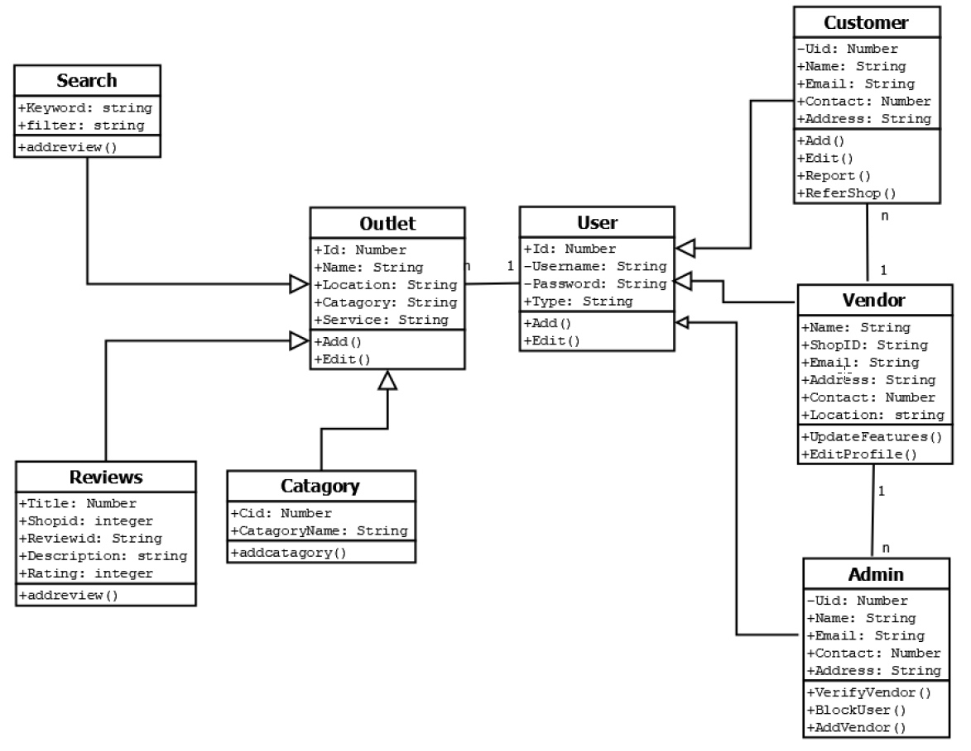

Class Diagram

Slide 7
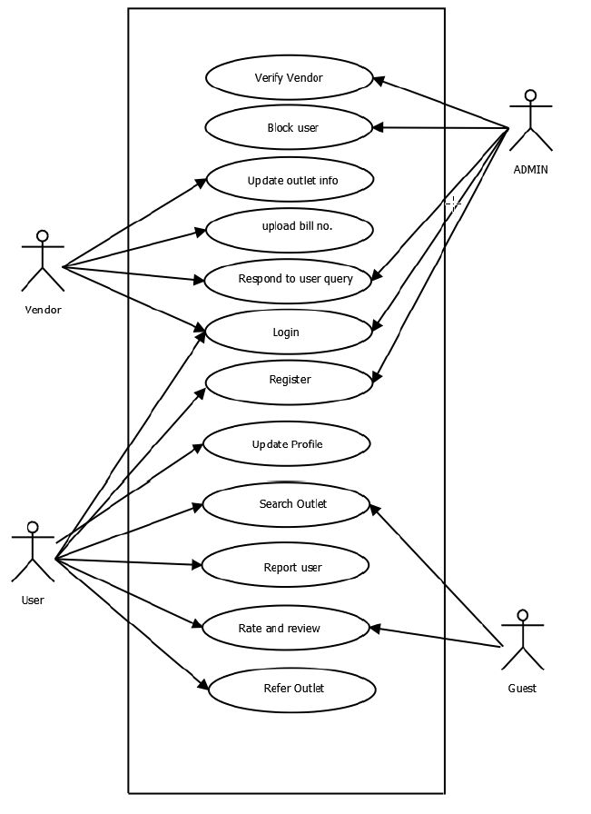
Use case Diagram

Slide 8
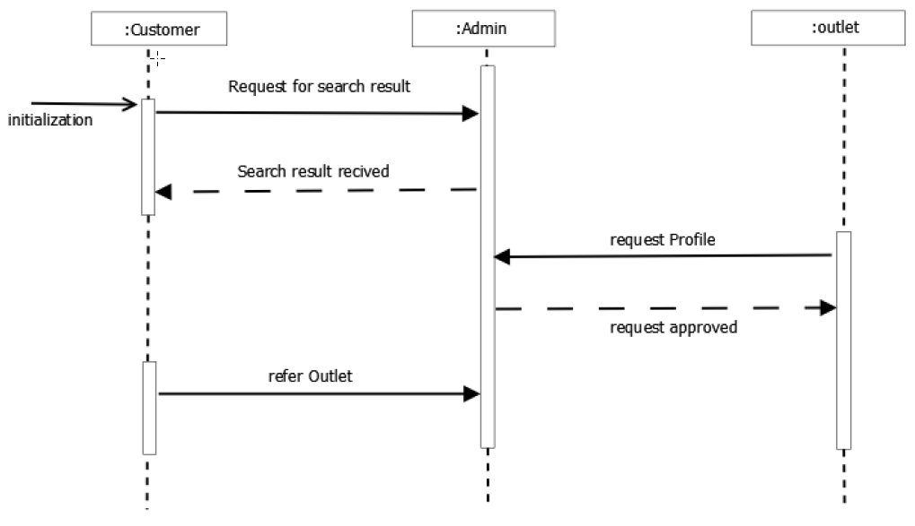
Sequence Diagram

Slide 9
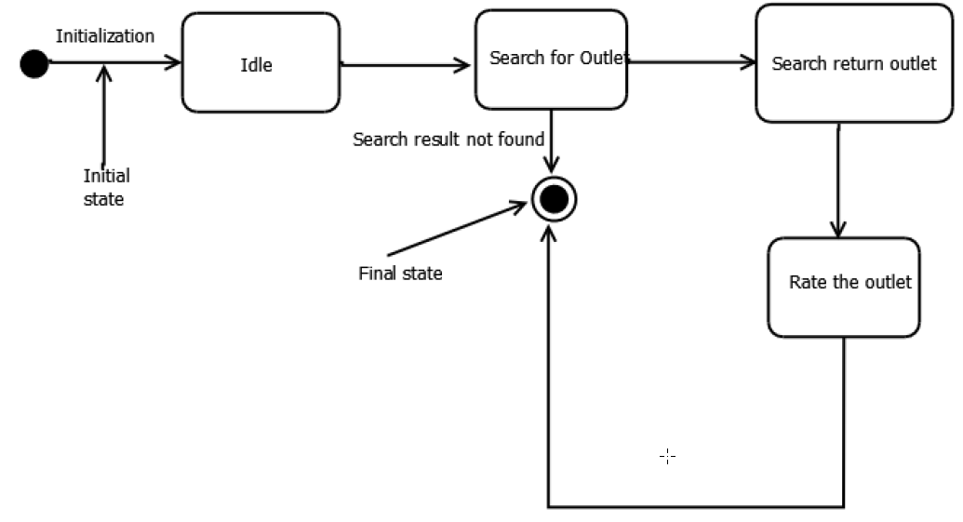
State chart
diagram

Slide 10
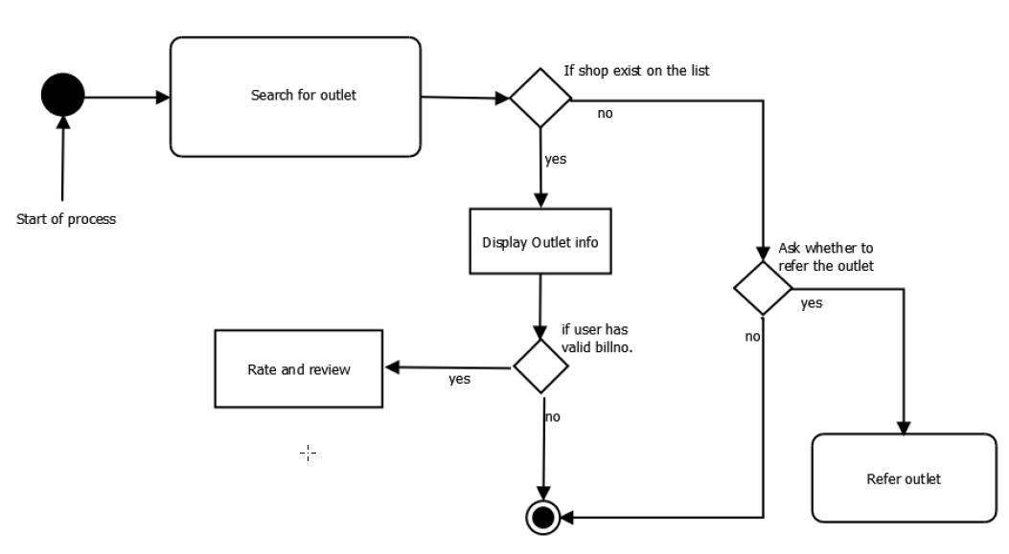
Activity
diagram

Slide 11
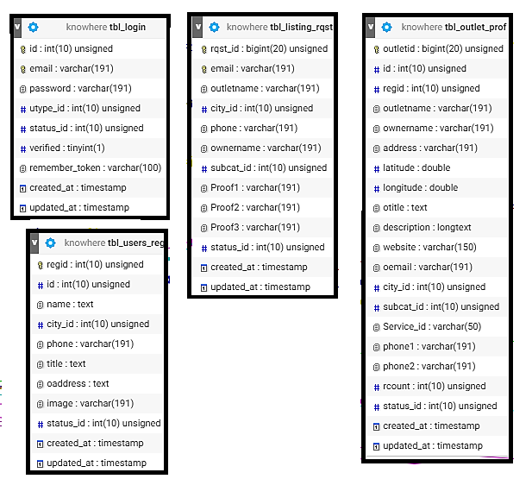
Table Design

Slide 12
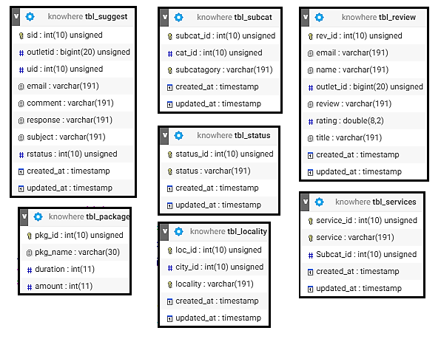
Table Design (cont.)

Slide 13
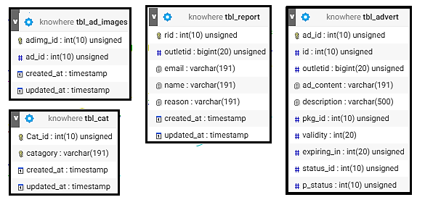
Table Design (cont.)

Slide 14
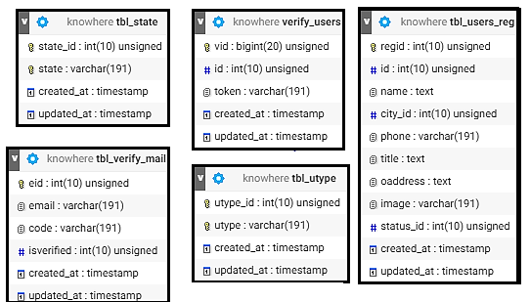
Table Design (cont.)

Slide 15
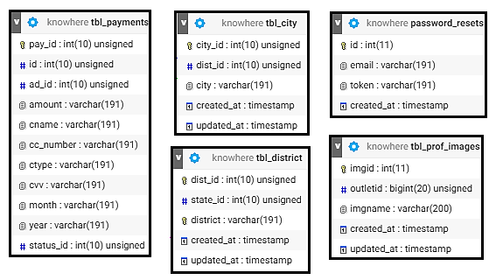
Table Design (cont.)

Slide 16

THANKS

