Slide 1
117
SMART INDIA HACKATHON 2026
ZeroLeak AI
SOVEREIGN
ON-PREMISE
AGENTIC AI
A local workbench for confidential industrial work
Problem Statement
SIH26117 | Sovereign On-Premise Agentic AI Workbench using Open-Weight Multimodal LLMs for Confidential Industrial Work
Mangalore Refinery and Petrochemicals Limited (MRPL) • Smart Automation • Software
Team: [TEAM NAME] • Team ID: [TEAM ID]
Idea submission deck
Prototype evidence from a local ZeroLeak AI workstation
Notes:
Problem statement metadata: SIH26117, S.No. 117, title, MRPL, category Software and theme Smart Automation.
Primary source: https://sih.gov.in/sih2026PS
Cross-check: https://github.com/jeevansai-hub/SIH-2026-/blob/main/ps_2026/SIH26117.md
Project source: C:/Users/harih/OneDrive/Documents/ocr/zero-leak-app/README.md
Replace [TEAM NAME] and [TEAM ID] with portal-registered values before submission.

Slide 2
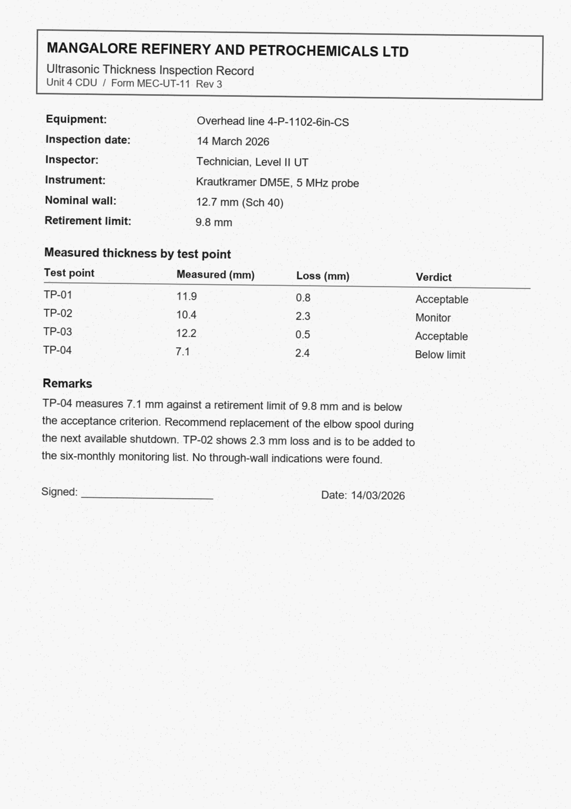
01 / PROPOSED SOLUTION
A private agent for work that cannot leave the site
The workbench keeps documents local while still acting like a useful task partner.
1
Self-hosted
Runs on the organization’s own workstation or GPU server. Public cloud assistants never sit in the workflow.
2
Task-aware
Routes coding, long-document, OCR and vision work to the right local model on demand.
3
Actionable
Reads files, searches local knowledge, runs sandboxed tools and creates reviewable deliverables.
The output is a work package
Source citations + approval note + action tracker
IMAGE-ONLY PAGE • OCR + EVIDENCE EXTRACTION
SIH 2026 • SIH26117
ZeroLeak AI • 02
Notes:
Solution claims are based on the SIH26117 description, which calls for a self-hosted, air-gapped workbench that supports multiple open-weight models, local tools, multimodal inputs and real deliverables.
Product evidence: C:/Users/harih/OneDrive/Documents/ocr/zero-leak-app/README.md and MRPL_WORKFLOWS.md.
Visual asset: synthetic inspection note at C:/Users/harih/OneDrive/Documents/ocr/zero-leak-app/examples/mrpl-demo/turbine-cdu4/turbine-reports/scan-inspection-note.png.
The sample corpus is synthetic and contains no proprietary MRPL record.

Slide 3
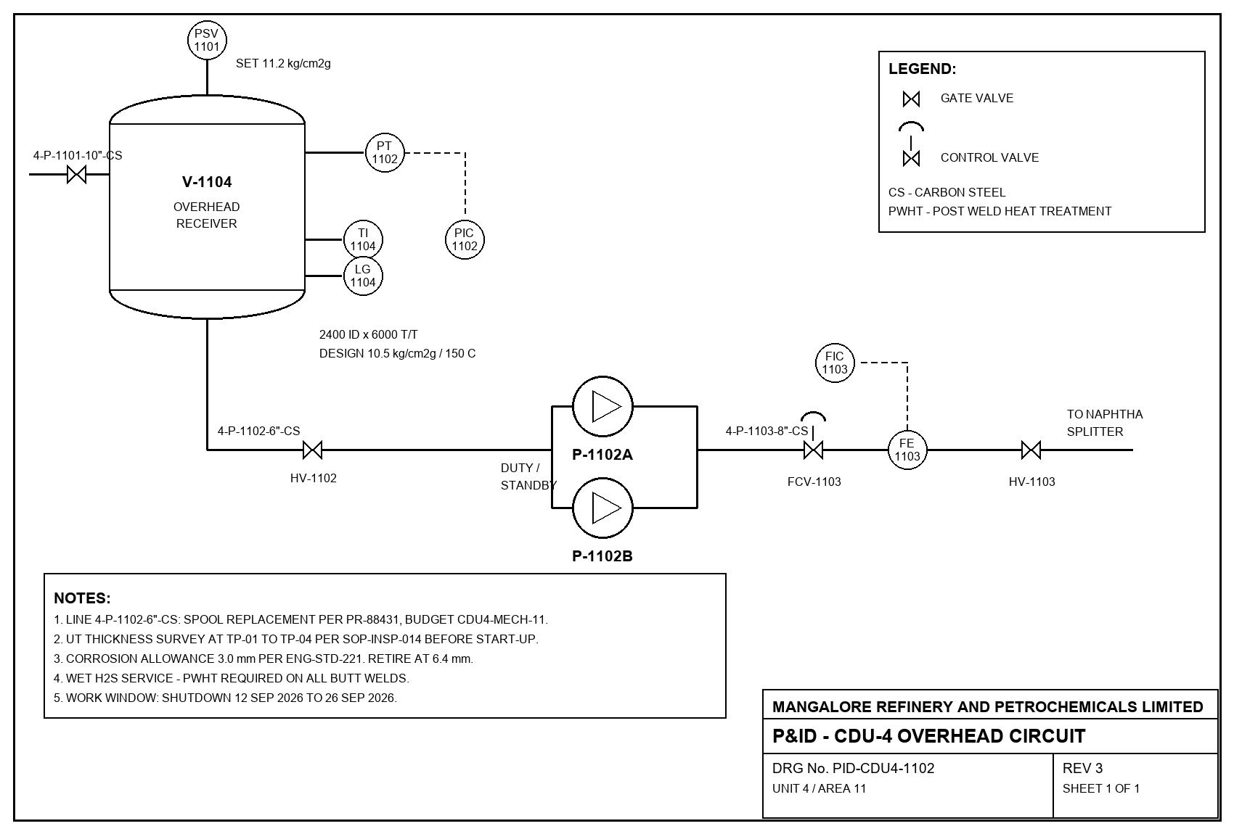
02 / TECHNICAL APPROACH
Local models, one controlled path
Route the task, ground it in local evidence, act through tools and verify the result.
INPUTS
ROUTER
LOCAL TOOLS
OUTPUTS
Scanned PDFs
P&IDs
Code and spreadsheets
SOPs and manuals
Task-aware
model
selection
OCR + vision
Knowledge + citations
Sandbox
Document generators
DOCX
XLSX
PPTX / PDF
Working code
127.0.0.1
load on demand
MODEL ROLES
Gemma 4 E4B
Reasoning and vision
PaddleOCR-VL 1.6
Printed scan specialist
olmOCR 2
Handwriting fallback
Nemotron 3 Nano 4B
Long-document context
BGE-M3
Local embeddings
Vision input
P&ID-CDU4-1102
SIH 2026 • SIH26117
ZeroLeak AI • 03
Notes:
Technical approach reflects the local model registry and router implementation.
Source: C:/Users/harih/OneDrive/Documents/ocr/zero-leak-app/src/services/registry.ts
Source: C:/Users/harih/OneDrive/Documents/ocr/zero-leak-app/src-tauri/src/router.rs
The workbench binds the model router to 127.0.0.1 and routes OCR, vision, embeddings, reasoning and coding to different local model roles.
Visual asset: synthetic P&ID at C:/Users/harih/OneDrive/Documents/ocr/zero-leak-app/examples/mrpl-demo/turbine-cdu4/turbine-reports/PID-CDU4-1102.png.

Slide 4
03 / FEASIBILITY AND VIABILITY
Feasibility on one workstation
The prototype closes the core demo loop while keeping remaining deployment gates visible.
PROTOTYPE PROOF POINTS
RISKS AND MITIGATIONS
✓
Local runtime
GPU contention
On-demand loading plus idle eviction keeps the memory budget visible.
llama.cpp, Python, Node and pdftoppm are available locally.
✓
GPU profile
Scanned pages
OCR specialist first, then vision fallback when confidence or handwriting requires it.
RTX 4060 Laptop GPU with 7,107 MiB usable and up to 2 resident models.
✓
Real exporters
Unknown fields
Preserve missing units, limits, owners and dates for human review.
Word, Excel and PowerPoint packages are generated and reopened for checks.
✓
Demo corpus
Sovereignty proof
Pair the application guard with independent OS-level packet capture.
Synthetic and open-dataset scans and P&IDs keep the rehearsal non-proprietary.
Deployment gate: warm up the target models and rehearse the capture interval on the venue machine before making a final sovereignty claim.
SIH 2026 • SIH26117
ZeroLeak AI • 04
Notes:
Readiness proof points come from the live local Workflows → Readiness screen and the project workflow guide.
Sources: C:/Users/harih/OneDrive/Documents/ocr/zero-leak-app/MRPL_WORKFLOWS.md and C:/Users/harih/OneDrive/Documents/ocr/zero-leak-app/.uifix/readiness-result.json.
The GPU number is a development-machine measurement from the local app UI, not a universal deployment requirement.
The project documentation explicitly says application network decisions are not a packet capture, so the deck preserves the independent OS capture step.

Slide 5
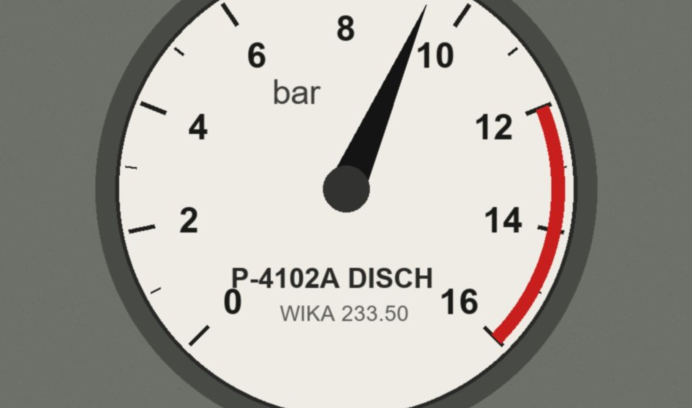
04 / IMPACT AND BENEFITS
Impact and benefits
Confidential work stays local while the workbench handles the task.
EXPECTED VALUE
1
Engineers and inspectors
Extract findings from scans and P&IDs while retaining the exact source page.
2
Approvers
Receive a draft note and action tracker with unresolved fields visible before a human decision.
3
Knowledge teams
Search manuals and SOPs locally with citations that point back to the retrieved evidence.
Operator context
The value is a verified work package, not a chat reply.
4
IT and security
Inspect model routing, tool calls, artifacts and network decisions in one workbench.
1
workstation-ready demo
5
model roles
7
artifact types
prototype catalog
SIH 2026 • SIH26117
ZeroLeak AI • 05
Notes:
Expected impact is derived from the SIH26117 expected solution and from the implemented workflow surfaces.
Product sources: C:/Users/harih/OneDrive/Documents/ocr/zero-leak-app/README.md, MRPL_WORKFLOWS.md and the live Artifacts, Audit and Knowledge panels.
The counts shown are prototype catalog facts: five named model roles in the registry and seven supported artifact kinds in the local types and artifact implementation.
Visual asset: synthetic gauge photograph at C:/Users/harih/OneDrive/Documents/ocr/zero-leak-app/examples/mrpl-demo/turbine-cdu4/turbine-reports/gauge-photo.jpg.

Slide 6
05 / RESEARCH AND REFERENCES
Research and references
The deck follows the SIH idea-submission order and separates public sources from local product evidence.
FORMAT FOLLOWED
PUBLIC SOURCES
1
Title page
SIH 2026 problem statement
sih.gov.in/sih2026PS
SIH26117 metadata and expected solution
2
Proposed solution
3
Technical approach
SIH idea presentation format
cmrit.ac.in/.../SIH2024_IDEA_Presentation_Format.pdf
Six-slide order and content pointers
4
Feasibility and viability
5
Impact and benefits
LOCAL PRODUCT EVIDENCE
README.md • MRPL_WORKFLOWS.md
Scoped Models, Readiness, Network, Artifacts and Audit panels
Synthetic inspection scans and open-dataset P&ID samples
6
Research and references
Submission note
Replace [TEAM NAME] and [TEAM ID] before upload. Export to PDF if the portal requires it.
SIH 2026 • SIH26117
ZeroLeak AI • 06
Notes:
Public sources used in the deck:
1) https://sih.gov.in/sih2026PS
2) https://github.com/jeevansai-hub/SIH-2026-/blob/main/ps_2026/SIH26117.md
3) https://www.cmrit.ac.in/wp-content/uploads/2024/10/SIH2024_IDEA_Presentation_Format.pdf
Local sources used in the deck:
C:/Users/harih/OneDrive/Documents/ocr/zero-leak-app/README.md
C:/Users/harih/OneDrive/Documents/ocr/zero-leak-app/MRPL_WORKFLOWS.md
C:/Users/harih/OneDrive/Documents/ocr/zero-leak-app/src/services/registry.ts
C:/Users/harih/OneDrive/Documents/ocr/zero-leak-app/examples/mrpl-demo/README.md
The local demo corpus is synthetic/open-dataset material, not proprietary industrial data.

