Slide 1
117
SMART INDIA HACKATHON 2026
SOVEREIGN
ON-PREMISE
AGENTIC AI
ZeroLeak AI
A local workbench for confidential industrial work
Problem Statement
SIH26117 | Sovereign On-Premise Agentic AI Workbench using Open-Weight Multimodal LLMs for Confidential Industrial Work
Mangalore Refinery and Petrochemicals Limited (MRPL) • Smart Automation • Software
Team: [TEAM NAME] • Team ID: [TEAM ID]
Idea submission deck
Prototype evidence from a local ZeroLeak AI workstation
Notes:
Problem statement metadata: SIH26117, S.No. 117, title, MRPL, category Software and theme Smart Automation.
Primary source: https://sih.gov.in/sih2026PS
Cross-check: https://github.com/jeevansai-hub/SIH-2026-/blob/main/ps_2026/SIH26117.md
Project source: C:/Users/harih/OneDrive/Documents/ocr/zero-leak-app/README.md
Replace [TEAM NAME] and [TEAM ID] with portal-registered values before submission.

Slide 2
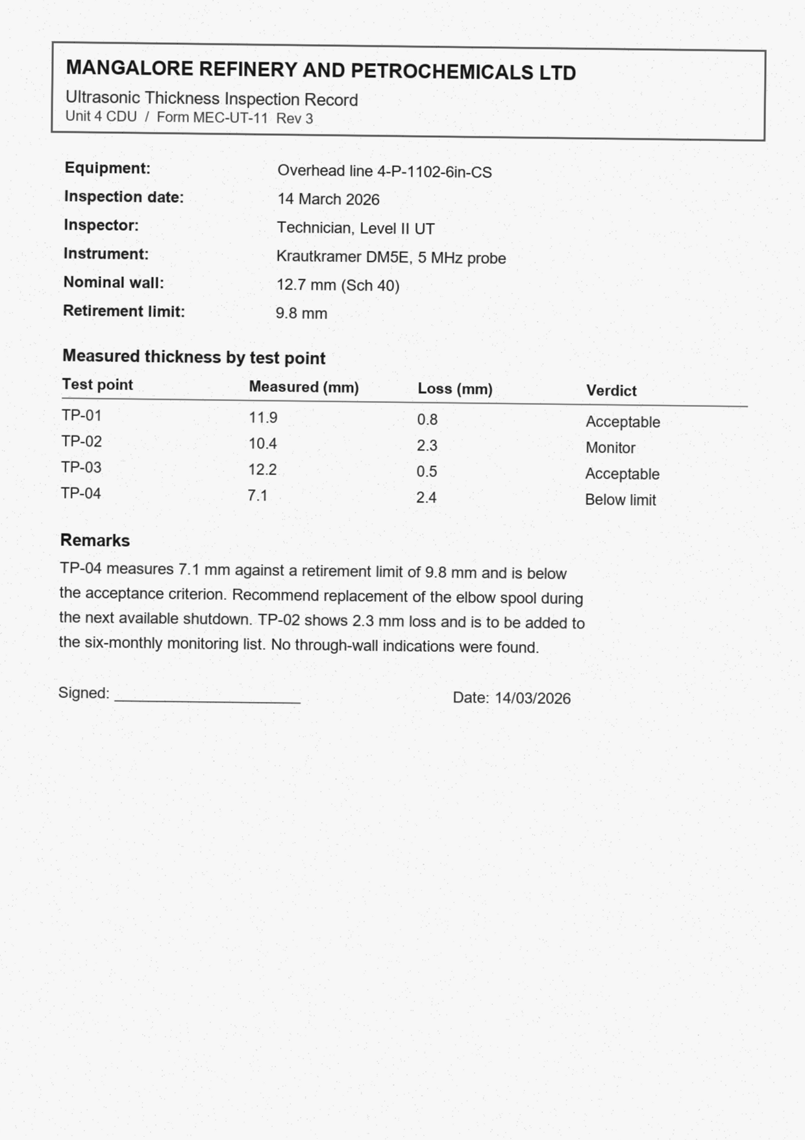
01 / PROPOSED SOLUTION
A private agent for work that cannot leave the site
The workbench keeps documents local while still acting like a useful task partner.
1
Self-hosted
Runs on the organization’s own workstation or GPU server. Public cloud assistants never sit in the workflow.
2
Task-aware
Routes coding, long-document, OCR and vision work to the right local model on demand.
3
Actionable
Reads files, searches local knowledge, runs sandboxed tools and creates reviewable deliverables.
The output is a work package
Source citations + approval note + action tracker
IMAGE-ONLY PAGE • OCR + EVIDENCE EXTRACTION
SIH 2026 • SIH26117
ZeroLeak AI • 02
Notes:
Solution claims are based on the SIH26117 description, which calls for a self-hosted, air-gapped workbench that supports multiple open-weight models, local tools, multimodal inputs and real deliverables.
Product evidence: C:/Users/harih/OneDrive/Documents/ocr/zero-leak-app/README.md and MRPL_WORKFLOWS.md.
Visual asset: synthetic inspection note at C:/Users/harih/OneDrive/Documents/ocr/zero-leak-app/examples/mrpl-demo/turbine-cdu4/turbine-reports/scan-inspection-note.png.
The sample corpus is synthetic and contains no proprietary MRPL record.

Slide 3
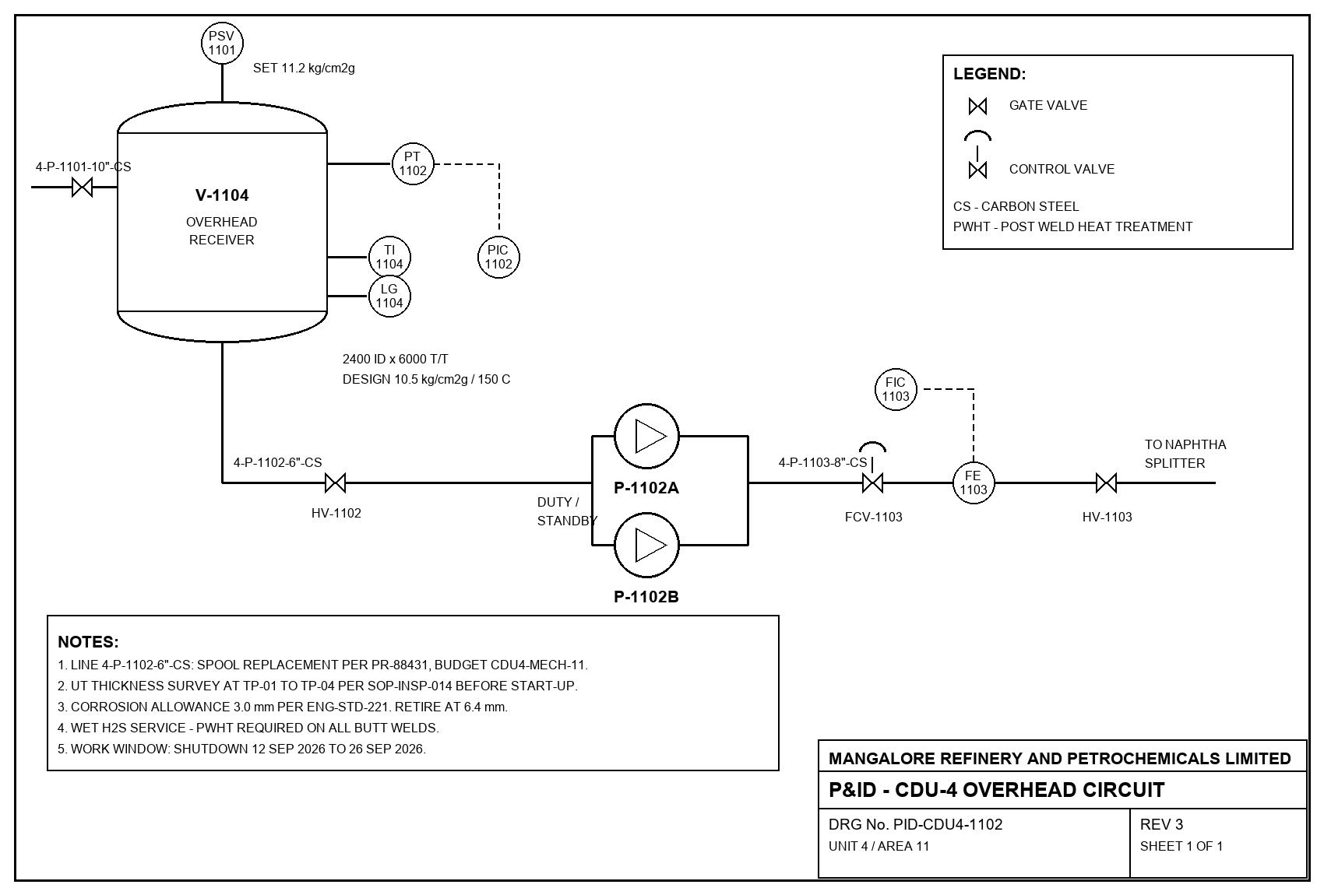
02 / TECHNICAL APPROACH
Local models, one controlled execution path
Route the task, ground it in local evidence, act through tools and verify the result.
INPUTS
ROUTER
LOCAL TOOLS
OUTPUTS
Scanned PDFs
P&IDs
Code and spreadsheets
SOPs and manuals
Task-aware
model selection
OCR and vision
Knowledge + citations
Sandbox execution
Document generators
DOCX
XLSX
PPTX / PDF
Working code
127.0.0.1
load on demand
MODEL ROLES
Gemma 4 E4B
Reasoning and vision
PaddleOCR-VL 1.6
Printed scan specialist
olmOCR 2
Handwriting fallback
Nemotron 3 Nano 4B
Long-document context
BGE-M3
Local embeddings
Vision input
P&ID-CDU4-1102
SIH 2026 • SIH26117
ZeroLeak AI • 03
Notes:
Technical approach reflects the local model registry and router implementation.
Source: C:/Users/harih/OneDrive/Documents/ocr/zero-leak-app/src/services/registry.ts
Source: C:/Users/harih/OneDrive/Documents/ocr/zero-leak-app/src-tauri/src/router.rs
The workbench binds the model router to 127.0.0.1 and routes OCR, vision, embeddings, reasoning and coding to different local model roles.
Visual asset: synthetic P&ID at C:/Users/harih/OneDrive/Documents/ocr/zero-leak-app/examples/mrpl-demo/turbine-cdu4/turbine-reports/PID-CDU4-1102.png.

Slide 4
03 / FEASIBILITY AND VIABILITY
Feasibility and viability are demonstrated on one workstation
The prototype closes the core demo loop while keeping the remaining deployment gates visible.
PROTOTYPE PROOF POINTS
RISKS AND MITIGATIONS
✓
Local runtime
GPU contention
On-demand loading plus idle eviction keeps the memory budget visible.
llama.cpp, Python, Node and pdftoppm are available locally.
✓
GPU profile
Scanned pages
OCR specialist first, then vision fallback when confidence or handwriting requires it.
RTX 4060 Laptop GPU with 7,107 MiB usable and up to 2 resident models.
✓
Real exporters
Unknown fields
Preserve missing units, limits, owners and dates for human review.
Word, Excel and PowerPoint packages are generated and reopened for checks.
✓
Demo corpus
Sovereignty proof
Pair the application guard with independent OS-level packet capture.
Synthetic and open-dataset scans and P&IDs keep the rehearsal non-proprietary.
Deployment gate: warm up the target models and rehearse the capture interval on the venue machine before making a final sovereignty claim.
SIH 2026 • SIH26117
ZeroLeak AI • 04
Notes:
Readiness proof points come from the live local Workflows → Readiness screen and the project workflow guide.
Sources: C:/Users/harih/OneDrive/Documents/ocr/zero-leak-app/MRPL_WORKFLOWS.md and C:/Users/harih/OneDrive/Documents/ocr/zero-leak-app/.uifix/readiness-result.json.
The GPU number is a development-machine measurement from the local app UI, not a universal deployment requirement.
The project documentation explicitly says application network decisions are not a packet capture, so the deck preserves the independent OS capture step.

Slide 5
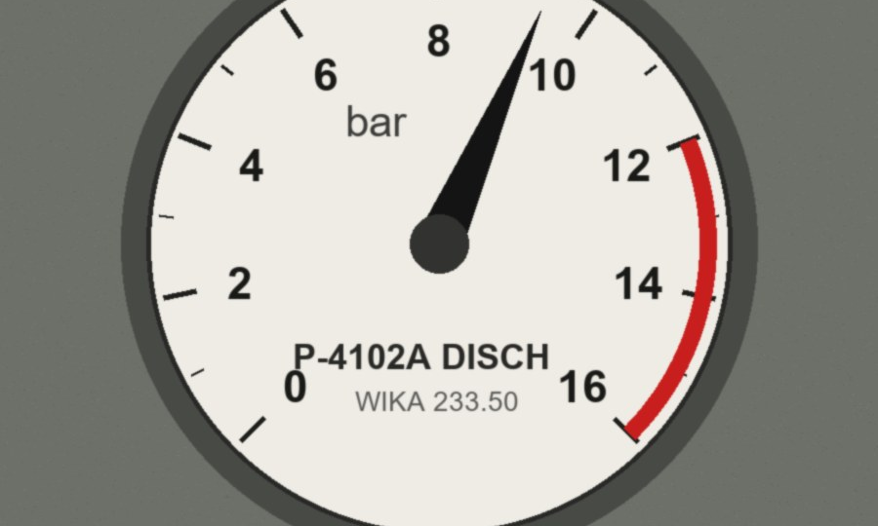
04 / IMPACT AND BENEFITS
Impact and benefits
Confidential industrial work becomes easier to complete without changing where the data lives.
EXPECTED VALUE
1
Engineers and inspectors
Extract findings from scans and P&IDs while retaining the exact source page.
2
Approvers
Receive a draft note and action tracker with unresolved fields visible before a human decision.
3
Knowledge teams
Search manuals and SOPs locally with citations that point back to the retrieved evidence.
Operator context
The value is a verified work package, not a chat reply.
4
IT and security
Inspect model routing, tool calls, artifacts and network decisions in one workbench.
1
workstation-ready demo
5
model roles
7
artifact types
prototype catalog
SIH 2026 • SIH26117
ZeroLeak AI • 05
Notes:
Expected impact is derived from the SIH26117 expected solution and from the implemented workflow surfaces.
Product sources: C:/Users/harih/OneDrive/Documents/ocr/zero-leak-app/README.md, MRPL_WORKFLOWS.md and the live Artifacts, Audit and Knowledge panels.
The counts shown are prototype catalog facts: five named model roles in the registry and seven supported artifact kinds in the local types and artifact implementation.
Visual asset: synthetic gauge photograph at C:/Users/harih/OneDrive/Documents/ocr/zero-leak-app/examples/mrpl-demo/turbine-cdu4/turbine-reports/gauge-photo.jpg.

Slide 6
05 / RESEARCH AND REFERENCES
Research and references
The deck follows the SIH idea-submission order and separates public sources from local product evidence.
FORMAT FOLLOWED
PUBLIC SOURCES
1
Title page
SIH 2026 problem statement
sih.gov.in/sih2026PS
SIH26117 metadata and expected solution
2
Proposed solution
3
Technical approach
SIH idea presentation format
cmrit.ac.in/.../SIH2024_IDEA_Presentation_Format.pdf
Six-slide order and content pointers
4
Feasibility and viability
5
Impact and benefits
LOCAL PRODUCT EVIDENCE
README.md • MRPL_WORKFLOWS.md
Scoped Models, Readiness, Network, Artifacts and Audit panels
Synthetic inspection scans and open-dataset P&ID samples
6
Research and references
Submission note
Replace [TEAM NAME] and [TEAM ID] before upload. Export to PDF if the portal requires it.
SIH 2026 • SIH26117
ZeroLeak AI • 06
Notes:
Public sources used in the deck:
1) https://sih.gov.in/sih2026PS
2) https://github.com/jeevansai-hub/SIH-2026-/blob/main/ps_2026/SIH26117.md
3) https://www.cmrit.ac.in/wp-content/uploads/2024/10/SIH2024_IDEA_Presentation_Format.pdf
Local sources used in the deck:
C:/Users/harih/OneDrive/Documents/ocr/zero-leak-app/README.md
C:/Users/harih/OneDrive/Documents/ocr/zero-leak-app/MRPL_WORKFLOWS.md
C:/Users/harih/OneDrive/Documents/ocr/zero-leak-app/src/services/registry.ts
C:/Users/harih/OneDrive/Documents/ocr/zero-leak-app/examples/mrpl-demo/README.md
The local demo corpus is synthetic/open-dataset material, not proprietary industrial data.

