Slide 1
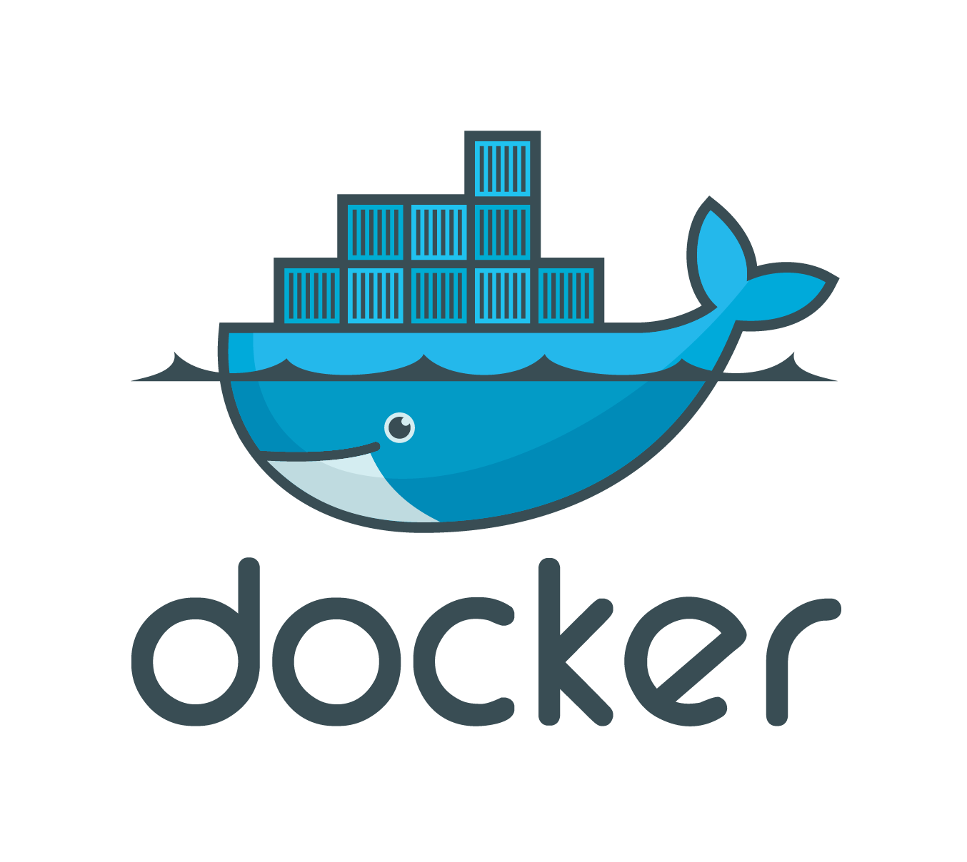
Using Docker Containers
Data: 17.06.2016 Ionuț Constantin
Andrei Șohan

Slide 2
Topics
What is a Virtual Machine?
What is a Container?
What is Docker?
How does it work?

Slide 3
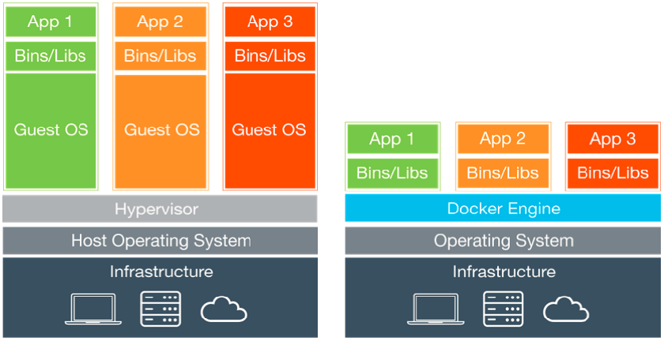
Virtual Machines vs Containers

Slide 4
What is a Virtual Machine?
1

Slide 5
Virtual Machines
A virtual machine is a program that acts as a virtual computer
It runs on the “host” operating system and provides isolated hardware to “guest” operating systems.

Slide 6
Virtual Machines
Virtual machines provide their own virtual hardware, including a virtual CPU, memory, hard drive, network interface, and other devices
The virtual hardware devices provided by the virtual machine are mapped to real hardware on your physical machine.

Slide 7
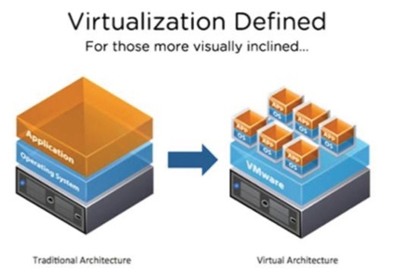
Virtual Machines

Slide 8
What is a Container?
2

Slide 9
Containers
Containers provide a way to run isolated systems on a single host Operating System
Each container shares the host OS kernel and, usually, the binaries and libraries, too

Slide 10
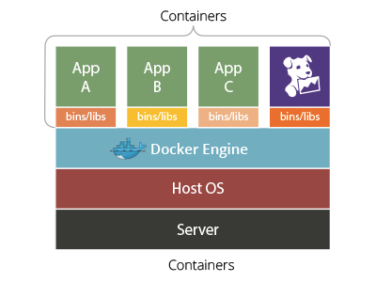
Containers

Slide 11
Containers Benefits
Containers are exceptionally “light” – containers are only megabytes in size and take just seconds to start, versus minutes for a VM
Containers are “shareable” and accelerate dev and test by quickly packaging applications along with their dependencies

Slide 12
Containers Benefits
Containers reduce management overhead. Because they share a common operating system, only a single operating system needs care and feeding (bug fixes, patches, etc)

Slide 13
Containers Challanges
You cannot run a container with a guest operating system that differs from the host OS because of the shared kernel – a Windows container cannot sit on a Linux-based host. You need a workaround.

Slide 14
Containers Challanges
Since containers share the same kernel, host operating systems require special care to avoid security issues from adjacent containers.
Solutions such as Docker make container management easier, but many customers still find container management more of an art than a science.

Slide 15
What is Docker?
3

Slide 16
What is Docker?
Docker containers wrap up a piece of software in a complete filesystem that contains everything it needs to run: code, runtime, system tools, system libraries – anything you can install on a server. This guarantees that it will always run the same, regardless of the environment it is running in.
Note: any of the colors defined can be used for the table

Slide 17
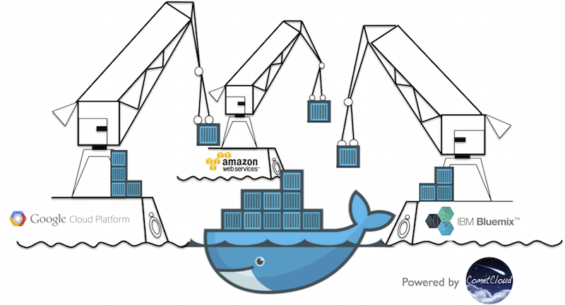
Docker Integration
What is Docker?

Slide 18
Docker Integration
Docker can be integrated into various infrastructure tools :
Amazon Web Services
Google Cloud Platform
Jenkins
Microsoft Azure

Slide 19
How does it work?
4

Slide 20
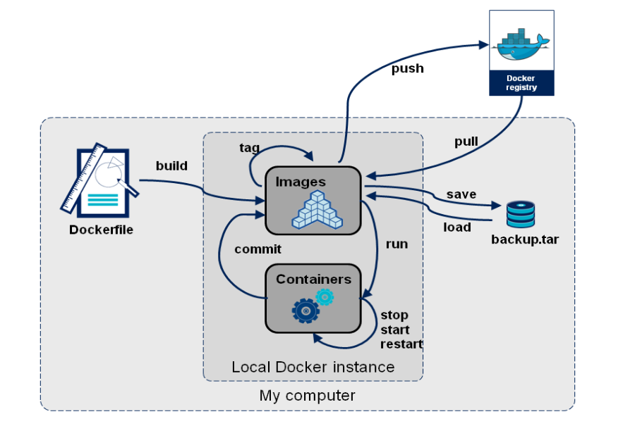
How does it work?

Slide 21
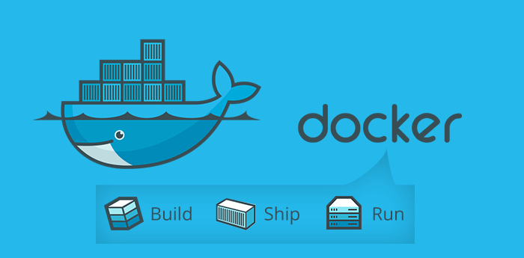
How does it work?

Slide 22
Install Docker Engine
Download and install Docker Engine :
https://www.docker.com/products/docker-toolbox
*Check ’’Install VirtualBox with NDIS5 Driver’’

Slide 23
Setup Oracle XE 11g Container
1. Pull Oracle XE Image :
docker pull wnameless/oracle-xe-11g
2. Run Oracle XE 11g Container :
docker run -d -p 49160:22 -p 49161:1521 -e ORACLE_ALLOW_REMOTE=true wnameless/oracle-xe-11g

Slide 24
Setup Docker ZTH Container
1. Build Custom Image :
docker build –t docker-zth:env1 .
2. Run Docker ZTH Container :
docker run --name zth -v ~/zthusr:/home/zthusr/app -v ~/.m2:/home/zthusr/.m2 -p 8080:8080 -p 3000:3000 -p 3001:3001 -p 9099:9099 -p 35729:35729 -d -t docker-zth:env1

Slide 25
Setup Docker ZTH Container
1. Pull DataModel Image :
docker pull costinn/z2h-datamodel:latest
2. Run DataModel Container :
docker run -d --name z2h-datamodel -v ~/zthusr:/home/zthusr/app -v ~/.m2:/home/zthusr/.m2 -p 8080:8080 -p 3000:3000 -p 3001:3001 -p 9099:9099 -p 35729:35729 -t costinn/z2h-datamodel:latest

Slide 26
Setup Docker ZTH Container
3. Access Docker ZTH Container :
docker exec -it zth bash

Slide 27
Useful Docker Commands
1. List Running Containers :
docker ps
2. Commit Running Container :
docker commit <container_id> <image_name>
3. Delete all local Docker Images :
docker rm $(docker ps -a -q)

Slide 28
Useful Docker Commands
4. Delete all local Docker Containers :
docker rmi $(docker images -q)

Slide 29
Useful Links
https://jhipster.github.io/installation/
https://training.docker.com/instructor-led-training

Slide 30


