Slide 1

IT 378: Database Processing
Module 10 – Joining Tables
Ch9: Joining Data from Multiple Tables
Ch11: Group Functions

Slide 2
Objectives
How to create an equality join
  Use the WHERE clause, or
  Use the JOIN keyword in the FROM clause
Oracle 11g: SQL

Slide 3
Purpose of Joins
Joins are used to link tables and reconstruct data in a relational database
  An equality join
  A non-equality join
  A self-join
  An outer join
Joins can be created through:
  Conditions in a WHERE clause
  Use of JOIN keywords in FROM clause
Oracle 11g: SQL

Slide 4
Cartesian Join (a.k.a. Cross Join)
Table 1
Record 1
Record 2
Table 2
Record A
Record B
Record C
Record D
Cartesian Join Results
Record 1 – Record A
Record 1 – Record B
Record 1 – Record C
Record 1 – Record D
Record 2 – Record A
Record 2 – Record B
Record 2 – Record C
Record 2 – Record D
Results in every possible row combination (m * n)
Oracle 11g

Slide 5
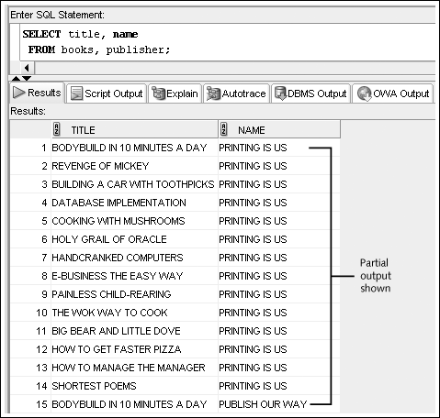
Cartesian Join Example
Created by omitting joining condition in the WHERE clause (or by using CROSS JOIN keywords in the FROM clause)
Oracle 11g: SQL

Slide 6
Equality Joins
Link rows through equivalent data in both tables
Created by:
  Creating equivalency condition in the WHERE clause
  Using NATURAL JOIN, JOIN…USING, or JOIN…ON keywords in the FROM clause
Oracle 11g: SQL

Slide 7
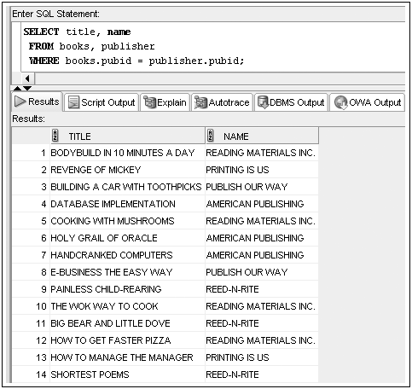
Equality Joins: WHERE Clause Example
Oracle 11g: SQL

Slide 8
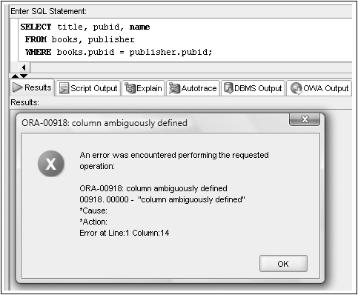
Qualifying Column Names
Columns in both tables must be qualified
Oracle 11g: SQL

Slide 9
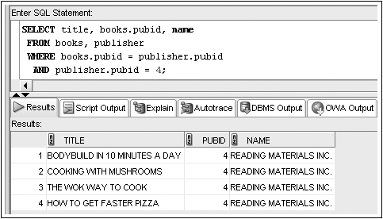
WHERE Clause Supports Join and Other Conditions
Oracle 11g: SQL

Slide 10
Table Alias
Aliases can be used to improve processing efficiency
  Oracle won’t need to identify which table a column is from
  Simplifies codes with (shorter) table alias
  If an alias is assigned in the FROM clause, it must be used any time the table is referenced in that command
SELECT b.title, b.pubid, p.name
FROM books b, publisher p
WHERE b.pubid = p.pubid
AND (b.cost < 15 OR p.pubid =1);
Oracle 11g

Slide 11
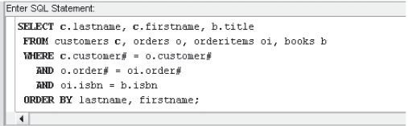
Joining More Than Two Tables
To list customer names and the books they bought
  Joining four tables requires three join conditions
Oracle 11g: SQL

Slide 12
Equality Join: the JOIN Keyword
Using the JOIN keyword frees the WHERE clause for exclusive use in restricting rows
Three approaches:
  The NATURAL JOIN keywords automatically create a join between two tables based on matching column names
  The JOIN…USING keywords create joins based on commonly named and defined columns
  The JOIN…ON keywords create joins in the absence of commonly named and defined columns
Oracle 11g: SQL

Slide 13

Equality Joins: NATURAL JOIN
With the NATURAL JOIN keywords, Oracle will identify commonly named columns – no need to specify them
  It is thus not recommended due to the possibility of joining identically named, but totally unrelated columns
Oracle 11g: SQL

Slide 14
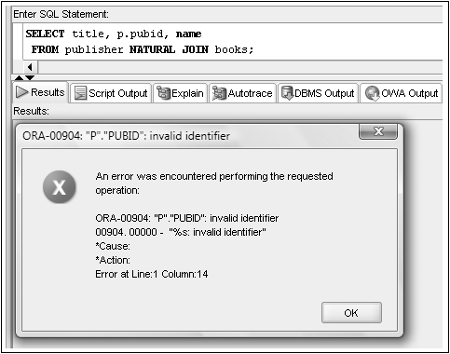
No Qualifiers with a NATURAL JOIN
Oracle 11g: SQL

Slide 15

Equality Joins: JOIN…USING
Used when column names and definitions are the same
NO qualifier for the common column
Must enclose column name with parentheses
Oracle 11g: SQL

Slide 16
Equality Joins: JOIN…USING
To display a list of names of customers and the books they purchased in the Computer category:
SELECT c.lastname, c.firstname, b.title
FROM customers c JOIN orders o USING (customer#)
JOIN orderitems oi USING (order#)
JOIN books b USING (isbn)
WHERE category = ‘COMPUTER’
ORDER BY lastname, firstname;
Oracle 11g

Slide 17

Equality Joins: JOIN…ON
Required if column names are different
  Can still be used when they are the same
A condition is specified in the ON clause, which is not allowed in the USING clause
Oracle 11g: SQL

Slide 18
Summary
Data from multiple tables can be linked through the use of joins
A Cartesian join between two tables returns every possible combination of rows from the tables; the resulting number of rows is always m * n
An equality join is created when the data joining the records from two different tables are an exact match
An equality join can be created by
  Using the JOIN keyword in the FROM clause, or
  Using equivalency conditions in the WHERE clause
Oracle 11g: SQL

Slide 19
Ch11: Group Functions
Objectives
  Differentiate between single-row and multiple-row functions
  Use the AVG, SUM, MAX, MIN, and COUNT functions
  Use the GROUP BY clause to group data
  Identify when the HAVING clause should be used
Oracle 11g: SQL

Slide 20
Group Functions
Return one result per group of rows processed
Are also called multiple-row and aggregate functions
All group functions ignore NULL values except COUNT(*)
Oracle 11g: SQL

Slide 21
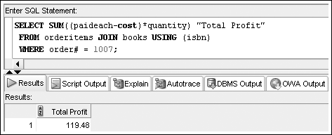
SUM Function
Calculates total amount stored in a numeric column for a group of rows
Oracle 11g: SQL

Slide 22
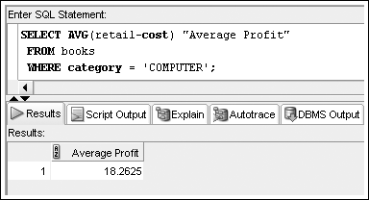
AVG Function
Calculates the average of numeric values in a specified column
Oracle 11g: SQL

Slide 23
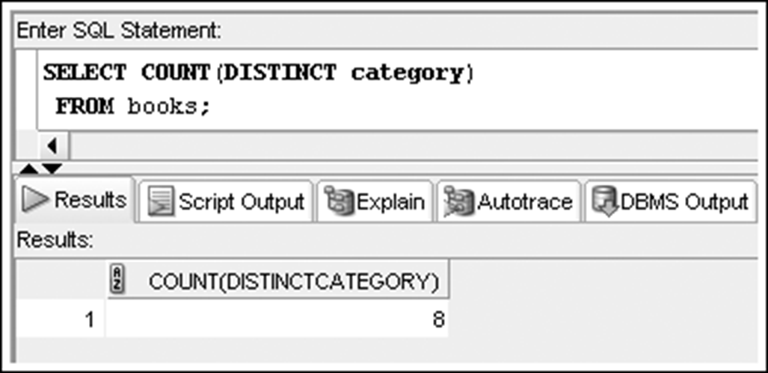
COUNT Function
Two purposes
  Count non-NULL values
  Count total records, including those with NULL values
Oracle 11g: SQL

Slide 24
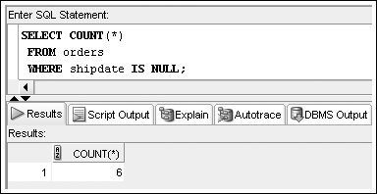
COUNT Function –
NULL Values
Include asterisk in argument to count number of rows
Oracle 11g: SQL

Slide 25
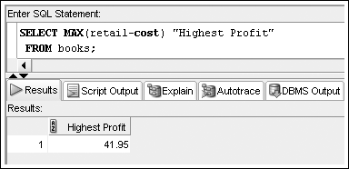
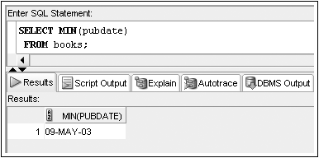
MAX and MIN Functions
Returns largest value
Returns the smallest value
Oracle 11g: SQL

Slide 26
Datatypes
The COUNT, MIN, and MAX functions can be used on values with character, numeric, and date datatypes
  Letter A is considered to have a lower “value” than Z
  More recent dates have higher “values”
Oracle 11g: SQL

Slide 27
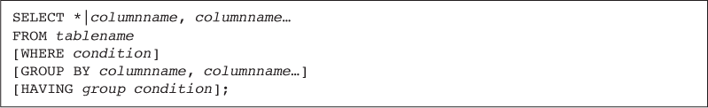
Added Clauses in the SELECT command
Oracle 11g: SQL

Slide 28
Grouping Data
GROUP BY clause is used to group data
  If a group function is used in the SELECT clause, then any and all nonaggregate column(s) in the SELECT clause must also be listed in the GROUP BY clause
  Columns used to group data in GROUP BY don’t have to be included in the SELECT clause
  Column aliases cannot be used in GROUP BY clause
Oracle 11g: SQL

Slide 29
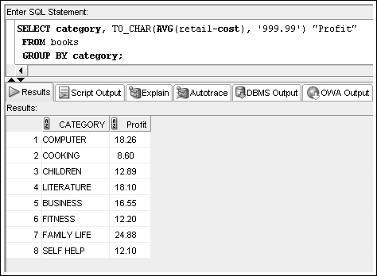
GROUP BY Example
AVG(retail-cost) “Profit”
Oracle 11g: SQL

Slide 30
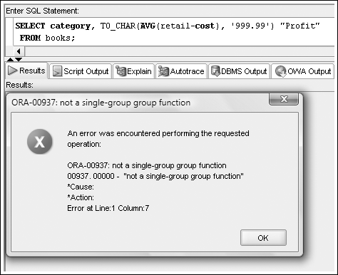
Common Error
A common error is to miss a GROUP BY clause for a nonaggregated column (category) in the SELECT clause
AVG(retail-cost) “Profit”
Oracle 11g: SQL

Slide 31
GROUP BY example
To calculate the total amount of each customer order --
SELECT customer#, order#, SUM(quantity*paideach) “Order Total”
FROM orders JOIN orderitems USING (order#)
GROUP BY customer#, order#;

Slide 32
Restricting Aggregated Output
The WHERE clause cannot include a group function
  HAVING clause serves as WHERE clause for grouped data
  HAVING can only be used after GROUP BY
SELECT customer#, order#, SUM(quantity*paideach) “Order Total”
FROM orders JOIN orderitems USING (order#)
GROUP BY customer#, order#
HAVING SUM(quantity*paideach) > 100;
Oracle 11g: SQL

Slide 33
Which is correct?
SELECT customer#, order#, SUM(quantity*paideach) “Order Total”
FROM orders JOIN orderitems USING (order#)
GROUP BY customer#, order#
HAVING SUM(quantity*paideach) > 100
AND orderdate LIKE ‘%15’;
SELECT customer#, order#, SUM(quantity*paideach) “Order Total”
FROM orders JOIN orderitems USING (order#)
WHERE orderdate LIKE ‘%15’
GROUP BY customer#, order#
HAVING SUM(quantity*paideach) > 100;

Slide 34
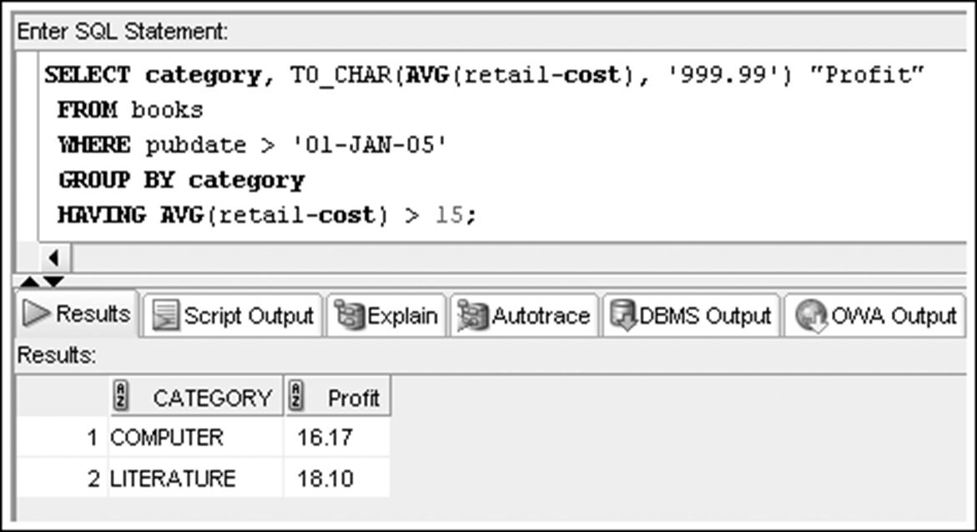
Restricting Aggregated Output (continued)
When included in the same SELECT statement, the clauses are evaluated in the order of:
  FROM
  WHERE
  GROUP BY
  HAVING
  SELECT
  ORDER BY
AVG(retail-cost) “Profit”
Oracle 11g: SQL

Slide 35
Summary
The AVG, SUM functions are used only with numeric fields
The COUNT, MAX, and MIN functions can be applied to any datatype
The AVG, SUM, MAX, MIN functions all ignore NULL values
The GROUP BY clause is used to divide table data into groups
If a SELECT clause contains both an individual column name(s) and a group function, the column name(s) must also be included in a GROUP BY clause
The HAVING clause is used to restrict groups after the GROUP BY clause
Oracle 11g: SQL

