Slide 1
Module 1
IT-378 Database Processing
Database Systems

Slide 2
Main Issues
The difference between data and information
What a database is, and its types
Evolution of modern databases from file systems
Main components of a database system
Functions of a database management system (DBMS)

Slide 3
Data vs. Information
Data:
  Raw facts; building blocks of information
Information:
  Result of processing data to reveal meaning

Slide 4
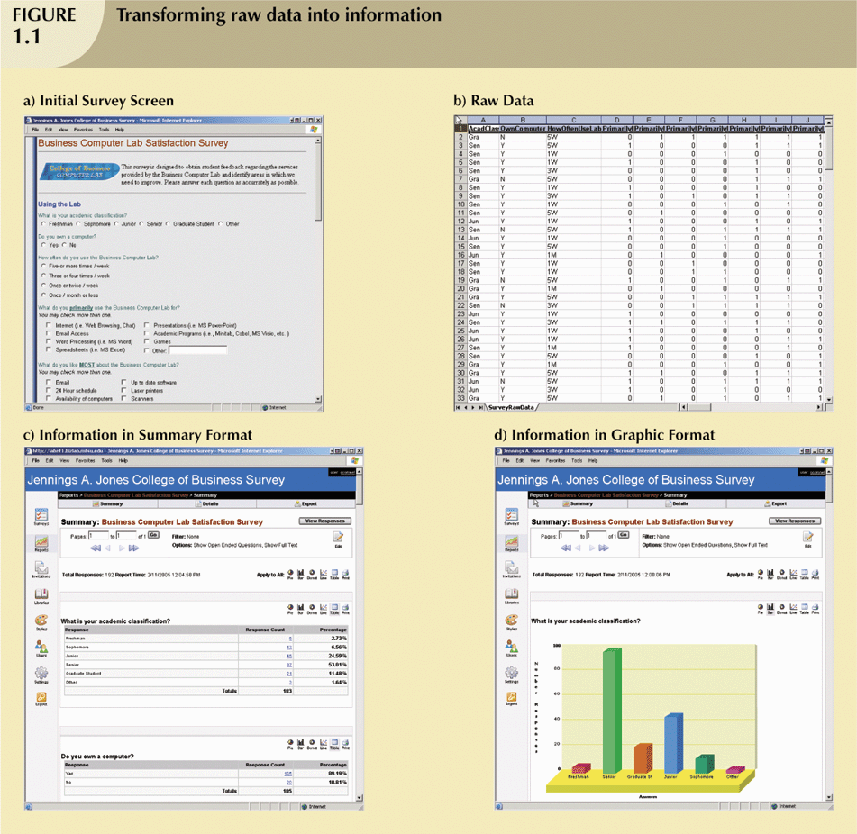
Transforming Raw Data into Information

Slide 5
Transforming Raw Data into Information (continued)

Slide 6
Introducing the Database
Database – shared, integrated computer structure that stores a collection of:
  End user data (raw facts)
  Metadata (data about data)

Slide 7
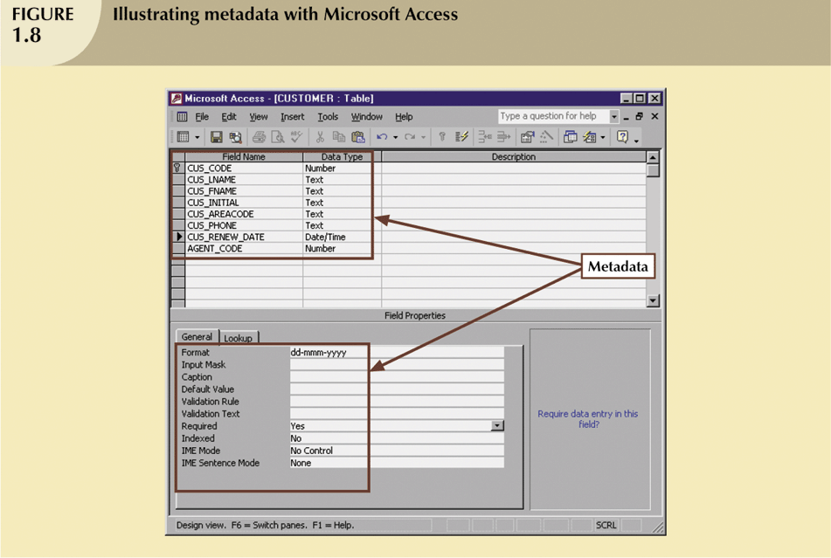

Slide 8
DBMS
DBMS (database management system):
  A collection of programs that manages database structure and controls access to data
  The intermediary between the user and the DB
  Advantages: (Users have more and better data)
    Improved data sharing
    Better data integration
    Reduced data inconsistency
    Improved data access
    …

Slide 9
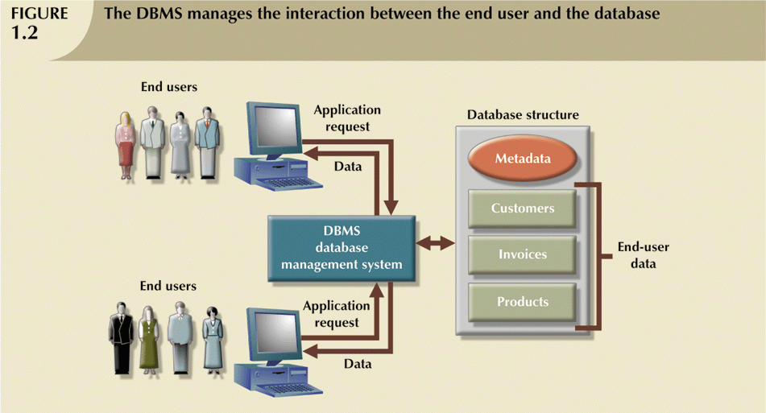

Slide 10
Types of Databases
Can be classified by the number of users
Single-user: Supports only one user at a time
Multi-user: Supports multiple users at the same time
  Workgroup
  Enterprise
Can be classified by location:
Centralized: Supports data located at a single site
Distributed: Supports data distributed across several sites

Slide 11
Types of Databases (continued)
Can be classified by use:
Operational database
  Supports a company’s day-to-day operations/transactions
Informational database (e.g., data warehouse):
  Stores data used to generate information required to make tactical or strategic decisions
  Often used to store historical data
  Structure is quite different

Slide 12
Historical Roots: Files and File Systems
Manual File systems:
Collection of file folders kept in file cabinet
Finding and using data in growing collections of file folders became time-consuming and cumbersome
Conversion from manual to computer system:
Initially, computer files were similar in design to manual files
Technically complex; required hiring of data processing (DP) specialists
Led to numerous “home-grown” systems being created

Slide 13
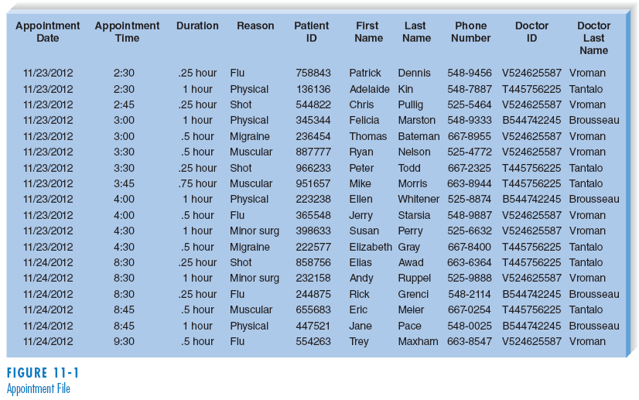
(cont’d)
Example of file: appointment File
11-<number>

Slide 14
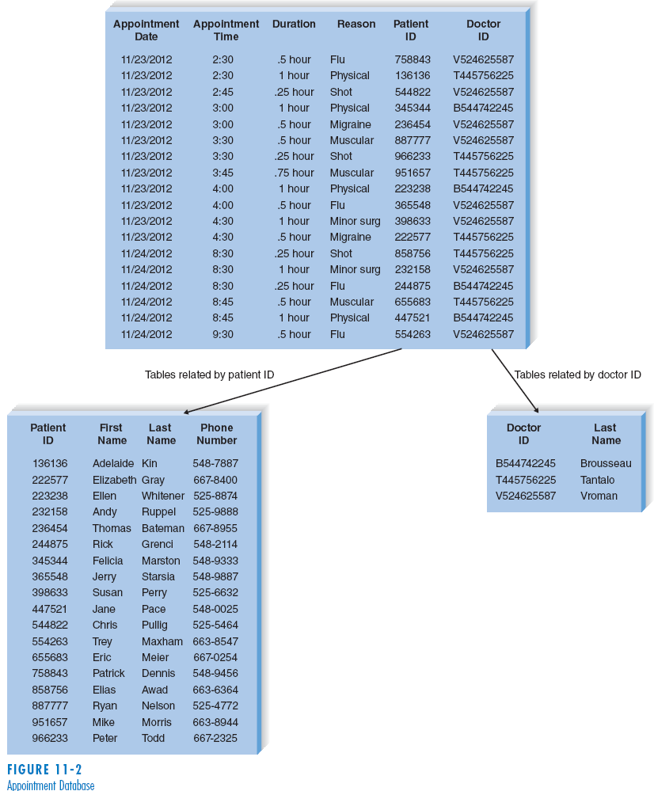
(cont’d)
Example of
database:
Appointment
database
11-<number>

Slide 15
Historical Roots: Files and File Systems
(continued)
As number of DBs increased, small file system evolved
  Each file used its own application programs
  Each file was owned by individual or department who commissioned its creation
Demand for DP’s programming skills grew as a result
  Additional programmers hired
  A few DP specialists grew into a DP department
  Primary activity of department remained programming

Slide 16
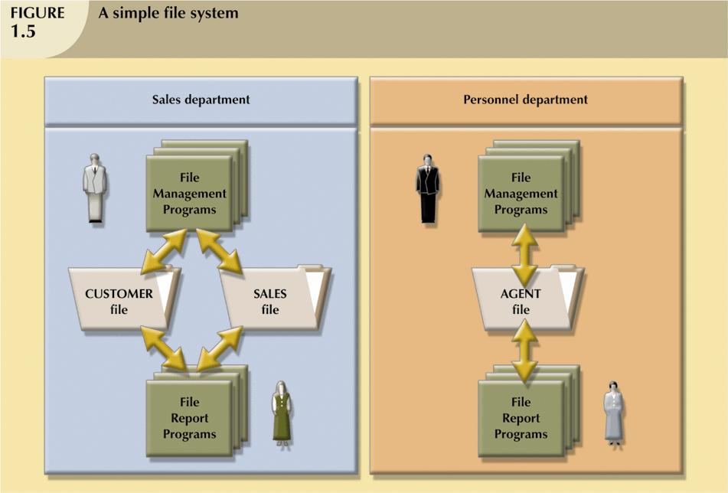
Historical Roots: Files and File Systems
(continued)

Slide 17
Problems with File System
Data Management
Data redundancy results in data inconsistency
  Different and conflicting versions of the same data appear in different places
System admin becomes complex and difficult
  Extensive programming
  Making changes in existing file structure is difficult
  File structure changes require modifications in all programs that use data in that file
Most of these issues are results of…

Slide 18
Data-Program Dependence
Data-program dependence
  Access to a file is dependent on its structure
  To change the data, one must modify the program
Conversely, data-program independence
  Can change data storage characteristics without affecting the application program’s ability to access data

Slide 19
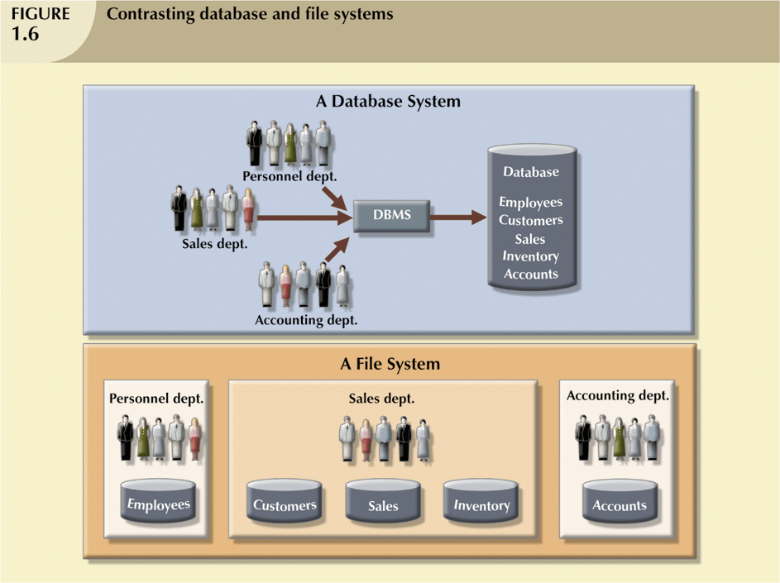
Database Systems
Database
  Logically related data stored in a single logical data repository
File system
  Many separate and unrelated files

Slide 20
The Database System Environment
Database system consists of five main parts:
  Hardware
  Software
    Operating system software
    DBMS software
    Application programs and utility software
  People
  Procedures (rules governing the design and use of a DB system)
  Data

Slide 21
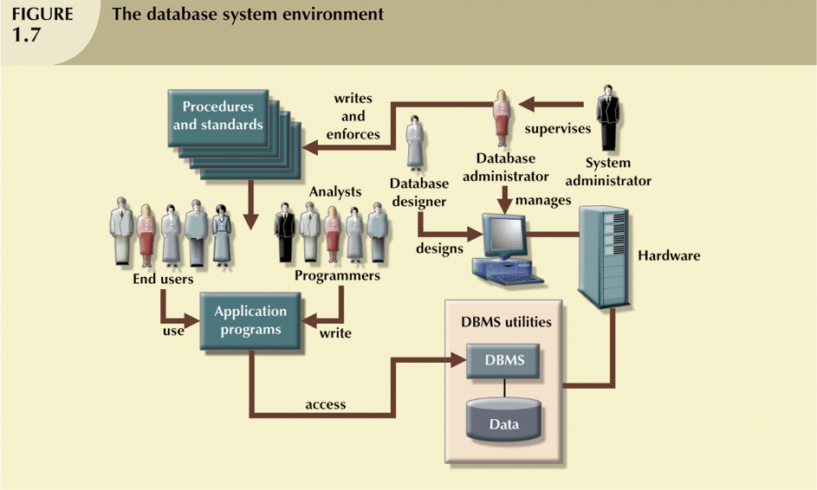
The Database System Environment (continued)

Slide 22
DBMS Functions
DBMS guarantees data integrity and consistency
  Data dictionary management
    defines data elements and their relationships
  Data storage management
    stores data and data entry forms, report definitions, etc.
  Data transformation and presentation
    14/01/2009 or 01/14/2009?
  Security management
    enforces user security and data privacy within database
  Multiuser access control (i.e., concurrency)
  Backup and recovery management
  …

Slide 23
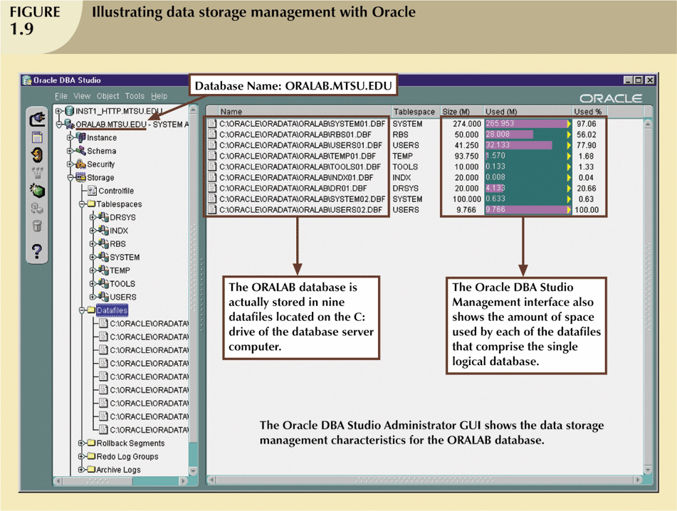
DBMS Functions (continued)

Slide 24
Summary
Data are raw facts. Information is the result of processing data to reveal its meaning.
To implement and manage a database, use a DBMS.
Database design defines the database structure.
A well-designed database facilitates data management and generates accurate and valuable information.
A poorly designed database can lead to bad decision making
Databases were preceded by file systems.
Limitations of file system data management:
  requires extensive programming
  system administration complex and difficult
  making changes to existing structures is difficult
  security features are likely to be inadequate
  independent files tend to contain redundant data
DBMS’s were developed to address file systems’ weaknesses

