Slide 1
Module 2
IT-378 Database Processing
Relational Data Models

Slide 2
We will learn:
What a data model is
What a business rule is, and how it influences DB design
How the major data models evolved
Advantages of the relational model
Key attributes and referential integrity
Relationships in the relational database

Slide 3
Data Models
Model
  An abstraction of a complex real-world object or event
Data models
  Relatively simple representations, usually graphical, of complex real-world data structures

Slide 4
The Importance of Data Models
  Facilitate interaction among the designer, the programmer, and the end user
  Users have different views and needs for data
  Data model organizes data for various users and improves understanding of the organization

Slide 5
Data Model Basic Building Blocks
Entity - anything about which data are to be collected and stored (e.g. person, thing, event, place)
Attribute - a characteristic of an entity
Relationship - describes an association among entities
  One-to-many (1:M) relationship
  Many-to-many (M:N or M:M) relationship
  One-to-one (1:1) relationship
Constraint - a restriction placed on the data to ensure data integrity

Slide 6
Business Rules
How do you identify entities, attributes, relationships and constraints?
Business Rule
  Brief, precise, and unambiguous descriptions of a policy, procedure, or principle in an organization
    E.g. classes with < 5 students will be canceled
    E.g. an order has to be > $100 to get free shipping
  Apply to any organization (not just business orgs)

Slide 7
Discovering Business Rules
It is important to discover and document business rules
  Facilitate user-designer communication
  Allow designer to understand business processes, and the nature, role, and scope of data
  Standardize company’s view of data
  Promote creation of an accurate data model
Sources of Business Rules:
Interviews with managers and key users
Written documentation (e.g., procedures, standards, manuals)

Slide 8
Translating Business Rules into Data Model Components
Generally, nouns translate into entities
Verbs translate into relationships among entities
Relationships are bidirectional
Two questions to identify the relationship type:
  How many instances of B are related to one instance of A?
  How many instances of A are related to one instance of B?

Slide 9
Naming Conventions
Naming occurs during translation of business rules to data model components
  Names should make the object unique and distinguishable from other objects
  Names should be descriptive of objects in the environment and be familiar to users
Proper naming:
  Facilitates communication between parties
  Promotes self-documentation

Slide 10
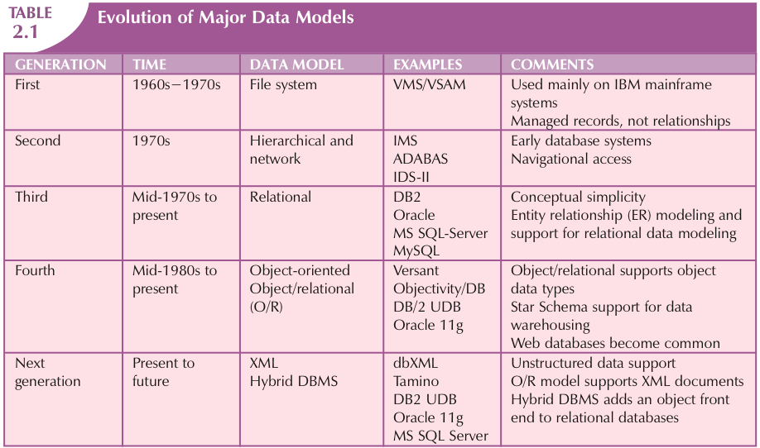
The Evolution of Data Models

Slide 11
The Relational Model
Developed by Edgar F. Codd (IBM) in 1970
Conceptually simple
Considered ingenious but impractical in 1970
  Computers lacked power to implement the relational model
  Today, microcomputers can run sophisticated relational DB software
Implemented through a Relational DBMS
  Hides complexity from the user

Slide 12
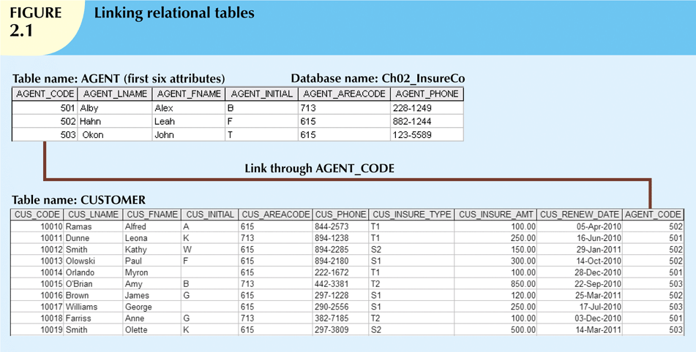
The Relational Model (continued)

Slide 13
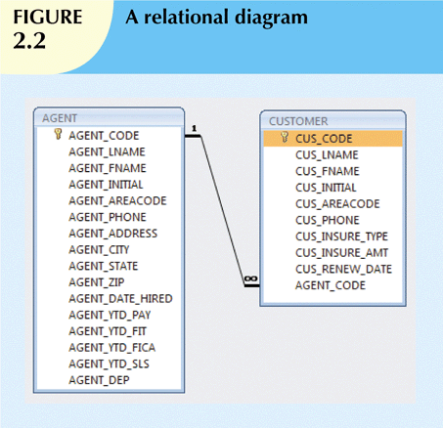
The Relational Model (continued)
Relational Diagram
  Representation of relational DB’s entities, attributes, and relationships

Slide 14
The Relational Model (continued)
Relational Table is a purely logical structure
  How data are physically stored in the DB is of no concern to the user or the designer
  This property became the source of a real DB revolution
Rise to dominance due in part to its powerful and flexible Structured Query Language
Though a vast improvement, it still lacks features as an effective design tool

Slide 15
The Entity Relationship Model
Introduced by Peter Chen in 1976
Widely accepted standard for data modeling
Graphical representation of entities and their relationships in a database structure
Entity relationship diagram (ERD)

Slide 16
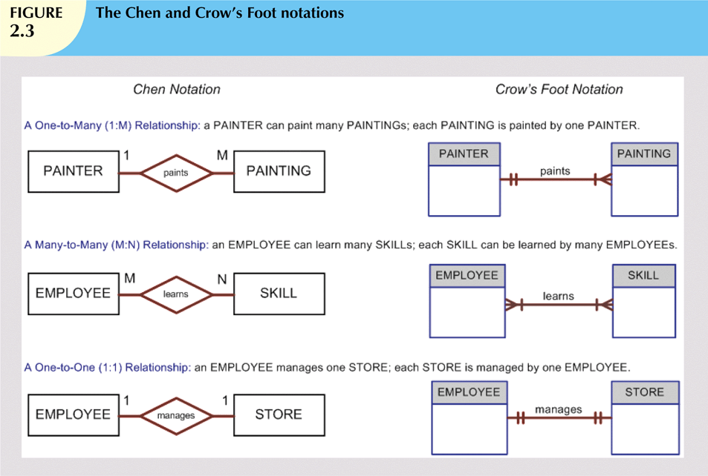
The Entity Relationship Model (continued)

Slide 17
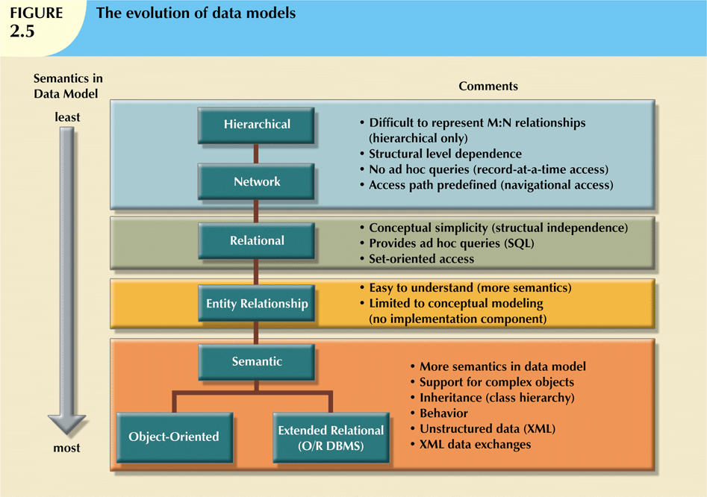
Data Models: A Summary

Slide 18
Data Models: A Summary (continued)
Each new data model improved on the previous ones
  Network Models replaced Hierarchical Models because it better represent M:N relationships
  Relational Models thrived with its data independence, simple data representation, easy-to-use query language
  OO have gained a substantial foothold, but cannot yet dislodge Relational Models

Slide 19
… back to the Relational Model

Slide 20
A Logical View of Data
Relational model
  Enables programmer to view data logically rather than physically
Table
  Has advantages of data-program independence
  Resembles a file from conceptual point of view

Slide 21
Tables and Their Characteristics
Table: Two-dimensional structure composed of rows and columns
  Codd used table and relation interchangeably
However, a relation must also satisfy the following:
  Every row (record) must be unique
  Every attribute value must be atomic (not multivalued)
  The order of rows and columns must be irrelevant
  Attributes (columns) must have unique names

Slide 22
Keys
A key consists of one or more attributes that determine other attributes
  Key’s role is based on determination
  If you know the value of attribute A, you can look up (determine) the value of attribute B

Slide 23
Keys (continued)
Primary key (PK)
  An attribute (or a combination of attributes) that uniquely identifies a row
Composite key
  Composed of more than one attribute
Key attribute
  Any attribute that is part of a key

Slide 24
Keys (continued)
Foreign key (FK)
  An attribute whose values match primary key values in the related table
Referential integrity
  FK contains a value that refers to an existing row in another relation

Slide 25
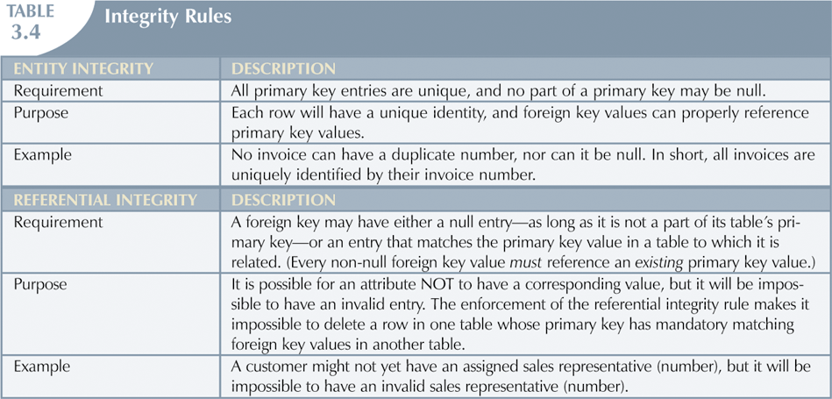
Integrity Rules

Slide 26
Integrity Rules (continued)
Nulls:
  No data entry
    An unknown attribute value
    A known, but missing, attribute value
    A “not applicable” condition
  Not permitted in PK
  Should be avoided in other attributes
    Can create problems when using functions e.g. COUNT, AVERAGE, and SUM
    Can create logical problems when tables are linked
  Some designers use codes (or flags) to indicate the absence of a value

Slide 27
The Data Dictionary
Data dictionary
  Contains metadata – detailed accounting of all tables in the DB
    Contains (at least) all the attribute names and characteristics for each table in the system
  Purpose: to ensure all design and implementation team members use the same tables, attributes and characteristics
  Often described as “the database designer’s database”

Slide 28
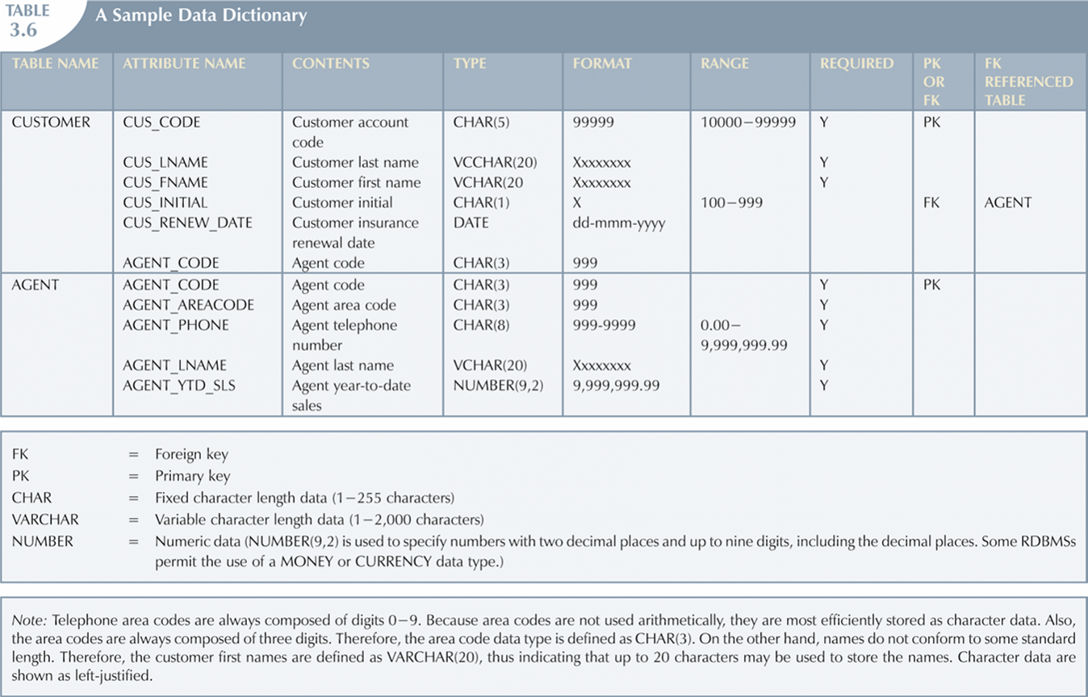
A Sample Data Dictionary

Slide 29
Relationships in the Relational DB
1:M relationship
  Relational modeling ideal
  Should be the norm in any relational database design
1:1 relationship
  Should be rare in any relational database design
M:N relationships
  Can be changed into two 1:M relationships

Slide 30
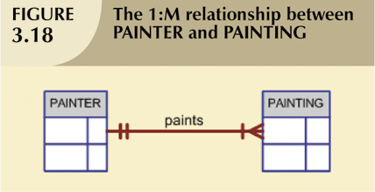
The 1:M Relationship
Relational database norm

Slide 31
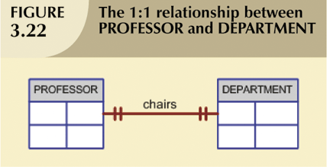
The 1:1 Relationship
One entity can be related to only one other entity, and vice versa
Sometimes means that entity components were not defined properly
  Two entities should be in the same table?
But certain conditions require its use

Slide 32
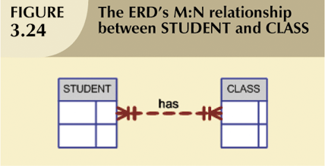
The M:N Relationship
Can be implemented by breaking it up to a set of 1:M relationships
Can avoid problems inherent to M:N relationships by creating a composite entity (or, associative entity, or bridge entity)

Slide 33
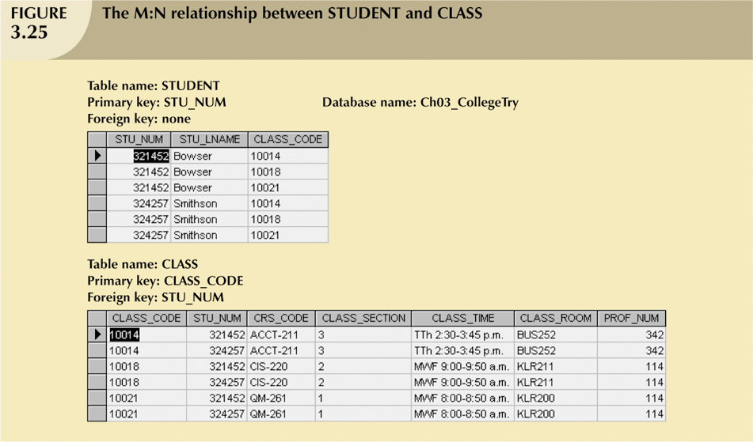
The M:N Relationship (continued)

Slide 34
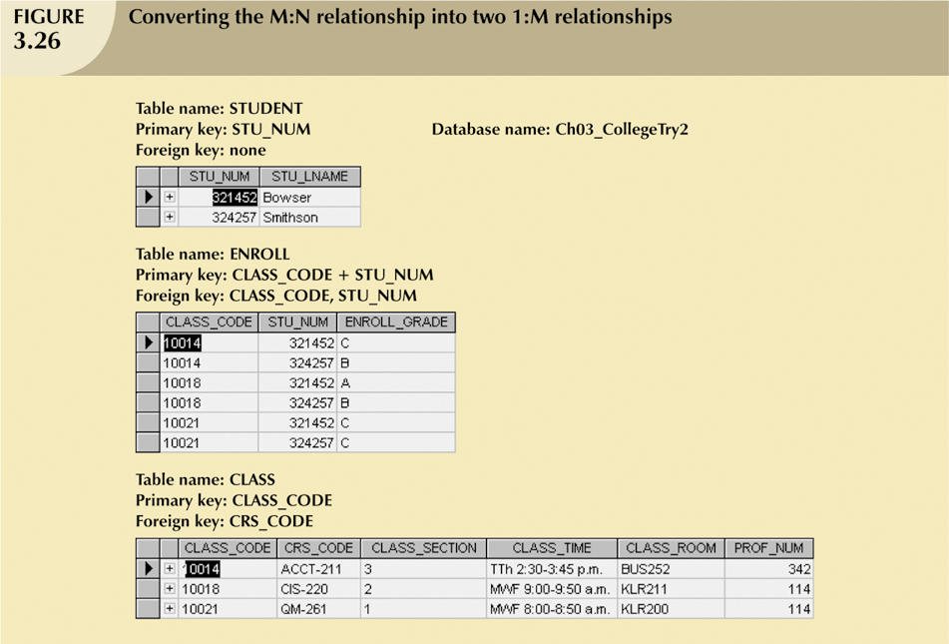
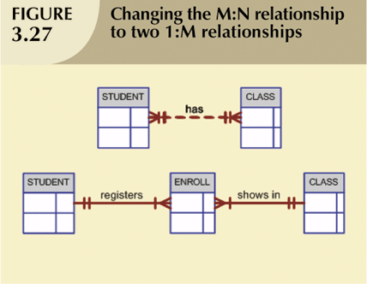
The M:N Relationship (continued)

Slide 35
Summary
A data model is a (relatively) simple abstraction of a complex real-world data environment
Basic data modeling components are: Entities, Attributes, Relationships, and Constraints
Relational model
  Current database implementation standard
  ER model is a popular graphical tool for data modeling that complements the relational model
The relational model has adopted many object-oriented extensions to become the extended relational data model (ERDM)
Data modeling requirements are a function of different data views (global vs. local) and level of data abstraction
Tables are basic building blocks of a relational database
  Keys are central to the use of relational tables
  Each table row must have a PK which uniquely identifies all attributes
  Tables can be linked by common attributes. Thus, the PK of one table can appear as the FK in another table to which it is linked
  Good design begins by identifying appropriate entities and attributes and the relationships among the entities. Those relationships (1:1, 1:M, and M:N) can be represented using ERDs

