Slide 1
Module 3
Entity Relationship (ER) Modeling

Slide 2
Main Issues
The main characteristics of entity relationship components
How relationships between entities are defined and incorporated into the DB design process
How ERD components affect DB design and implementation

Slide 3
The Entity Relationship (ER) Model
ER model forms the basis of an ER Diagram
ERD represents conceptual database as viewed by end user
ERD depicts database’s main components:
  Entities
  Attributes
  Relationships

Slide 4
Entities
Corresponds to table in relational environment
Represented by rectangle containing entity name
Entity name, a noun, is written in capital letters

Slide 5
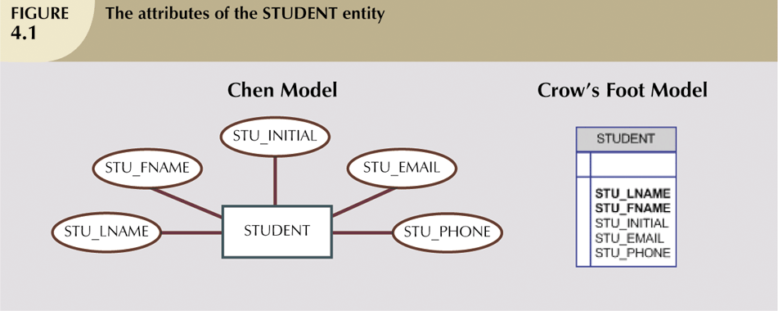
Attributes
Characteristics of entities
  Written in attribute box below entity rectangle
  Attributes have domain (i.e. set of possible values)

Slide 6
Primary Keys
Underlined in the ERD
PKs ideally composed of only single attribute
Possible to use a composite PK

Slide 7
Composite v. Simple Attributes
Composite attribute can be subdivided
  Address, phone number
Simple attribute cannot be subdivided
  Gender, marital status

Slide 8
Single-valued v. Multivalued Attributes
Single-value attribute can have only one value
  e.g. SSN
Multivalued attributes can have many values
  e.g. Car_Color (interior, exterior)
  Should not implement them in relational DBMS
  Car_color → Int_Color, Ext_Color
Question: Is a single-valued attribute necessarily a simple attribute?

Slide 9
Derived Attributes
Attribute whose value may be calculated (derived) from other attributes
Need not be physically stored within the DB
Can be derived by using an algorithm

Slide 10
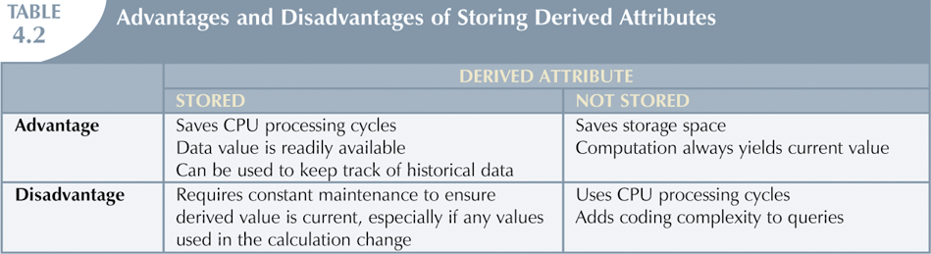
Derived Attributes (continued)

Slide 11
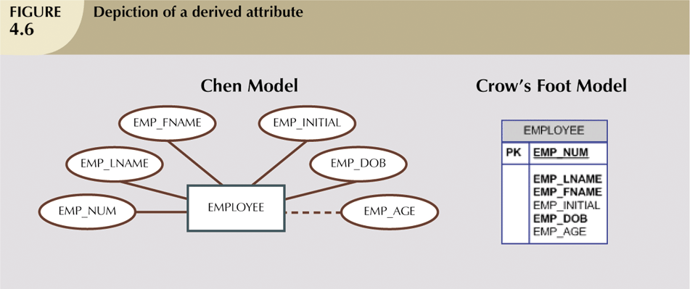
Derived Attributes (continued)

Slide 12
Relationships
Association between entities
Participants are entities that participate in a relationship
Relationships between entities always operate in both directions
  Relationship is difficult to classify if only one side of the relationship is known

Slide 13
Connectivity and Cardinality
Connectivity
  Describes the relationship classification (1:1, 1:M, M:N)
Cardinality
  Expresses min and max number of entity occurrences associated with one occurrence of related entity
Established by very concise statements known as business rules

Slide 14
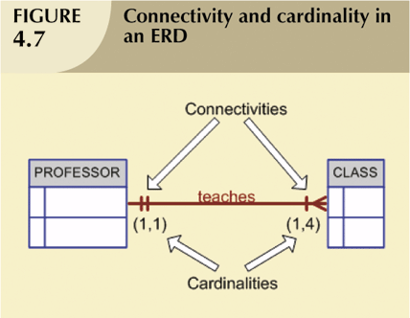

Slide 15
Relationship Strength
Weak (non-identifying) relationships
  Exists if PK of related entity does not contain PK component of parent entity
Strong (Identifying) Relationships
  Exists when PK of related entity contains PK component of parent entity

Slide 16
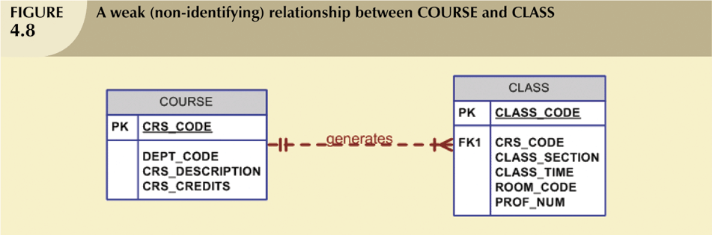
Weak (Non-Identifying) Relationships

Slide 17
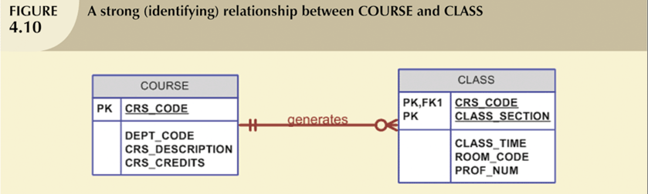
Strong (Identifying) Relationships

Slide 18
Weak vs. Strong Entities
Strong entity (or regular entity)
  Can exist apart from one or more related entities
Weak entity meets two conditions
  Existence-dependent
    Cannot exist w/o entity with which it has a relationship
  Has PK that is partially or totally derived from parent entity in relationship
DB designer usually determines whether an entity can be described as weak based on business rules

Slide 19
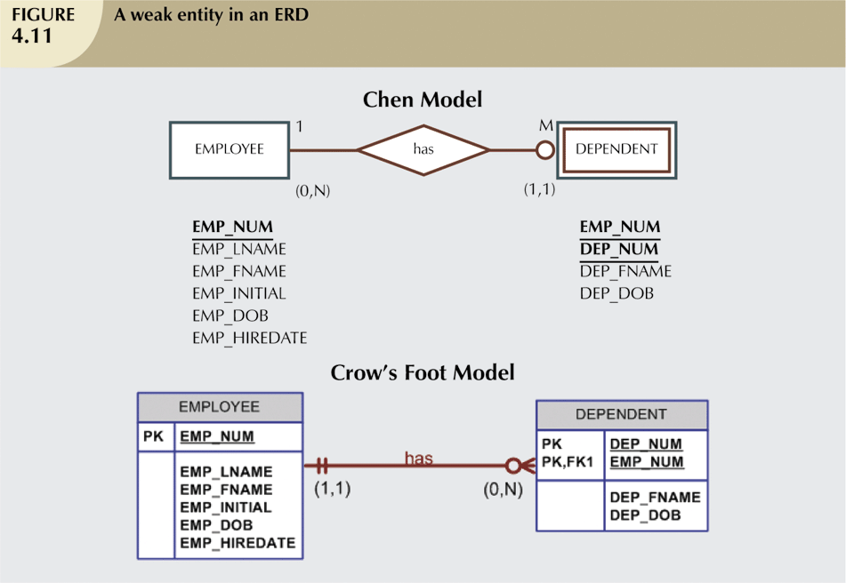
Question:
Can a weak entity exist in a strong relationship?

Slide 20
Relationship Participation
Optional participation
  One entity occurrence does not require corresponding entity occurrence in particular relationship
Mandatory participation
  One entity occurrence requires corresponding entity occurrence in particular relationship

Slide 21
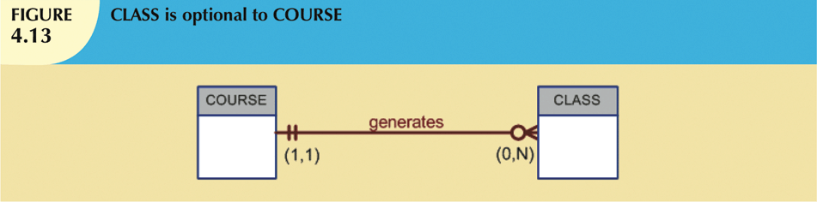


Slide 22
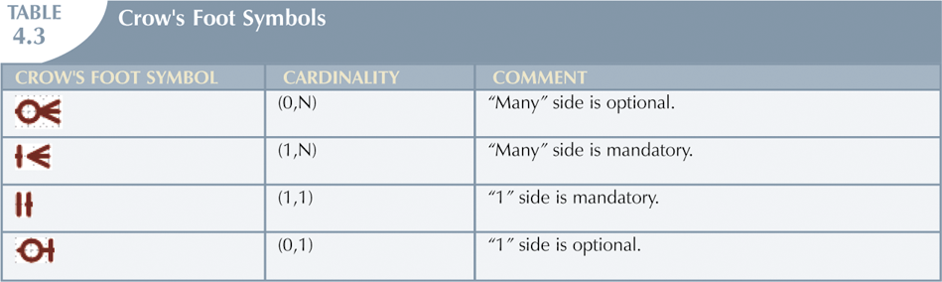
Relationship Participation (continued)

Slide 23
Relationship Degree
Indicates number of entities or participants associated with a relationship
Unary relationship
  Association is within single entity; recursive
Binary relationship
  Two entities are associated
Ternary relationship
  Three entities are associated

Slide 24
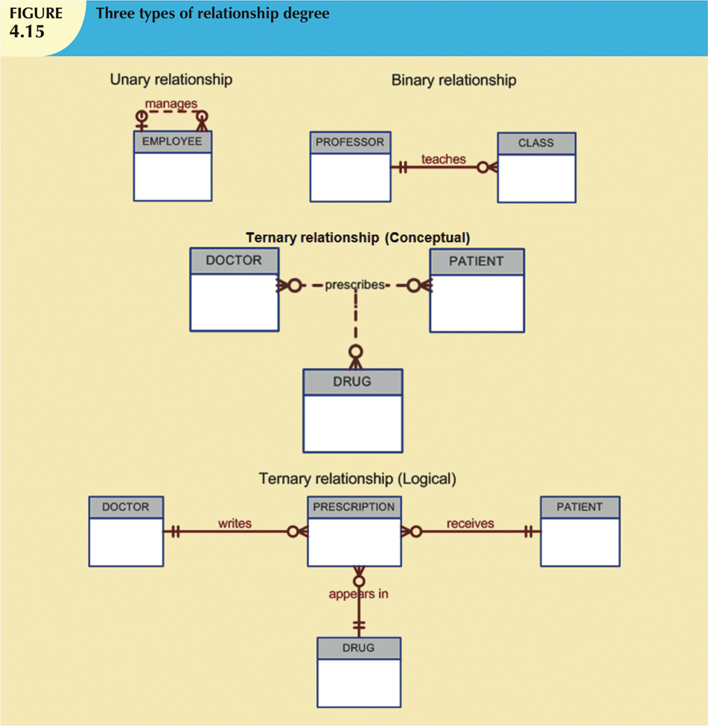

Slide 25
Recursive Relationships
Relationship can exist between occurrences of the same entity set
Naturally found within unary relationship

Slide 26
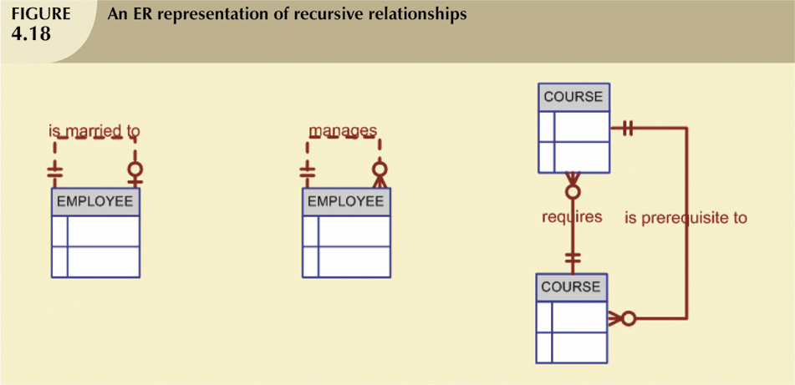
Recursive Relationships
(continued)
Just FYI, not required

Slide 27
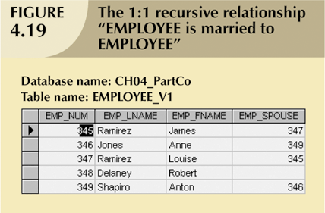
Recursive Relationships
(continued)

Slide 28
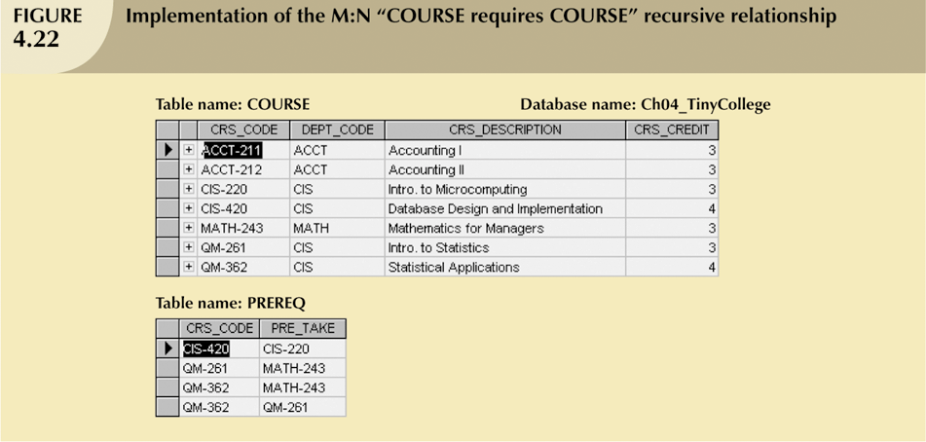
Recursive Relationships
(continued)

Slide 29
Composite Entities
Also known as associative, or bridge entities
Used to implement M:N relationships
Composed of PKs of each of the entities to be connected
An alternative to adding attributes to relationships
  In Chen’s original ERM, relationships did not have attributes

Slide 30

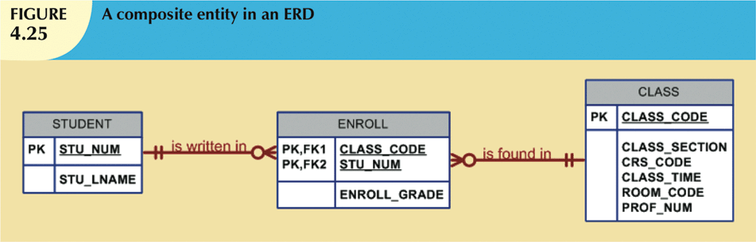
Composite Entities (continued)

Slide 31
Developing an ER Diagram
Database design is iterative, rather than linear or sequential process
Building an ERD usually involves the following:
  Create detailed description of organization’s operations
  Identify business rules based on these descriptions
  Identify entities and relationships from business rules
  Develop initial ERD
  Identify attributes and PKs that describe entities
  Revise and review ERD

Slide 32
Developing an ER Diagram (continued)
Tiny College
  Tiny College is divided into several schools
    Each school is composed of several departments
  Each dept may offer courses
  Each dept may have many professors assigned to it
  Each professor may teach up to 4 classes; each class is a section of course
  Student may enroll in several classes, but (s)he takes each class only once during any given enrollment period

Slide 33
Developing an ER Diagram (continued)
Tiny College (continued)
  Each dept has several students
    Each student has only one major and is associated with a single dept
  Each student has an advisor in his or her department
    Each advisor counsels several students
  The relationship between class is taught in a room and the room in the building

Slide 34
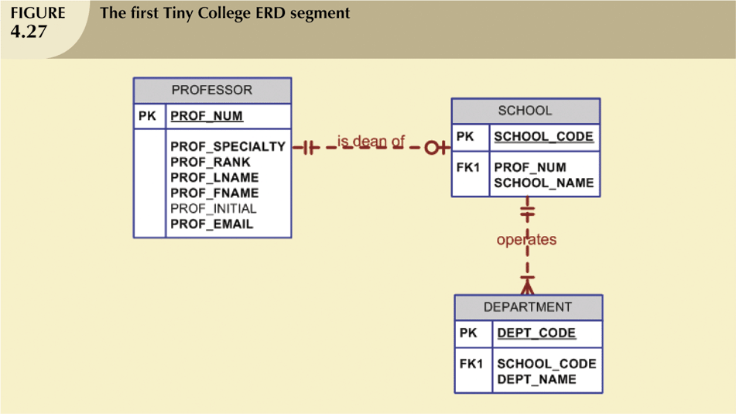
Developing an ER Diagram (continued)

Slide 35
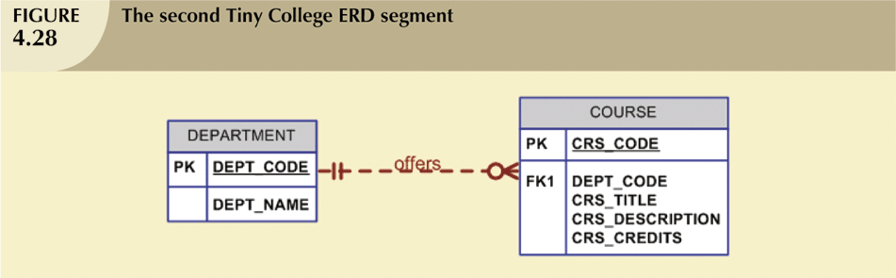
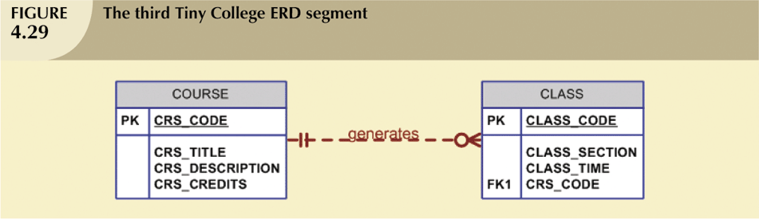
Developing an ER Diagram (continued)

Slide 36
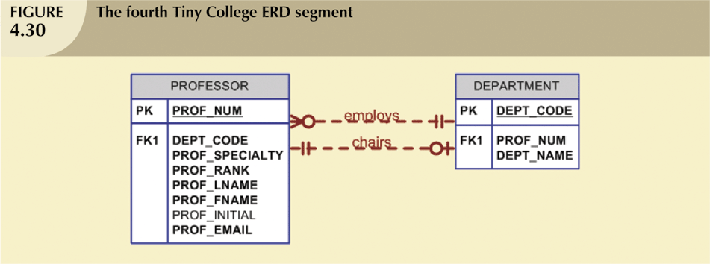
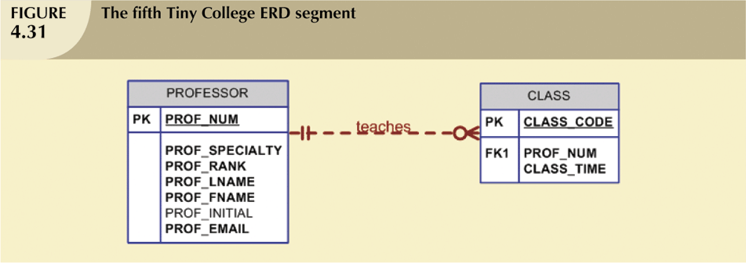
Developing an ER Diagram (continued)

Slide 37
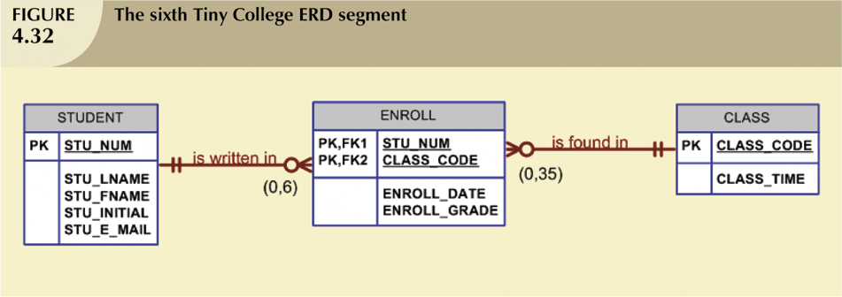
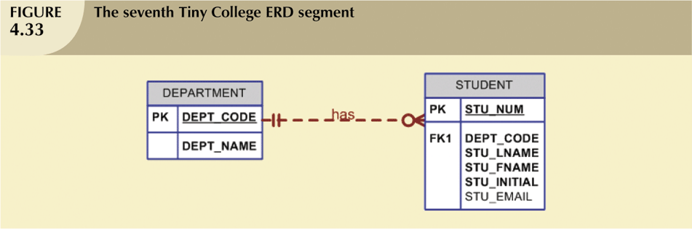
Developing an ER Diagram (continued)

Slide 38
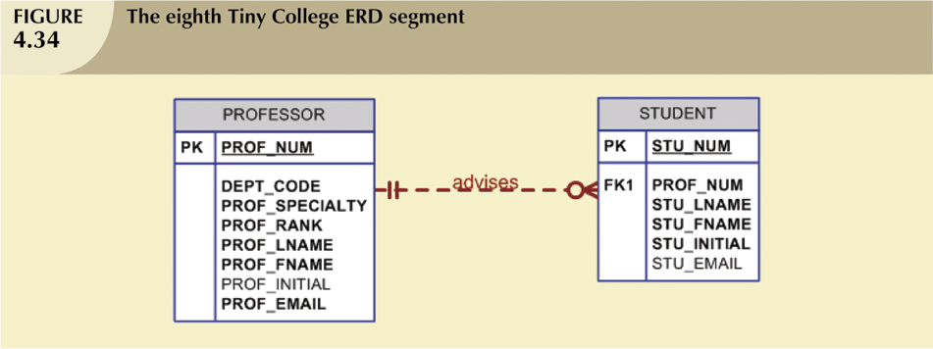
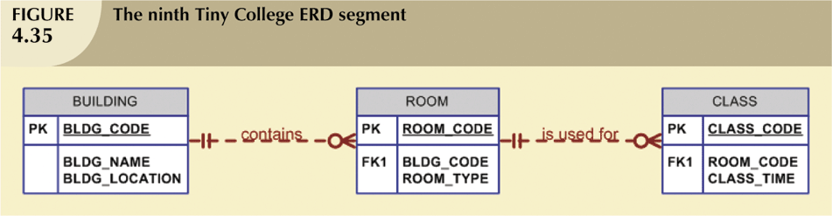
Developing an ER Diagram (continued)

Slide 39
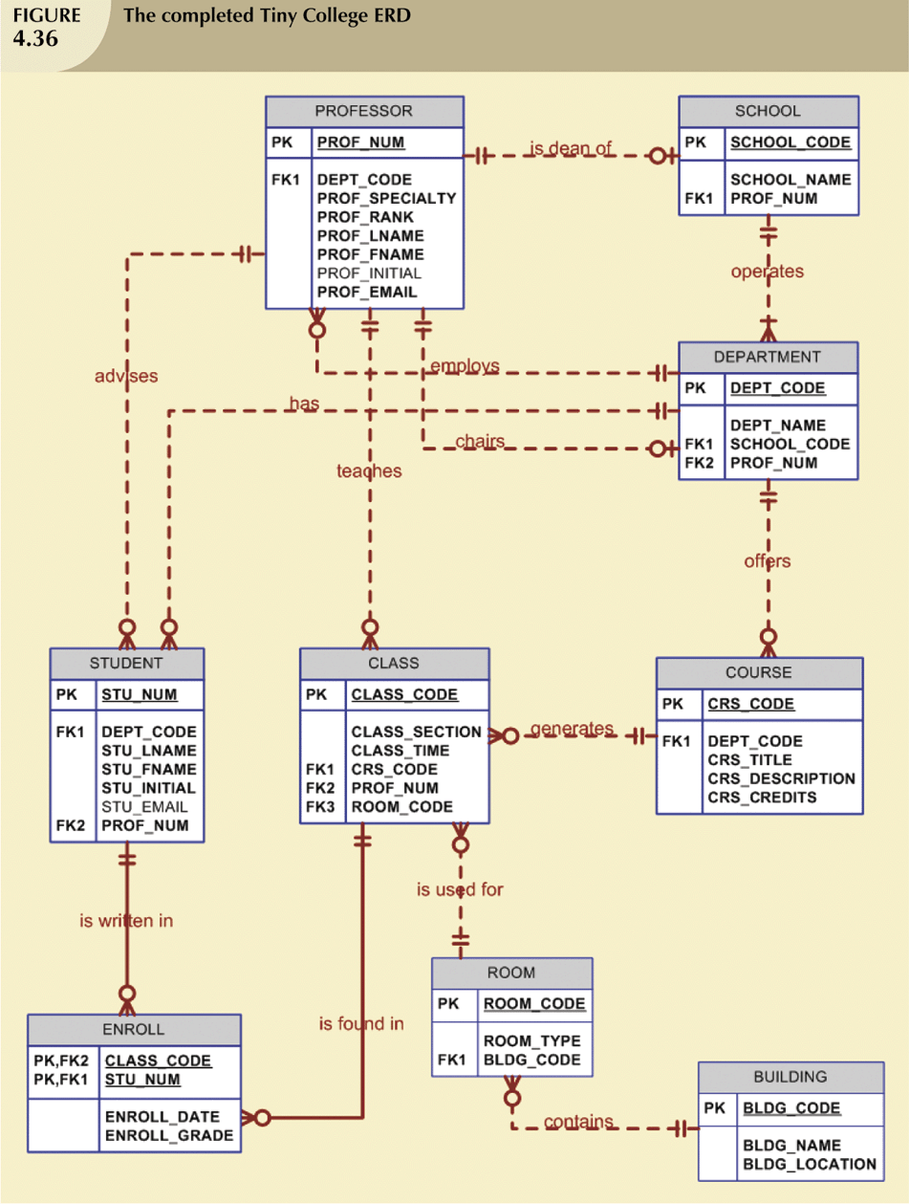
Developing an ER Diagram (continued)

Slide 40
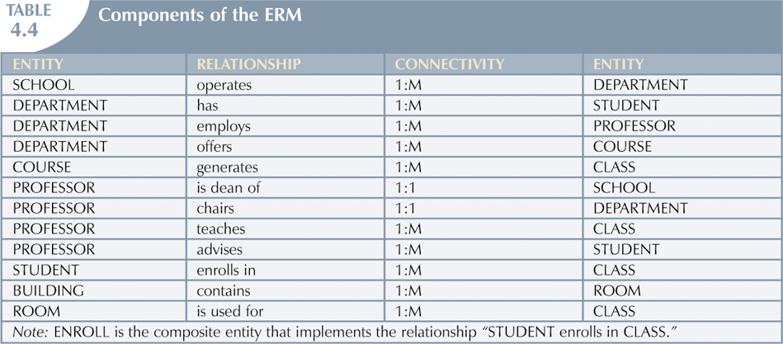
Developing an ER Diagram (continued)

Slide 41
Database Design Challenges:
Conflicting Goals
  Conflicting goals: design standards, processing speed, information requirements
DB design must conform to design standards
  Must minimize redundancies and anomalies
High processing speed is often a priority in DB design
  By minimizing the number of complexity of relationships
Quest for timely information might be focus of DB design
  Have to sacrifice “clean” designs and speed to ensure max info generation

Slide 42
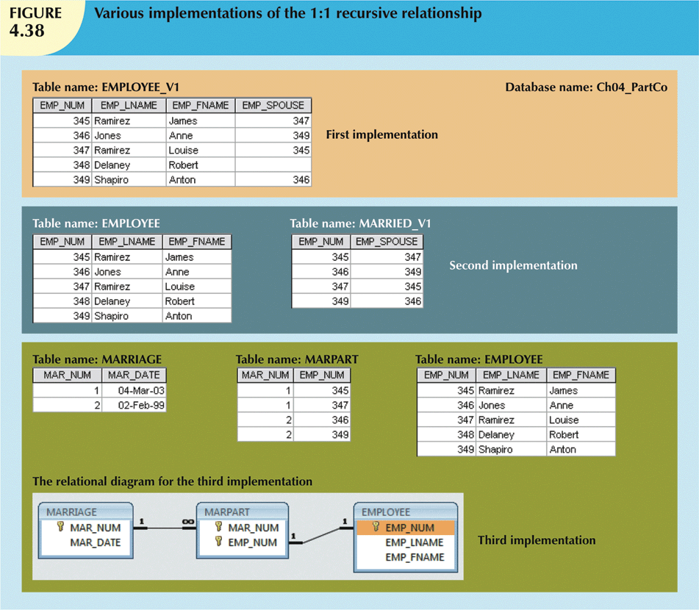

Slide 43
Summary
Entity relationship (ER) model
  Uses ERD to represent conceptual database as viewed by end user
  ERM’s main components:
    Entities
    Relationships
    Attributes
  Includes connectivity and cardinality notations
Connectivities and cardinalities are based on business rules
In ERM, M:N relationship is valid at conceptual level
ERDs may be based on many different ERMs
Database designers are often forced to make design compromises

