Slide 1
Module 4
IT-378 Database Processing
Advanced Data Modeling:
Extended ER Model

Slide 2
In this chapter, you will learn:
Main constructs in extended ER models
Supertypes vs. subtypes
Specialization hierarchy
  Inheritance
  Subtype discriminator
  Disjoint and Completeness constraints

Slide 3
The Extended E-R Model
Result of adding more semantic constructs to original ER model
Diagram using this model is called an extended ER diagram (EERD)

Slide 4
Entity Supertypes and Subtypes
Entity supertype
  Generic entity type that is related to one or more entity subtypes
  Contains common characteristics
Entity subtypes
  Contains unique characteristics of each subtype

Slide 5
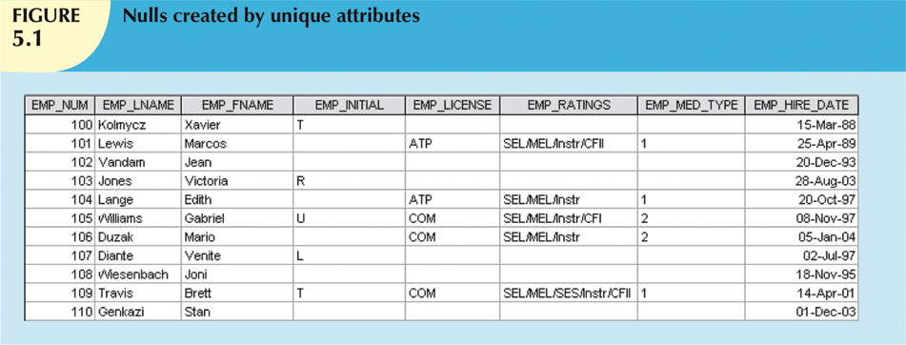

Slide 6
Specialization Hierarchy
Entity supertypes/subtypes are organized in a specialization hierarchy
  It depicts arrangement of higher-level supertypes (parent entities) and lower-level subtypes (child entities)
Subtype can exist only within context of supertype
Every subtype can have only one supertype to which it is directly related
Can have many levels of supertype/subtype relationships

Slide 7
Specialization Hierarchy (continued)
Provides the means to:
  Support attribute inheritance
  Define special supertype attribute known as subtype discriminator
  Define disjoint/overlapping constraints and complete/partial constraints

Slide 8
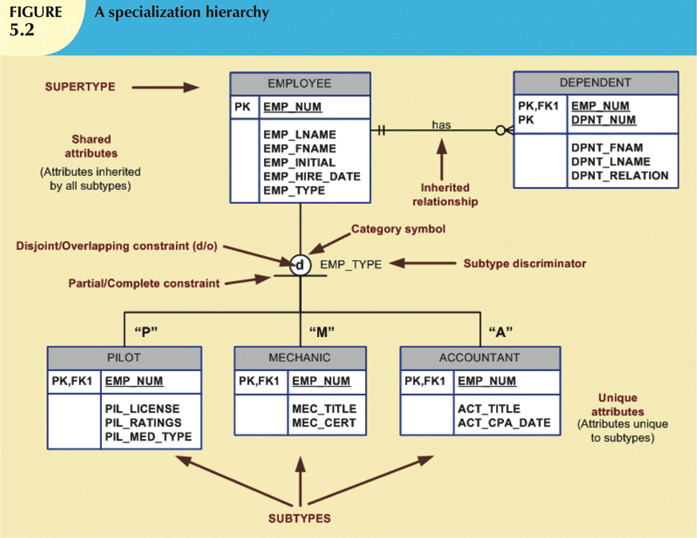

Slide 9
Inheritance
Enables entity subtype to inherit attributes and relationships of supertype
All entity subtypes inherit their PK attribute from their supertype
At implementation level, supertype and its subtype(s) maintain a 1:1 relationship

Slide 10
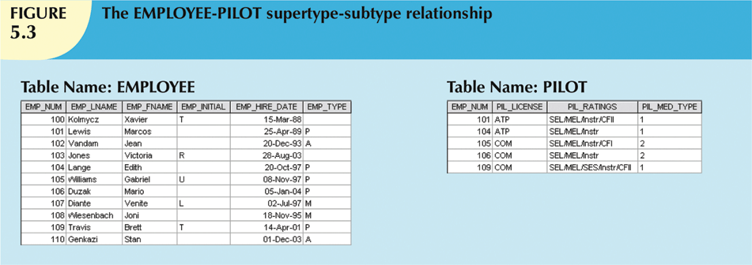
Inheritance (continued)

Slide 11
Subtype Discriminator
The attribute in supertype entity that determines to which entity subtype each supertype occurrence is related
The default comparison condition for subtype discriminator attribute is equality comparison

Slide 12
Disjoint and Overlapping Constraints
Disjoint subtypes
  Also known as non-overlapping subtypes
  Subtypes that contain unique subset of supertype entity set
Overlapping subtypes
  Subtypes that contain nonunique subsets of supertype entity set

Slide 13
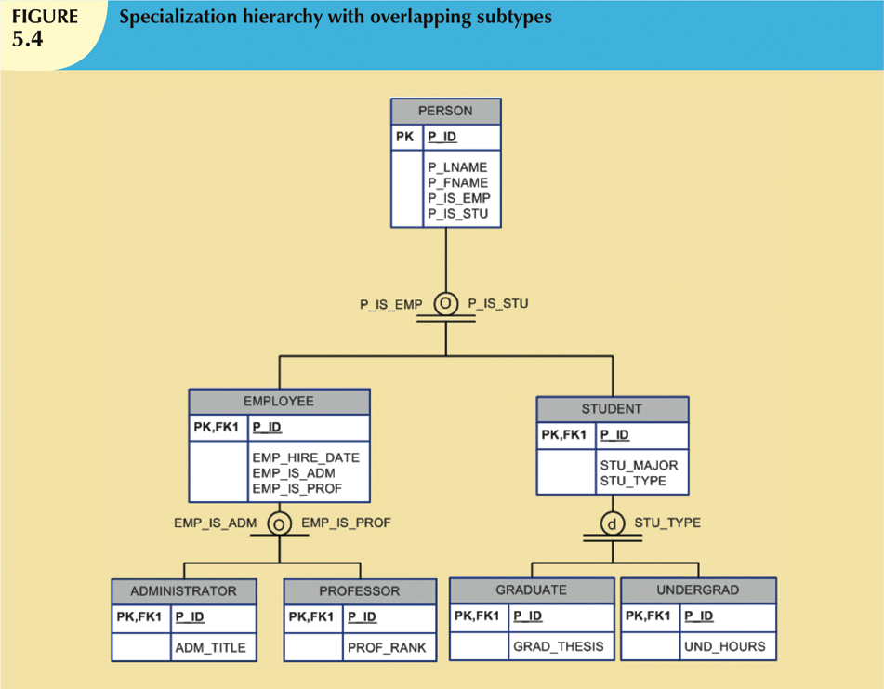

Slide 14
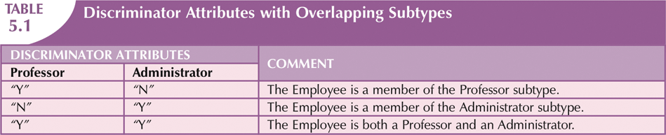
Disjoint and Overlapping
Constraints (continued)

Slide 15
Completeness Constraint
Specifies whether each entity supertype occurrence must be member of at least one subtype
Can be partial or total
  Partial completeness: not every supertype occurrence is a member of a subtype
  Total completeness: every supertype occurrence must be a member of a subtype

Slide 16
Specialization and Generalization
Specialization
  Top-down process of identifying entity subtypes from entity supertype
  Based on grouping unique characteristics and relationships of the subtypes
Generalization
  Bottom-up process of identifying generic entity supertype from lower-level entity subtypes
  Based on grouping common characteristics and relationships of the subtypes

Slide 17
Design Considerations:
Selecting Primary Keys
PK is the most important characteristic of an entity
  Single attribute or some combination of attributes
The PK’s function is to guarantee entity integrity
PK and FK work together to implement relationships
Properly selecting PK has direct bearing on efficiency and effectiveness

Slide 18
Natural Keys and Primary Keys
Natural key is a real-world identifier used to uniquely identify real-world objects
  Familiar to end users and forms part of their day-to-day business vocabulary
Generally, data modeler uses natural identifier as PK of entity being modeled
May instead use a surrogate key

Slide 19
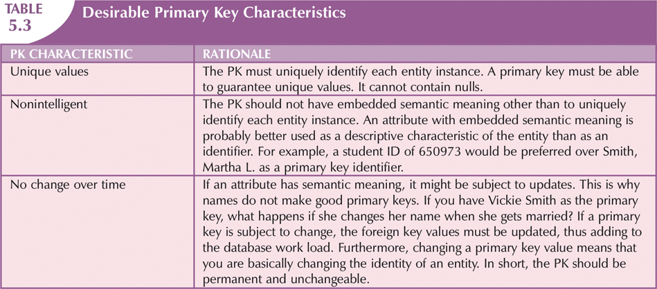
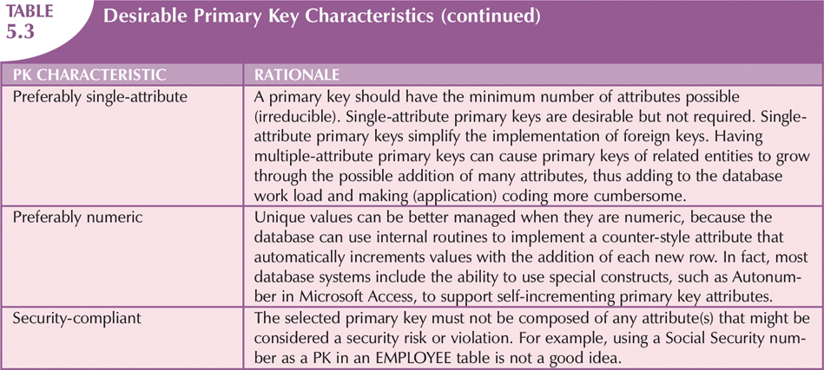

Slide 20
When to Use Composite Primary Keys
Composite primary keys useful in two cases:
  As identifiers of composite entities
    In which each PK combination is allowed once in M:N relationship
  As identifiers of weak entities
    In which weak entity has a strong identifying relationship with the parent entity
Automatically provides benefit of ensuring that there cannot be duplicate values

Slide 21
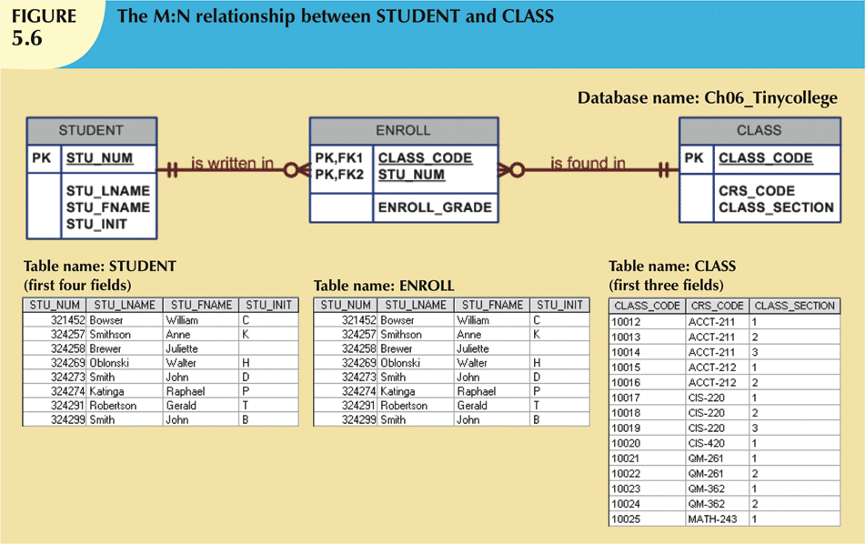

Slide 22
When To Use Surrogate Primary Keys
Especially helpful when there is:
  No natural key
  Selected candidate key has embedded semantic contents
  Selected candidate key is too long or cumbersome

