Slide 1
Module 5
Relational Schema:
Transforming ERD to Relations
IT 378 Database Processing

Slide 2
Relation
Relation: A named, two-dimensional table of data
Requirements for a table to qualify as a relation:
  It must have a unique name
  Every attribute value must be atomic (not multivalued)
  Every row must be unique (no duplicate rows allowed)
  Attributes (columns) must have unique names
  The order of the columns and rows must be irrelevant
  NOTE: The word relation (in relational database) is NOT the same as the word relationship (in ERD)

Slide 3
Correspondence with E-R Model
Relations correspond with entity types and with M:N relationship types
Rows correspond with entity instances and with M:N relationship instances
Columns correspond with attributes

Slide 4

Key Fields
Keys are special fields that serve two main purposes:
  Primary keys are unique identifiers of the relation in question. Examples include employee numbers, SSN, etc.
  Foreign keys are identifiers that enable a dependent relation (on the many side of a relationship) to refer to its parent relation (on the one side of the relationship)
Keys can be simple (a single field) or composite (more than one field)
Keys usually are used as indexes to speed up the response to user queries

Slide 5
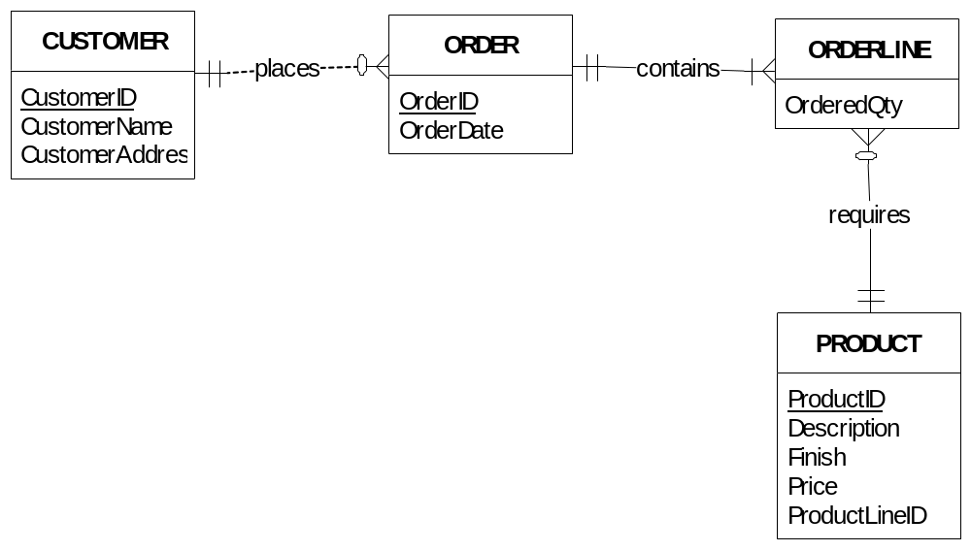
ERD Transformation:
A Simple Example

Slide 6
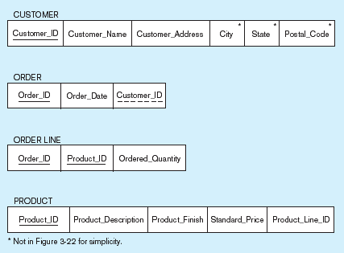
Relational schema for four relations
Primary Key
Foreign Key (implements 1:M relationship between customer and order)
Combined, these are a composite primary key…individually they are foreign keys (implement M:N relationship between order and product)

Slide 7
Integrity Constraints
Domain Constraints
  Allowable values for an attribute (e.g. integer 3 digits)
Entity Integrity
  No PK attribute may be null. All PK fields MUST have data
Referential Integrity Constraint
  Any FK value (M side) must match a PK value in the relation of the 1 side. (Or the FK can be null)

Slide 8
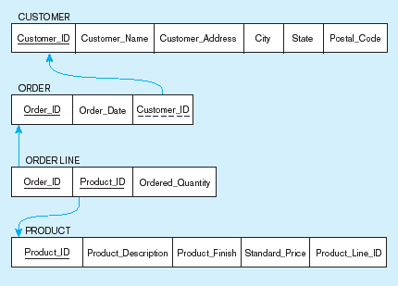
Referential integrity constraints
Referential integrity constraints are drawn via arrows from dependent to parent table

Slide 9
Transforming EER Diagrams into Relations
Mapping Regular Entities to Relations
  Simple attributes: E-R attributes map directly onto the relation
  Composite attributes: Use only their simple, component attributes
  Multivalued Attribute: Becomes a separate relation with an FK taken from the superior entity

Slide 10


Mapping a regular entity
(a) CUSTOMER entity type with simple attributes
(b) CUSTOMER relation

Slide 11


Mapping a composite attribute
(a) CUSTOMER entity type with composite attribute
(b) CUSTOMER relation with address detail

Slide 12

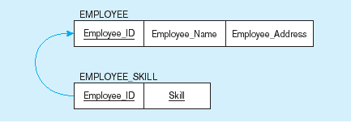
Mapping an entity with a multivalued attribute
(a)
Multivalued attribute becomes a separate relation with foreign key
(b)
1:M relationship between original entity and new relation

Slide 13
Transforming EER Diagrams into Relations (cont.)
Mapping Weak Entities
  Becomes a separate relation with an FK taken from the strong entity
  PK composed of:
    Partial identifier of weak entity
    PK of identifying relation (strong entity)

Slide 14
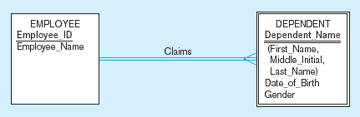
Example of mapping a weak entity
a) Weak entity DEPENDENT

Slide 15
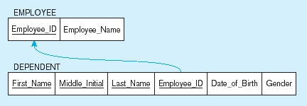
Example of mapping a weak entity (cont.)
b) Relations resulting from weak entity
NOTE: the domain constraint for the FK should NOT allow null values if DEPENDENT is a weak entity
Foreign key
Composite primary key

Slide 16
Transforming EER Diagrams into Relations (cont.)
Mapping Binary Relationships
  1:M – PK on the one side becomes an FK on the many side
  M:N – Create a new relation with the PKs of the two entities as its PK
  1:1 – PK on the mandatory side becomes an FK on the optional side

Slide 17
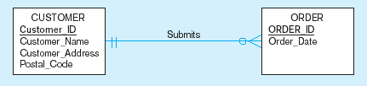
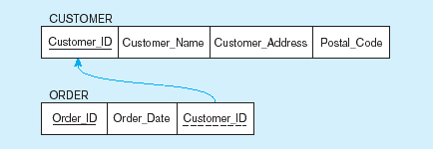
Example of mapping a 1:M relationship
a) Relationship between customers and orders
Note the mandatory one
b) Mapping the relationship
Again, no null value in the FK because of the mandatory minimum cardinality
Foreign key

Slide 18
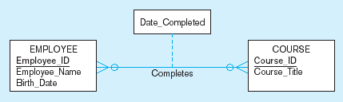
Example of mapping an M:N relationship
a) Completes relationship (M:N)
The Completes relationship will need to become a separate relation

Slide 19
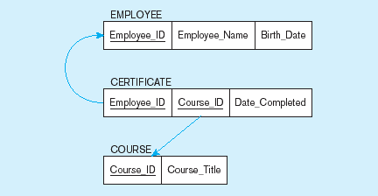
Example of mapping an M:N relationship (cont.)
b) Three resulting relations
Composite primary key
Foreign key
New intersection relation
Foreign key

Slide 20
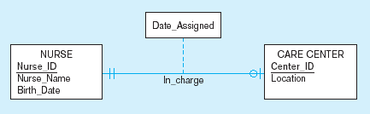
Example of mapping a binary 1:1 relationship
a) In_charge relationship (1:1)
Often in 1:1 relationships, one direction is optional.

Slide 21
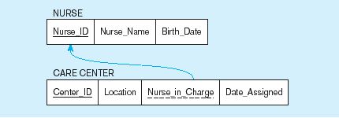
Example of mapping a binary 1:1 relationship (cont.)
b) Resulting relations
FK goes in the relation on the optional side,
matching the PK on the mandatory side

Slide 22
Transforming EER Diagrams into Relations (cont.)
Mapping Associative Entities
  Identifier Not Assigned
    Default PK for the association relation is composed of the PKs of the two entities (as in M:N relationship)
  Identifier Assigned
    It is natural and familiar to end-users
    Default identifier may not be unique

Slide 23
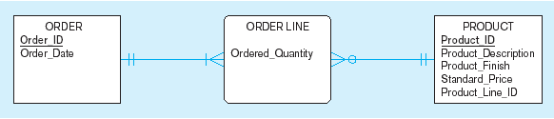
Example of mapping an associative entity
a) An associative entity

Slide 24
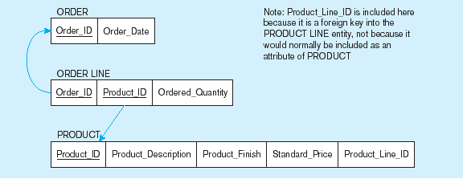
Example of mapping an associative entity (cont.)
b) Three resulting relations
Composite primary key formed from the two foreign keys

Slide 25

Example of mapping an associative entity with an identifier
a) SHIPMENT associative entity

Slide 26
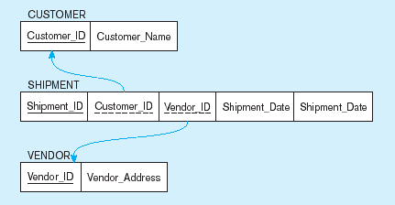
Example of mapping an associative entity with an identifier
b) Three resulting relations
Primary key differs from foreign keys

Slide 27
Transforming EER Diagrams into Relations (cont.)
Mapping Unary Relationships
  1:M – Recursive FK in the same relation
  M:N – Two relations:
    One for the entity type
    One for an associative relation in which the PK has two attributes, both taken from the PK of the entity

Slide 28
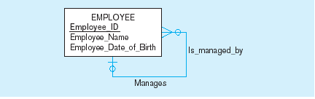

Mapping a unary 1:N relationship
(a) EMPLOYEE entity with unary relationship
No underline here!
(b) EMPLOYEE relation with recursive FK

Slide 29
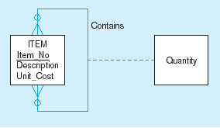
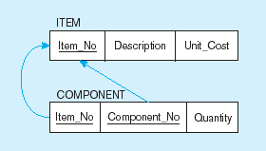
Mapping a unary M:N relationship
(a) Bill-of-materials relationships (M:N)
(b) ITEM and COMPONENT relations

Slide 30
Transforming EER Diagrams into Relations (cont.)
Mapping Ternary (and n-ary) Relationships
  One relation for each entity and one for the associative entity
  Associative entity has FKs to each entity in the relationship

Slide 31
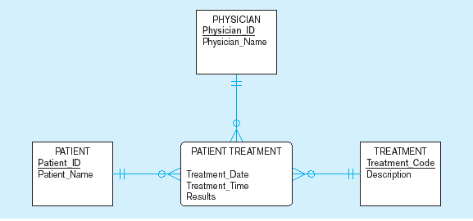
Mapping a ternary relationship
a) PATIENT TREATMENT Ternary relationship with associative entity

Slide 32
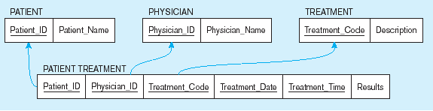
Mapping a ternary relationship (cont.)
b) Mapping the ternary relationship PATIENT TREATMENT
Remember that the PK MUST be unique
This is why treatment date and time are included in the composite PK
But this makes a cumbersome key…
It would be better to create a surrogate key like Treatment#

Slide 33
Transforming EER Diagrams into Relations (cont.)
Mapping Supertype/Subtype Relationships
  One relation for supertype and for each subtype
  Supertype attributes go into supertype relation
  Subtype attributes go into each subtype
  Subtype relations inherit the supertype’s PK
  1:1 relationship established between supertype and each subtype, with supertype as primary table

Slide 34
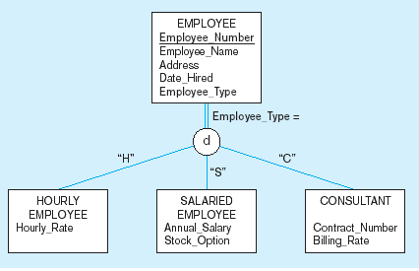
Supertype/subtype relationships

Slide 35
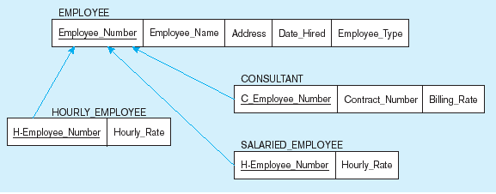
Mapping Supertype/subtype relationships to relations
S
These are implemented as 1:1 relationships

