Slide 1
Module 6
Database Normalization
IT 378 Database Processing

Slide 2
Objectives
What normalization is and what role it plays in the DB design process
About the normal forms 1NF, 2NF, 3NF, …
How to transform lower to higher normal forms
That some situations require denormalization to generate information efficiently

Slide 3
Data Normalization
Primarily a tool to validate and improve a logical design so that it satisfies certain constraints that avoid unnecessary data duplication
The process of decomposing relations with anomalies to produce smaller, well-structured relations

Slide 4
Well-Structured Relations
A relation that contains minimal data redundancy and allows users to insert, delete, and update rows without causing data inconsistencies
Goal is to avoid anomalies
  Insertion Anomaly–adding new rows forces user to create duplicate data
  Deletion Anomaly–deleting rows may cause a loss of data that would be needed for other future rows
  Modification Anomaly–changing data in a row forces changes to other rows because of duplication
General rule of thumb: A table should not pertain to more than one entity type

Slide 5

Example
Question–Is this a relation?
Answer–Yes: Unique rows and no multivalued attributes
Question–What’s the primary key?
Answer–Composite: Emp_ID, Course_Title

Slide 6
Anomalies in this Table
Insertion – duplicate data will be generated when employee 100 takes a new course
Deletion – if we remove employee 140, we lose information about the existence of a Tax Acc class
Modification – giving a raise to employee 100 forces us to update multiple records
Why do these anomalies exist?
  Because there are two themes (entity types) in this one relation. This results in data duplication and an unnecessary dependency between the entities

Slide 7
Functional Dependencies and Keys
Functional Dependency: The value of one attribute (the determinant) determines the value of another attribute
Candidate Key:
  A unique identifier. One of the candidate keys will become the primary key
    E.g. perhaps there is both credit card number and SS# in a table… then both are candidate keys
  Each non-key attribute is functionally dependent on every candidate key

Slide 8
First Normal Form
No multivalued attributes
  Every attribute value is atomic
All relations are in 1st Normal Form

Slide 9
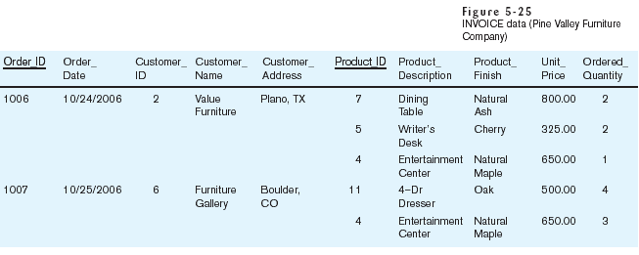
Table with multivalued attributes, not in 1st normal form
Note: this is NOT a relation

Slide 10
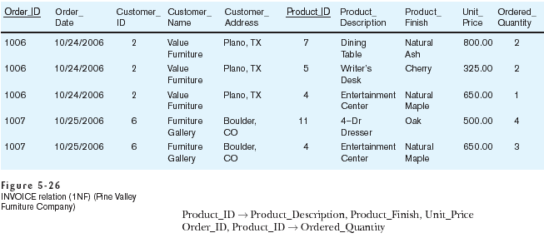
Table with no multivalued attributes and unique rows, in 1NF
Note: this is relation, but not a well-structured one

Slide 11
Anomalies in this Table
Insertion – if new product is ordered for order 1007 of existing customer, customer data must be re-entered, causing duplication
Deletion – if we delete the Dining Table from Order 1006, we lose information concerning this item's finish and price
Update – changing the price of product ID 4 requires update in several records
Why do these anomalies exist?
  Because there are multiple themes (entity types) in one relation. This results in duplication and an unnecessary dependency between the entities

Slide 12
Second Normal Form (2NF)
1NF PLUS every non-key attribute is fully functionally dependent on the ENTIRE primary key
  Every non-key attribute must be defined by the entire key, not by only part of the key
  No partial functional dependencies

Slide 13
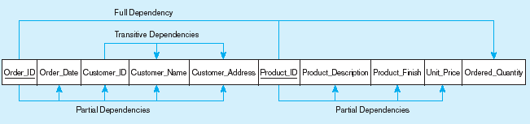
Functional dependency diagram for INVOICE
Order_ID ➔ Order_Date, Customer_ID, Customer_Name, Customer_Address
Customer_ID ➔ Customer_Name, Customer_Address
Product_ID ➔ Product_Description, Product_Finish, Unit_Price
Order_ID, Product_ID ➔ Order_Quantity
Therefore, NOT in 2nd Normal Form

Slide 14
Convert to 2NF
Create a new relation for each PK attribute that is a determinant in a partial dependency. That attribute becomes the PK of the new relation.
Move the non-key attributes dependent on the new PK to the new relation.

Slide 15
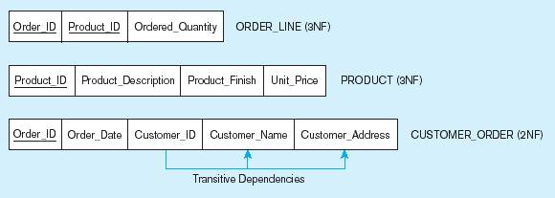
Removing partial dependencies
Getting it into 2nd Normal Form
Partial dependencies are removed, but there are still transitive dependencies

Slide 16
Third Normal Form (3NF)
2NF PLUS no transitive dependencies (functional dependencies on non-PK attributes)
  Called transitive, because the PK is a determinant for another attribute, which in turn is a determinant for a third
Convert to 3NF:
  Non-key determinant with transitive dependencies goes into a new relation
  It becomes PK in the new relation and stays as FK in the old relation

Slide 17
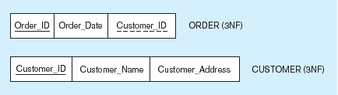
Removing transitive dependencies

Slide 18
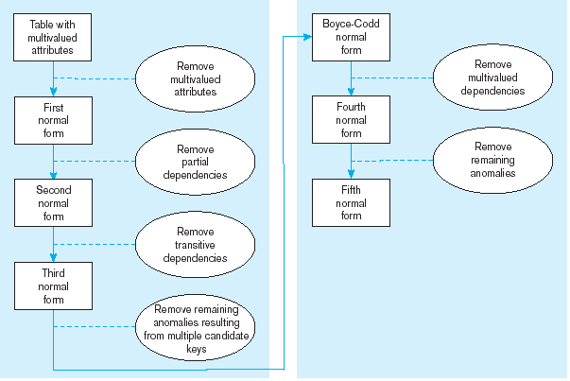
Steps in normalization

Slide 19
Normalization and Database Design
Normalization should be part of design process
  Proposed entities need to meet required normal form before table structures are created
You may be asked to redesign/modify existing DBs
  Existing DBs may have been improperly designed or burdened with anomalies, or improperly modified over time

Slide 20
Normalization and Database Design
ERD
  Provides big picture, or macro view, of an organization’s data requirements and operations
  Created through an iterative process
Normalization
  Focuses on characteristics of specific entities
  Represents micro view of entities within ERD
Two techniques should be used concurrently
  Difficult to separate normalization process from ER modeling process

Slide 21
Denormalization
Creation of normalized relations is an important design goal
Processing requirements should also be a goal
  Number of DB tables expands in the normalization process
  Joining more tables takes additional I/O operations and processing logic, thereby reducing system speed
  Conflicts between design and performance goals are often resolved through compromises that include denormalization
Under some circumstances, unnormalized tables are better choice
Use denormalization cautiously

