Slide 1

IT 378: Database Processing
Module 7 – Creating Tables
Ch3: Table Creation & Management
Ch4: Constraints

Slide 2
Ch3: Table Creation & Management
Objectives
  Identify the table name and structure
  Create a new table with the CREATE TABLE command
  Add, modify and delete a column in an existing table
  Rename, truncate and drop a table
Oracle 11g: SQL

Slide 3
Table Design
Tables are created and modified through data definition language (DDL) commands
Table and column names:
  Can contain up to 30 characters – no blank spaces
  Must begin with a letter
  Can contain numbers, underscore (_), and number sign (#)
  Must be unique
  No reserved words are allowed (e.g., NUMBER, CHAR)
Oracle 11g: SQL

Slide 4
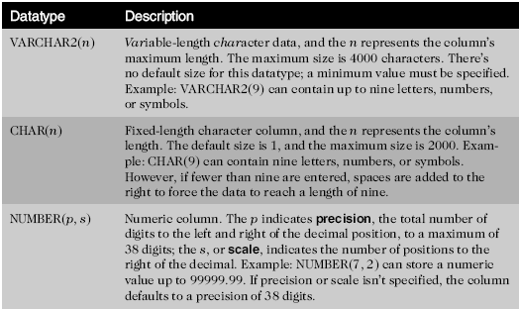

Table Design (continued)
Oracle 11g: SQL

Slide 5
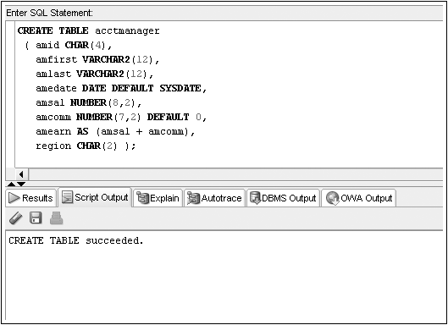
CREATE TABLE Command Example
Column definition list must be enclosed in ()
Datatype must be specified for each column
Maximum of 1,000 columns
Oracle 11g: SQL

Slide 6
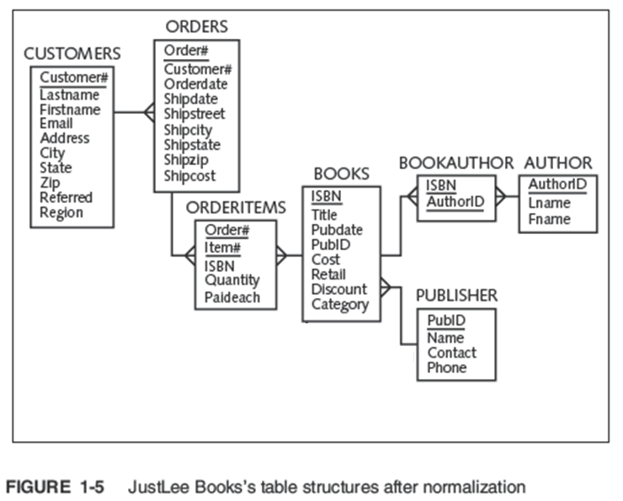
Create the JustLee Database
Use the script (JLDB_Build.sql) to create the DB
Oracle 11g: SQL

Slide 7
Viewing List of Tables: USER_TABLES
Can query the data dictionary to verify all the tables that exist in your schema
The USER_TABLES data dictionary object maintains information regarding all your tables
SELECT table_name
FROM user_tables;
Oracle 11g: SQL

Slide 8
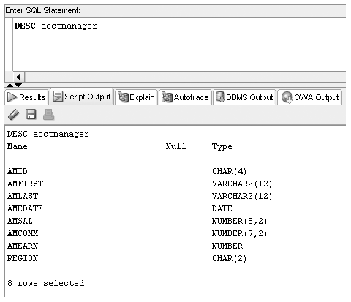
Viewing Table Structures: DESCRIBE
DESCRIBE displays the structure of a specified table
Oracle 11g: SQL

Slide 9
Modifying Existing Tables (ALTER TABLE)
Accomplished through the ALTER TABLE command
  Use an ADD clause to add a column
  Use a MODIFY clause to change a column
  Use a DROP COLUMN to drop a column
Oracle 11g: SQL

Slide 10
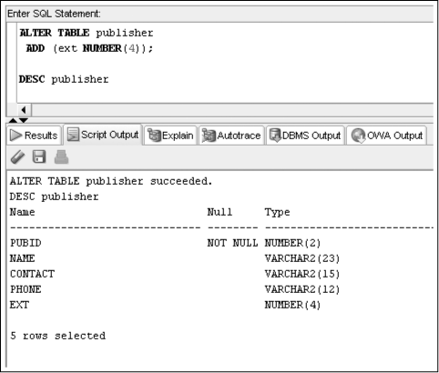
ALTER TABLE…ADD Command
Oracle 11g: SQL

Slide 11
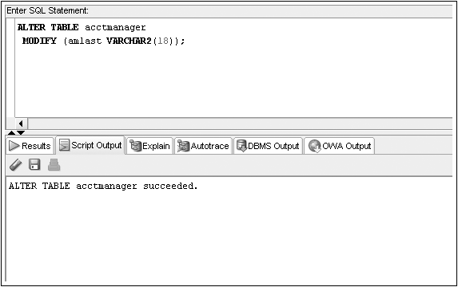
ALTER TABLE…MODIFY Command
Oracle 11g: SQL

Slide 12
Modification Guidelines
Column must be as wide as the existing data
If a NUMBER column already contains data, size cannot be decreased
Adding or changing default data does not affect existing data
ALTER TABLE publisher
ADD (rating CHAR(1));
ALTER TABLE publisher
MODIFY (rating DEFAULT ‘N’);
Oracle 11g: SQL

Slide 13
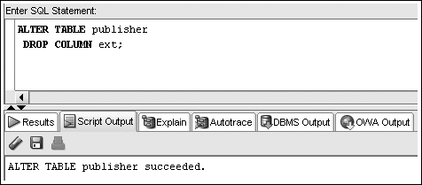
ALTER TABLE…DROP COLUMN Command
Can only reference one column per execution
Deletion is permanent
Cannot delete last remaining column in a table
Oracle 11g: SQL

Slide 14
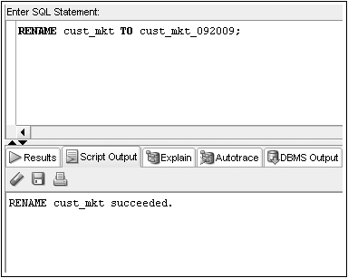
Renaming a Table
RENAME…TO is used to rename a table
  the old name is no longer valid
Oracle 11g: SQL

Slide 15
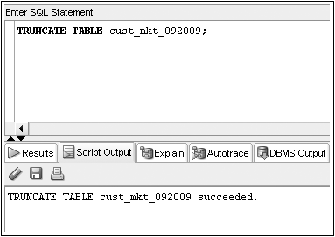
Truncating a Table
TRUNCATE TABLE command – rows are deleted
Structure of table remains
Oracle 11g: SQL

Slide 16
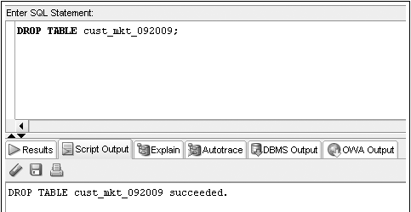
Deleting a Table
DROP TABLE command – table structure and contents are deleted
Oracle 11g: SQL

Slide 17
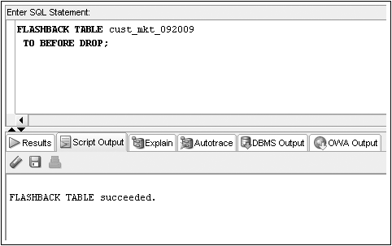
FLASHBACK Command
Recovers a dropped table from the recycle bin
Oracle 11g: SQL

Slide 18

PURGE Option for
DROP TABLE Command
Using the PURGE option will permanently remove a table from the database
The table will not be copied into the recycle bin
Oracle 11g: SQL

Slide 19
Summary
You create a table with the CREATE TABLE command
Each column to be contained in the table must be defined in terms of the column name, data type, and for certain data types, the width
A table can contain up to 1000 columns
Each column name within a table must be unique
You can change the structure of a table with the ALTER TABLE command
Columns can be added, resized, and even deleted with the ALTER TABLE command
Tables can be renamed with the RENAME...TO command
To delete all the rows in a table, use the TRUNCATE TABLE command
To remove both the structure of a table and all its contents, use the DROP TABLE command
A dropped table is moved to the recycle bin and can be recovered using the FLASHBACK TABLE command
Using the PURGE option in a DROP TABLE command permanently removes the table, meaning you cannot recover it from the recycle bin
Oracle 11g: SQL

Slide 20
Ch4: Constraints
Objectives:
  Explain the purpose of constraints in a table
  Create PRIMARY KEY, FOREIGN KEY, UNIQUE, CHECK, and NOT NULL constraints
  Understand how constraints can be created when creating a table or modifying an existing table
  Distinguish between creating constraints at the column level and table level
  Use DISABLE and ENABLE commands
  Use the DROP command
Oracle 11g: SQL

Slide 21
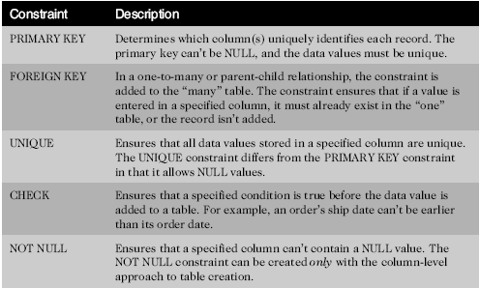
Constraints
Used to enforce business rules and data accuracy and integrity
Abbreviation
_pk
_fk
_uk
_ck
_nn
Oracle 11g: SQL

Slide 22
Creating Constraints
Use the optional CONSTRAINT keyword during creation to assign a name
Constraint naming Convention:
  tablename_columnname_constrainttype
  e.g.,
  customers_customer#_pk
Oracle 11g: SQL

Slide 23
Creating Constraints (continued)
When
  After table creation, by modifying the existing table
  During table creation
How (during table creation)
  Column level approach
  Table level approach
Oracle 11g: SQL

Slide 24
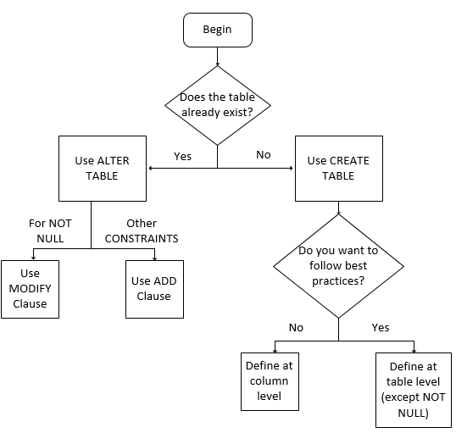

Decision Tree: Creating Constraints
Oracle 11g: SQL

Slide 25
Adding Constraints to Existing Tables
Constraints are added to an existing table with the ALTER TABLE command
Add a NOT NULL constraint using MODIFY clause
All other constraints are added using ADD clause
Oracle 11g: SQL

Slide 26
Using the PRIMARY KEY Constraint
Ensures that columns do not contain duplicate or NULL values
Only one per table is allowed
ALTER TABLE customers
ADD CONSTRAINT customers_customer#_pk PRIMARY KEY (customer#);
Oracle 11g: SQL

Slide 27
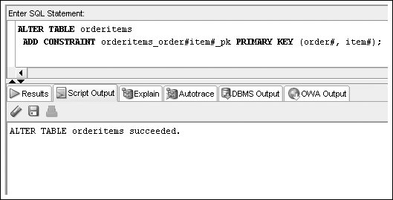
PRIMARY KEY Constraint for Composite Key
Column names separated by commas
Oracle 11g: SQL

Slide 28
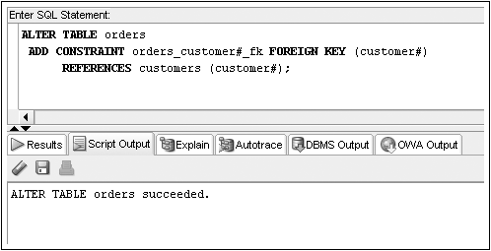
Using the FOREIGN KEY Constraint
Maps to the PRIMARY KEY in parent table
NULL values are allowed
Oracle 11g: SQL

Slide 29
Deletion of Foreign Key Values
You cannot delete a value in a parent table referenced by a row in a child table
Use ON DELETE CASCADE keywords when creating FOREIGN KEY constraint
  It automatically deletes the corresponding child records when a parent record is deleted
  It can be included in either CREATE TABLE or ALTER TABLE statements
Or acle 11g: SQL

Slide 30
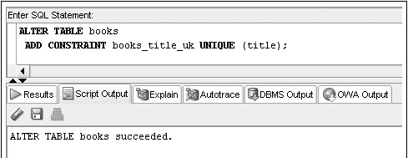
Using the UNIQUE Constraint
No duplicates are allowed in the referenced column
NULL values are permitted
Oracle 11g: SQL

Slide 31
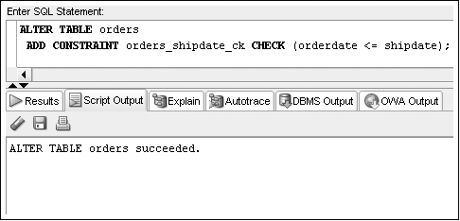
Using the CHECK Constraint
Updates must meet specified condition
Oracle 11g: SQL

Slide 32
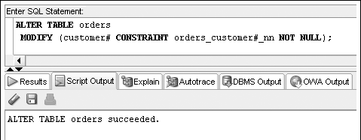
Using the NOT NULL Constraint
It is a special CHECK constraint with IS NOT NULL condition
Included in output of DESCRIBE command
Can only be added to an existing table using ALTER TABLE… MODIFY command
Oracle 11g: SQL

Slide 33

Including Constraints during Table Creation – Column Level
Include in column definition
Note: 2 constraints are created for dname, and there is no comma between them
Oracle 11g: SQL

Slide 34
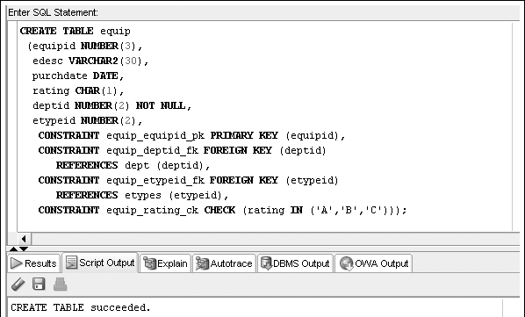
Including Constraints during Table Creation – Table Level
Include at end of column list
NOT NULL constraints can only be created at the column level
Oracle 11g: SQL

Slide 35
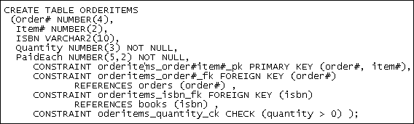
Multiple Constraints on a Single Column
A column may be included in multiple constraints
  The order# column included in a PK and an FK constraint
Composite PK constraints can only be created at table level
Oracle 11g: SQL

Slide 36
Enforcement of Constraints
All constraints are enforced at the table level
If a data value violates a constraint, the entire row is rejected
Oracle 11g: SQL

Slide 37
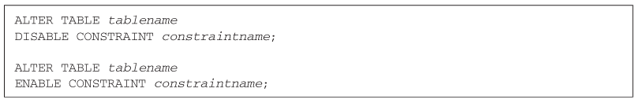
Using DISABLE/ENABLE
Use DISABLE or ENABLE clause of ALTER TABLE command
Oracle 11g: SQL

Slide 38
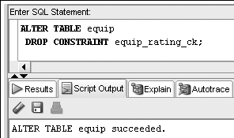

Dropping Constraints
Constraints cannot be modified; they must be dropped and recreated
  Actual syntax depends on type of constraint
    PRIMARY KEY – just list type of constraint
    UNIQUE – include column name
    All others – reference constraint name
Oracle 11g: SQL

Slide 39
Summary
A constraint is a rule that is applied to data being added to a table
  The constraint represents business rules, policies, and/or procedures
  Data violating the constraint is not added to the table
A constraint can be included during table creation as part of the CREATE TABLE command or added to an existing table using the ALTER TABLE command
A PRIMARY KEY constraint does not allow duplicate or NULL values in the designated column
Only one PRIMARY KEY constraint is allowed in a table
A FOREIGN KEY constraint requires that the column entry match a referenced column entry in the referenced table or be NULL
A UNIQUE constraint is similar to a PRIMARY KEY constraint except it allows NULL values to be stored in the specified column
A CHECK constraint ensures a value meets a specified condition
A NOT NULL constraint ensures a value is provided for a column
A constraint can be disabled or enabled using the ALTER TABLE command and the DISABLE and ENABLE keywords
A constraint cannot be modified. To change a constraint, it must first be dropped and then re-created
Oracle 11g: SQL

