Slide 1
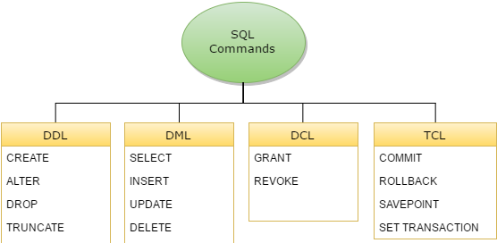

Slide 2
INSERT ALL statement
INSERT ALL
INTO table1 (col1, col2, col_n) VALUES (value1, value2, value_n)
INTO table2 (col1, col2, col_n) VALUES (value1, value2, value_n)
INTO table3 (col1, col2, col_n) VALUES (value1, value2, value_n)
SELECT * FROM dual;

