Slide 1

IT 378: Database Processing
Topic 8 – Inserting & Modifying Data
Ch5: Data Manipulation & Transaction Control

Slide 2
Objectives
Use the INSERT command to add records to an existing table
Use the UPDATE command to modify existing table rows
Delete records
Manage transactions with transaction control commands COMMIT, ROLLBACK, and SAVEPOINT
Oracle 11g: SQL

Slide 3
INSERT Command
Enclose nonnumeric data in single quotes
If a column list is not provided, a value must be assigned to each column in the table
Can only add one row at a time to a table
    INSERT ALL can add multiple records in one statement
Oracle 11g: SQL

Slide 4
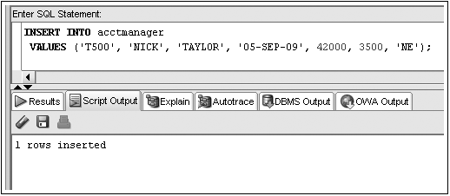
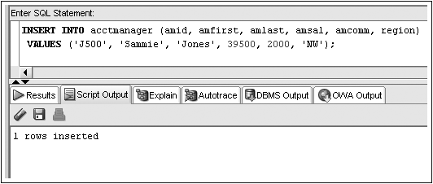
INSERT Command Examples
No Column List
Column List
Oracle 11g: SQL

Slide 5
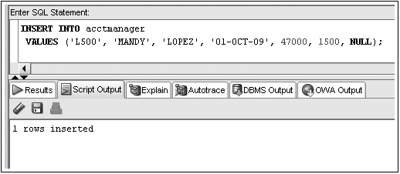
Inserting NULL Value
Omit column name from INSERT INTO clause column list
Use NULL keyword
Substitute two single quotes ('')
INSERT INTO acctmanager
VALUES ('L500', 'MANDY', 'LOPEZ', '01-OCT-09', 47000, 1500, '');
NULL value input
Oracle 11g: SQL

Slide 6
Constraint Violations
When you add or modify table data, the data is checked for compliance with any applicable constraints
Oracle 11g: SQL

Slide 7
Activating the DEFAULT option
Include a column list in the INSERT statement ignoring the column to use the DEFAULT option
Use the DEFAULT keyword as the column value
INSERT INTO acctmanager (amid, amfirst, amlast, amedate, amsal, …, region)
VALUES ('J500', 'MANDY', 'JONES', 'DEFAULT', 48000, …, 'NW');
Oracle 11g: SQL

Slide 8
Handling Single Quotes in the Data
Inserting values containing single quotes (O'hara) causes an error
Must enter two single quotes together in the value
INSERT INTRO acctmanager (amid, amfirst, amlast, …, region)
VALUES ('O500', 'Peg', 'O''Hara', …, 'NW');
Oracle 11g

Slide 9
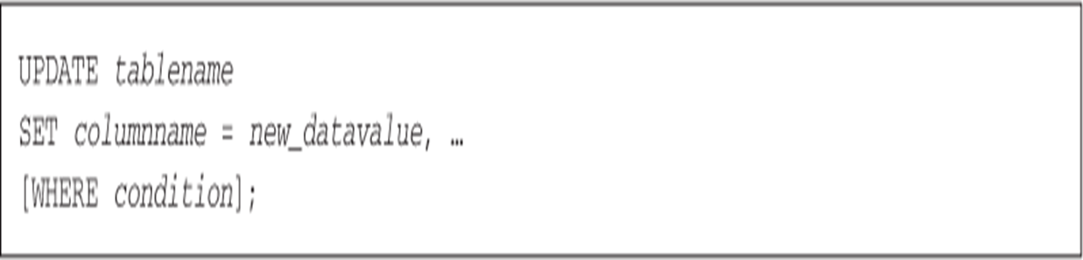
Modifying Existing Rows
Use the UPDATE command
  UPDATE clause identifies table
  SET clause identifies column(s) to take on new value(s)
  WHERE clause specifies row(s) to be changed
    If omitted, all rows will be updated!
Oracle 11g: SQL

Slide 10
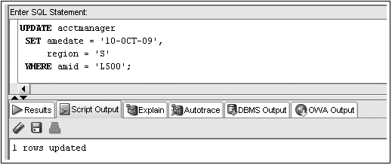
UPDATE Command Examples
UPDATE acctmanager
SET region = 'N'
WHERE region IN ('NE', 'NW');
Oracle 11g: SQL

Slide 11
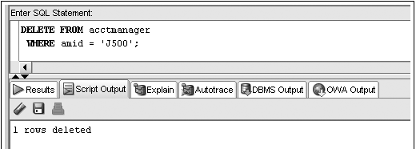

Deleting Rows
DELETE command removes a row from a table
To remove all rows in a table
WHERE clause determines which row(s) are removed
Oracle 11g: SQL

Slide 12
Transaction Control Statements
Results of data manipulation language (DML) commands are NOT permanently updated to a table until explicit or implicit COMMIT occurs
Transaction control statements can:
  Commit data through COMMIT command
  Undo data changes through ROLLBACK command
Oracle 11g: SQL

Slide 13
COMMIT Command
Explicit COMMIT occurs by executing COMMIT;
Implicit COMMIT occurs when DDL command is executed or user properly exits system
Permanently updates table(s) and allows other users to view changes
Oracle 11g: SQL

Slide 14
ROLLBACK Command
Used to “undo” changes that have not been committed
Occurs when:
  ROLLBACK; is executed
  System restarts after a crash
SAVEPOINT marks a specific spot within the transaction
Can ROLLBACK to a SAVEPOINT to undo part of the transaction
Oracle 11g: SQL

Slide 15
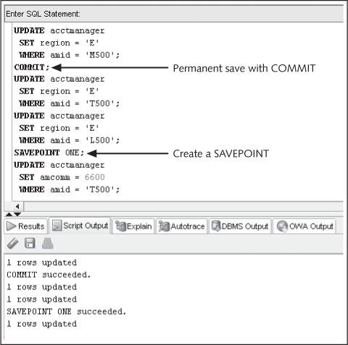
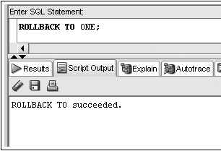
Transaction Control Example
Only undo DML actions after SAVEPOINT
Oracle 11g: SQL

Slide 16
Summary
Data manipulation language (DML) includes the INSERT, UPDATE, DELETE, COMMIT, and ROLLBACK commands
The INSERT INTO command is used to add new rows to an existing table
The column list specified in the INSERT INTO clause must match the order of data entered in the VALUES clause
You can use a NULL value in an INSERT INTO command by including the keyword NULL, omitting the column from the column list of the INSERT INTO clause, or entering two single quotes (without a space) in the position of the NULL value
To assign a DEFAULT option value, a column must be excluded from the column list in an INSERT statement or the keyword DEFAULT must be included as the value for the column
In a DML statement, two single quotes together must be used to represent a single quote in a value
You can change the contents of a row or group of rows with the UPDATE command
DML operations aren’t stored permanently in a table until a COMMIT command is issued implicitly or explicitly
A transaction consists of a set of DML operations committed as a block
Uncommitted DML operations can be undone by issuing the ROLLBACK command
A SAVEPOINT serves as a marker for a point in a transaction and allows rolling back only a portion of the transaction
Use the DELETE command to remove records from a table; if the WHERE clause is omitted, all rows in the table are deleted
Oracle 11g: SQL

