Slide 1

IT 378: Database Processing
Topic 9 – Writing Queries
Ch2: Basic SELECT Statements
Ch8: Restricting Rows and Sorting Data

Slide 2
Ch2: Basic SELECT Statements
Objectives:
  Understand the basics of the SELECT command
    Identify its keywords, mandatory and optional clauses
    Display one, multiple, and all columns of a table
    Use a column alias to clarify the contents of a column
    Perform arithmetic operations in the SELECT clause
    Remove duplicates with DISTINCT or UNIQUE
    Concatenate fields, literals, and other data
Oracle 11g: SQL

Slide 3
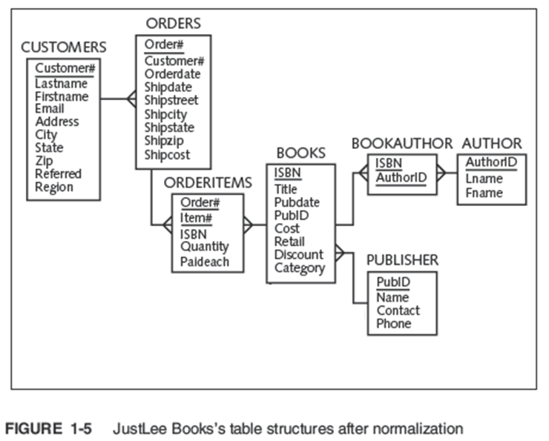

Oracle 11g: SQL

Slide 4
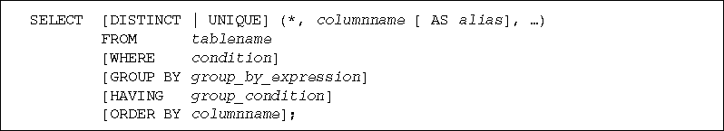
SELECT Statement Syntax
A SELECT statement (or query) retrieves data from the DB
SELECT and FROM clauses are required
  SELECT clause identifies column(s)
  FROM clause identifies table(s)
Each clause begins with a keyword
Oracle 11g: SQL

Slide 5
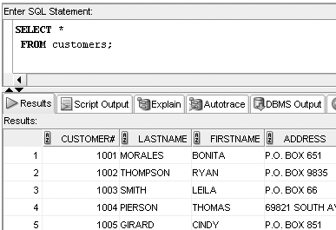
Selecting All Data in a Table
Use an asterisk for the column names in the SELECT clause
Oracle 11g: SQL

Slide 6
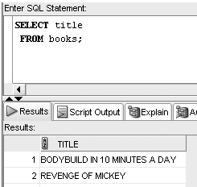
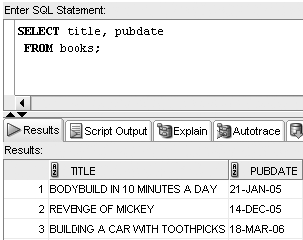
Selecting Column(s) from a Table
Enter column name(s) in SELECT clause
Separate column names with a comma
Oracle 11g: SQL

Slide 7
Operations within the SELECT Statement
Column alias can be used for column headings
Perform arithmetic operations
Suppress duplicates
Concatenate data
Oracle 11g: SQL

Slide 8
Using Column Aliases
List the alias after the column heading
AS keyword is optional
Enclose in double quotes:
  If it contains blank space(s)
  If it contains special symbol(s)
  To retain case
Oracle 11g: SQL

Slide 9
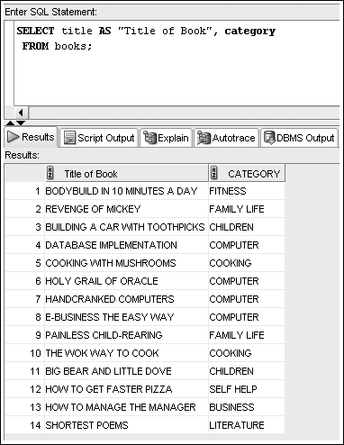
Column Alias Example
SELECT title, retail price
FROM books;
Oracle 11g: SQL

Slide 10
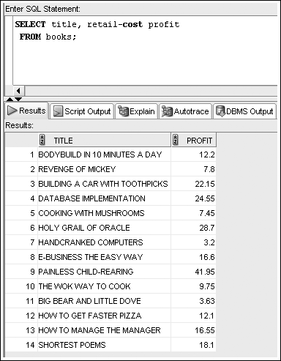
Using Arithmetic Operations
Arithmetic operations
  Executed left to right
  Multiplication and division are solved first
  Addition and subtraction are solved last
  Override order with parentheses
Oracle 11g: SQL

Slide 11
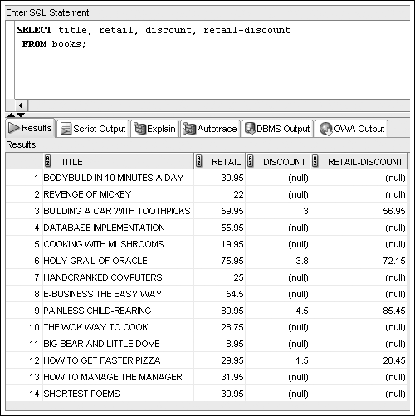
NULL Values
Oracle 11g: SQL

Slide 12
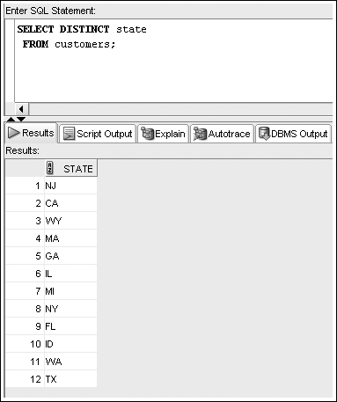
Using DISTINCT and UNIQUE
Enter DISTINCT or UNIQUE after SELECT keyword to suppress duplicates
Oracle 11g: SQL

Slide 13
Using Concatenation
You can combine data with a string literal
Use the concatenation operator, ||
It allows the use of column aliases
Oracle 11g: SQL

Slide 14
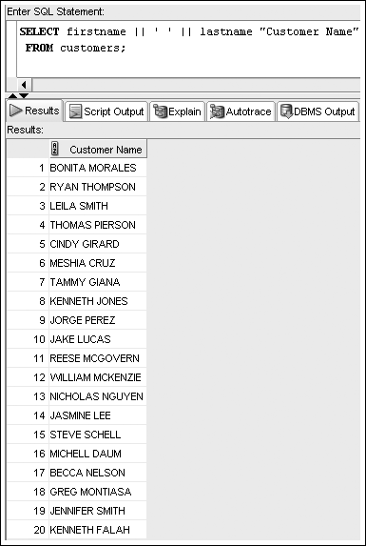
Concatenation Examples
SELECT firstname || lastname
FROM customers;
SELECT firstname || ' ' || lastname
FROM customers;
Oracle 11g: SQL

Slide 15
Summary
A basic query in Oracle 11g SQL includes the SELECT and FROM clauses, the only mandatory clauses in a SELECT statement
To view all columns in the table, specify an asterisk (*) or list all of the column names individually in the SELECT clause
To display a specific column or set of columns, list the column names in the SELECT clause (in the order in which you want them to appear)
When listing column names in the SELECT clause, a comma must separate column names
A column alias can be used to clarify the contents of a particular column; if the alias contains spaces or special symbols, or if you want to display the column with any lowercase letters, you must enclose the column alias in double quotation marks (" ")
Indicate the table name following the FROM keyword
Basic arithmetic operations can be performed in the SELECT clause
NULL values indicate an absence of a value
To remove duplicate listings, include either the DISTINCT or UNIQUE keyword
To specify which table contains the desired columns, you must list the name of the table after the keyword FROM
Use vertical bars (||) to concatenate, fields, literals, and other data
Oracle 11g: SQL

Slide 16
Ch8: Restricting Rows & Sorting Data
Objectives:
  Use a WHERE clause to restrict the rows returned by a query
  Create a search condition using
    Mathematical comparison operators
    The BETWEEN…AND comparison operator
    The IN operator with a list of values
    The LIKE comparison operator
    The % and _ wildcard characters
  Join multiple search conditions using the appropriate logical operator
  Perform searches for NULL values
  Specify the order of query results using an ORDER BY clause
Oracle 11g: SQL

Slide 17
WHERE Clause Syntax
A WHERE clause is used to retrieve rows based on a stated condition
Requires:
  Column name
  Comparison operator
  Value or column for comparison
Values are case sensitive
Oracle 11g: SQL

Slide 18
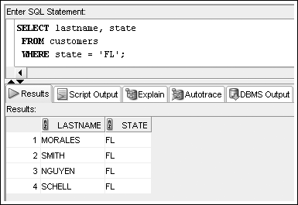
WHERE Clause Examples
List WHERE clause after FROM clause
Enclose nonnumeric data in single quotes
SELECT *
FROM customers
WHERE customer# = 1010;
SELECT *
FROM books
WHERE pubdate = ‘21-JAN-05’;
Oracle 11g: SQL

Slide 19
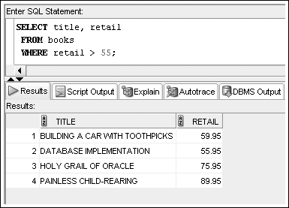
Comparison Operators
Indicate how the data should relate to a given value
SELECT title, retail-cost profit
FROM books
WHERE retail-cost < cost*0.2;
SELECT firstname, lastname, state
FROM customers
WHERE state <= ‘GA’;
SELECT order#, orderdate
FROM orders
WHERE orderdate < ‘01-OCT-12’;
Oracle 11g: SQL

Slide 20
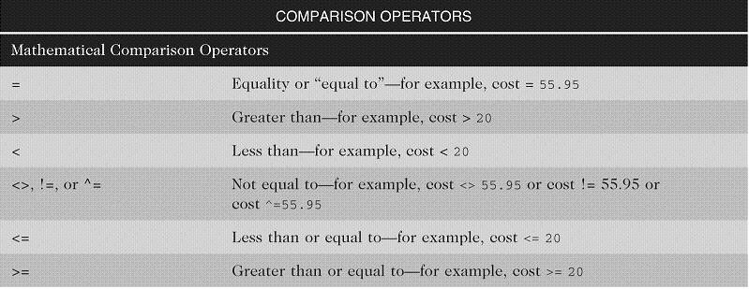
Arithmetic Comparison Operators
Oracle 11g: SQL

Slide 21
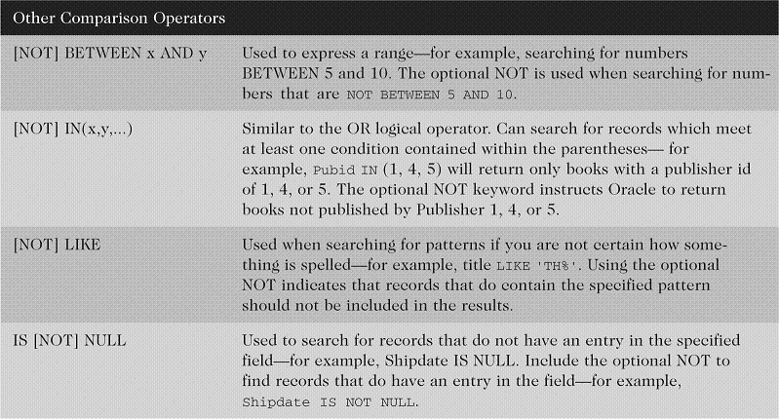
Other Comparison Operators
Oracle 11g: SQL

Slide 22
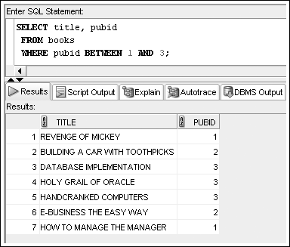
BETWEEN…AND Operator
Finds values in a specified range
Other examples:
BETWEEN ‘A’ AND ‘D’
BETWEEN ‘01-OCT-12’ AND ‘31-OCT-12’
Oracle 11g: SQL

Slide 23
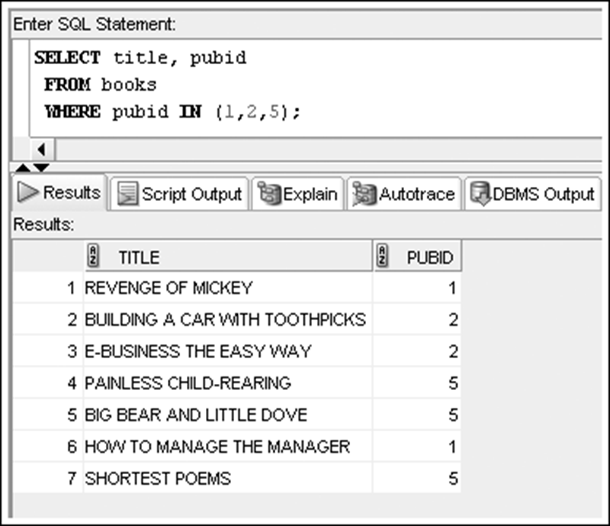
IN Operator
List of values must be in parentheses
Other examples:
WHERE state IN (‘CA’, ‘TX’)
WHERE state NOT IN (‘CA’, ‘TX’)
Oracle 11g: SQL

Slide 24
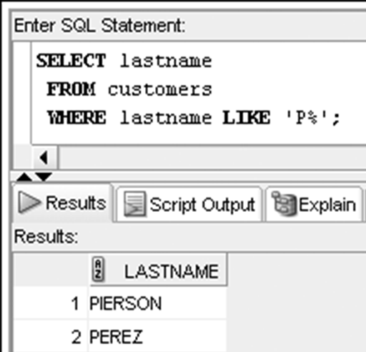
LIKE Operator
Performs pattern searches
Used with wildcard characters
  Underscore (_) for exactly one character in the indicated position
  Percent sign (%) represents any number of characters
SELECT customer#, lastname, firstname
FROM customers
WHERE customer# LIKE ‘10_9’;
SELECT isbn, title
FROM books
WHERE isbn LIKE ‘_4%0’;
Oracle 11g: SQL

Slide 25
Logical Operators
Used to combine conditions
Evaluated in order of NOT, AND, OR
  NOT – reverses meaning
  AND – both conditions must be TRUE
  OR – at least one condition must be TRUE
Oracle 11g: SQL

Slide 26
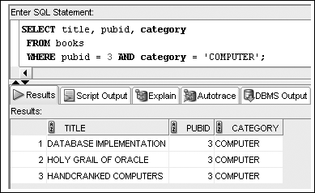
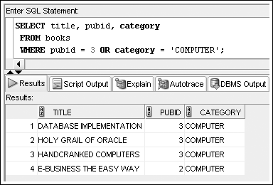
AND v. OR Logical Operator Examples
Oracle 11g: SQL

Slide 27
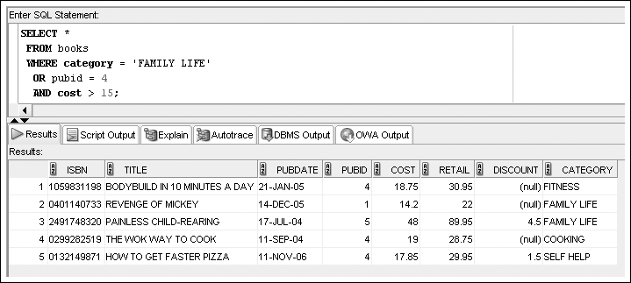
Multiple Logical Operators
Resolved in order of NOT, AND, OR
Oracle 11g: SQL

Slide 28
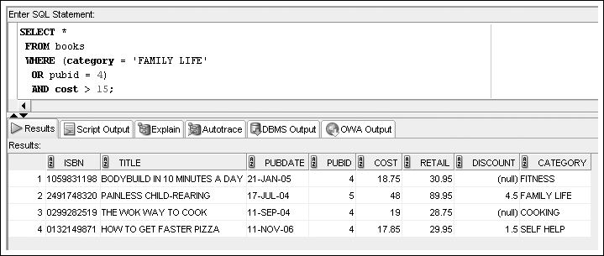
Multiple Logical Operators
Use parentheses to override the order of evaluation
Oracle 11g: SQL

Slide 29
Resolving Multiple Types of Operators
Arithmetic operators
Comparison operators
Logical operators
Oracle 11g: SQL

Slide 30
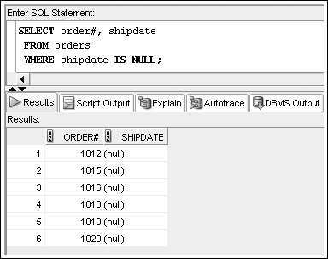
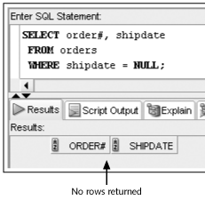
Treatment of NULL Values
Requires use of IS NULL operator (or IS NOT NULL)
A common error is using = NULL, which does not raise an Oracle error but also does not return any rows
Oracle 11g: SQL

Slide 31
ORDER BY Clause Syntax
The ORDER BY clause presents data in sorted order
  255 columns maximum
Ascending order is default
  Use DESC keyword to override column default
In ascending order, values will be in the following sequence:
  Numeric values
  Character values
  NULL values
In descending order, sequence is reversed
Oracle 11g: SQL

Slide 32
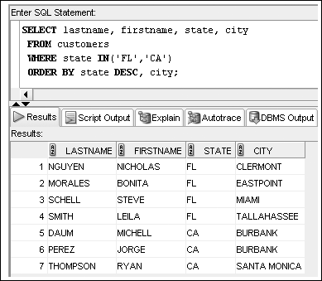
ORDER BY Examples
SELECT *
FROM publisher
ORDER BY name;
Oracle 11g: SQL

Slide 33
Summary
The WHERE clause can be included in a SELECT statement to restrict the rows returned by a query to only those meeting a specified condition
When searching a nonnumeric field, the search values must be enclosed in single quotation marks
Comparison operators are used to indicate how the record should relate to the search value
The BETWEEN...AND comparison operator is used to search for records that fall within a certain range of values
The LIKE comparison operator is used with the percent and underscore symbols (% and _) to establish search patterns
Logical operators such as AND and OR can be used to combine several search conditions
When using the AND operator, all conditions must be TRUE for a record to be returned in the results
  However, with the OR operator, only one condition must be TRUE
A NULL value is the absence of data, not a field with a blank space entered
Use the IS NULL comparison operator to match NULL values; the IS NOT NULL comparison operator finds records that do not contain NULL values in the indicated column
You can sort the results of queries by using an ORDER BY clause; when used, the ORDER BY clause should be listed last in the SELECT statement
By default, records are sorted in ascending order; entering DESC directly after the column name sorts the records in descending order
A column does not have to be listed in the SELECT clause to serve as a basis for sorting
Oracle 11g: SQL

