Slide 1
Week 1
Vehicle Registration & Plate Recognition
Automated Traffic Management
Submission-ready weekly summary deck
Week 1 established vehicle registration, input validation, and junction plate logging through the Django gateway, Crow backend, and PostgreSQL-backed records.

Slide 2
Objective and implemented work
Week 1
• Objective: register vehicles and record plates observed at city junctions. • Implemented vehicle registration with owner details and validation for plate, email, phone, and vehicle type. • Implemented junction logging with REGISTERED or UNREGISTERED status and automatic speeding flags when the speed limit is exceeded. • Delivered the first end-to-end API flow through Django, Crow, and PostgreSQL.
7 APIs
vehicle + junction flow
2
sequence diagrams
Validated
plate + owner input

Slide 3
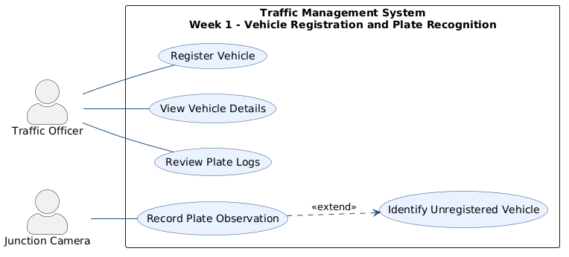
UML and main files
Week 1
Main files
• MicroserviceLayer/VehicleController.cpp • MicroserviceLayer/JunctionController.cpp • MicroserviceLayer/VehicleValidator.cpp • DataAccessLayer/VehicleRepository.* • DataAccessLayer/JunctionLogRepository.*
Repository anchors
• docs/week1/: use case + two sequence diagrams • database/schema.sql and database/seed.sql
Use case diagram from docs/week1

Slide 4
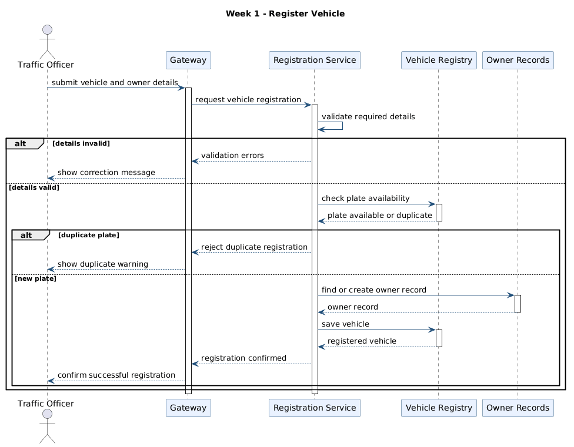
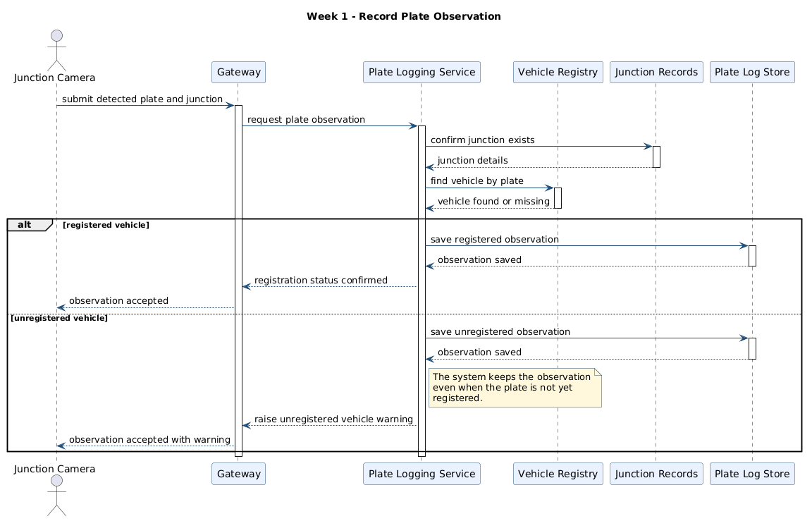
Run and test evidence
Week 1
Verification points
• Run path: docker compose up --build; use the Django gateway at http://localhost:8000/api. • docs/api-testing.md documents POST /api/vehicles and POST /api/junctions/2/log. • backend/tests/RulesTests.cpp checks VehicleValidator::validateAll and PlateValidator::validate. • The Postman collection supports the same registration and logging flow.
Register vehicle sequence
Record plate observation sequence
Run: docker compose up --build | API checks: docs/api-testing.md | Validation tests: backend/tests/RulesTests.cpp

