Slide 1
Week 2
Traffic Violations & Fines
Automated Traffic Management
Submission-ready weekly summary deck
Week 2 extended the logging workflow into configurable violation detection, automatic fine creation, and owner email notification.

Slide 2
Objective and implemented work
Week 2
• Objective: detect traffic violations and issue fines based on type and severity. • Implemented detection for speeding, red-light, and parking events from unprocessed plate logs. • Implemented fine issuing, payment, and cancellation with severity-based multipliers. • Django sends owner email notifications after detection while Crow remains the domain service.
9 APIs
violation + fine flow
2
sequence diagrams
4
severity levels

Slide 3
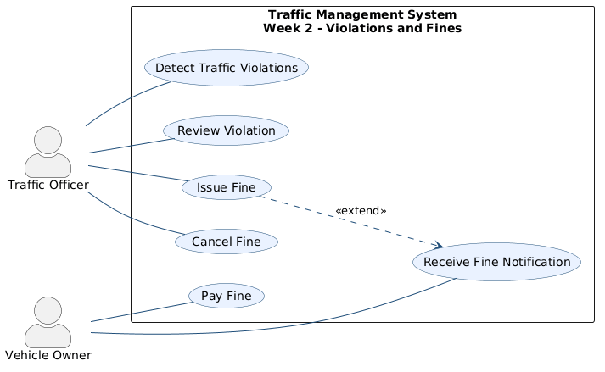
UML and main files
Week 2
Main files
• MicroserviceLayer/ViolationController.cpp • MicroserviceLayer/FineController.cpp • MicroserviceLayer/ViolationRules.cpp • DataAccessLayer/ViolationRepository.* • DataAccessLayer/FineRepository.*
Repository anchors
• docs/week2/: use case + two sequence diagrams • gateway/gateway_app/email_service.py
Use case diagram from docs/week2

Slide 4
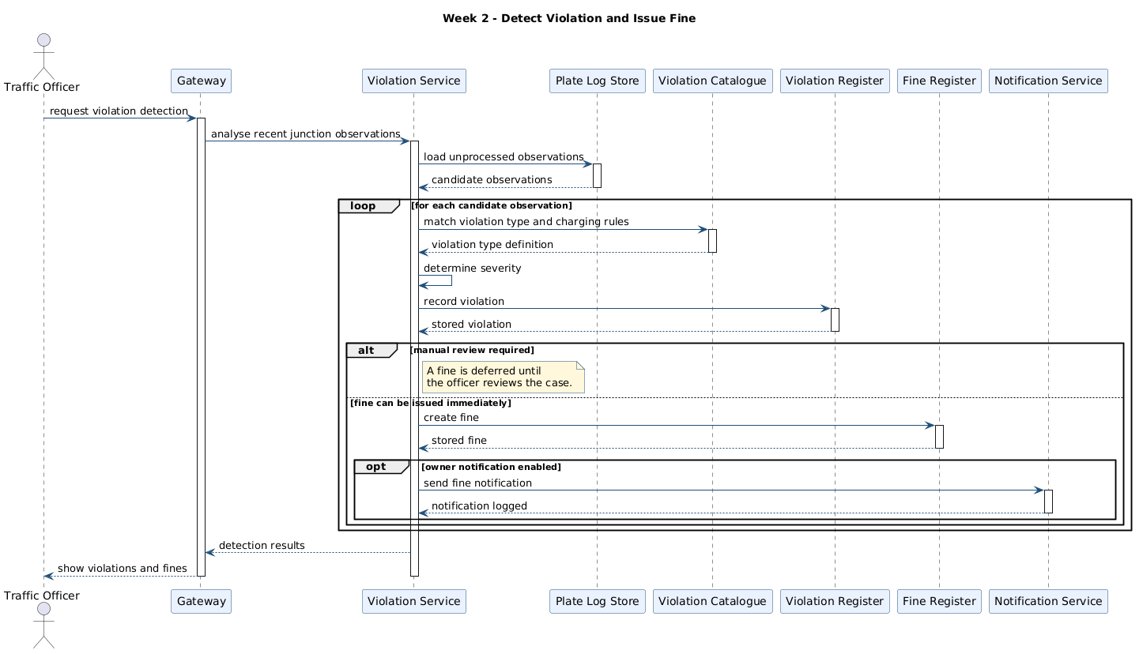
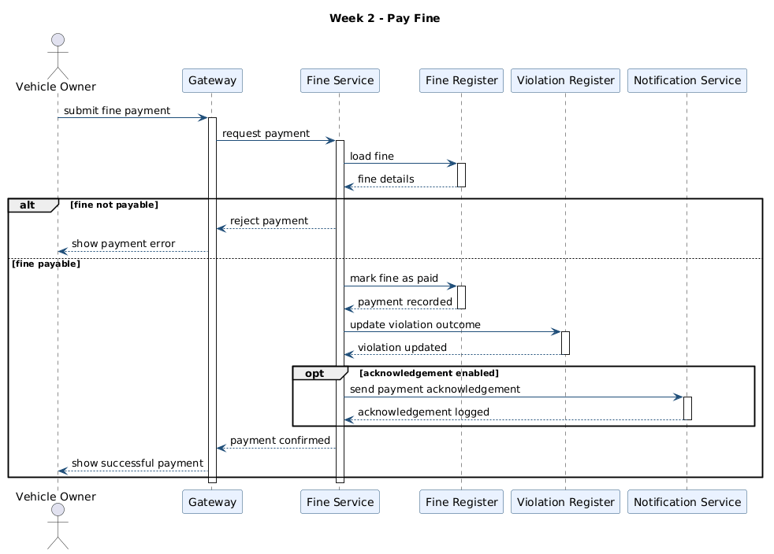
Run and test evidence
Week 2
Verification points
• Run path: docker compose up --build; the gateway remains the main interface on port 8000. • docs/api-testing.md covers POST /api/violations/detect, POST /api/fines/:id/pay, and cancel flow. • backend/tests/RulesTests.cpp verifies ViolationRules speed and event severity decisions. • gateway/gateway_app/web_views.py triggers send_fine_notification after successful detection.
Detect violation and issue fine
Pay fine sequence
Run: docker compose up --build | Violation flow: docs/api-testing.md | Rule checks: backend/tests/RulesTests.cpp

